Slide 1
LYNX Project and Portfolio Management Critical Chain Project Management
Integration of Agile and Kanban Workflows – Agile CCPM
Notes:
Als we het hebben over projecten dan zien wij dat bedrijven en projectorganisaties zich op zich voorbereiden voor de realisatie van een project. Scope wordt beschreven, rollen en verantwoordelijkheden, risico analyse, governance structuur, etc. Dus je kan zeggen dat organisaties goed voorbereid voor de praktijk / avontuur ingaan. Zo volwassen is men geworden.
Het punt is het blijft een avontuur. Dus alle risico’s die van te voren benoemd waren komen voor. En ook Murphy komt om de hoek kijken. En daar sta je dan. Onze boodschap is: als je dan het avontuur ingaat zorg dat je de juiste instrumenten bij je hebt. Een kompas en GPS, zodat je tijdens je avontuur de juiste beslissing kan nemen en controle over je bestemming kan houden.

Slide 2
LYNX Overview
LYNX Building Blocks
Levers for improvement (Operations Management for Projects)
LYNX Demonstration:
LYNX Project and Portfolio Management
“Unconsidered” needs – did you think of…..
Some examples, e.g. “Vertreterregelung”, run in Debuffered and CCPM mode
Often initiated by our customers

Slide 3
The multi-project playing field Objectives and Challenges
Teams
&
Resources
Optimal Conditions for innovation
Deliver quality
Be able to focus and getting work done
Must be Reliable and Fast
Manage Scope, Time and Budget
Needs to know if the project is on “track”
Satisfy the stakeholders
Project
Multi-Project and Portfolio
Portfolio with many projects
High Due-Date performance
Deliver more projects
1. In Time 2. Within budget 3. Deliver Scope 4. Right Quality 5. Across Projects

Slide 4
A-dato customers presenting at the TOC Anwenderkonferenz 2019, Heidelberg
Presenters:
Römheld
Beekenkamp
SICK
Diamond Air

Slide 5
TOCPA 2018

Slide 6
A-dato customers presenting at the TOC Anwenderkonferenz 2018, Heidelberg
Presenters:
Fraunhofer Institut
Holzner & Bertagnolli
Endress+Hauser
SICK
Richard Wolf

Slide 7
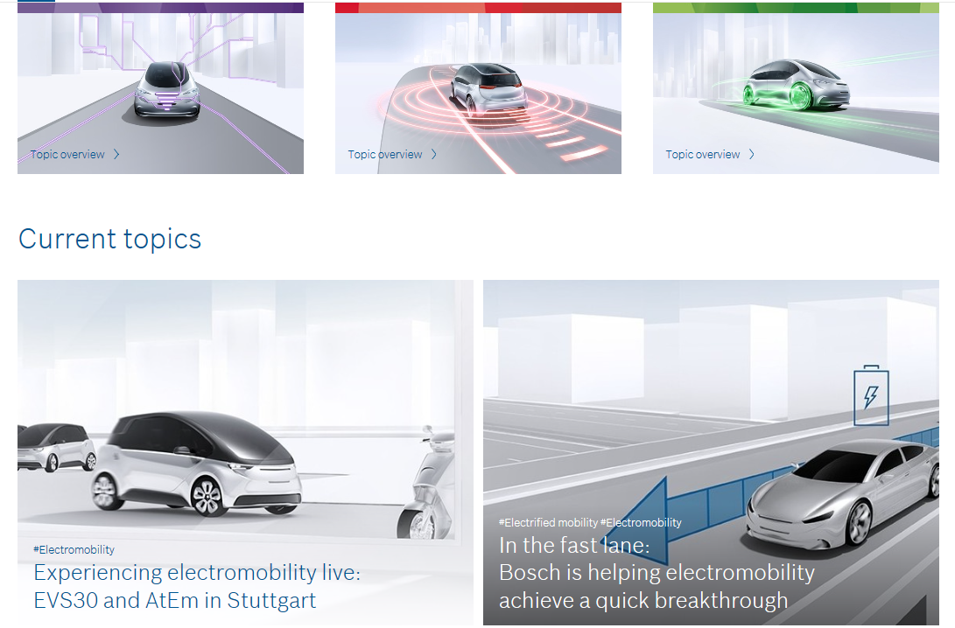
Bosch Mobility Solutions

Slide 9
Digital Transformation at VIVO (Telefônica Brazil)
Andre Kriger, CIO of Vivo, reveals a mix of critical chain, lean and agile techniques to aggressively double the rate of project deliveries (April 2019)
https://inform.tmforum.org/digital-transformation-and-maturity/2019/04/andre-kriger-cio-telefonica-reveals-mix-critical-chain-lean-agile-techniques-aggressively-double-rate-project-deliveries/

Slide 11
Fraunhofer

Slide 12
Diamond Aircraft Industries

Slide 13
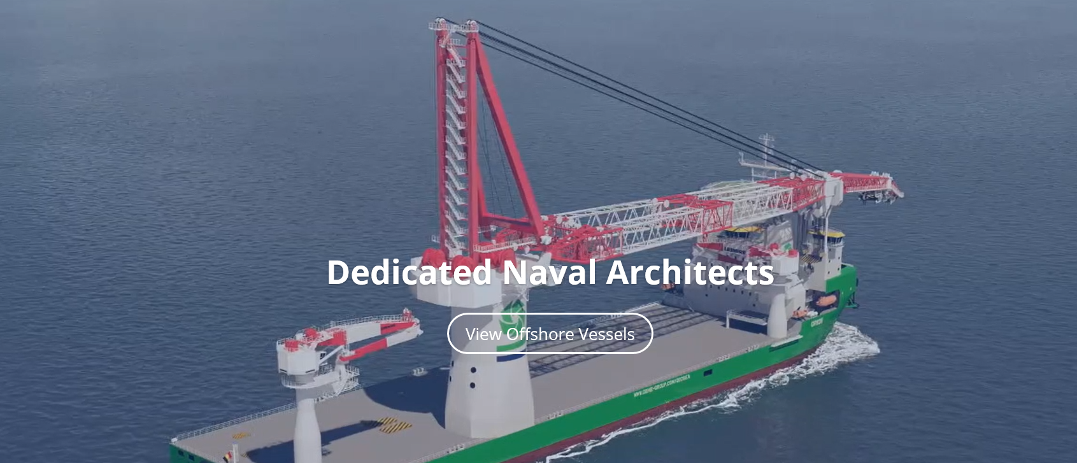
C-JOB

Slide 14
Endress + Hauser

Slide 15
Beekenkamp

Slide 16
Bruns, Exhibitions Shop Floor Workflow Management
Projects:
Anne Frank Huis
Over the Edge
Europe Experience Berlin
Powerplay, Heilbronn, Germany
Projects:
Museum for Communication, Bern Switzerland
FIFA World Football Museum
Nest, Vevey Switzerland
In Flanders Fields Museum, Ieper, Belgium

Slide 17
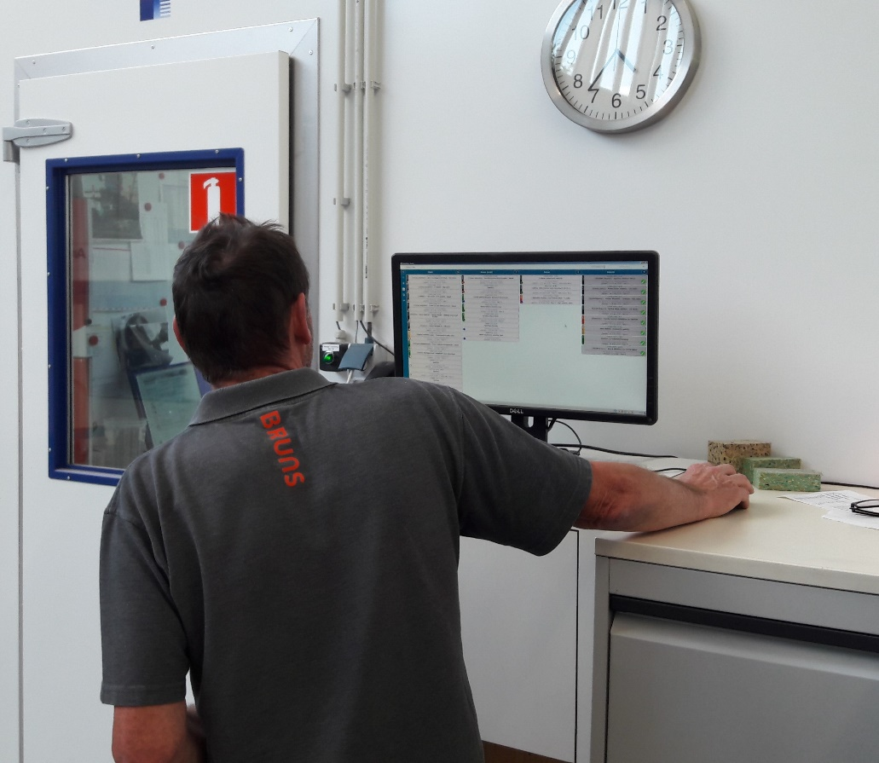
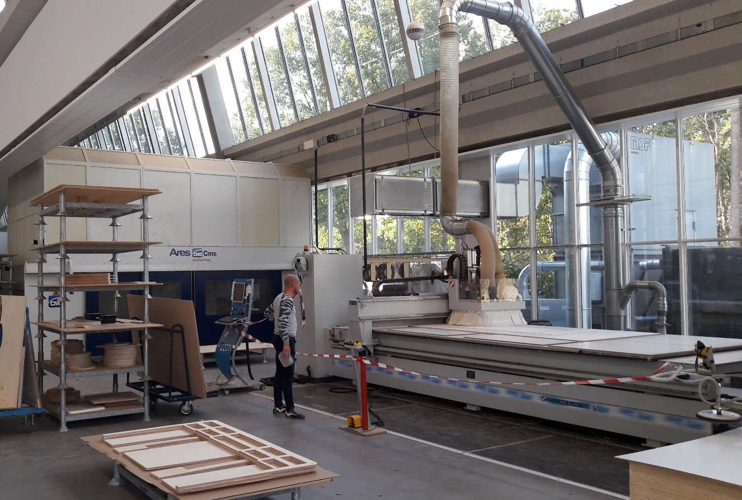
LYNX TameFlow @ the Shopfloor

Slide 18
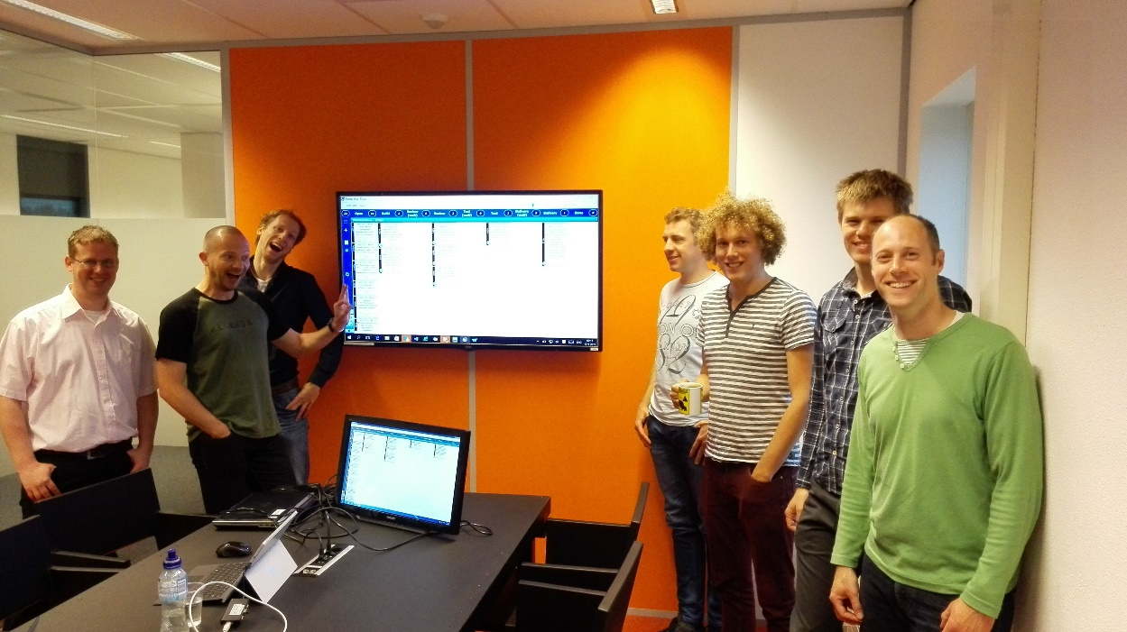
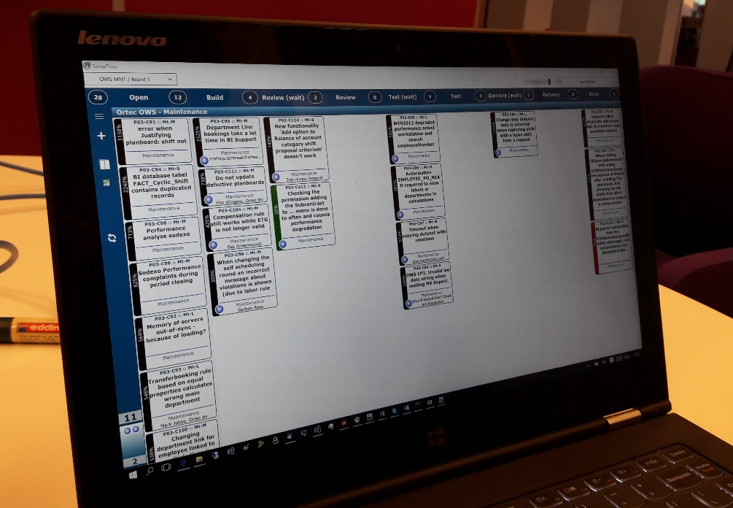
ORTEC

Slide 19
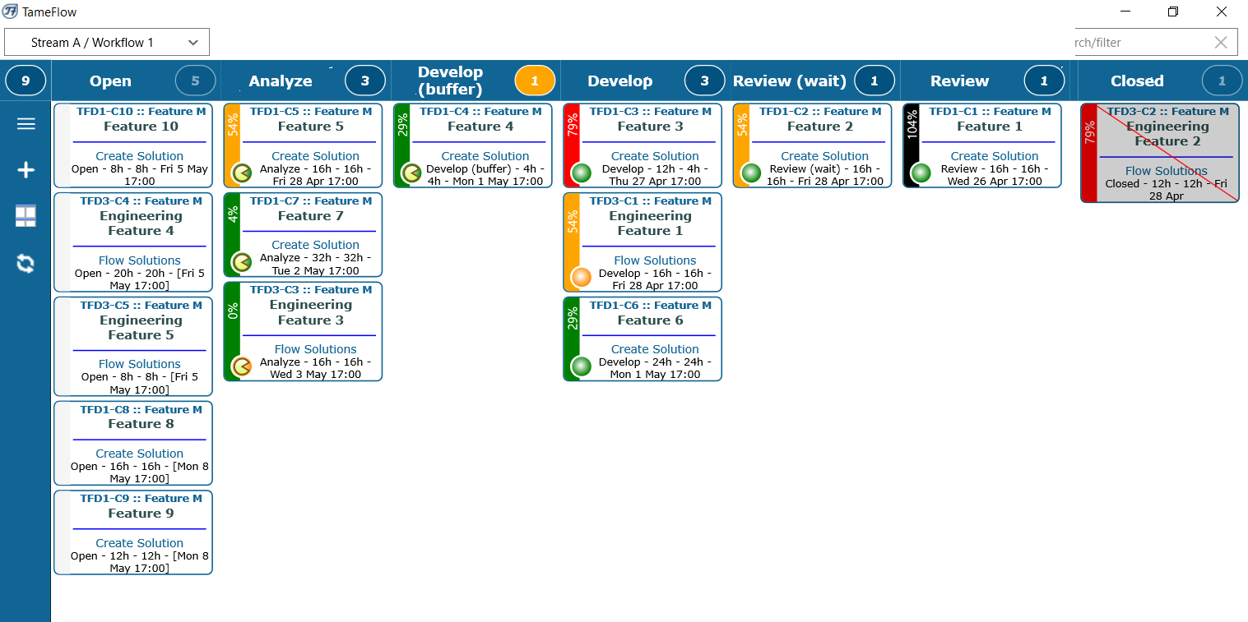
LYNX TameFlow Task Board Layer 3 Integration Example – including Flow Buffer Management

Slide 20
LYNX Layers and Building Blocks

Slide 21
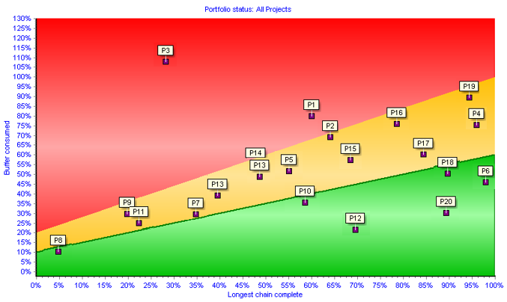
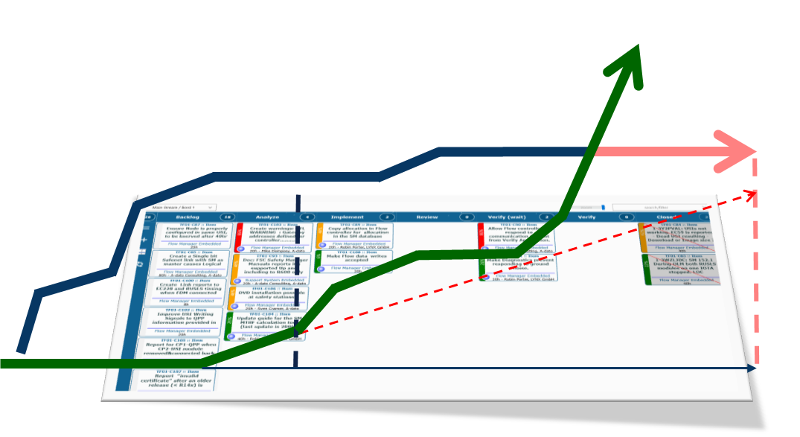
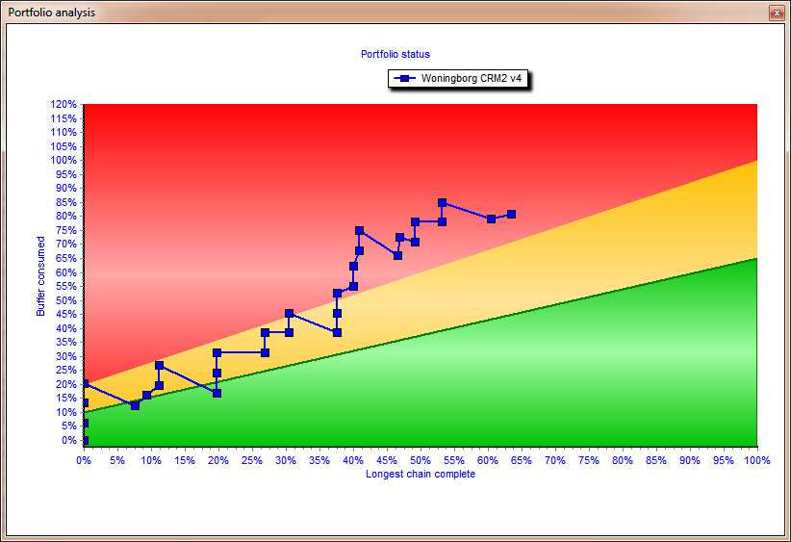
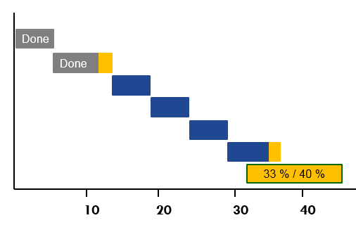
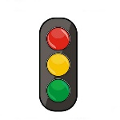
LYNX Workflow Optimization – The Project “Factory”
Pipeline & Scenario Planning
Release Wizard
Scenario Wizard
“Strategic Priorities”
Stakeholder
„Priority board“
PIPELINE
Layer 1
Multi-Project
New projects
Project #4
Project # 5
#2
Project #3
Project #1
Projects
CCPM or LFPM
Buffer Management
“Operational Priorities”
Layer 2
Single Project
teams
Workpackages with Cards
Agile/Kanban Processes
e.g. Sub-tasks / Stories
Layer 3
Workpackages Agile & Kanban
Notes:
3 lagen model. – wat is dan nog een missing link? → kenniswerk. Agile and everything is good.

Slide 22
LYNX TameFlow Task Board Layer 3 Integration Example – including Flow Buffer Management

Slide 23
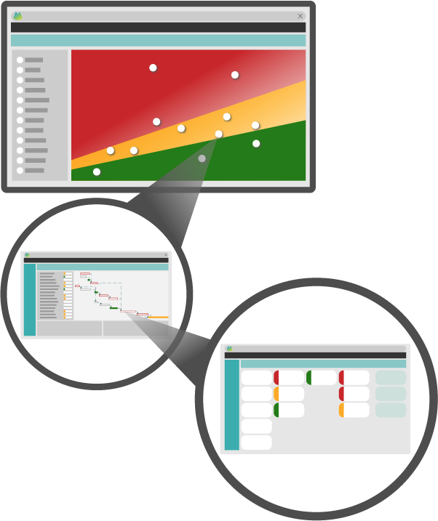
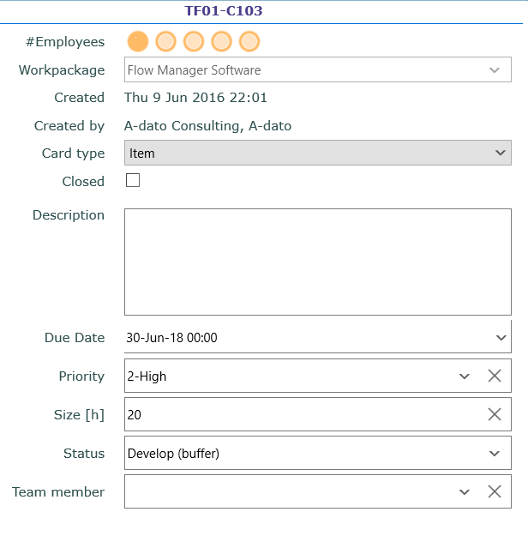
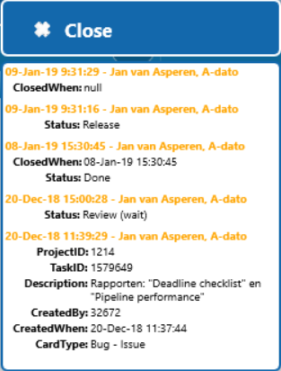
LYNX and LYNX TameFlow
Multi-project resource management
(Skills, profiles, resources, teams, team members)
Portfolio / Multi-Project
Card
Projects with tasks
Workpackages with Cards (subtasks, user-stories, cases)

Slide 24
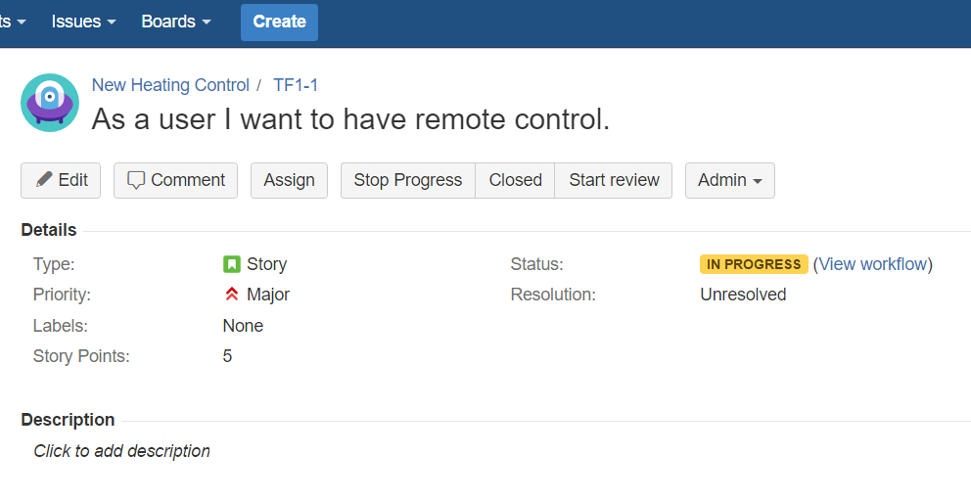
LYNX TameFlow Task board with JIRA Issue processing
LYNX Users
Professional / Light
LYNX TF
JIRA Synchronization
LYNX TF Team Users
Using LYNX TameFlow Visual Taskboard for Flow Management
JIRA Users
Working on “Issues” (Cards) in JIRA.

Slide 25
Collaboration and Team work Working together at the same time in the same project
Projects, tasks, sub-tasks, cards
Resource manager
Team manager
Task manager
Skill/ Resource
Project manager
Portfolio manager
Team member
“Timing is everything”
There is only 1 moment you can be on time!
If you are not there you are either too early or too late.
Johan Cruijff
External partner
Just “invite” others in one “click”
A-dato Confidential

Slide 26
Observations
Multi-Project Landscape – why change?

Slide 27
The multi-project playing field Objectives and Challenges
Teams
&
Resources
Optimal Conditions for innovation
Deliver quality
Be able to focus and getting work done
Must be Reliable and Fast
Manage Scope, Time and Budget
Needs to know if the project is on “track”
Satisfy the stakeholders
Project
Multi-Project and Portfolio
Portfolio with many projects
High Due-Date performance
Deliver more projects
1. In Time 2. Within budget 3. Deliver Scope 4. Right Quality 5. Across Projects

Slide 28
Task Durations (within Projects)
Task
Work
Typical task Execution Pattern
Wait
Work
Work
Work
Work
Typical
“Flow Efficiency”
Work
Most tasks are not slow, but typically just have to wait a lot.
100 %
10 - 20 %
Wait
Work
Notes:
Vaak niet boeven 20 % - EERDER ROND DE 5
Zin is krom. → om echtt te verbeteren kan je veel nbeter richten op verminderen van de wachttijden

Slide 29
Resources are scarce and often not efficiently allocated (spread “thin”)
Limited Resources
Many projects waiting
High Work in Progress
Consequence: Projects fight for resources!
Suboptimal resourcing of projects
(bad) multi-tasking
Multitasking and lack of focus
SETUP
SETUP
SETUP
SETUP
SETUP
SETUP
SETUP
SETUP
SETUP
Dedicated task completion
SETUP
Task project 1
SETUP
Task project 2
SETUP
Task project 3
>3 Times longer duration for project 1

Slide 30
Waiting Time Multi-Tasking
Multitasking and lack of focus
SETUP
SETUP
SETUP
SETUP
SETUP
SETUP
SETUP
SETUP
SETUP
Dedicated task completion
SETUP
Task project 1
SETUP
Task project 2
SETUP
Task project 3
>3 Times longer duration for project 1

Slide 31
Constant Changes Variability and Murphy’s law
Did we think of everything?
How many/which changes will be required?
What else can happen?
(What can go wrong, goes wrong)
Many deviations from the Plan!
What would be the duration of a task?
Uwe Techt (Vistem Germany)

Slide 32
Intermezzo
Een klein testje met 2 taken….
M | U | L | T | I | T | A | S | K
1 | 2 | 3 | 4 | 5 | 6 | 7 | 8 | 9
Het beste brein van Nederland
https://youtu.be/E3bXAzlbA4w
Notes:
Multi-Task oefening.
Single task order: 8 to 12 seconds.
Multi-task: 12 tot 20 seconds.
If you have done it richt, there was also an element of quality coming in. What is the next letter to right. A struggle to maintain the quality.
What are the effects:
It took 8 seconds in the first, 12 seconds in the second – that is a 50 % impact on speed and productivy in which we could do the taks done
quality issue. A struggle to maintain the quality.
the first task finsihed after 4 seconds in the first approach, but only after 12 seconds in the second approach. So the duration that took me to do that task, extended dramatically.
So those are the losses: we have a 40 to 50 % loss of productivity, we struggle with the quality and there is certain level of stress that happens, and there is a 2 X or 3 X extension in durations.

Slide 33
The brain cannot do Multitasking!

Slide 34
The ASAP Trap Little’s Law
Leadtime
Increases
Limited Resources
Uncertainty
WiP (Work in Progress) is high
Delays are increasing
There are always new projects or there is more work to do.
Murphy
Start Work
(ASAP)
Little’s Law
WIP (# units)
= Avg. Leadtime (in periods)
Output (# units per period)

Slide 35
Any system needs WIP control….
Cycle time (duration)
OUTPUT
Reliability

Slide 36
Today and Tomorrow
Undesired
Desired
Parkinson’s law
Student syndrome
Cherry picking
Overload
Multi-tasking
Task Interruptions
Local safeties
De-synchronisation
Kopfmonopole
Early starts
Batching
Roadrunner
Global priorities
WIP Control
Single tasking
Single-touching
Global buffers
Different way of planning
Different way of working
Late binding
Full-kit
Single-piece flow
Synchronisation

Slide 37
Time for action?
Symptoms:
Backlog too big
Long leadtimes
Unreliable due dates
High Work pressure
Poor quality and a lot of rework
Customers are not happy
….
Issues in “Operations Management”:
A lot of “Work-in-Process”
Multi-Tasking
Waiting Times
Changing priorities
Many “Top Priority” tasks that are urgent
Peaks in workload, but also the opposite

Slide 38
Where to start improving? “Low” hanging fruit
Wait
Work
Most jobs are not slow, but typically just have to wait a lot.
Notes:
Overlay met euro tekens, waar zet je geld op in? → groen kost heel veel.

Slide 39
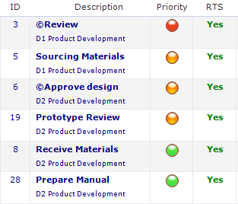
A different approach… The Critical Chain (Multi-)Project Management Key Ingredients
Buffer Management
Execute by Single Priority
Manage across projects
(Control the WIP)
Buffer
50%
Traffic light = 1 operational
priority for everybody across projects

Slide 40
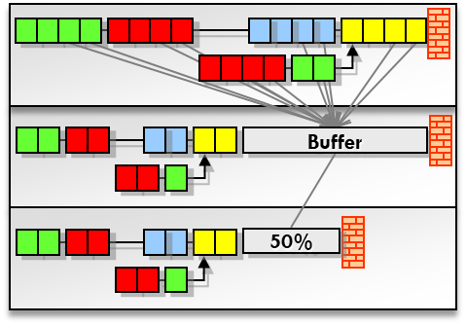
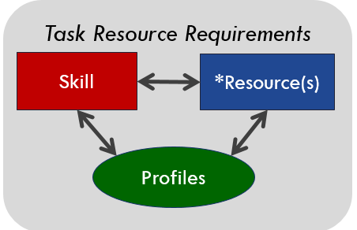
Levers for achieving improvements Operations Management for (multi-)project operations
Introduction of Buffer Management with Dynamic Schedules →Manage the Buffer
Aggregate and (re-)move safety time
Introduction of buffers at strategic positions to absorb uncertainty
Introduction of one single priority and feedback loop → Execute by single priority
Track progress by Expected-Time-To-Complete (~ ETA)
Synchronized Execution of Tasks
Introduction of Pipeline and Portfolio Management → Control the WIP
Constraint based Work-in-Progress management
Release management (staggering)
Introduction of Aggregation and (dynamic) “Late Binding” → Flexible Capacity

Slide 41
How to achieve improvements?
Introduction of Buffer Management
Feedback Loop for generating “single” operational priorities

Slide 42
Psychology of Estimates
relative
probability
Typically >50% durations is a safety buffer
Early completions are rare animals
Many tasks are still late
achievable
50%
max.
typical estimate
> 80%
0%
n days
Safe (2 x n days)
“Laws”:
Available time will always be used (Parkinson´s-Law)
Postponement Behavior (Student-Syndrome)
Murphy will bring a visit
Notes:
SPI Index bij Honeywell (Schedule Performance Index)

Slide 43
Critical Chain Solution Take advantage of Central Limit Theorem
Good Statistics
Central Limit Theorem (add enough things together and everything looks normal)
Notes:
Van een normaal plan naar een goed plan – kan allen als dus de taaktijden verkoren en buffer toevoegen.

Slide 44
Pooling of Contingency – Insurance Model Buffer Management
“To be safer, (re)move the safety”
Protect the project (not tasks)
Focus on due-date
Achievable
Contingency
Time
10
20
30
40
50
60
60
45
Notes:
Laat zien hoe buffer naar achteren wordt geplaatst en ingekort. Om dit te bewaken heb je een goede projectmanagement tool nodig, want: hoe weet je of en hoeveel je al van die centrale projectbuffert hebt gebruikt?

Slide 45
Progress Example 1: 50 % progress on the longest chain / 15 % buffer used
Today
Project is on track. The risk that the project will be late is very low.
Done
Done
Done
50 % / 15 %
10
20
30
40
50
60
Time
45
“To be safer, (re)move the safety”
Notes:
Laat zien hoe buffer naar achteren wordt geplaatst en ingekort. Om dit te bewaken heb je een goede projectmanagement tool nodig, want: hoe weet je of en hoeveel je al van die centrale projectbuffert hebt gebruikt?

Slide 46
Feeding chain detection Always present the right priority during the Execution
Today
Critical Chain
Done
Done
Current Longest Chain Detection
33 % / 40 %
10
20
30
40
50
60
Time
45
“To be safer, (re)move the safety”
Notes:
Laat zien hoe buffer naar achteren wordt geplaatst en ingekort. Om dit te bewaken heb je een goede projectmanagement tool nodig, want: hoe weet je of en hoeveel je al van die centrale projectbuffert hebt gebruikt?

Slide 47
Progress example 2: 33 % progress on the longest chain / 40 % buffer used
Today
Project is still on track, but sits in the “orange” zone. You may need to take action.
Done
Done
33 % / 40 %
10
20
30
40
50
60
Time
45
“To be safer, (re)move the safety”
Notes:
Laat zien hoe buffer naar achteren wordt geplaatst en ingekort. Om dit te bewaken heb je een goede projectmanagement tool nodig, want: hoe weet je of en hoeveel je al van die centrale projectbuffert hebt gebruikt?

Slide 48
Progress example 3: 55 % progress on the longest chain / 65 % buffer used
Today
Relatively to much buffer is used. Measure are need to make sure the project can be delivered on time.
Done
Done
Done
Done
55 % / 65 %
10
20
30
40
50
60
Time
45
“To be safer, (re)move the safety”
Notes:
Laat zien hoe buffer naar achteren wordt geplaatst en ingekort. Om dit te bewaken heb je een goede projectmanagement tool nodig, want: hoe weet je of en hoeveel je al van die centrale projectbuffert hebt gebruikt?

Slide 49
Levers for achieving improvements Operations Management for (multi-)project operations
Introduction of Buffer Management with Dynamic Schedules →Manage the Buffer
Aggregate and (re-)move safety time
Introduction of buffers at strategic positions to absorb uncertainty
Introduction of one single priority and feedback loop → Execute by single priority
Track progress by Expected-Time-To-Complete (~ ETA)
Synchronized Execution of Tasks
Introduction of Pipeline and Portfolio Management → Control the WIP
Constraint based Work-in-Progress management
Release management (staggering)
Introduction of Aggregation and (dynamic) “Late Binding” → Flexible Capacity

Slide 50
Buffer Management addresses day-to-day resource conflicts (and prevents (bad) multi-tasking)
The original plan for ONE System Engineer called “Mike”
D2
D1
T1
D2
T1
The actual situation Today
D1
D1
T1
How to solve the “resource conflict” for Mike?
D2
Manage the Queue !
Today
Execution sequence of the queue for Mike
T1
D1
D2
Today
„In the Autopilot-Modus, Resource Managers , Task- and Project managers are supported by Operational Priorities for the synchronized execution of their projects”

Slide 51
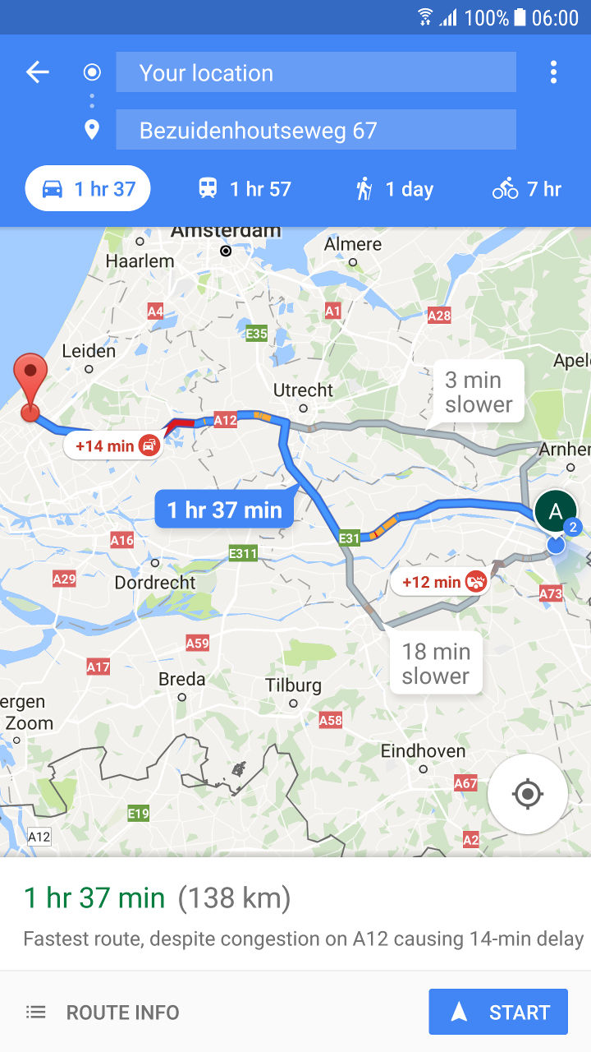
What is needed? Fast-Feedback Loop (ETTC)
Continuous (frequent) update of the “Expected Time to Complete” for each active task (ETTC)
Flawless handovers:
Ensure Delivery is complete
Be Ready-to-Start
Good preparation
Notes:
SHOW
We know now what we should not do but what do we need to do?

Slide 52
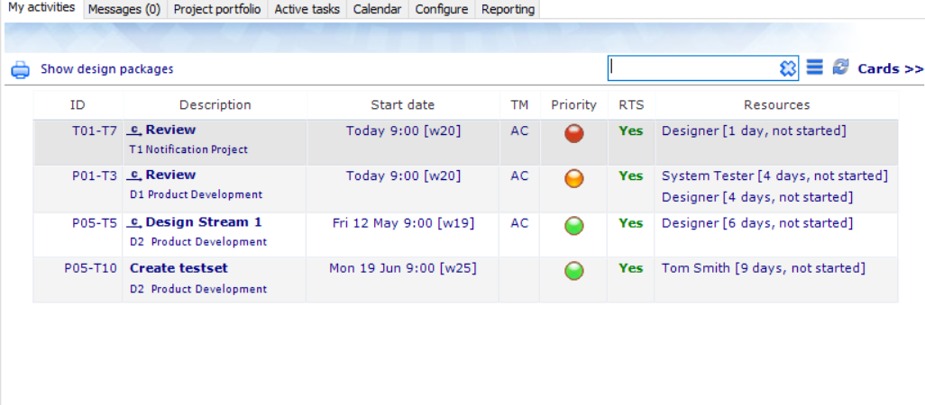
“To do” List Sequenced by Priority – Focus on Getting Tasks Done
Notes:
1. Doorlooptijd van elke taak – er gaat meer dan 30 % verloren aan verstoringen, andere zaken
2. Weniger Projekte geleichzeitig
3. Stoppen met Teiltermine, focus op endtermine en een prioriteit
4. Focus op fertig machen

Slide 53
From Desynchronization to Synchronization (the value of single priorities)
Inefficient allocation
Efficient allocation
30 Days
40 Days
20 Days
30 Days
40 Days

Slide 54
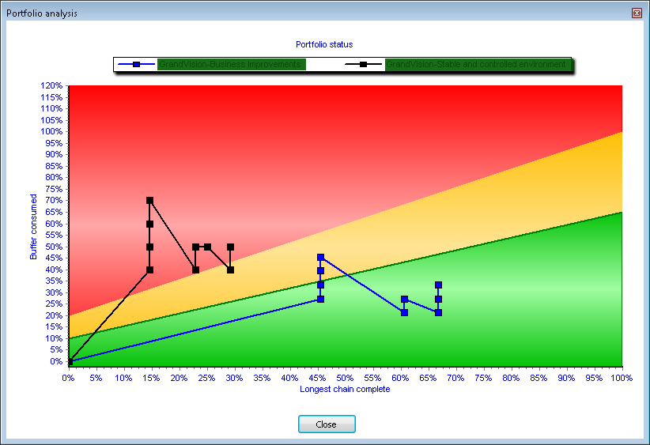
Manage Due Date delivery with CCPM Project and Cross-Project Optimisation (Portfolio or Program)
Per Project
Red means “CRITICAL”. Risk of late delivery is high. Immediate “buffer recovery actions” need to be taken
Orange means CAUTION. There is a risk of late delivery. Recovery actions may need to be prepared.
Green means SAFE. The risk of a late delivery is small. No buffer recovery actions need to be taken or prepared.
Cross-Project (Program or Portfolio)

Slide 55
Levers for achieving improvements Operations Management for (multi-)project operations
Introduction of Buffer Management with Dynamic Schedules →Manage the Buffer
Aggregate and (re-)move safety time
Introduction of buffers at strategic positions to absorb uncertainty
Introduction of one single priority and feedback loop → Execute by single priority
Track progress by Expected-Time-To-Complete (~ ETA)
Synchronized Execution of Tasks
Introduction of Pipeline and Portfolio Management → Control the WIP
Constraint based Work-in-Progress management
Release management (staggering)
Introduction of Aggregation and (dynamic) “Late Binding” → Flexible Capacity

Slide 56
4. Manage your portfolio with CCPM Global optimisation across projects

Slide 58
The power of Buffer Management Simulations
Strategy | Setup | 1st project cmpl. | 1st project late | #Completed | #Late | hrs. overdue | #Red | %Yellow
Start date | 5% +MT | 21.14:00 | 26.15:00 | 21 | 15 | 3410 | 35 | 52%
Start date | 5% -MT | 20.12:00 | 22.09:00 | 29 | 15 | 2679 | 27 | 63%
Due date | 5% +MT | 21.9:00 | 21.14:00 | 20 | 15 | 2709 | 36 | 53%
Due date | 5% -MT | 16.14:00 | 36.11:00 | 41 | 12 | 846 | 14 | 83%
LYNX | 5% -MT | 17.9:00 | 141.12:00 | 50 | 1 | 2 | 0 | 97%
Buffer Management outperforms any other sequencing strategy!

Slide 59
How to achieve improvements?
Aggregation and (dynamic) “Late Binding”

Slide 60
Achieving more “Flow” and Resource Management Allocate work to team (or skill) first (not individuals)
Aggregation of resource requirements on „Skill“ or „Team“ Level
Resources are “pooled” by „Skill“ or Team
Specification of any “Task Resource Requirement” by “Skill”
Principle of (dynamic) “Late Binding”
Keep your options open as long as possible (“rotation”)
Prevent “Kopfmonopole”

Slide 61
Scope LYNX TameFlow solution
Implementation of the ISA95 Skill / Resource and Aggregation model
Skills
Resources
Profiles
Concept of „*Soft-Reservations“ for the implementation of:
Principle of Aggregation and „Late Binding“
The possibility of „Cross-Skill“ Management
Control of reservations against „Profiles“
CCPM with optimal support of Resource Management
Monitoring the Multi-Project Resource Load
Stimulation of more flexibility by „Cross-skill“ training and assignments
„Decision Support“ for optimizing of the capacity (Cross-Training, Hiring, Education)

Slide 62
The “Late Binding“ solution within LYNX Specification of “Resource Requirements“
Implementation of the ISA95 Skill / Resource and Aggregation Model
Skills
Resources
Profiles
Projects and Tasks
Task Resource Requirements
Skill
*Resource(s)
Profiles

Slide 63
The “Late Binding“ solution within LYNX Specification of “Resource Requirements“
Implementation of the ISA95 Skill / Resource and Aggregation Model
Skills
Resources
Profiles
Projects and Tasks
Projects and Tasks
Task Resource Requirements
Task Resource Requirements
Skill
*Resource(s)
Virtual Skill
# FTE
Resource Names
Profiles
Profiles

Slide 64
LYNX basic structures for „Skills“ Available Capacity
ISA95
Resource Model
Calendar
Standard (5 days)
Standard (5 days)
Standard (5 days)
4 days per week
50% Available
(„Normal“) Skill with Resource (Names):
Available Capacity is the total of the individual availability of each resource, given ist calendar
Considers also non-working periods
There is a Skill / Resource Matrix
„Cross-Skill“ Management for resources with multiple skills
Extended:
Additional Skill / Resource Profiles
(„Virtual“) Skill (or Team):
Available capacity expressed in #Full Time Equivalents (anonym)
There are „only“ Skills and #FTE
Skill | Name | Calendar
System Engineer | Michael | Standard (5 days)
 | Sven | Standard (5 days)
 | Peter | Standard (5 days)
 | Karl | Standard (5 days)
 | Fabian | Standard (5 days)
Name | Skill
Peter | Skill 1: Electrical Engineer
 | Skill 2: System Engineer
 | Skill 3: ……
 |  | Profile
Skill | Name | Seniority | Product Group | Location
System Engineer | Michael | Senior | Electric/Road | Netherlands
 | Sven | Junior | Mountain/Road | Germany
 | Peter | Senior | Mounain | Netherlands
 | Karl | Medior | Road | Netherlands
 | Fabian | Senior | Electric | USA
Skill | # FTE
System Engineer | 5
Tester | 4

Slide 65
LYNX basic strucures for „Skills“ Available Capacity
ISA95
Resource Model
Skill
Candidates
Skill | Resources
System Engineer | 4 Candidates
Name | Calendar
*Steve | Standard (5 days)
*Tom | Standard (5 days)
*Richard | 4 days per week
*Peter | 50% Available
Profile
Profile
Seniority | Product Group | Location
Senior | Electric | Netherlands
Medior | Mountain | Germany
Junior | Road | USA

Slide 66
Example: System Engineer needed for Task A Task Resource Requirements: *Soft-reservation funnel process (Matching-Resources)
Soft-Assignment = *Name
All
Location
Product Group
Experience
Confirmation of Daniela for TASK A
*Baptiste
*Daniel
*Daniela
*Eric
*Heinrich
*Jochen
*Konstantin
*Markus
*Michael
*Oleg
*Olivier
*Werner
*Matthias
Germany
Electric Bikes
Senior
*Baptiste
*Daniel
*Daniela
*Eric
*Heinrich
*Jochen
*Konstantin
*Markus
*Michael
*Olivier
*Werner
*Baptiste
*Daniel
*Daniela
*Heinrich
*Konstantin
*Michael
*Baptiste
*Daniela
*Konstantin
Daniela
Project Manager + Resource Manager + Portfolio Management

Slide 67
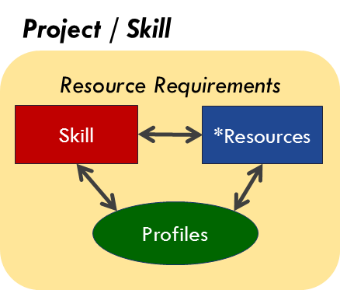
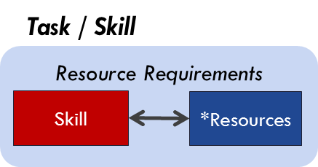
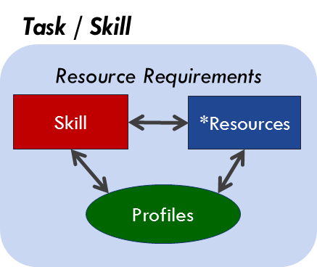
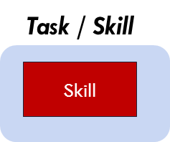
Setting of Project / Task Resource Requirements Examples
START

Slide 68
“Cross-Skill” Management and available capacity Assumes that Resource names are organised by skill and/or profiles
Name | Availability | Skill
Peter | 5 days / 40 hrs per week | Skill 1: Electrical Engineer
 |  | Skill 2: System Engineer
Peter has 40 hours per week available for either Skill
However this does not mean that 2 * 40 = 80 hours are available
The available 40 hours per week can only be used once
Examples:
If a task needs 16 hours of Peter as „Electrical Engineer“
This leaves only 24 hours available for assignment to either Skill:
A maximum of 24 hours as Electrical Engineer
Or a maximum of 24 hours as System Engineer
Or any combination of both skill until 24 hours
„Cross-Skill“ applies to:
The Skill Level
Additional „Profile“ Level

Slide 69
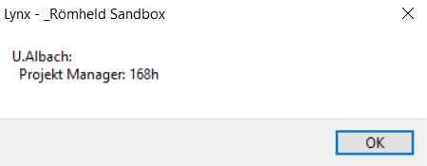
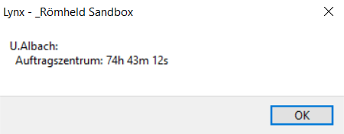
Example „Cross-Skill“ Management Mr. Albach has two skills or roles (Auftragzentrum and Projekt Manager)

Slide 70
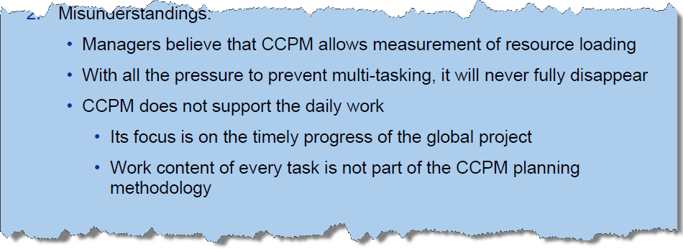
Not the complete answer… Example Case and Issues
Resource planning and management need to be included in the solution!

Slide 71
Example Skill and Resources with Profiles
This model is following the ISA 95 Standard
Seniority
Resource Property Profile Daniel
4
Senior
Location
Department
Languages
German
Dutch
English
Luxemburg
Engineering
Department
3
Profiles are examples
2
Skill Property Profile
1
Radar
BMW
Customer Exposure
Technology
Skill(s)
(SE)
n – Resources
(Daniel)
Resource
(Daniel)
Daniel is a System Engineer mit Profile: BMW /.. + Radar/… + Senior
Daniel: Based in Luxemburg, works in the System Engineering Department and speaks German, Dutch and English
A-dato Confidential

Slide 72
The Principle of (dynamic) „Late Binding“ and Capacity Flexibility Timing Skill Specification and Resource Confirmations
Project Planning Phase
Project Release Phase
Execution Phase
Skill Specifications
Resource Confirmations (names)
Confirmations preferably as late as possible
(when Tasks are Ready to Start !)

Slide 73
Summary of the *Soft-Reservation Concept Application of the principles of Aggregation and “Late binding”
A *Soft-Reservation gives a Projectmanager the assurance, that the required capacity is reserved for his project.
A *Soft-Reservation means at the same time Flexibility for the Resource Manager, which allows him to consider alternatives until the „latest“ moment.
Also he has more accurate information about required capacity and profiles in the (near) future and when required.
Therefore he is able to pro-actively anticipate on these requirements.

Slide 74
Demonstration

Slide 75
Demonstration
LYNX Project and Portfolio Management
LYNX TameFlow:
Example with Subtasks
Example with Flow-Buffer Management
Example with User Stories (and subtasks)

Slide 76
Levers for achieving improvements Operations Management for (multi-)project operations
Introduction of Buffer Management with Dynamic Schedules →Manage the Buffer
Aggregate and (re-)move safety time
Introduction of buffers at strategic positions to absorb uncertainty
Introduction of one single priority and feedback loop → Execute by single priority
Track progress by Expected-Time-To-Complete (~ ETA)
Synchronized Execution of Tasks
Introduction of Pipeline and Portfolio Management → Control the WIP
Constraint based Work-in-Progress management
Release management (staggering)
Introduction of Aggregation and (dynamic) “Late Binding” → Flexible Capacity

Slide 77
How to achieve improvements? Introduction of Pipeline and Scenario planning
LYNX Release Wizard
LYNX Resource Load Graph
LYNX Pipeline and Scenario Planning

Slide 78
Topics
“Constraint based” Portfolio Management
LYNX Release Wizard
LYNX Scenario Wizard
LYNX Pipeline and Scenario planning

Slide 79
Strategic Prioritization to control the Work-in-Progress and Sequence Projects
§1 Identify
§2 Exploit
§3 Subordinate
§4 Eliviate
§5 Step 1 …
Complex systems typically have only one „Constraint“
5 Focussing steps
4 Levels of Constraints
„Staggering“ using a (virtual) drum e.g.:
A critical phase in each project (integration)
Specific Team(s)
Strategic priorities (ranking)
Results:
Less WIP
Reduction of Lead-time
More output
A phase
(integration)
A team
A specialist
The Market
Typical Constraint(s)
PIPELINE
Project #4
Project # 5
#2
Project #3
Project #1

Slide 80
Identification of the “Constraint”
10
10
Load
100%
Load / Capacity
100%
System Engineer
Skill D
Skill F
Skill G
System Engineer
Skill D
Skill F
Skill G
Scenario Planning process
Current Load vs Capacity
Target Load vs Capacity

Slide 81
Any system needs WIP control….
Cycle time (duration)
OUTPUT
Reliability

Slide 82
LYNX Release Wizard Finding the optimal timeslot for each new project entering the “highway”
Staggering
Project D
When green 1 car !
Project A
Virtual Drum(s)
Project C
Intelligent Access Control
(for new Projects)
Project B
Notes:
SHOW

Slide 86
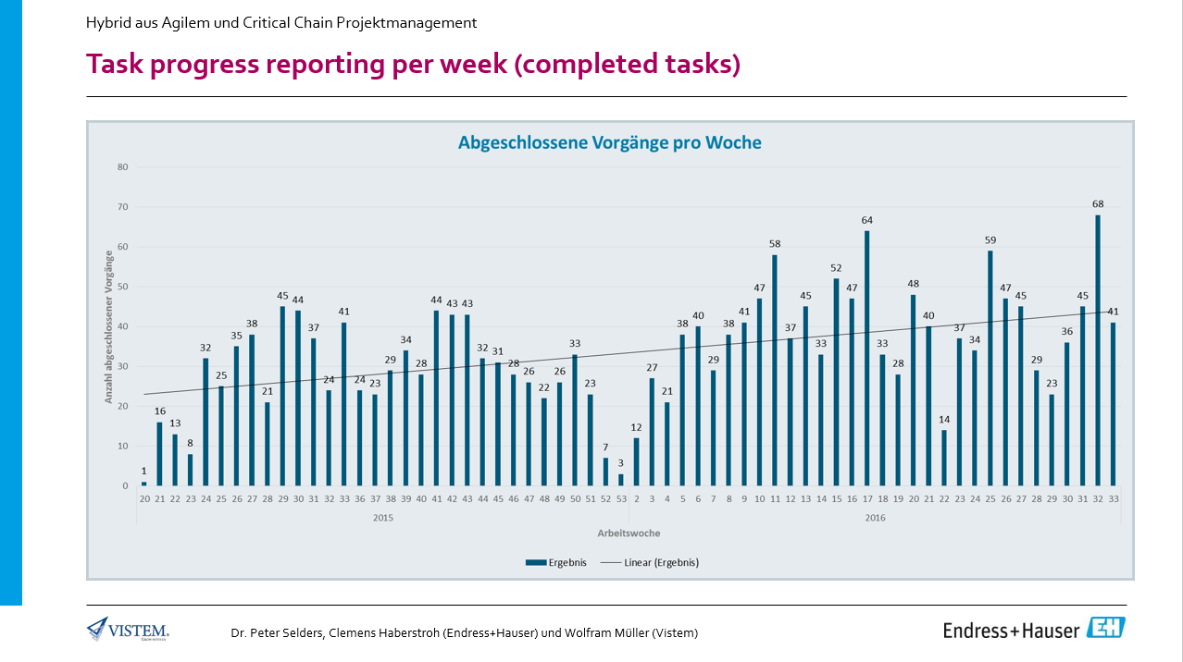

Slide 88
Pipeline Management & Resource Planning Key Questions to answer
Starting point:
“What-if” we want to deliver current and future projects in time?
Question 1: Are there any conflicts? If yes, where?
Which of the skill(s) are likely to be the “constraint”?
Which of these skill(s) is most used in the projects?
Question 2: How big is the problem actually?
Without “Due-Date Tolerance”
After using the “Due-Date Tolerance”
Question 3: Is it possible to expand the capacity, permanently or temporarily?
Does this solve the problem?
If not…
Question 4: What Pipeline sequence to implement?
Which projects can be moved?
What can be achieved?
Question 5: How to use available free capacity at other skill(s)?
Which projects can be started, without impacting the “constraint” skills?

Slide 89
Scope
Resource Load
Skills
Resources
Availability
Future work and projects
Ongoing work and projects (WIP)
Inspired by TOC
Smart Planning & Scheduling

Slide 90
Scenario planning Constraint Based
Project 2
Project 3
Project 1
Project 1
Project 5
Workpackage A
Project 3
Project 6
Workpacage B
Project 4
Project 2
Project 4
Questions:
What happens when resource or skill availability changes?
What happens when a project is delayed in order to free up resources?
What happens when a project is added to the pipeline?
What happens when a project is removed from the pipeline?

Slide 91
“What if” you want to deliver current (and future) projects in time? (1)
Are there any capacity overloads?
If yes, where? Which of the skill(s) are likely to be the “primary constraint”?
Which of these skill(s) is most used in the projects?
Is the "virtual drum" overloaded?
Is the current pipeline at risk?
are there (too) many projects in the red zone of the fever chart?
what is the trend?
Is there a problem? If yes, how big is the problem actually?
How much delay can be expected, across all projects in the current portfolio pipeline?
What is the expected "due-date" performance of your current portfolio pipeline?

Slide 92
“What if” you want to deliver current (and future) projects in time? (2)
Is it possible to expand the capacity, permanently or temporarily?
For which skill is this possible?
Does this solve the problem?
Is resequencing of the pipeline required?
Which projects have the highest business priority?
Can projects with a lower business priority be postponed or (temporarily) put on hold?
Does this free up capacity for the more important projects?
How to use available free capacity at other skill(s)?
Which projects can be started, without impacting the “constraint” skills?

Slide 93
Scenario n
Scenario n
Resource Load Analysis
Constraint(s) Detection
System engineer
Resources
Availability
More future work and projects
Ongoing work and projects (WIP)
Inspired by TOC
Smart Planning & Scheduling

Slide 94
Being in control – the new standard
Make you projects flow

Slide 95
Multi-Project Progress Chart Global optimisation across projects

Slide 96
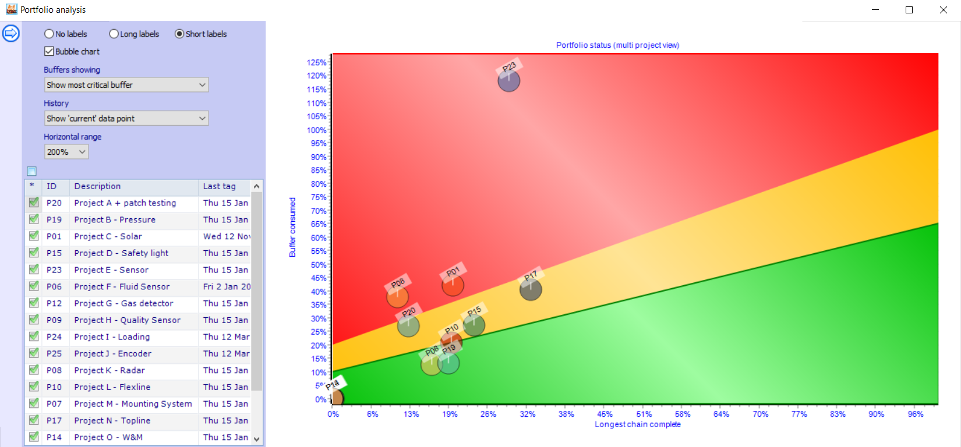
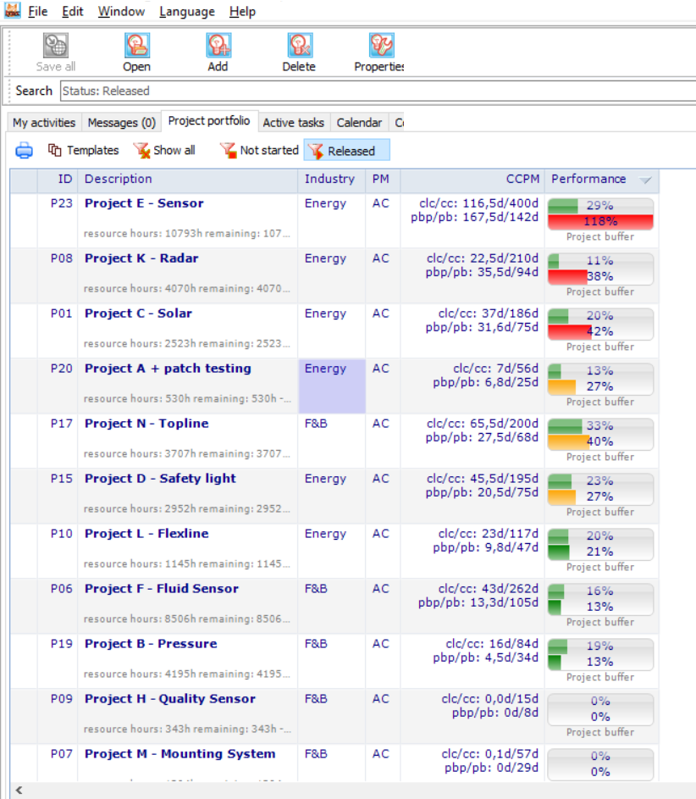
LYNX Portfolio view with configurable Fever chart

Slide 97
A. Critical Penetrating Tasks Report Shows just the one critical task per project (Project Buffer or a Milestone buffer)

Slide 98
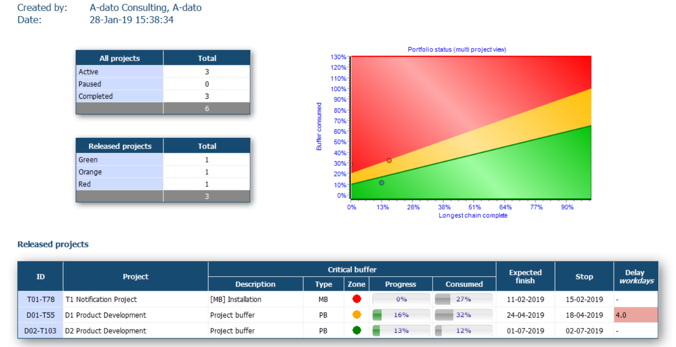
Portfolio Status

Slide 99
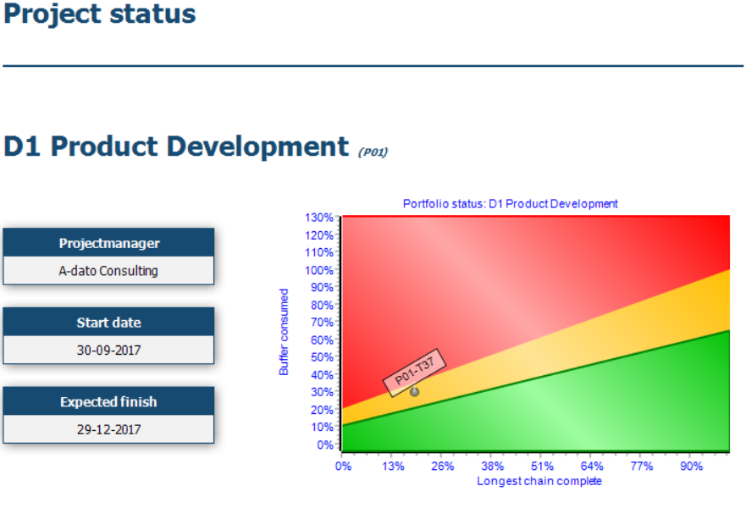
B. Project Status Buffer Status + Active Tasks + Notes
This report can be used by the Project Manager and Portfolio Manager to discuss the status of the projects.

Slide 100
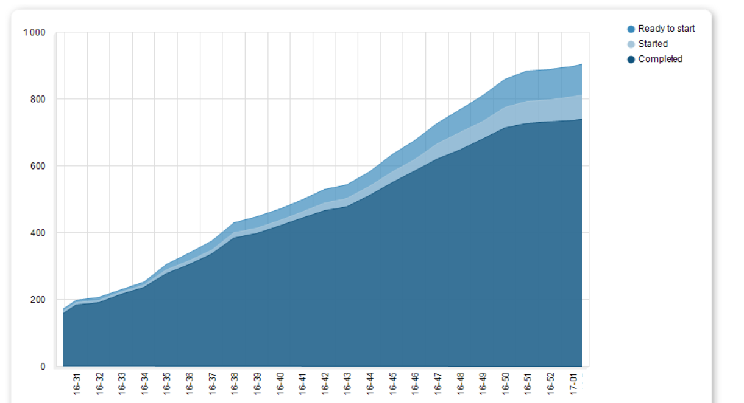
C. Flow Reports Cumulative Flow Diagram
Backlog
Lead Time
WIP
Cycle Time

Slide 101
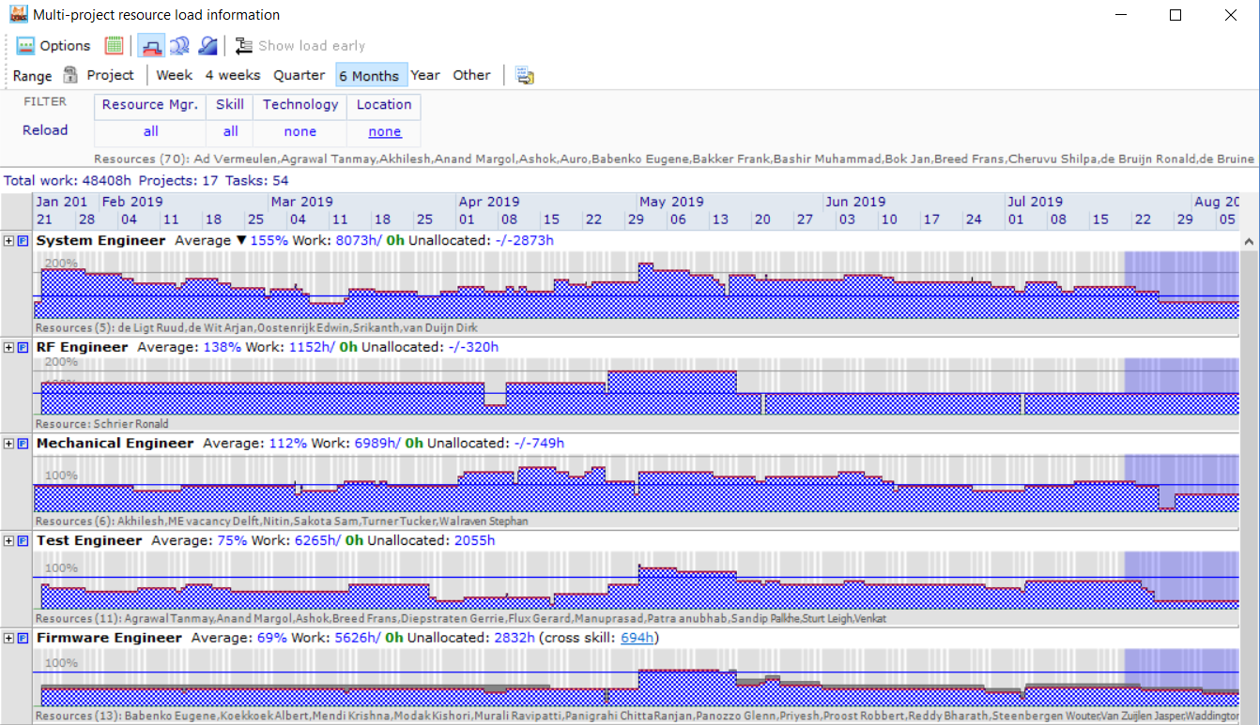
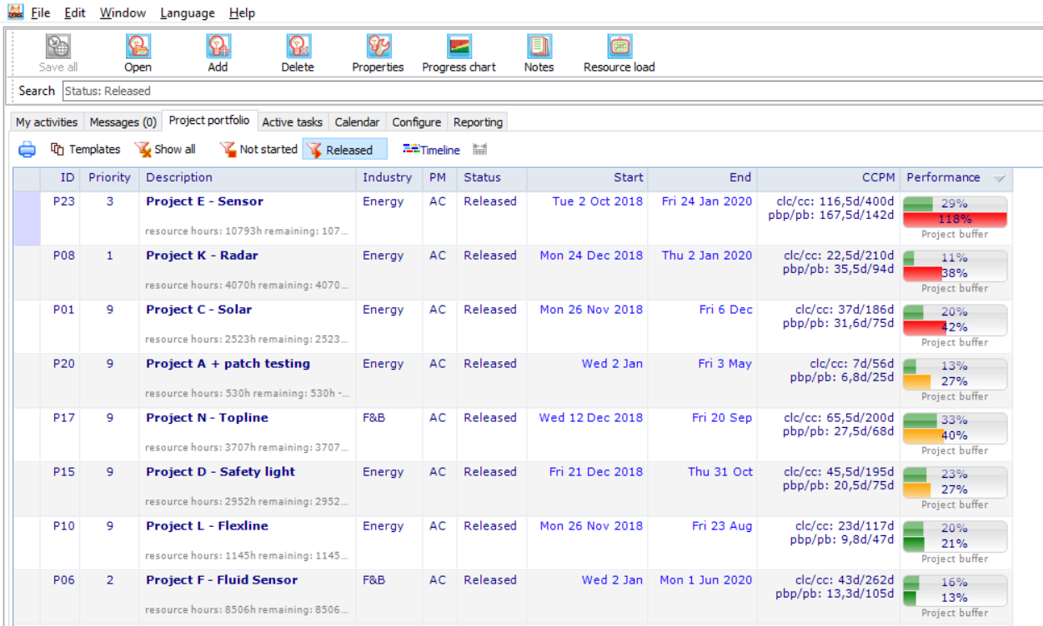
Multi-project Resource Management

Slide 103
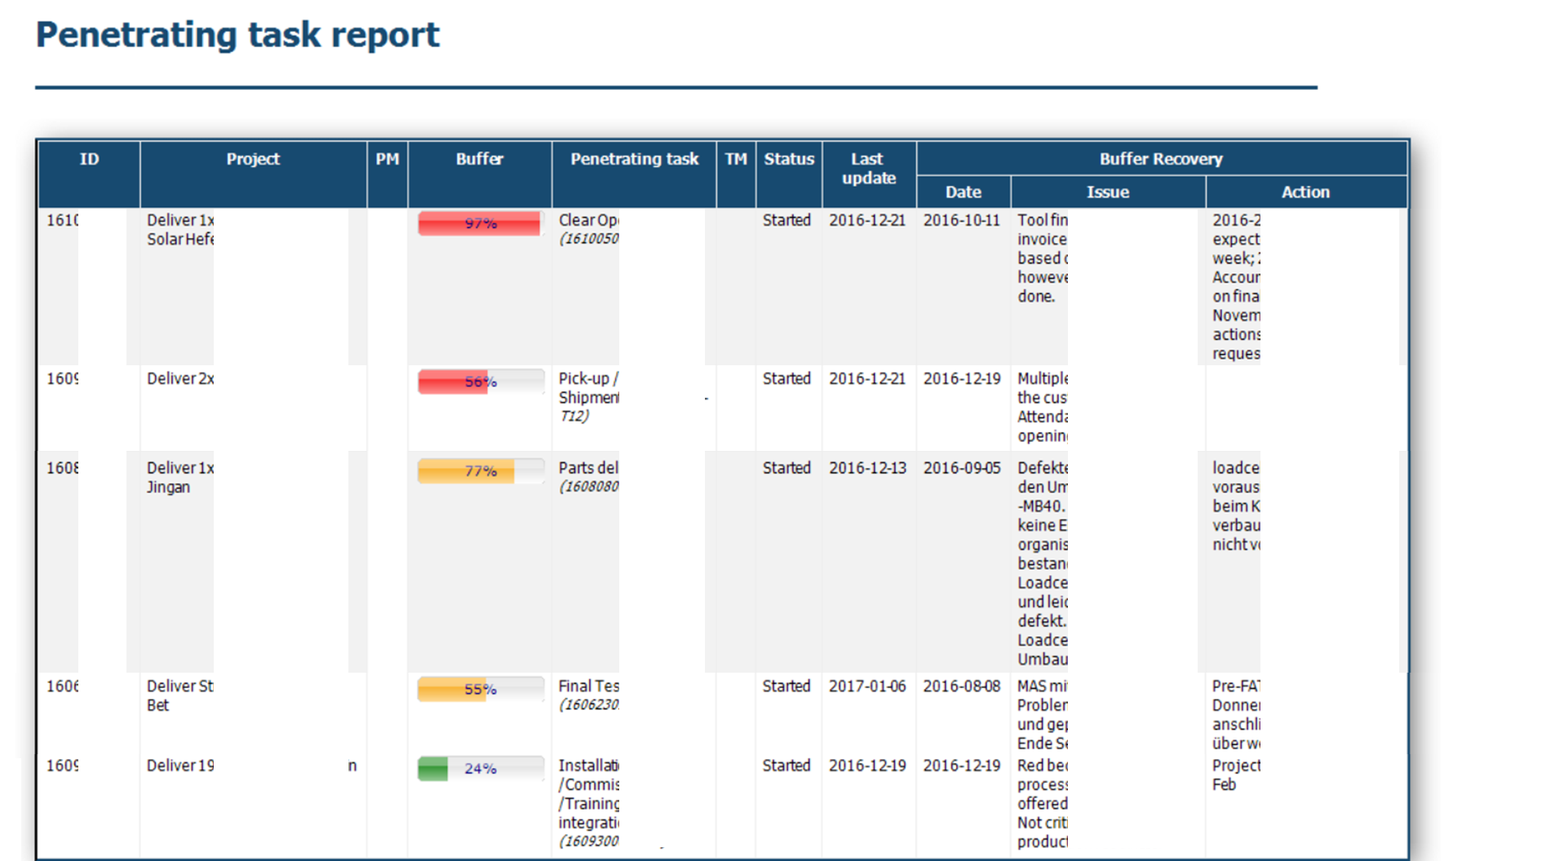

Slide 104
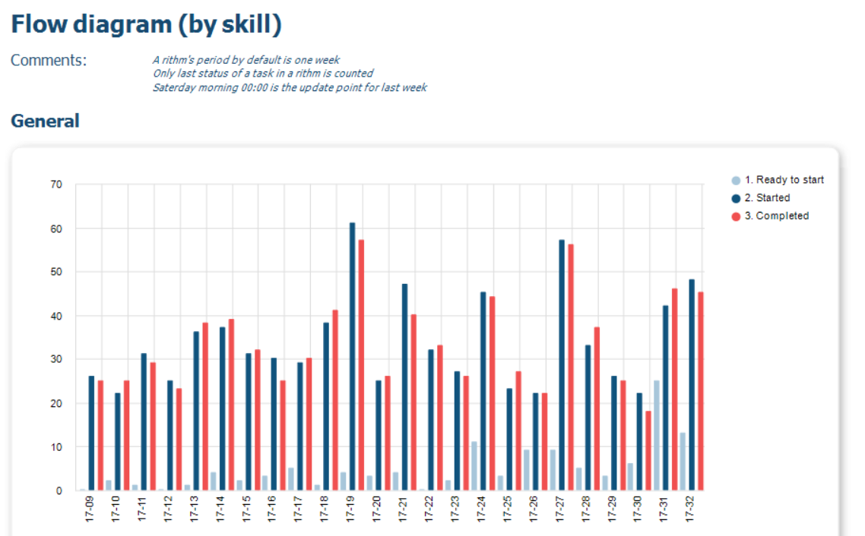
Flow diagram by skill

Slide 105
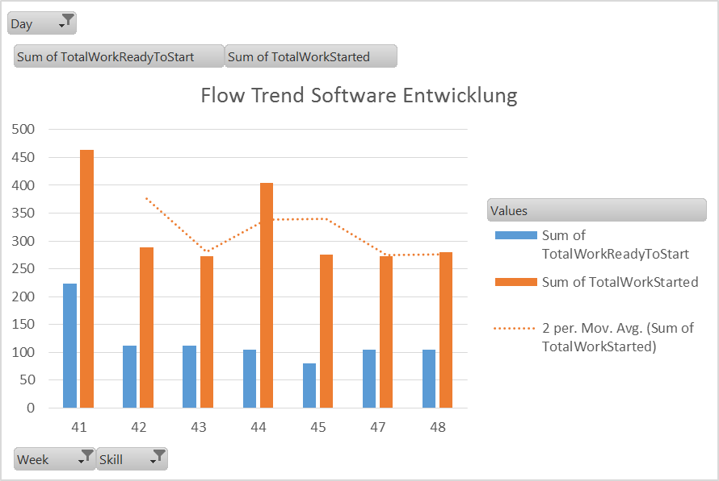
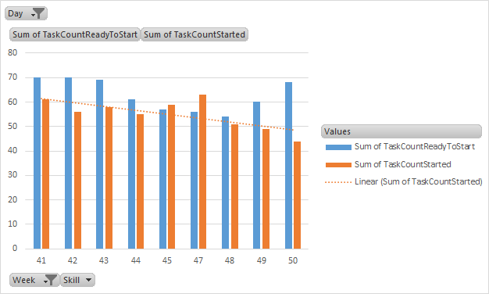
Flow Trends KPI’s Queue Management

Slide 106
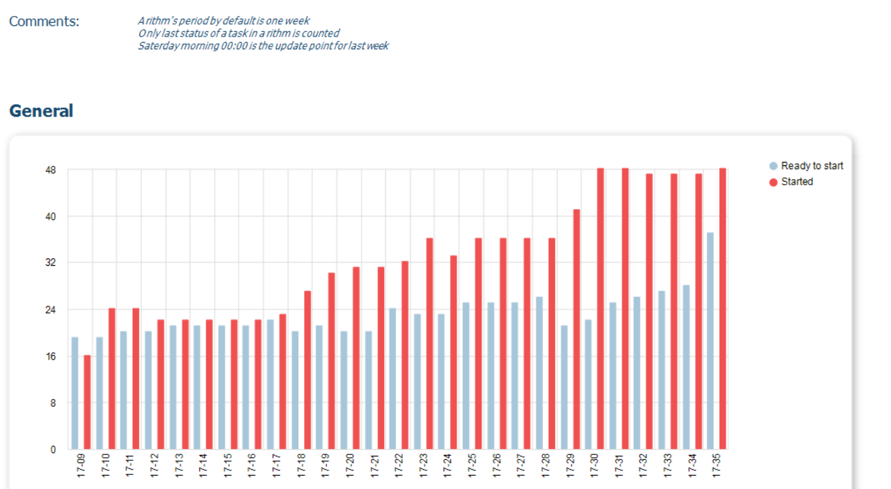
C. Flow WIP Diagram by Skill Work-in-Progress Diagram

Slide 107
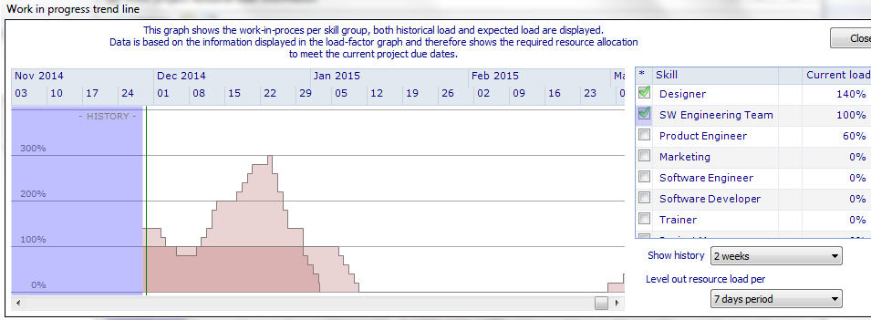
Work-in-Progress Trend Line

Slide 108
Summary

Slide 109
Levers for achieving improvements Operations Management for (multi-)project operations
Introduction of Buffer Management with Dynamic Schedules →Manage the Buffer
Aggregate and (re-)move safety time
Introduction of buffers at strategic positions to absorb uncertainty
Introduction of one single priority and feedback loop → Execute by single priority
Track progress by Expected-Time-To-Complete (~ ETA)
Synchronized Execution of Tasks
Introduction of Pipeline and Portfolio Management → Control the WIP
Constraint based Work-in-Progress management
Release management (staggering)
Introduction of Aggregation and (dynamic) “Late Binding” → Flexible Capacity

Slide 110
LYNX and LYNX TameFlow
Multi-project resource management
(Skills, profiles, resources, teams, team members)
Portfolio / Multi-Project
Card
Projects with tasks
Workpackages with Cards (subtasks, user-stories, cases)

Slide 111
LYNX Workflow Optimization – The Project “Factory”
Pipeline & Scenario Planning
Release Wizard
Scenario Wizard
“Strategic Priorities”
Stakeholder
„Priority board“
PIPELINE
Layer 1
Multi-Project
New projects
Project #4
Project # 5
#2
Project #3
Project #1
Projects
CCPM or LFPM
Buffer Management
“Operational Priorities”
Layer 2
Single Project
teams
Workpackages with Cards
Agile/Kanban Processes
e.g. Sub-tasks / Stories
Layer 3
Workpackages Agile & Kanban
Notes:
3 lagen model. – wat is dan nog een missing link? → kenniswerk. Agile and everything is good.

Slide 112
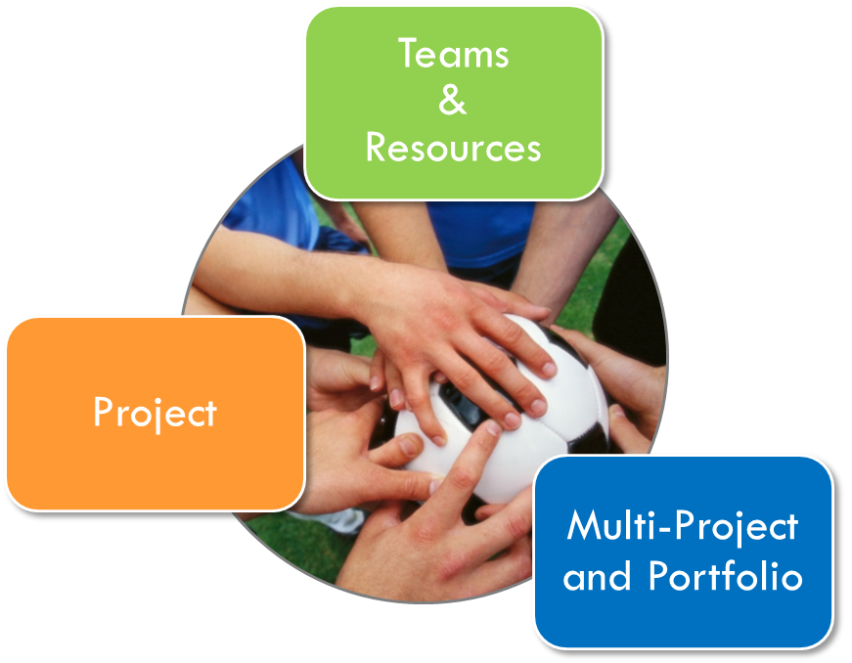
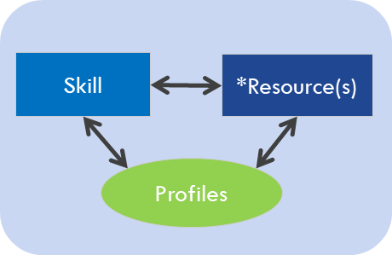
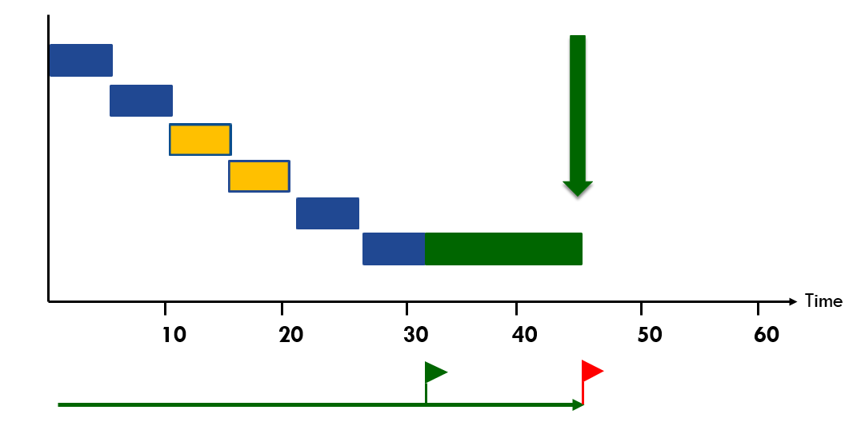
LYNX and LYNX TameFlow Workflow optimisation with Resource Management
Optimal
Workflow
Optimal
Resourcing
Optimal
Results

