Slide 1
LYNX Configuration
The Basics

Slide 2
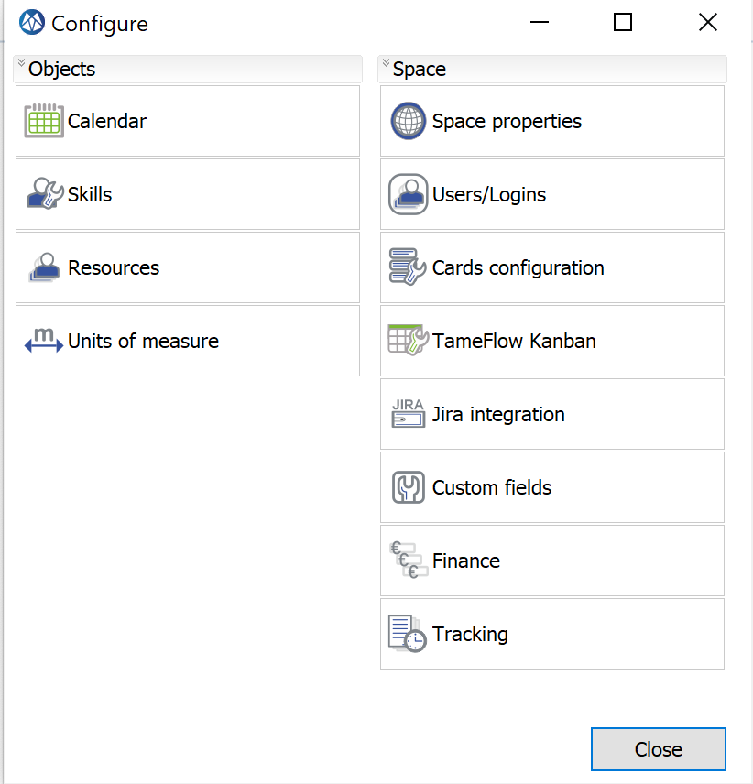
Configure – Basic Set-up
Add Calendar, Skills and
Resources to your “Default”
workspace
NOTE: if you are invited to an existing workspace, it is likely that this workspace already has a Calendar, Skills and Resources. You may skip this step

Slide 3
Overview Basic Configuration
Add and Configure:
Calendars
Skills
Resources
When Applicable:
If you want to configure your own personal space
If you are a space owner of a company space
When not applicable:
If you are invited to a workspace and do not have a role as space owner. For example if you are invited as a project manager

Slide 4
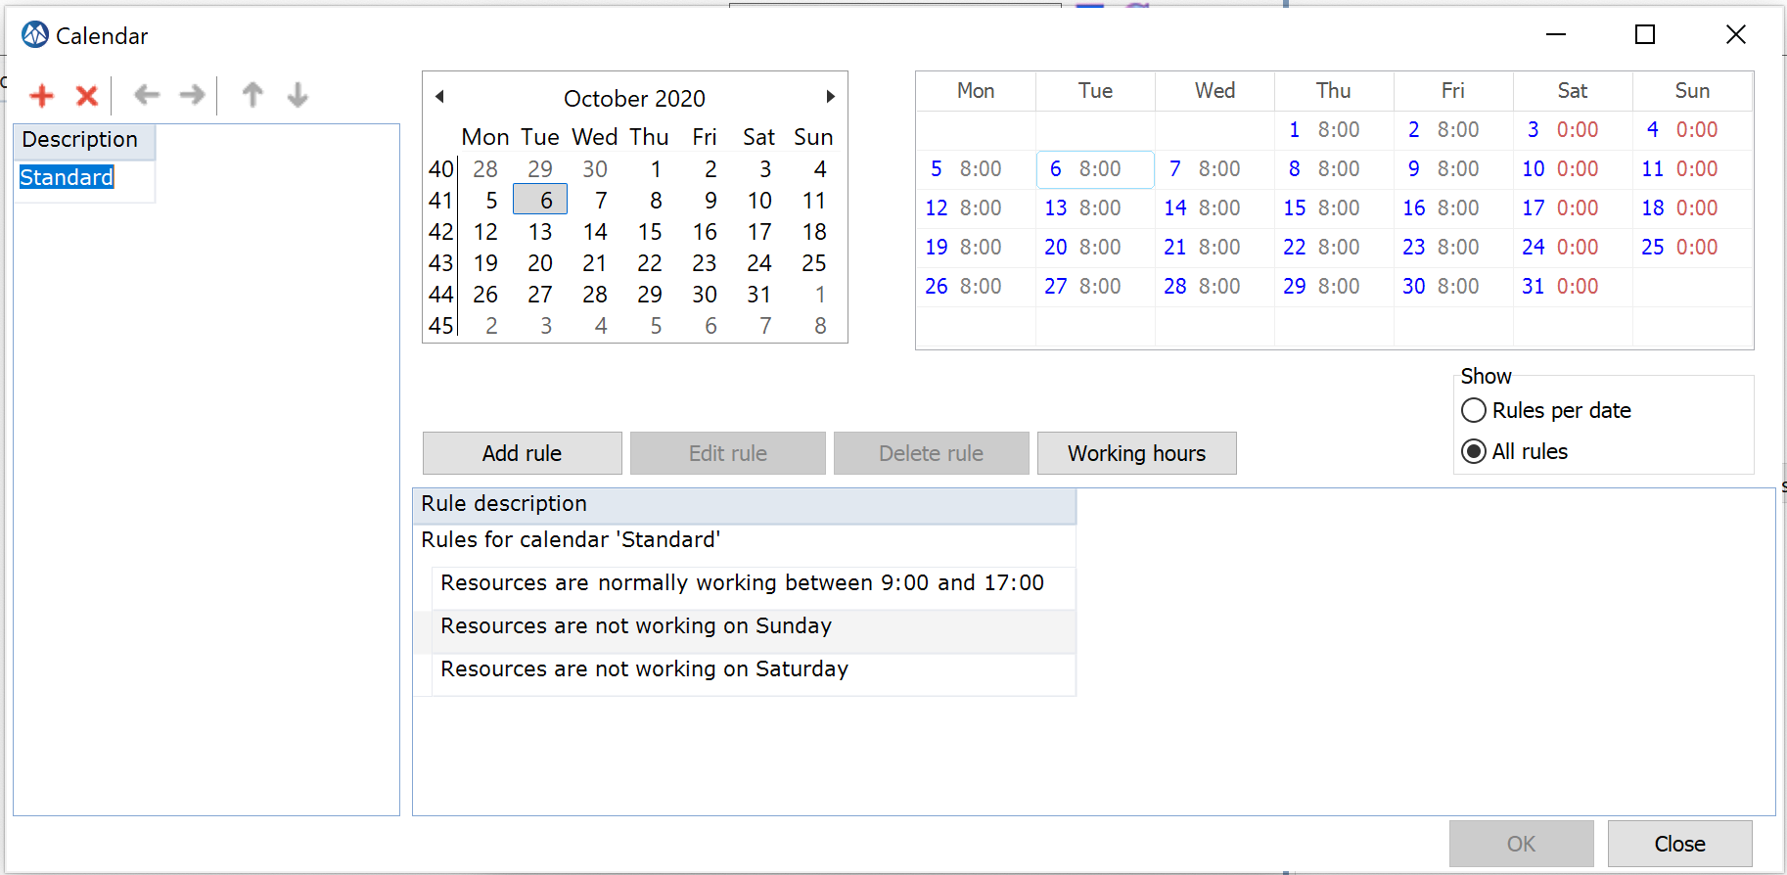
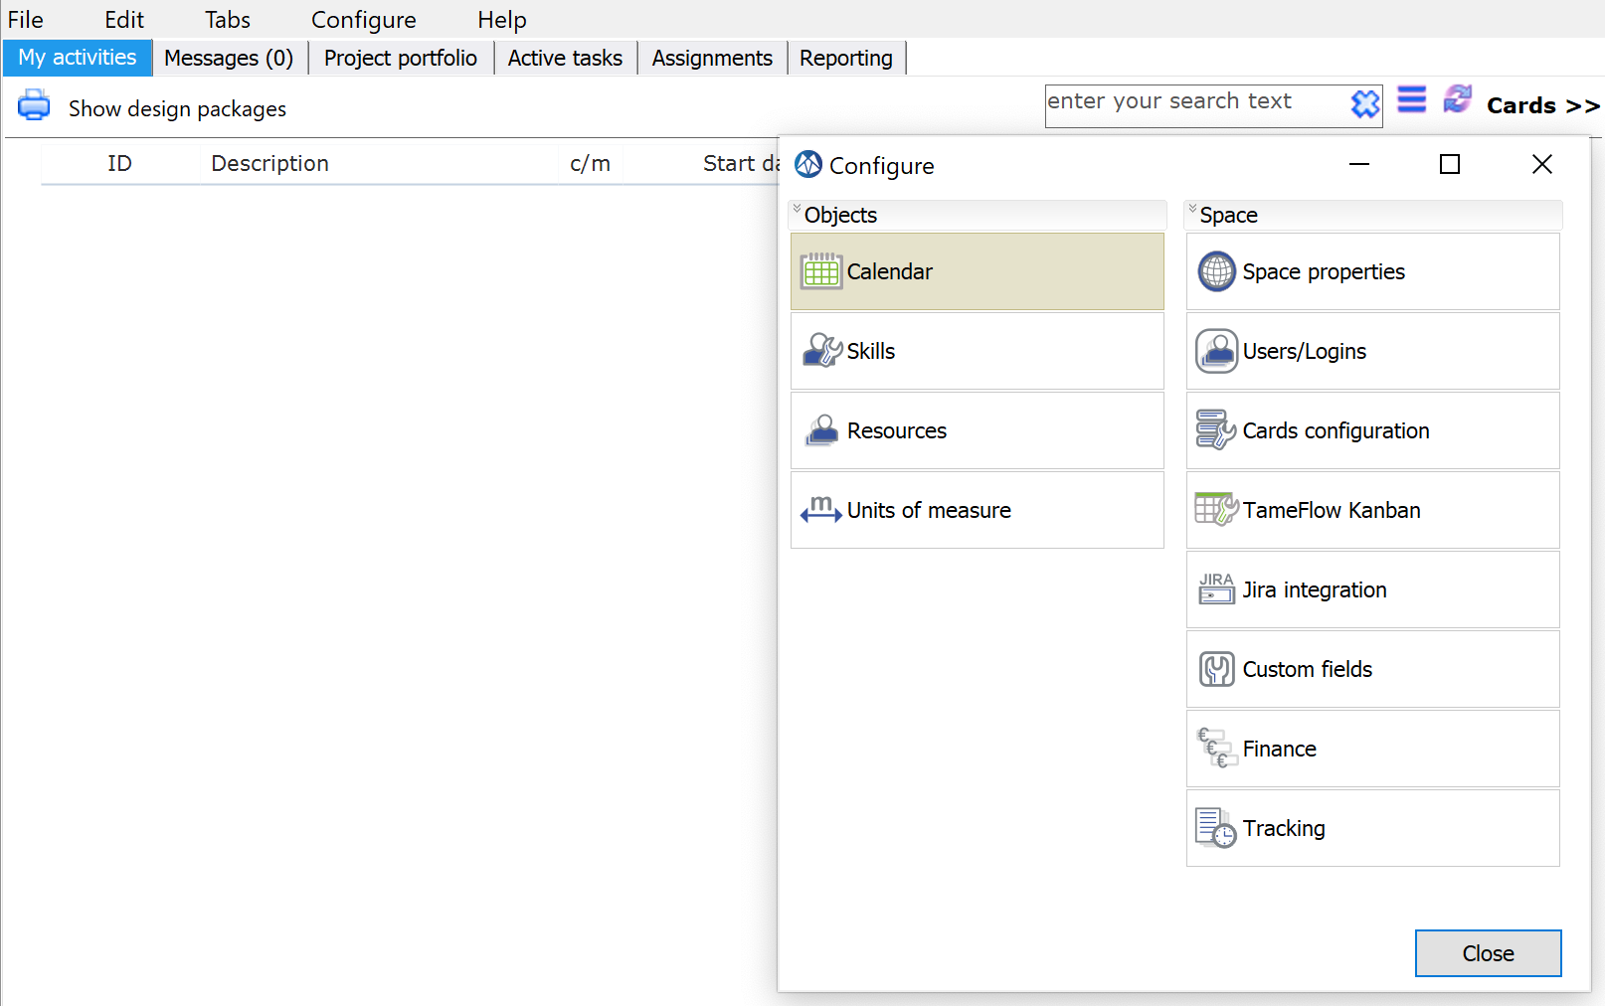
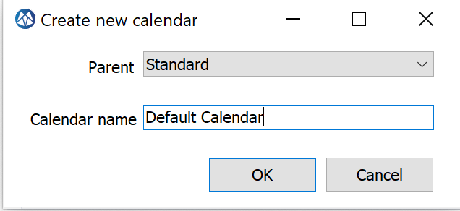
Add your Standard Calendar
Select Configure
1
2. You can choose any name.
Calendars are linked to projects, skills and resources. A calendar drives the capacity or availability in terms of resource hours.

Slide 5
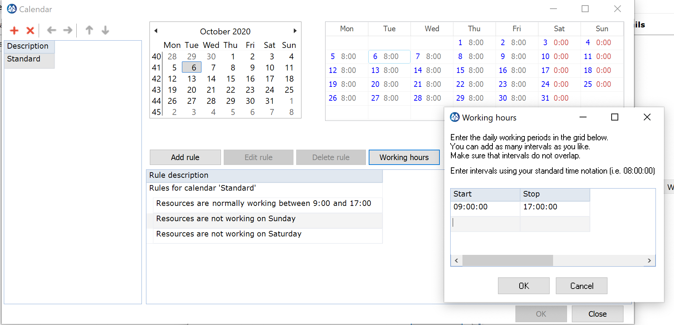
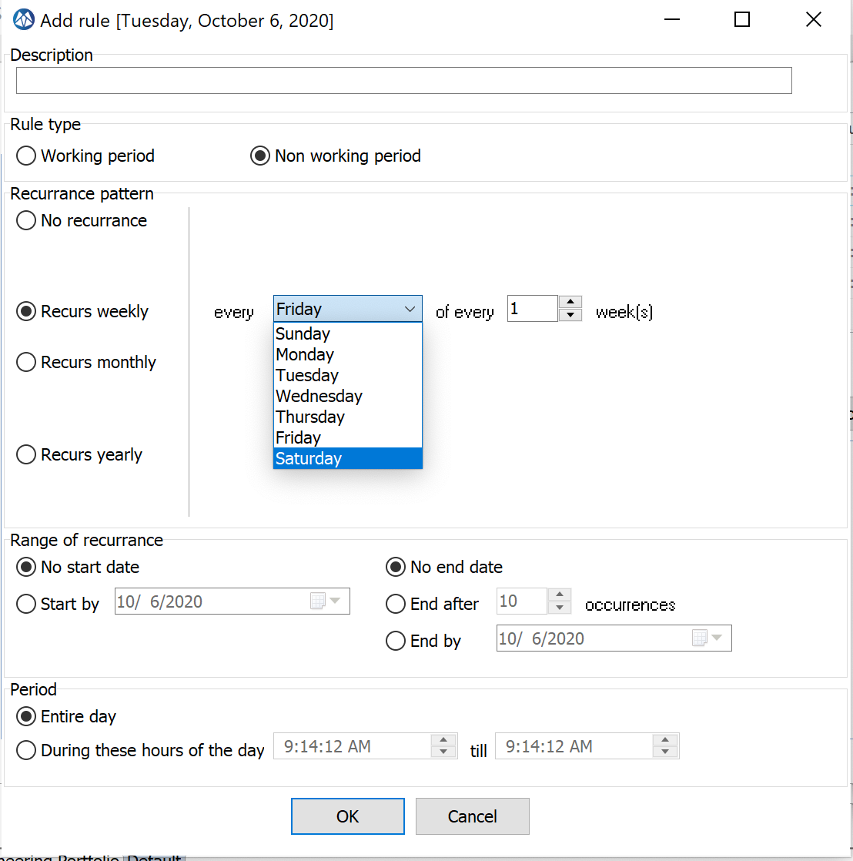
Define working hours and non-working days
3.
4. Add Rule: exclude Saturday & Sunday as a non-working day

Slide 6
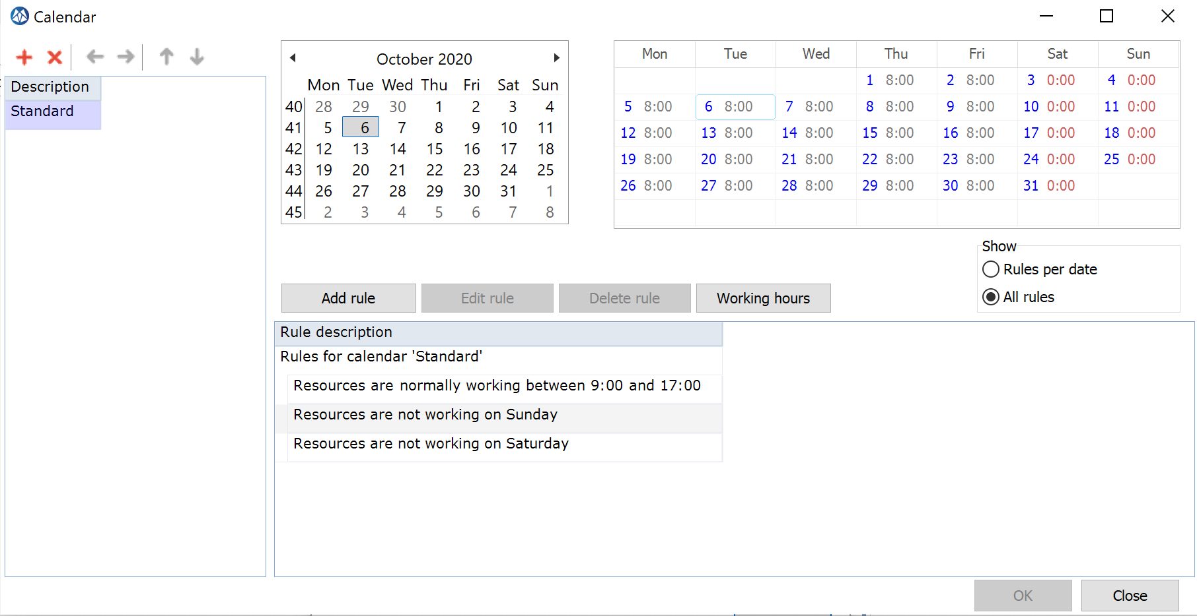
Standard Calendar - Result
No hours available on Saturday and Sunday
You can add more (sub) calendars
You can add holidays, like 25th December and 1st January.

Slide 7
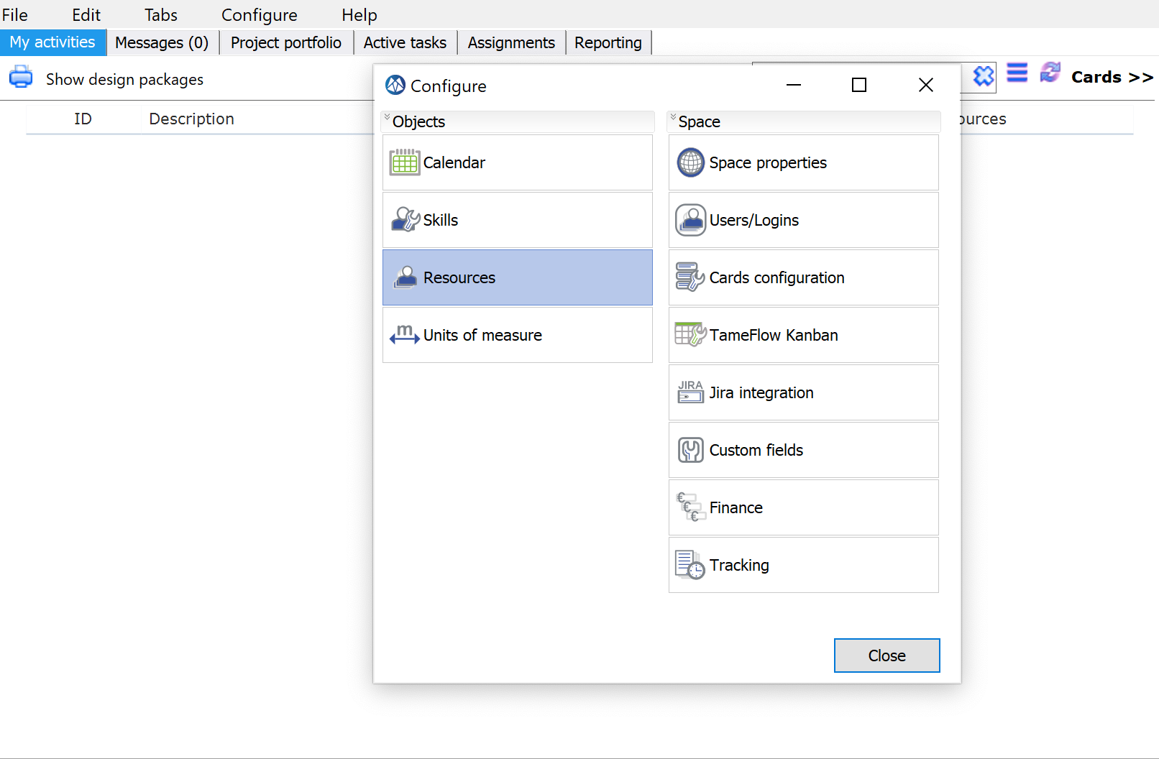
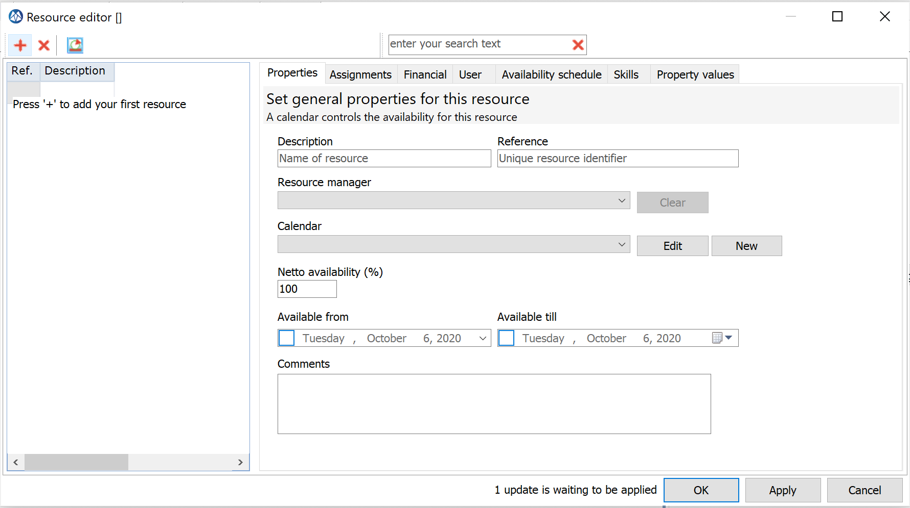
Define Resources (normal skills) in the Resource Editor
Click on the plus icon to create a new resource
Fill in the name of project team members
Fill in a unique reference, e.g. initials of the resource

Slide 8
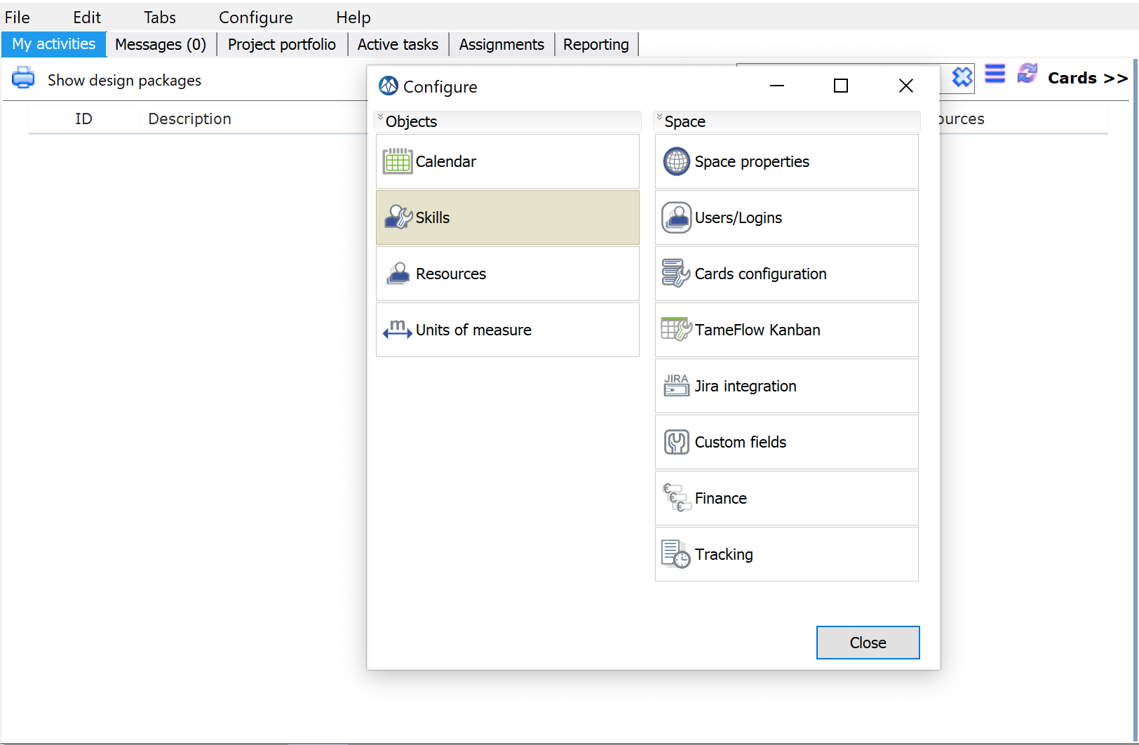
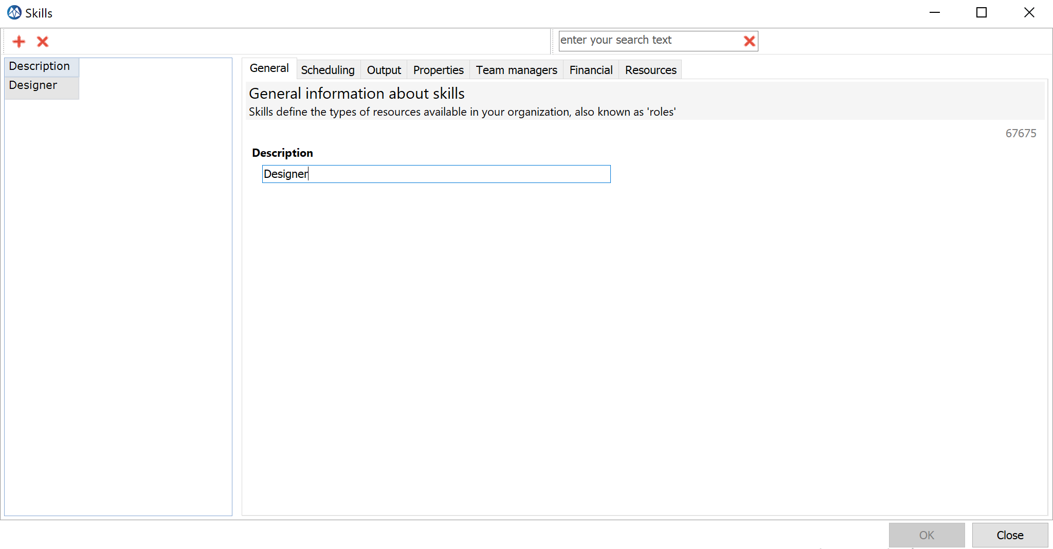
Create a new skill
Click on the plus to add a new skill
Define the skills/roles available

Slide 9
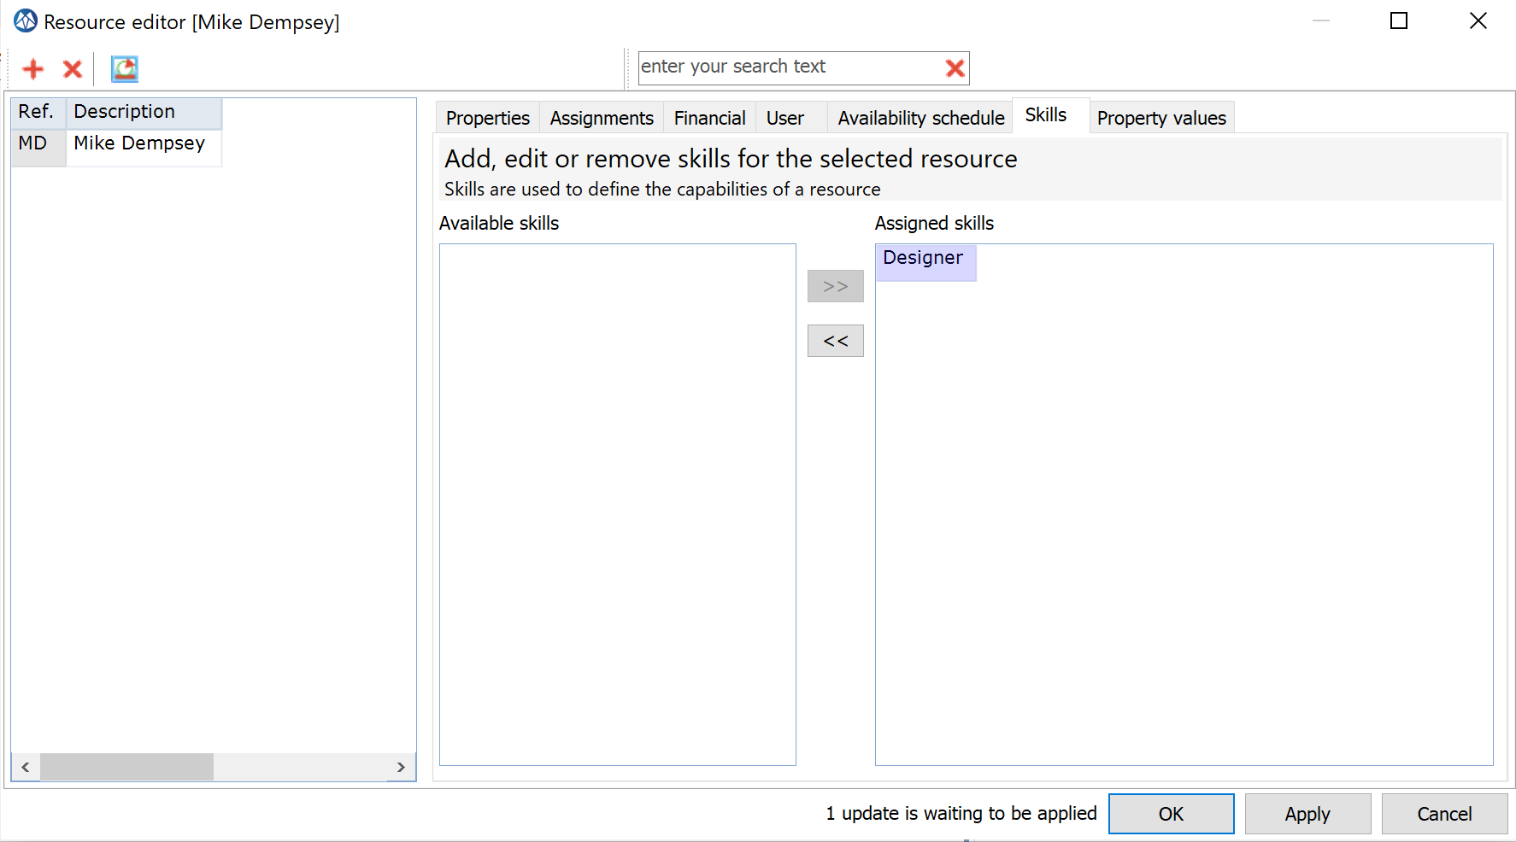
Add a skill(s) for a resource
Select the Skills tab
Mike Dempsey is a designer

Slide 10
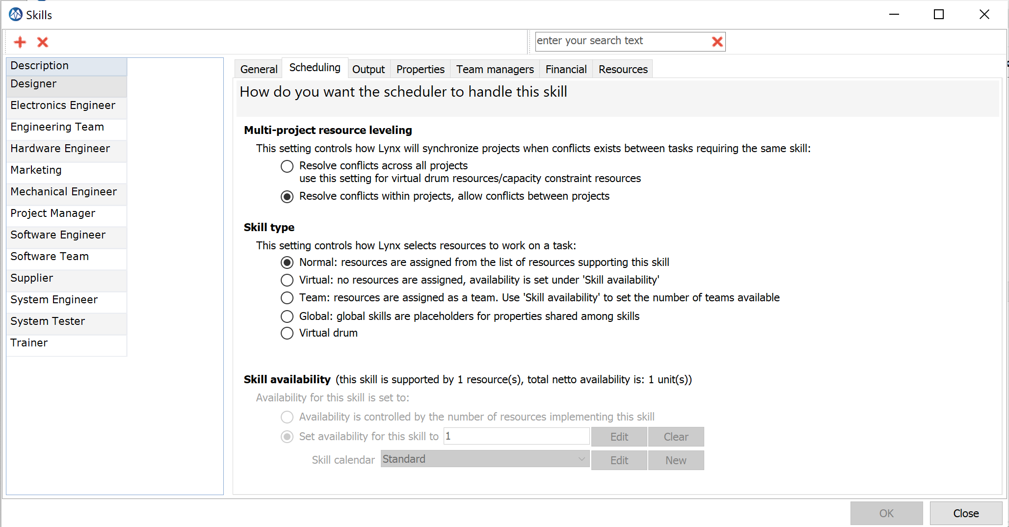
Define Skills and Skill Type (“virtual” or “normal”)
Select the scheduling tab
Virtual: LYNX plans against a total availability for the skill (in FTE) based on FTE or “Controlled by #resources…”
Normal: LYNX plans against total skill availability based on resource (names) individual availabilities
Refer also the special tutorial “Resource Skill Model and assignment process”
As customer of A-dato you have the possibility to work with Virtual Skills only, Normal Skills and Combinations. This is an implementation choice. Contact A-dato for recommendations.

Slide 11
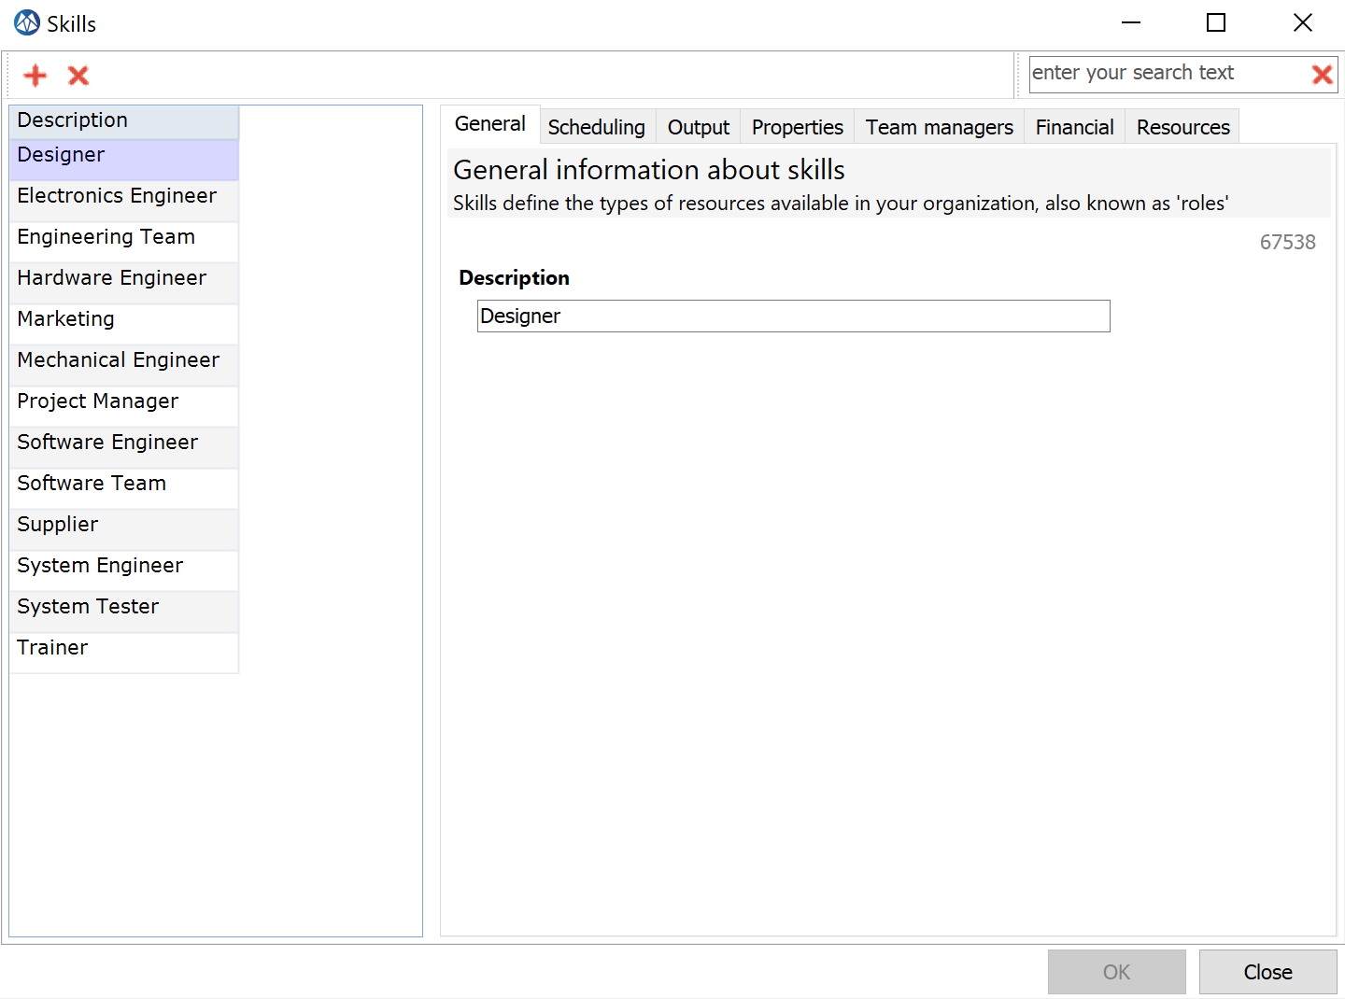
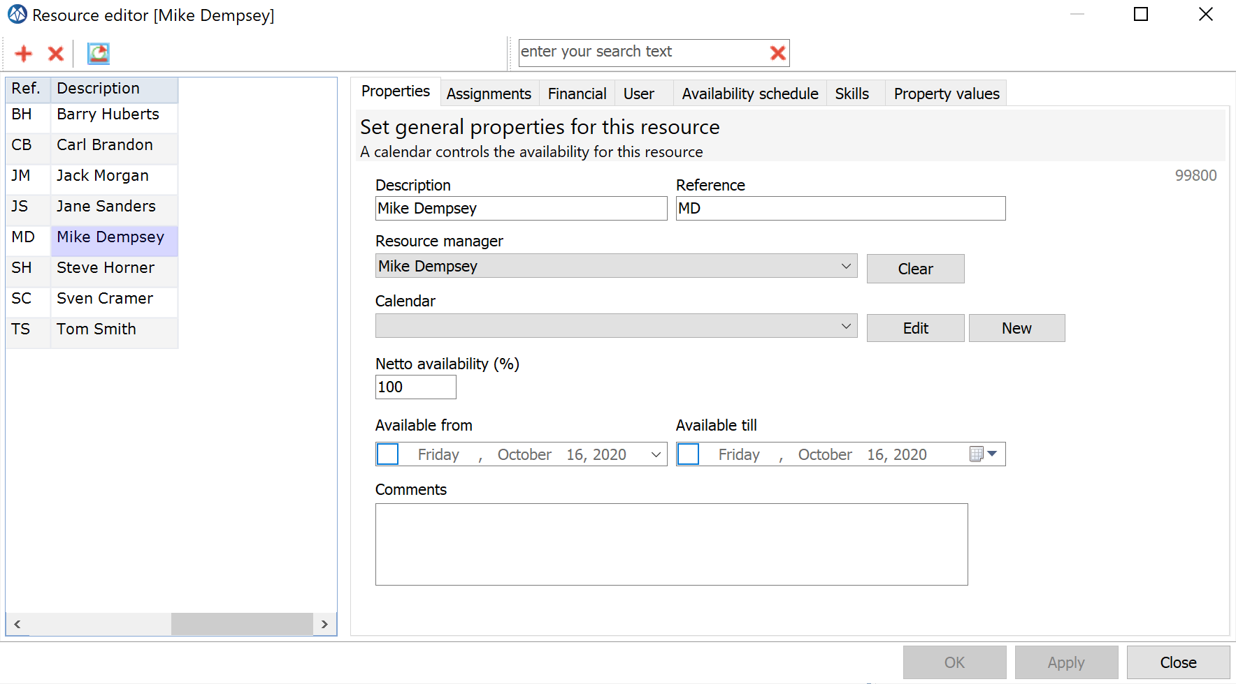
Add some more (virtual) skills and resources
Skills | Availability | Resources
Designer | 1 | Mike Dempsey
Supplier | 1 | Virtual Skill
System Engineer | 1 | Barry Huberts
System Tester | 2 | Steve Horner, Tom Smith

Slide 12
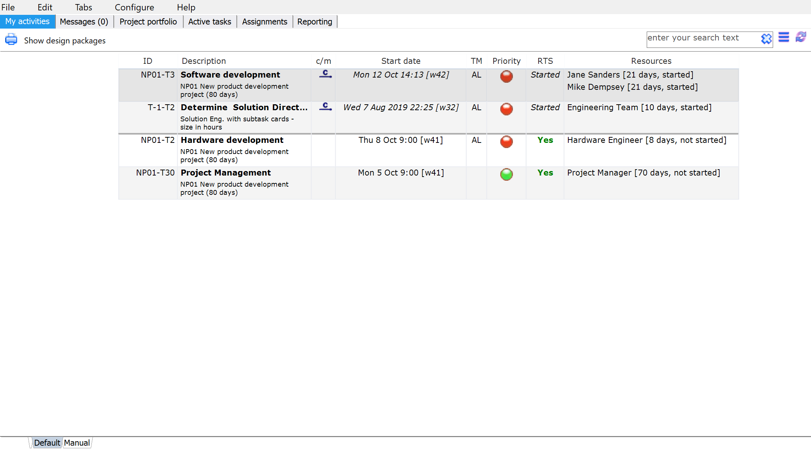
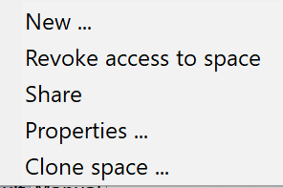
Create a new workspace
When downloading LYNX you will start in a LYNX DEMO space. Start your own new workspace
2.
Select New.. to create a new workspace to get started
Right click on the workspace tab
1.

Slide 13
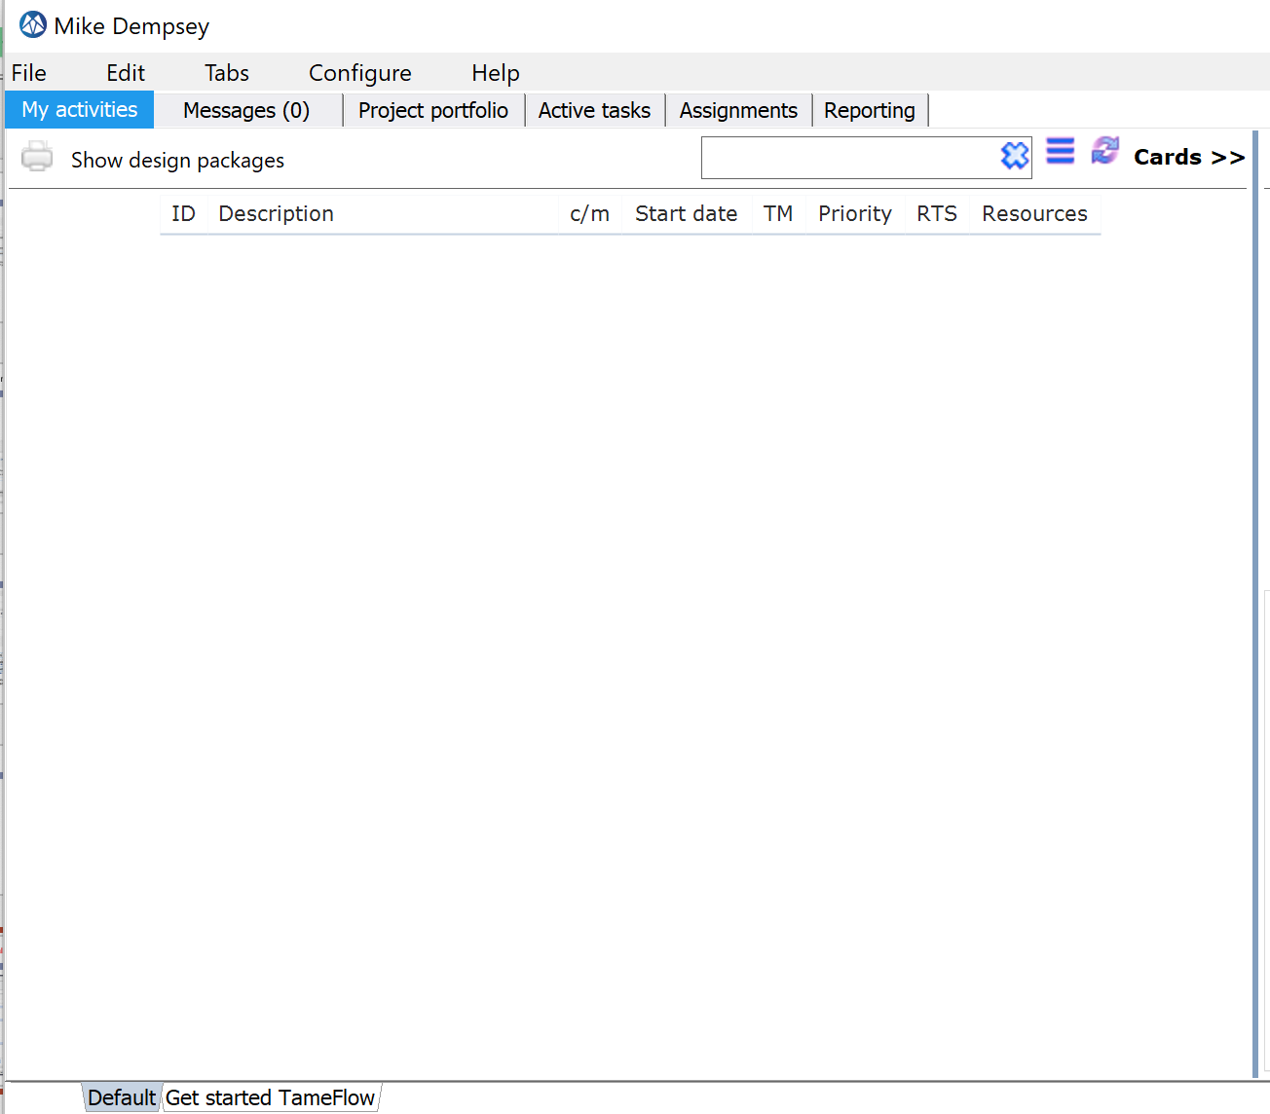
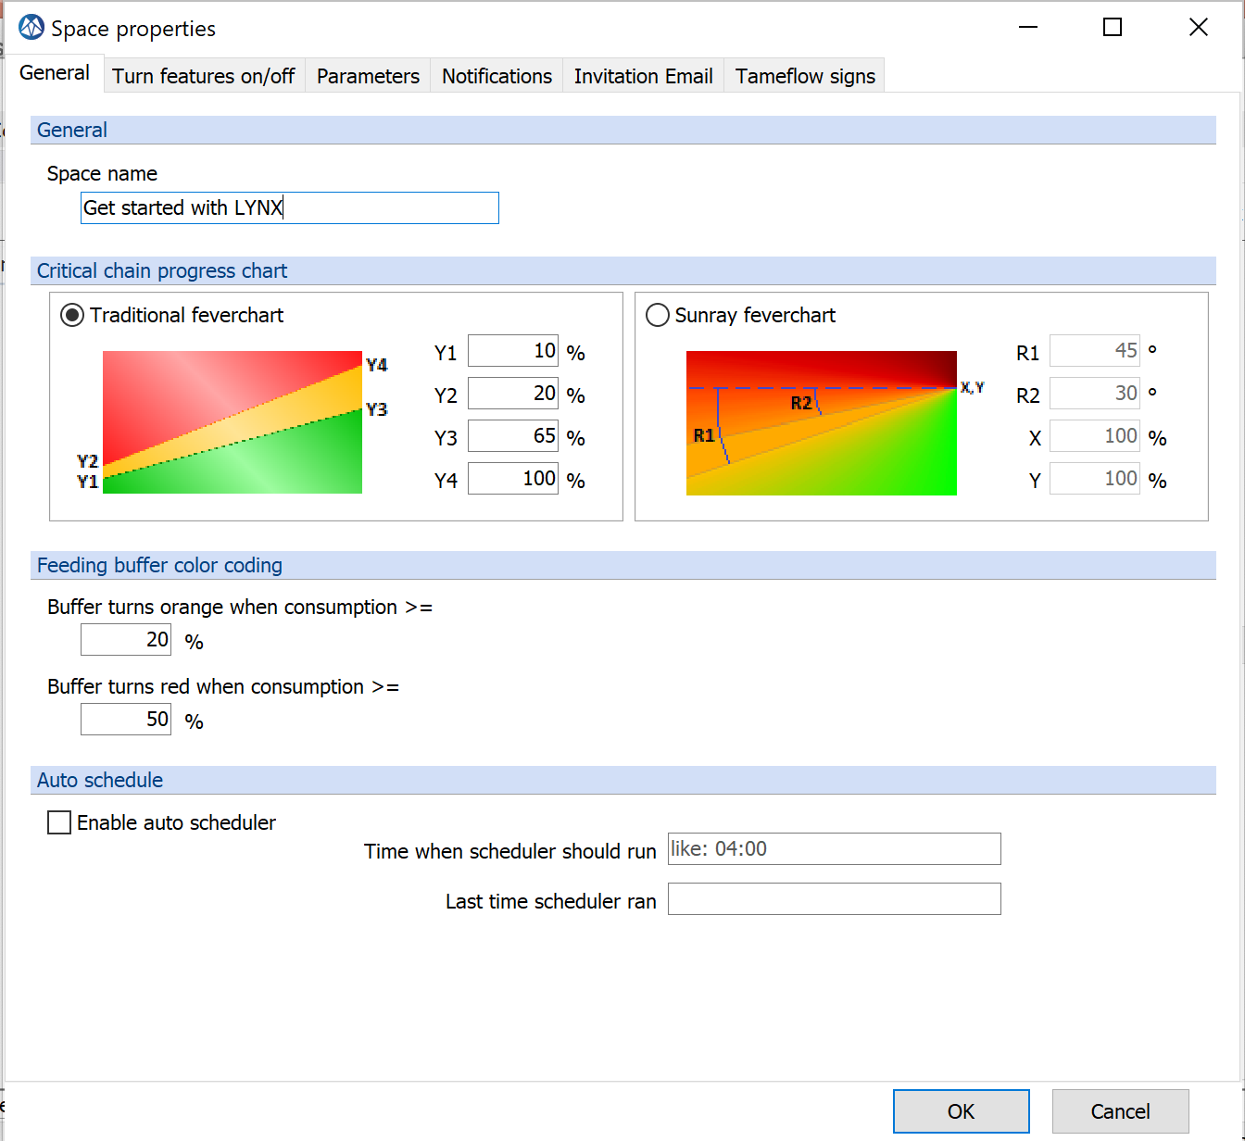
Change the name of your workspace (optional)
2
Change the name of the space here
3
Right mouse click, select Properties
1

