Slide 1
Get started with LYNX
Project Managers

Slide 2
Contents
DOWNLOAD LYNX
https://www.a-dato.com/download-lynx/
Configuration
Planning
Execution
Create your first project (21)
Add Tasks (26)
Add Dependencies (31)
Add Skills and Resources (39)
Add Task Managers (45)
Apply CCPM Behavior (48)
Registration and Login (5)
LYNX Overview (10)
Release your project and tasks for execution (56)
Other:
A few tips and tricks
More information
Visit the
LYNX HELP CENTER
https://support.a-dato.com/hc/en-us

Slide 3
Visit the LYNX Help Center

Slide 4
Search and Replace (CTRL F)

Slide 5
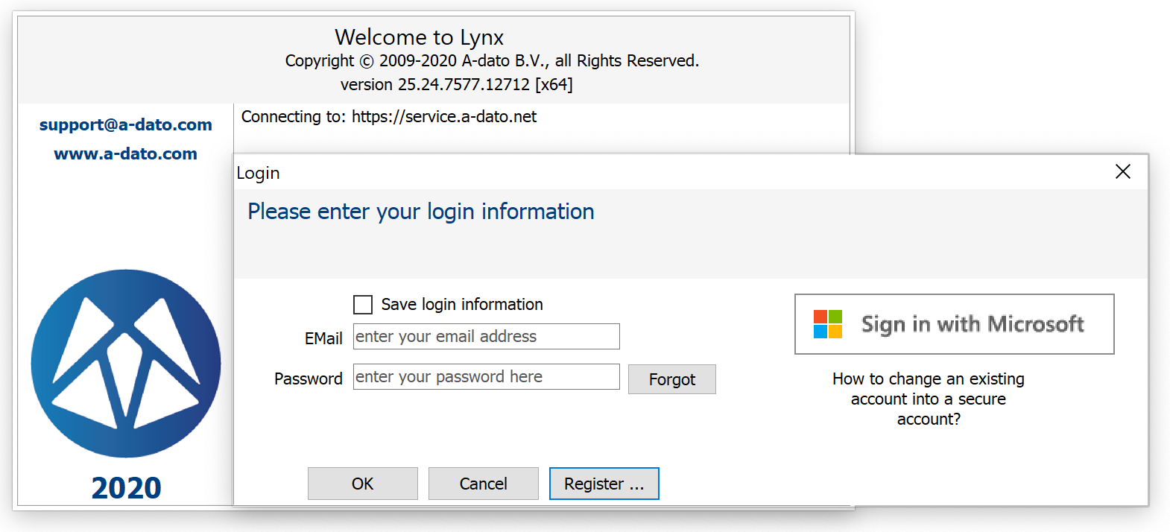
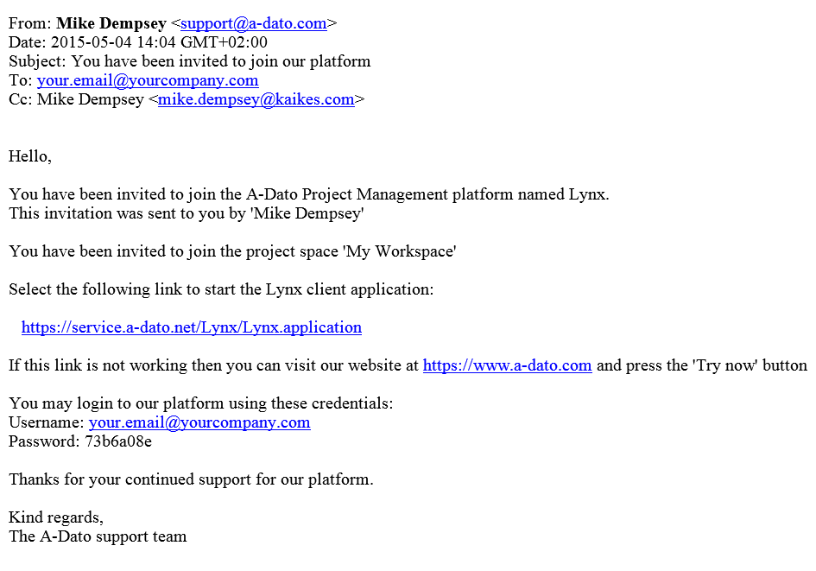
Register as a new user OR Login by invitation with your (new) credentials received per email
If you already received an invitation to join LYNX from another user (e.g. colleague, admin, workspace owner) your login credentials are provided in the invitation email.
Create a new account.
If you are invited as a first-time user, LYNX will provide an initial password, which can be changed in MyProfile

Slide 6
New User Registration
Do not forget to enter your initials.

Slide 7
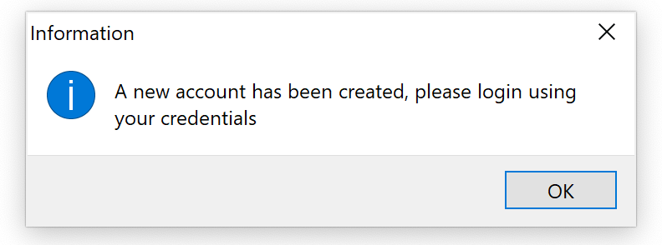
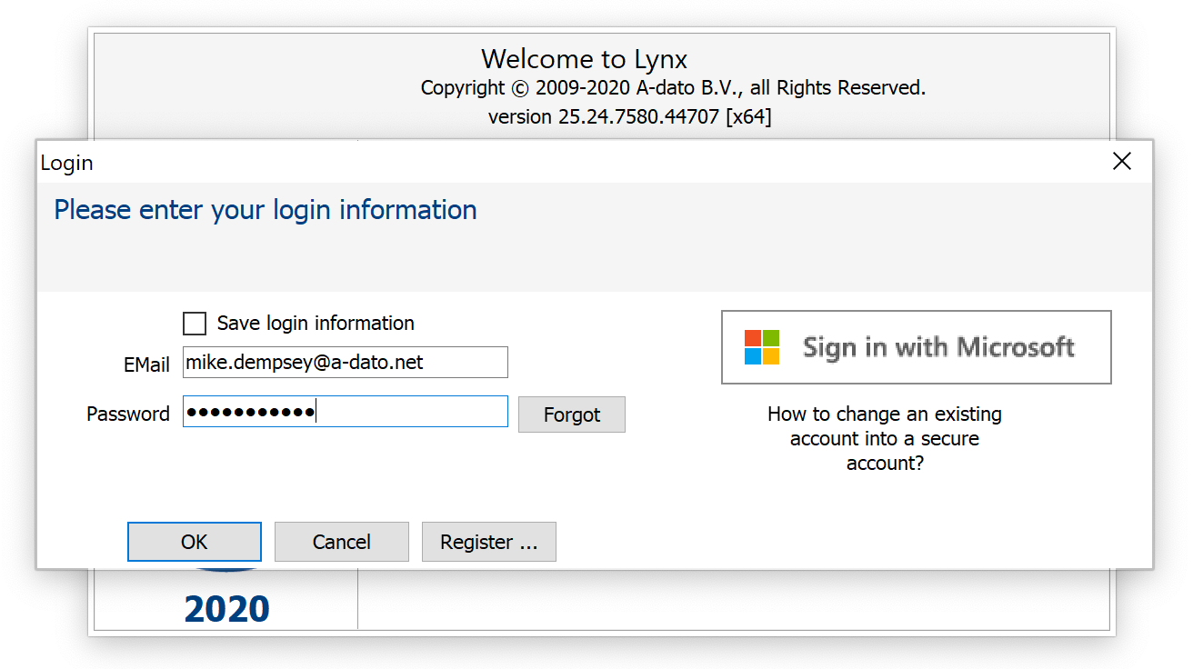
Login after registration with your email and your password

Slide 8
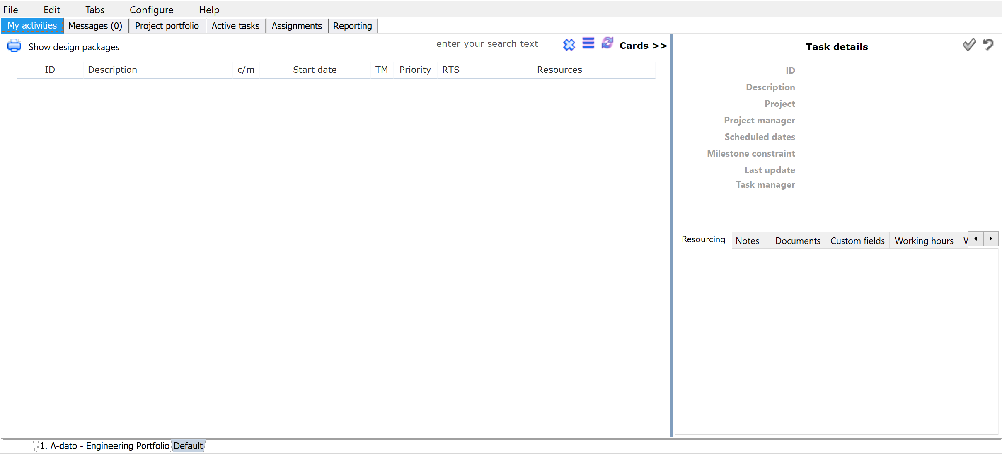
My activities Your First Screen showing your activities / Select “ Configure”
If you are a new registered user, this screen is (still) empty.
Select Configure as the next step.
If you are invited as a (new) user, for example in the role of Task Manager, your tasks may already be displayed here.
If you are invited the name of an existing workspace is displayed here. For example “MyCompany” or “Training”

Slide 9
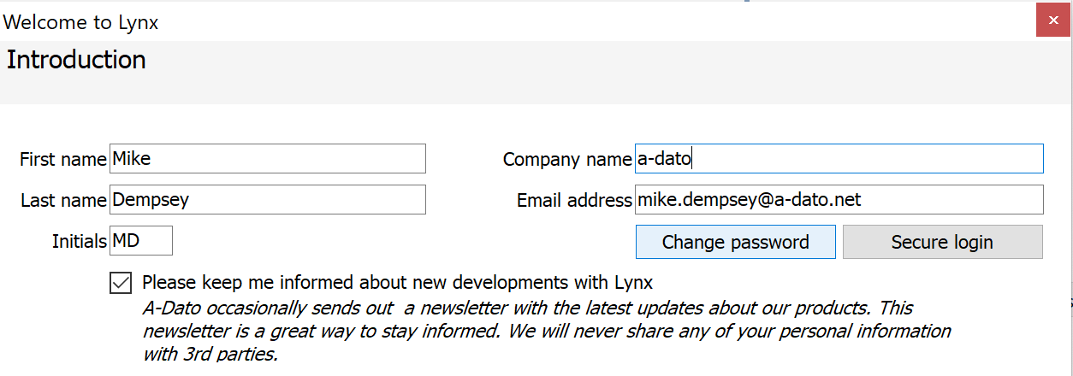
Check or Update My Profile
You can change your password here
Go to File → My profile

Slide 10
LYNX Overview

Slide 11
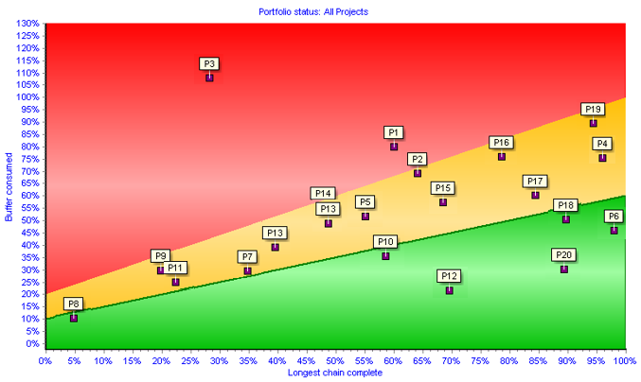
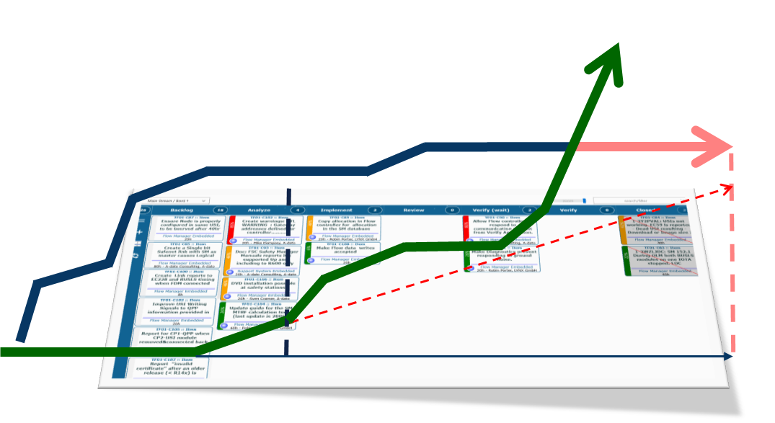
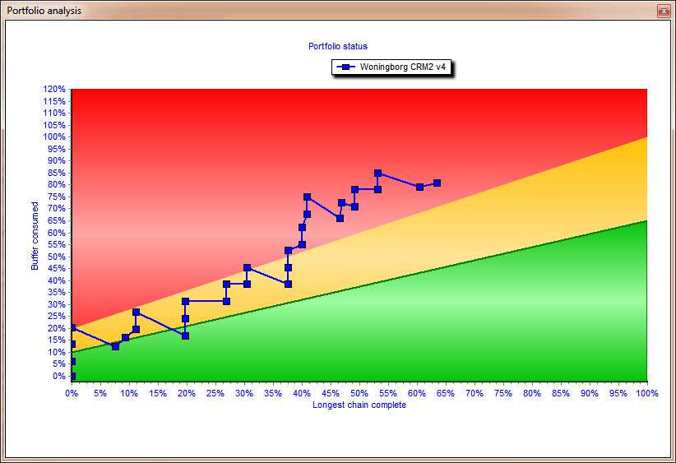
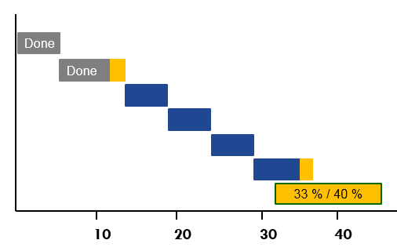
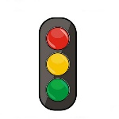
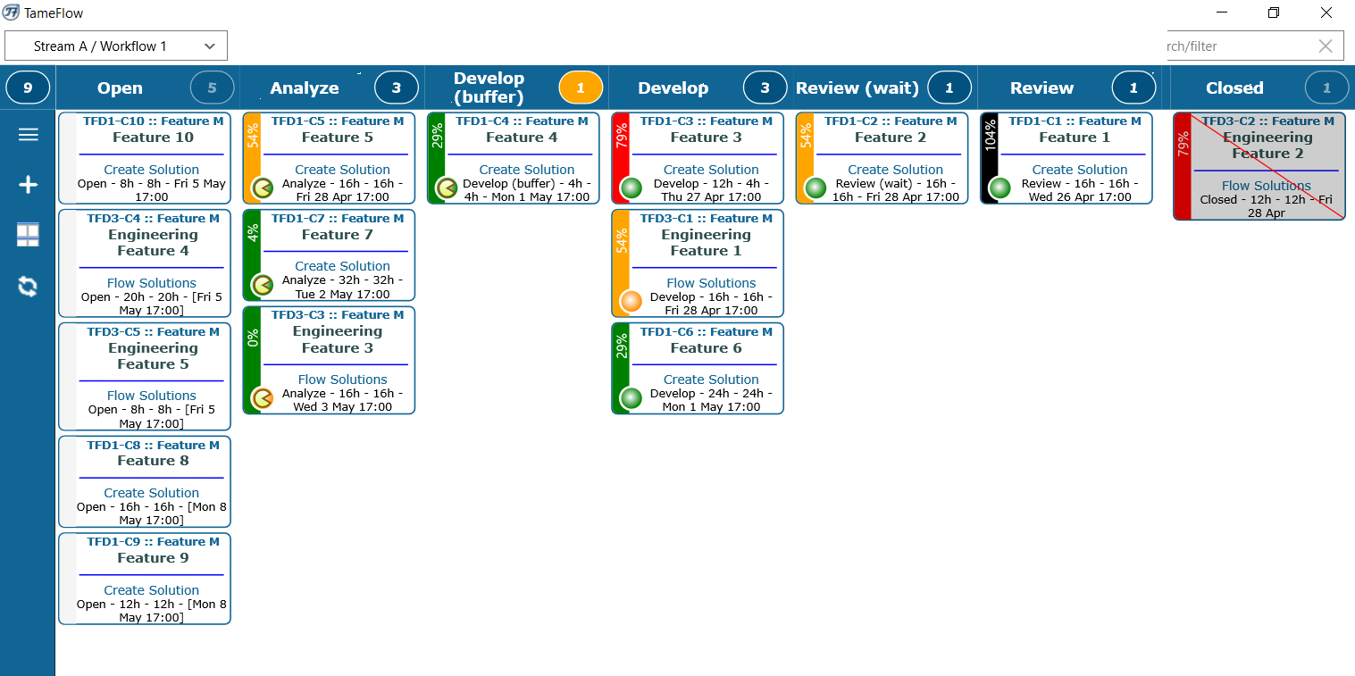
LYNX Workflow Optimization – The Project “Factory”
Pipeline & Scenario Planning
Release Wizard
Scenario Wizard
“Strategic Priorities”
Stakeholder
„Priority board“
PIPELINE
Layer 1
Multi-Project
New projects
Project #4
Project # 5
#2
Project #3
Project #1
Projects
CCPM
Buffer Management
“Operational Priorities”
Layer 2
Single Project
teams
Workpackages with Cards
Agile/Kanban Processes
e.g. Sub-tasks / Stories
Layer 3
Workpackages Agile & Kanban
Notes:
3 lagen model. – wat is dan nog een missing link? → kenniswerk. Agile and everything is good.

Slide 12
Layer 3 Integration LYNX TameFlow Task Board, including Flow Buffer Management

Slide 13
Focus of this manual: Layer 2
Create Projects
CCPM
Buffer Management
“Operational Priorities”
Layer 2
Single Project

Slide 14
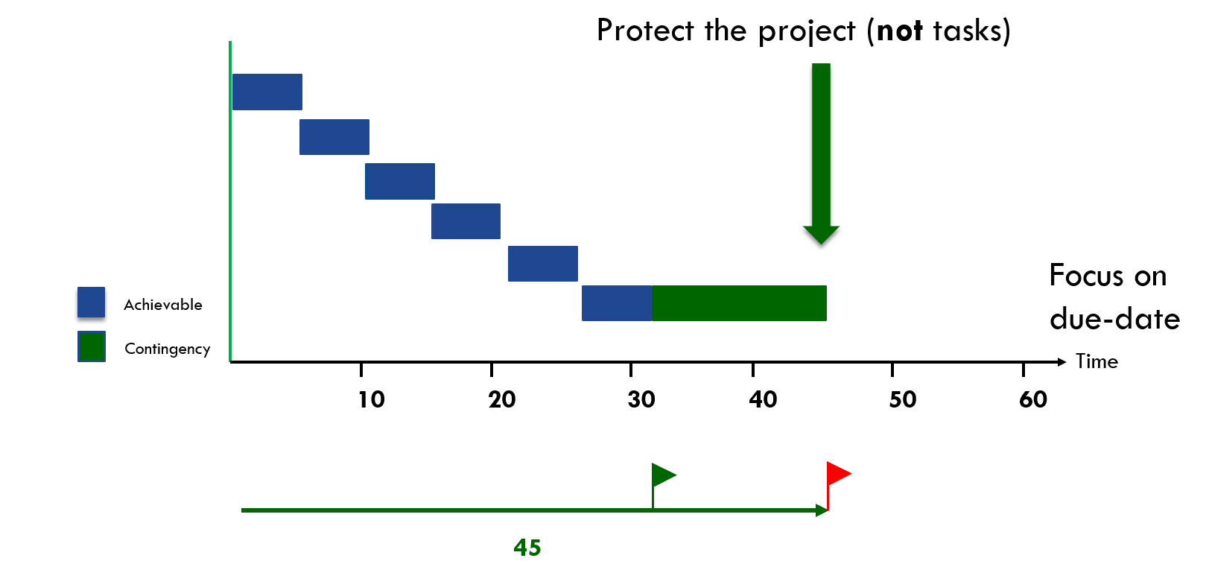
Pooling of Contingency – Insurance Model Buffer Management
“To be safer, (re)move the safety”
Notes:
Laat zien hoe buffer naar achteren wordt geplaatst en ingekort. Om dit te bewaken heb je een goede projectmanagement tool nodig, want: hoe weet je of en hoeveel je al van die centrale projectbuffert hebt gebruikt?

Slide 15
Green 50 % progress on the longest chain / 15 % buffer used
Today
Project is on track. The risk that the project will be late is very low.
Done
Done
Done
50 % / 15 %
10
20
30
40
50
60
Time
45
“To be safer, (re)move the safety”
Notes:
Laat zien hoe buffer naar achteren wordt geplaatst en ingekort. Om dit te bewaken heb je een goede projectmanagement tool nodig, want: hoe weet je of en hoeveel je al van die centrale projectbuffert hebt gebruikt?

Slide 16
Red 55 % progress on the longest chain / 65 % buffer used
Today
Relatively to much buffer is used. Measure are need to make sure the project can be delivered on time.
Done
Done
Done
Done
55 % / 65 %
10
20
30
40
50
60
Time
45
“To be safer, (re)move the safety”
Notes:
Laat zien hoe buffer naar achteren wordt geplaatst en ingekort. Om dit te bewaken heb je een goede projectmanagement tool nodig, want: hoe weet je of en hoeveel je al van die centrale projectbuffert hebt gebruikt?

Slide 17
What can you do with Red, Orange and Green? Resolve day-to-day resource conflicts (and prevents (bad) multi-tasking)
The original plan for ONE System Engineer called “Mike”
D2
D1
T1
D2
T1
The actual situation Today
D1
D1
T1
How to solve the “resource conflict” for Mike?
D2
Manage the Queue !
Today
Execution sequence of the queue for Mike
T1
D1
D2
Today
„In the Autopilot-Modus, Resource Managers , Task- and Project managers are supported by Operational Priorities for the synchronized execution of their projects”

Slide 18
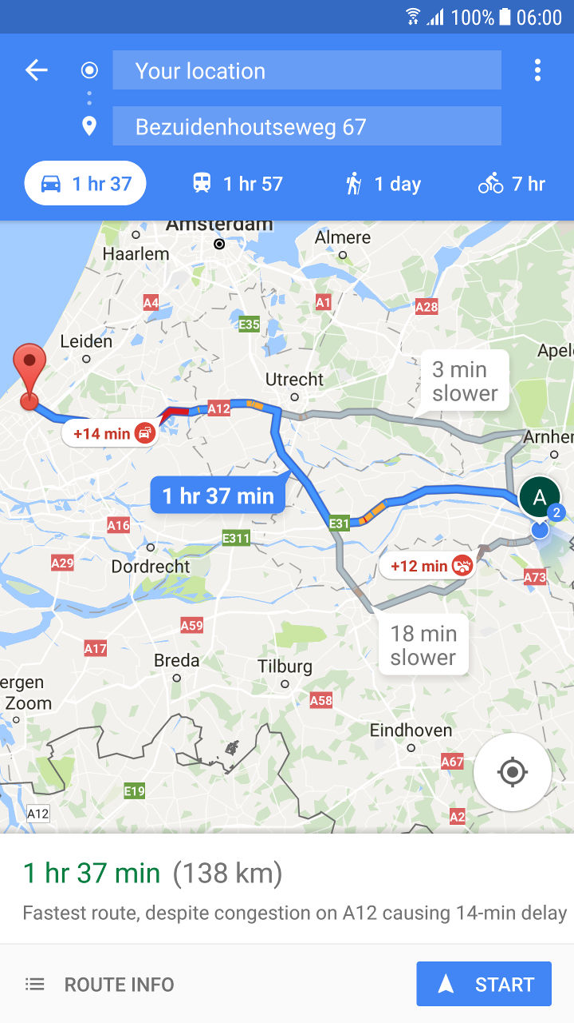
What is needed? Fast-Feedback Loop (ETTC)
Continuous (frequent) update of the “Expected Time to Complete” for each active task (ETTC)
Flawless handovers:
Ensure Delivery is complete
Be Ready-to-Start
Good preparation
Notes:
SHOW
We know now what we should not do but what do we need to do?

Slide 19
“To do” List Sequence from red to green
Notes:
1. Doorlooptijd van elke taak – er gaat meer dan 30 % verloren aan verstoringen, andere zaken
2. Weniger Projekte geleichzeitig
3. Stoppen met Teiltermine, focus op endtermine en een prioriteit
4. Focus op fertig machen

Slide 20
What can you do with Red, Orange and Green? Manage all projects together

Slide 21
Create your First Project

Slide 22
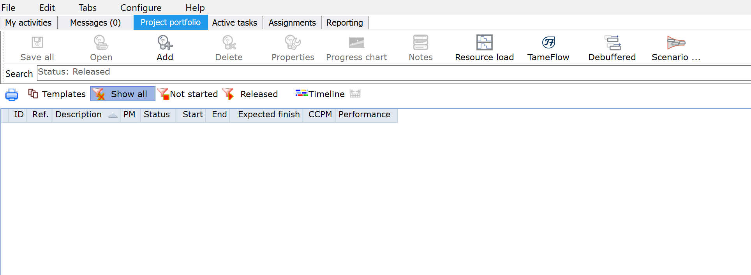
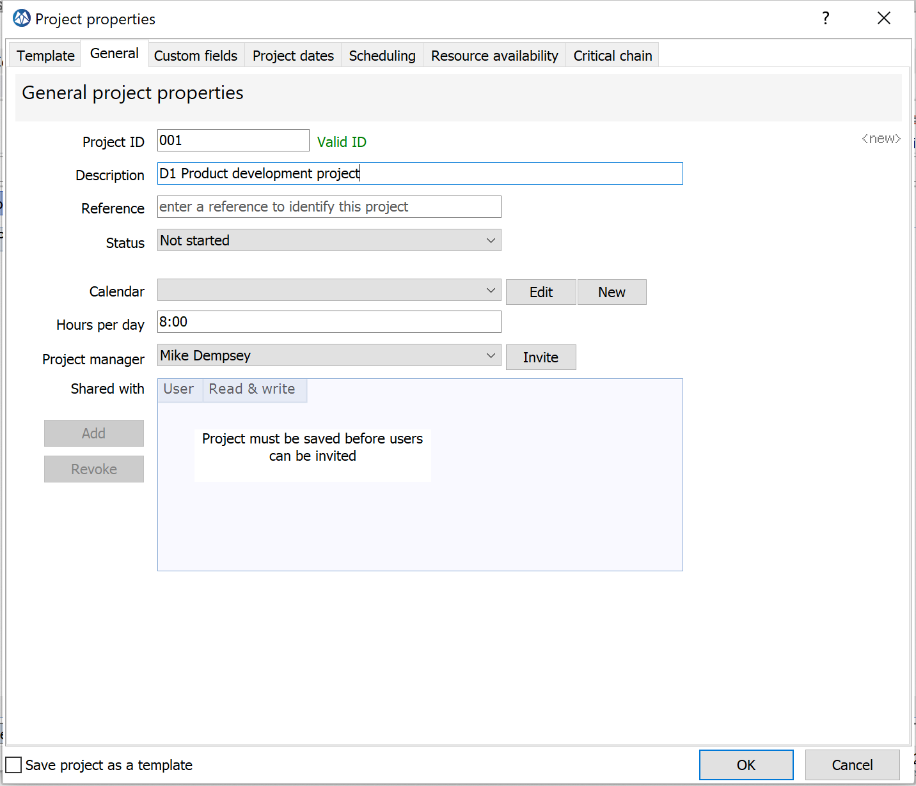
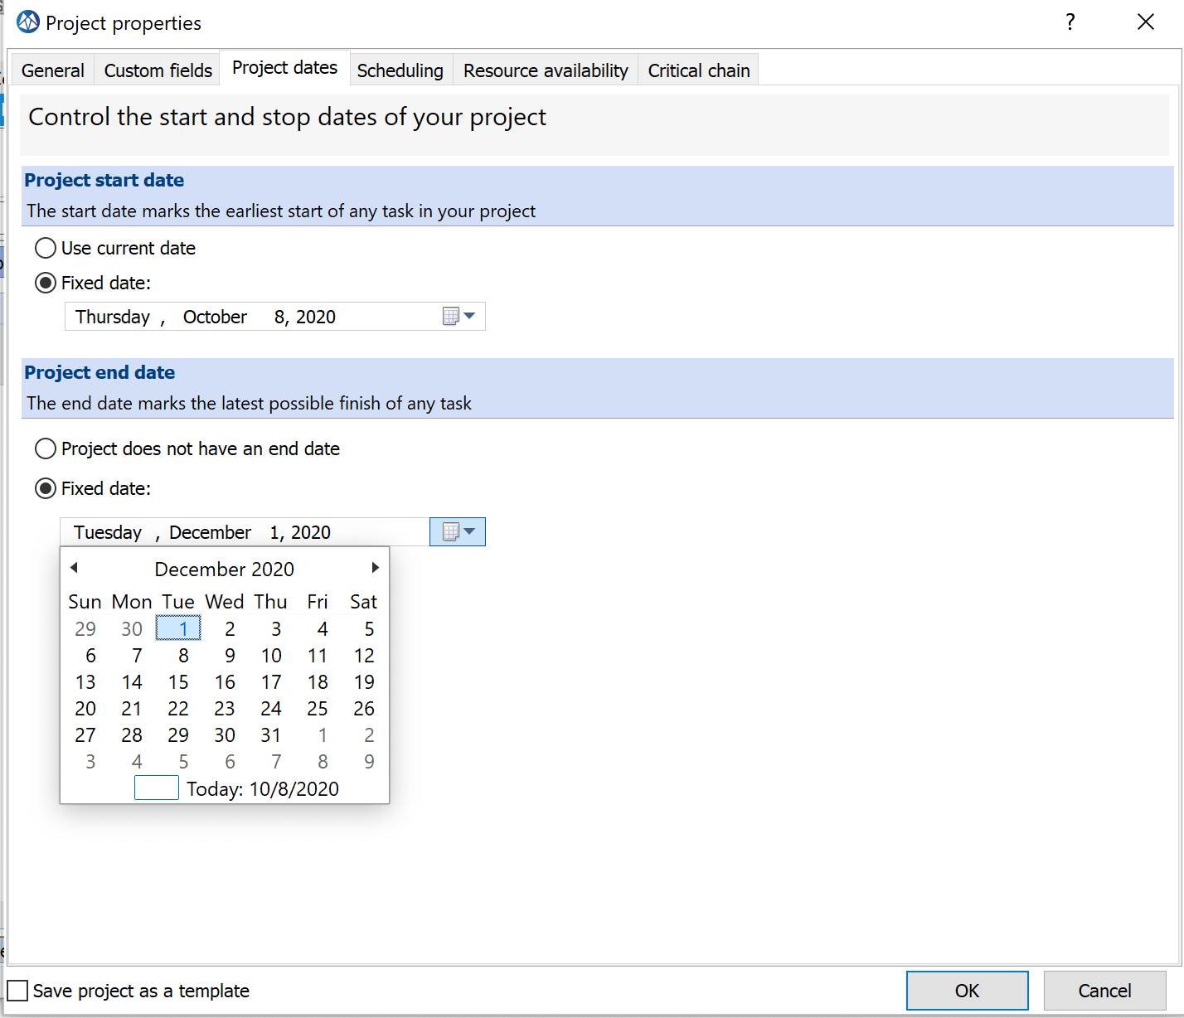
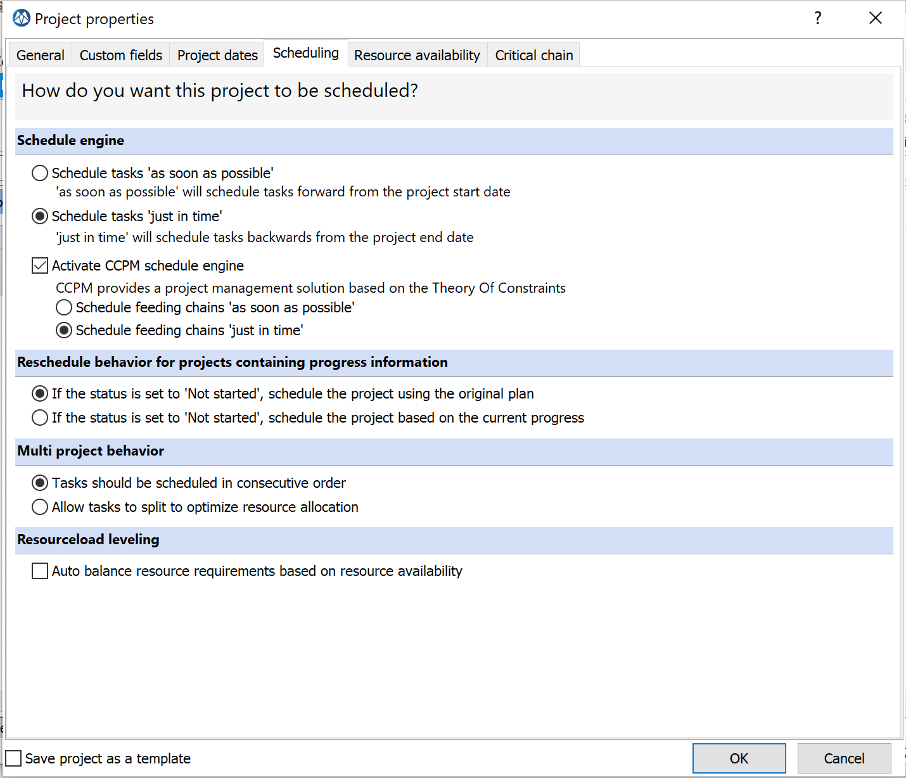
Add your first project
Select Project Portfolio in the Desktop Window (F5)
Select Add
1
2
3
Add a Project ID and Project name (description)
Ensure the “Critical Chain Engine” is selected.
Select your preferences. In CCPM Just in Time is considered as “Best Practice.”
Add an initial desired or requested end-date (due date)

Slide 23
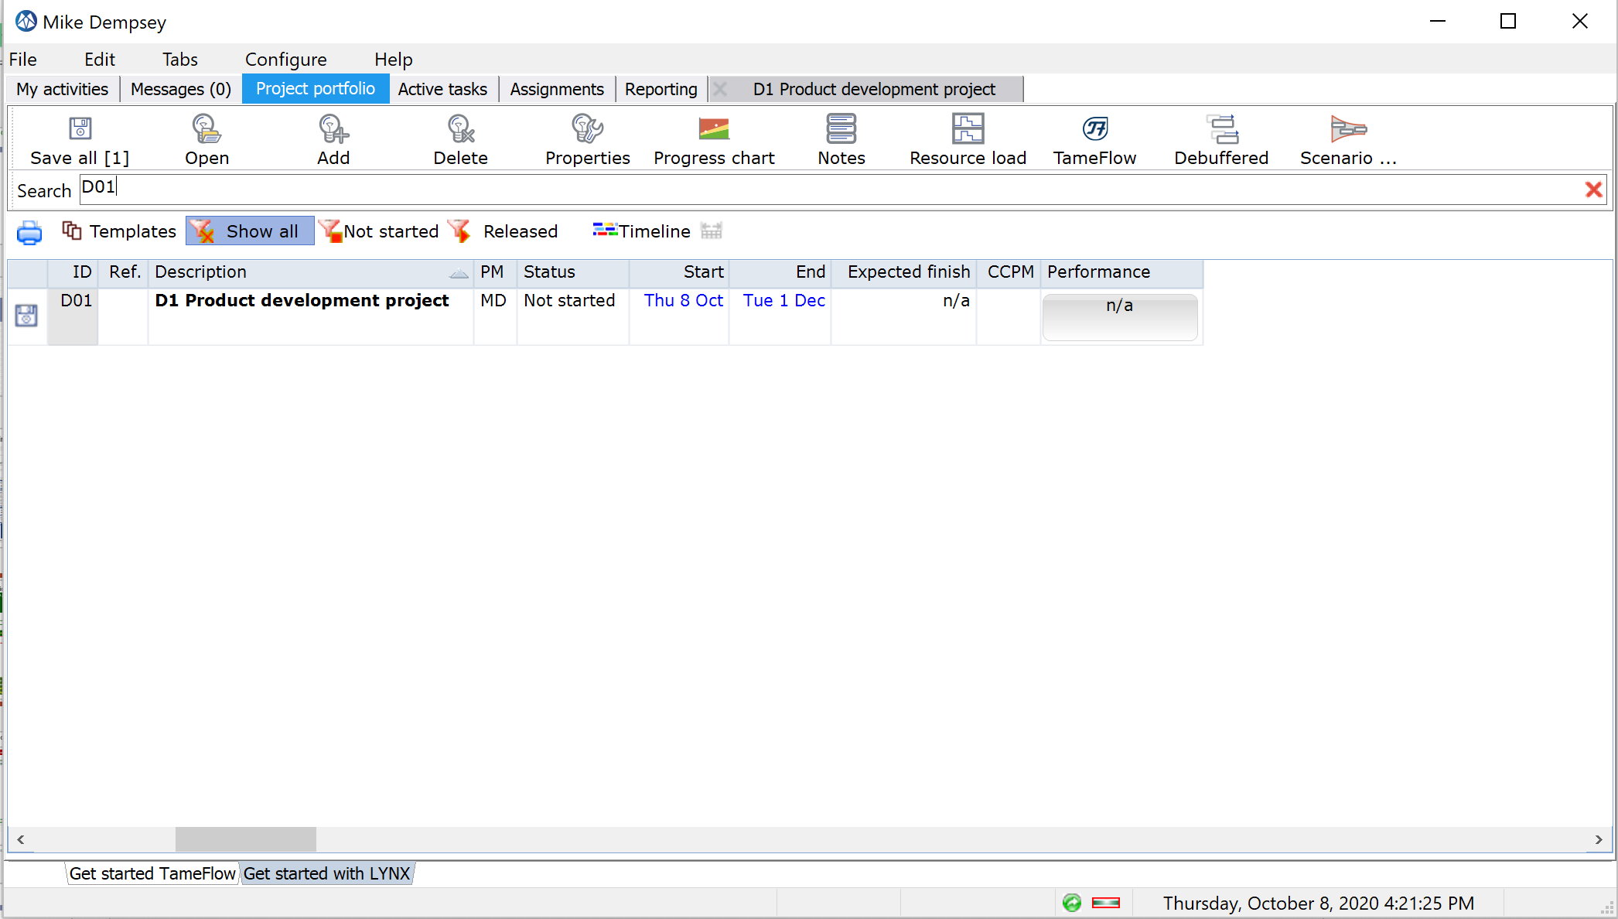
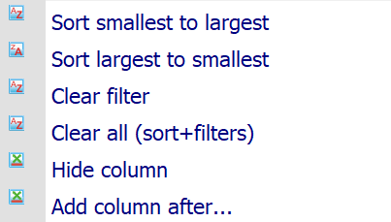
Your first project is listed in the Project Portfolio / Not started
Default filters to apply to list of projects:
Status “ Not Started”
Status “Released”
Show all
Show Templates
Filter applied to list of projects
Remove Filter
TIP: Try right mouse-click on column headers for additional sorting and filtering
Double clicking opens the project
Your FIRST project (D1) has been created and is listed in the Project Portfolio, with status “ Not started”
If you want to go back to or recover the default sorting and filtering

Slide 24
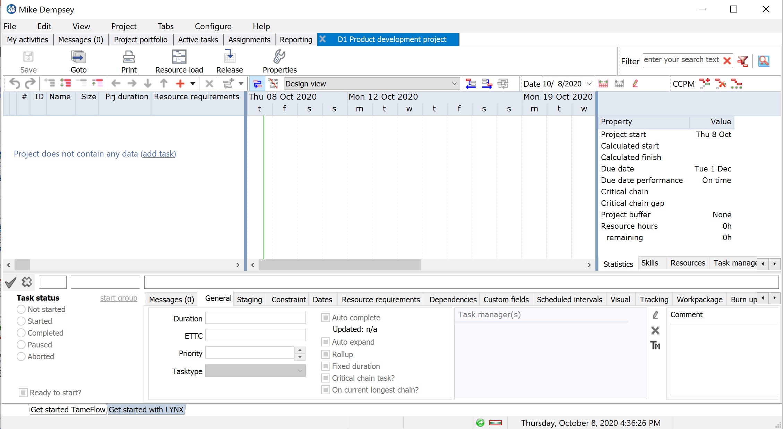
The “Project Window” – Multiple Views and Windows
D1 Product Development Project Window
Auto scale timebar
Undo and Redo buttons
Gantt Chart
Task Grid
Also click in the Gantt area to confirm changes
Multiple tabs
Confirms Task Property updates
Task Properties

Slide 25
Create the Project Plan
Add Tasks
Create the Project Network
Add task dependencies (predecessors / successors)
Add (Virtual) Skills (and resources)
Convert the plan into a Critical Chain Plan

Slide 26
Add Tasks

Slide 27
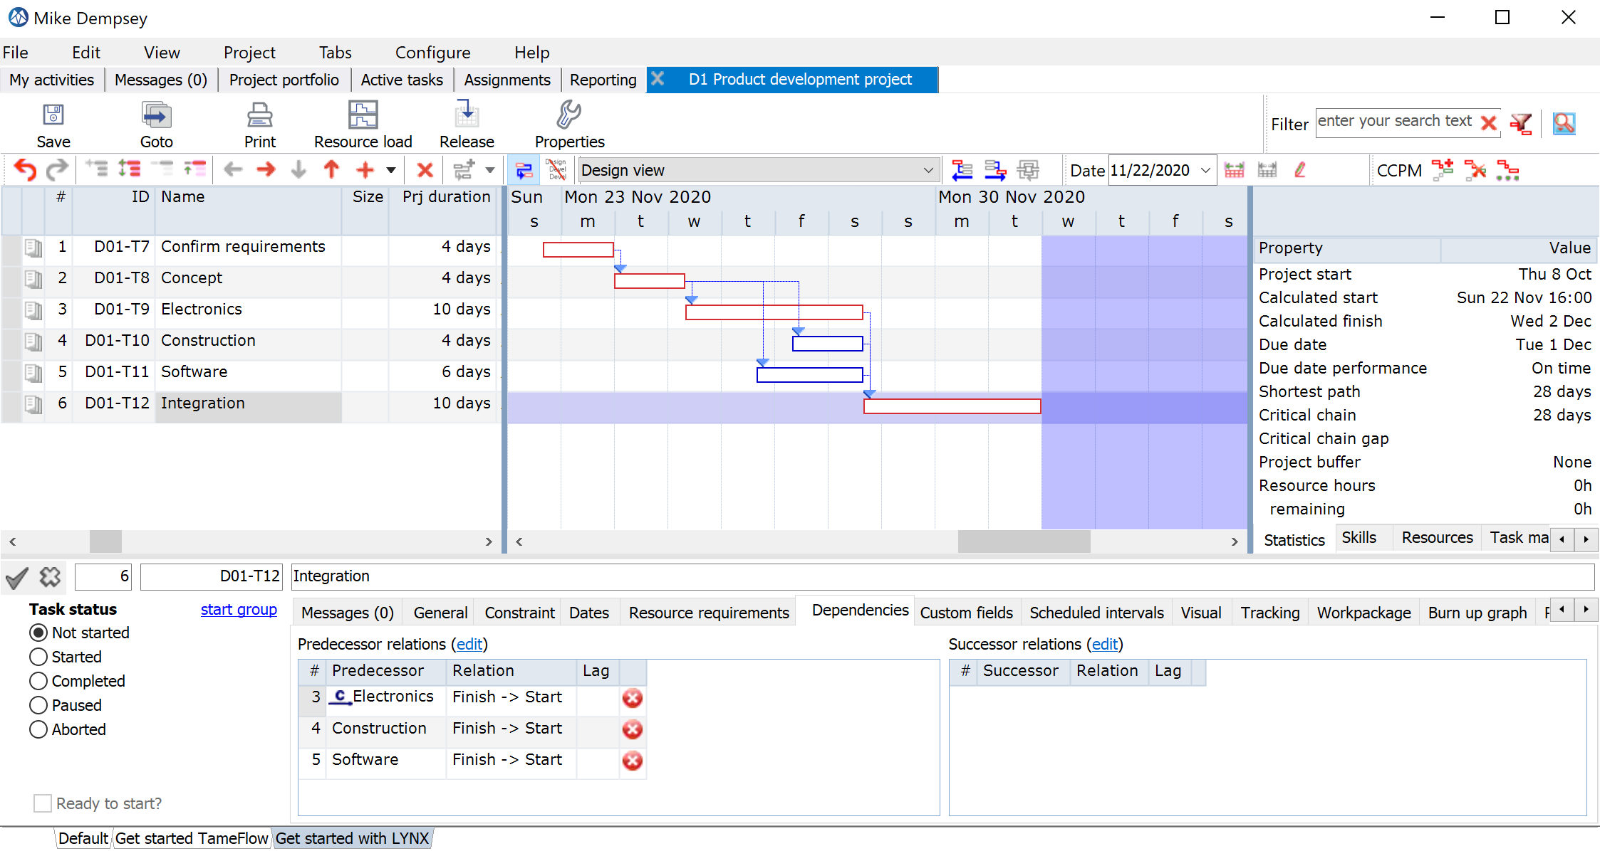
Target Plan

Slide 28
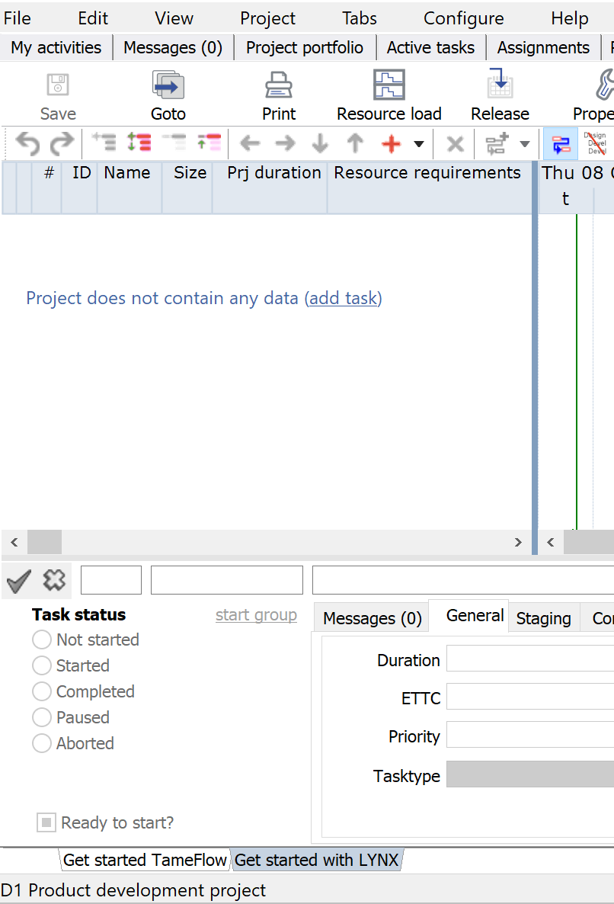
Add Tasks
Green Line = TODAY
Any new task gets a default duration of 1 day after giving the task a name. You can change the expected duration in the duration column.
Start here to create your first task.
Click in the Gantt Chart, to confirm your update! *
* Background of this process is the optimization of the performance and prevents that any (small) change triggers a re-calculation of the complete (large) project plan

Slide 29
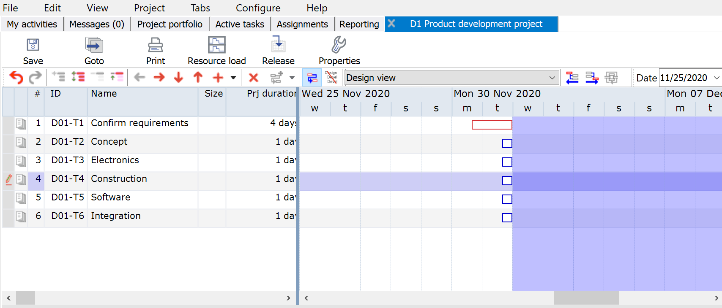
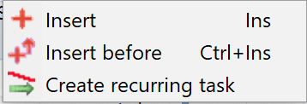
Add more tasks
Add a new task by pressing the +. Via the dropdown you can also add a task before (Ctrl Insert).
Delete a task with X
Tasks 2 – 6 are considered feeding chain tasks, not (yet) part of the “ Critical Chain”.
In this example “Feeding Chains” are positioned “ Just in Time,” offset against the Critical Chain (task 1).
Use the “down arrow” key on you key-board to quickly add new rows
Press “Enter” or Click to confirm your changes

Slide 30
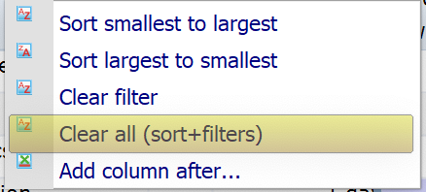
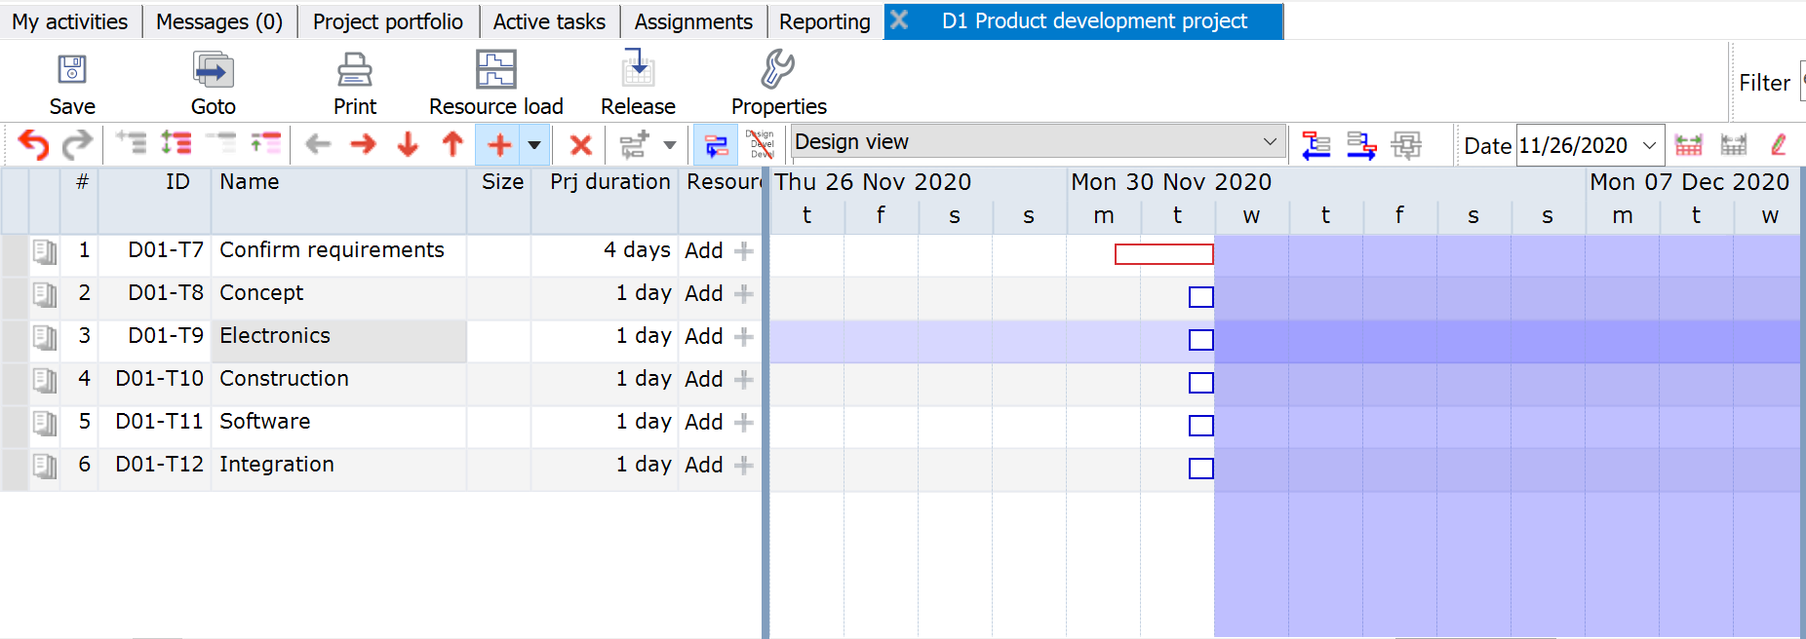
Save
Right click on header of the task list, to remove any unwanted filter or sorting.
Click on Auto scale for an adjusted timebar
Each tasks gets its own ID
Change Task duration here

Slide 31
Add Dependencies

Slide 32
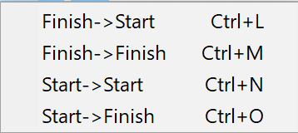
Add Dependencies between tasks
Button for adding dependencies between tasks. The default is a Finish-Start dependency (just click on button, without opening drop-down)
Use the drop-down to see all options.
In CCPM typically only Finish Start is used.
Between task 1 and 2 there is a Finish-Start relation.
See also the CTRL Fast-Keys!
Task 1 and 2 are selected for adding a dependency (use SHIFT or CTRL to select two or more tasks)

Slide 33
You can also select Tasks with your mouse in the Gantt Chart to add a dependency
Dependency will go from the task selected first to the next selected task(s)

Slide 34
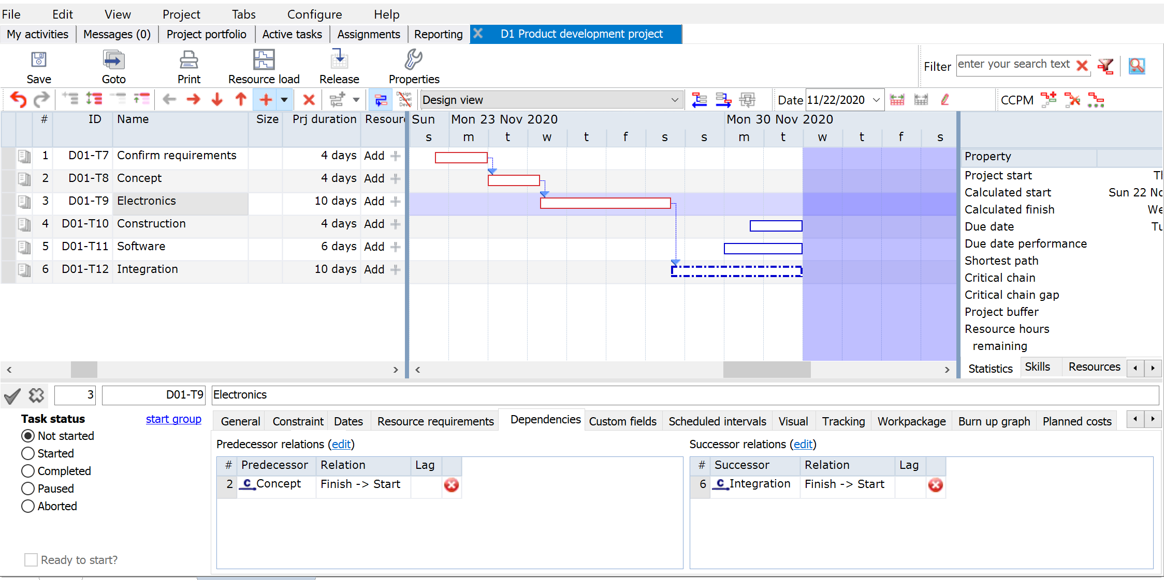
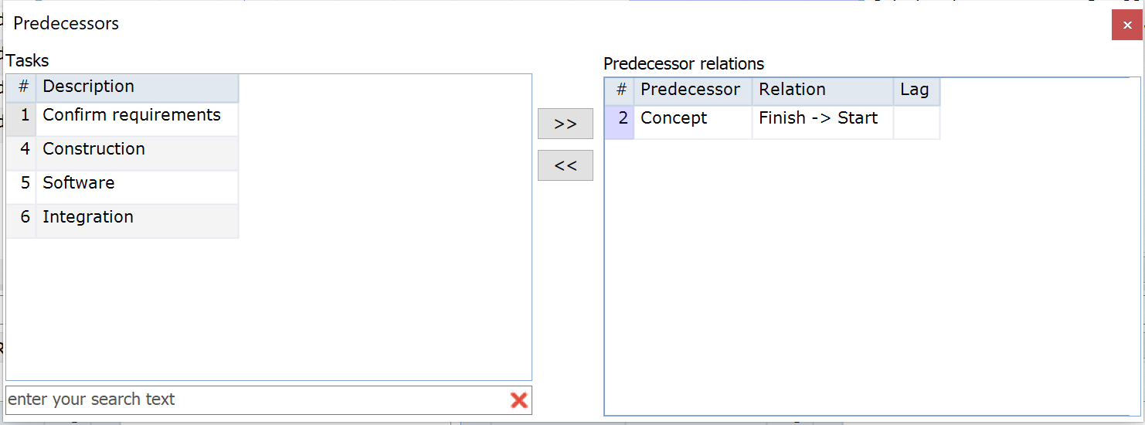
Add dependencies via the Edit Boxes Predecessor box and Successor box
The edit boxes are very useful especially in case of projects with many tasks.
Use this filter

Slide 35
Deleting dependencies Via Task properties → Tab “Dependencies”
Delete Successor relationship between task # 3 and task #6.

Slide 36
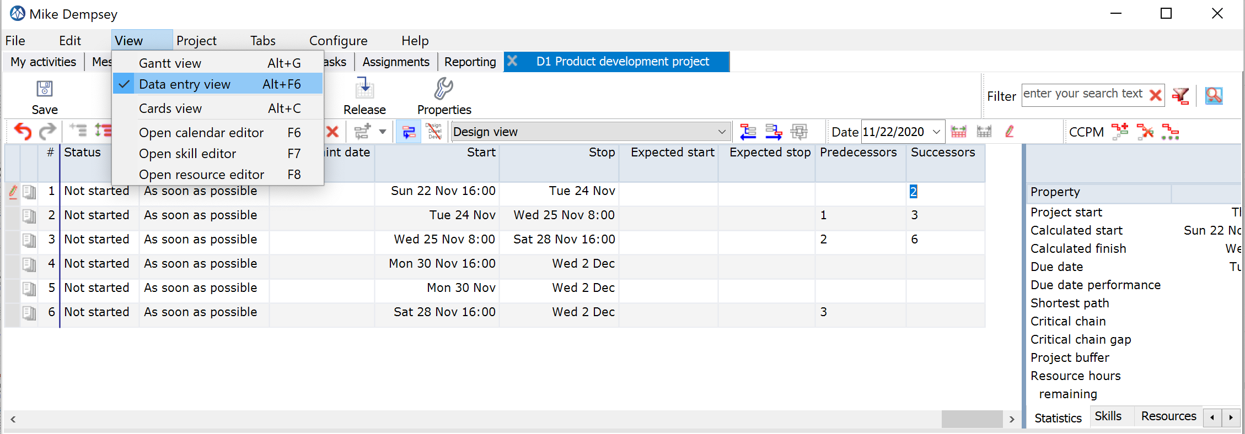
Add/update dependencies Select view → Data entry view

Slide 37
Review result and statistics
Use the Auto scale timebar (F4), to scale your plan to fit in the Gantt window.
Current length of the Critical Chain is 28 days
Task properties/Dependencies for task #6
Project statistics are displayed here.

Slide 38
Select “Critical Chain View”
Only tasks on the Critical Chain are displayed

Slide 39
Add Skills & Resources

Slide 40
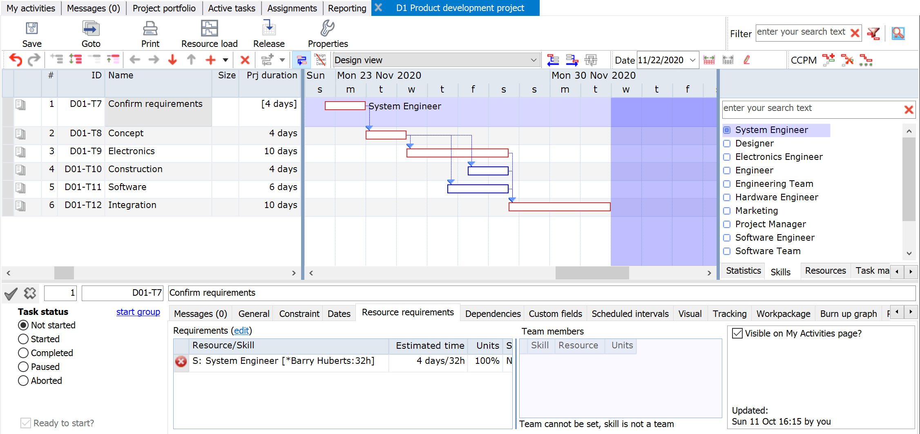
Add skills (and resources)
2.
Drag & Drop Skills to the selected tasks (1 or more)
A System Engineer will be added to the selected task(s)
1.
Select the Skill/Resource/Task Manager Window

Slide 41
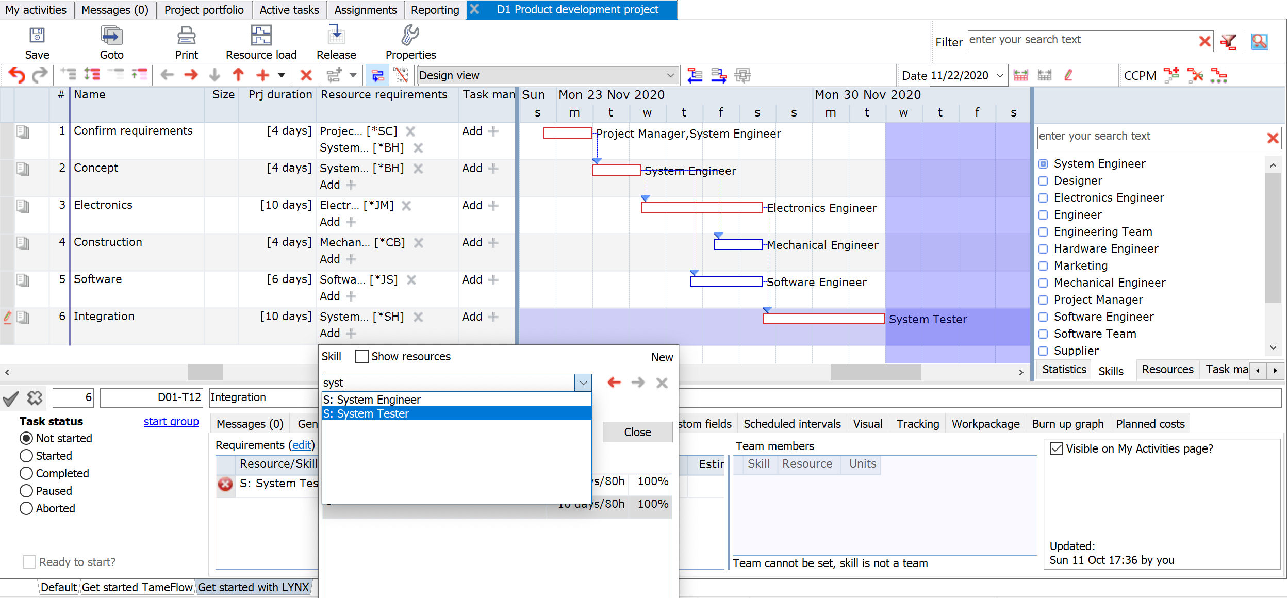
Adding Skills via the Resource requirements column

Slide 42
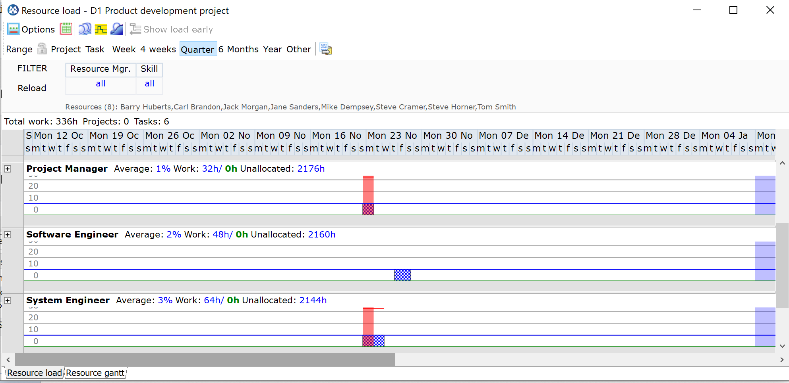
Review the resource load for your project
Resource Requirements for Task 2 are red shaded in the load graph

Slide 43
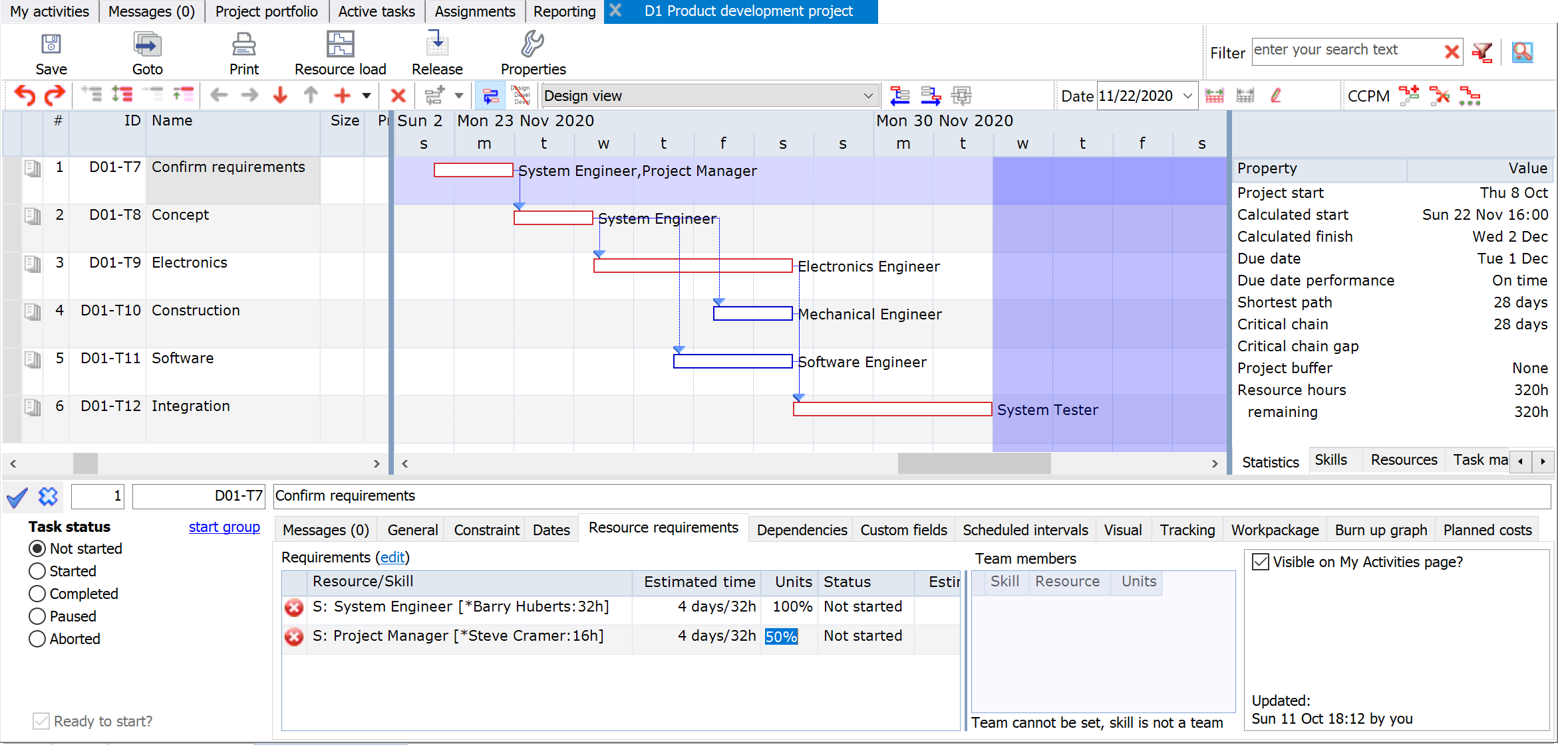
Modify Task Estimated Time and Units % (optional)
You can modify the estimated time and unit percentage

Slide 44
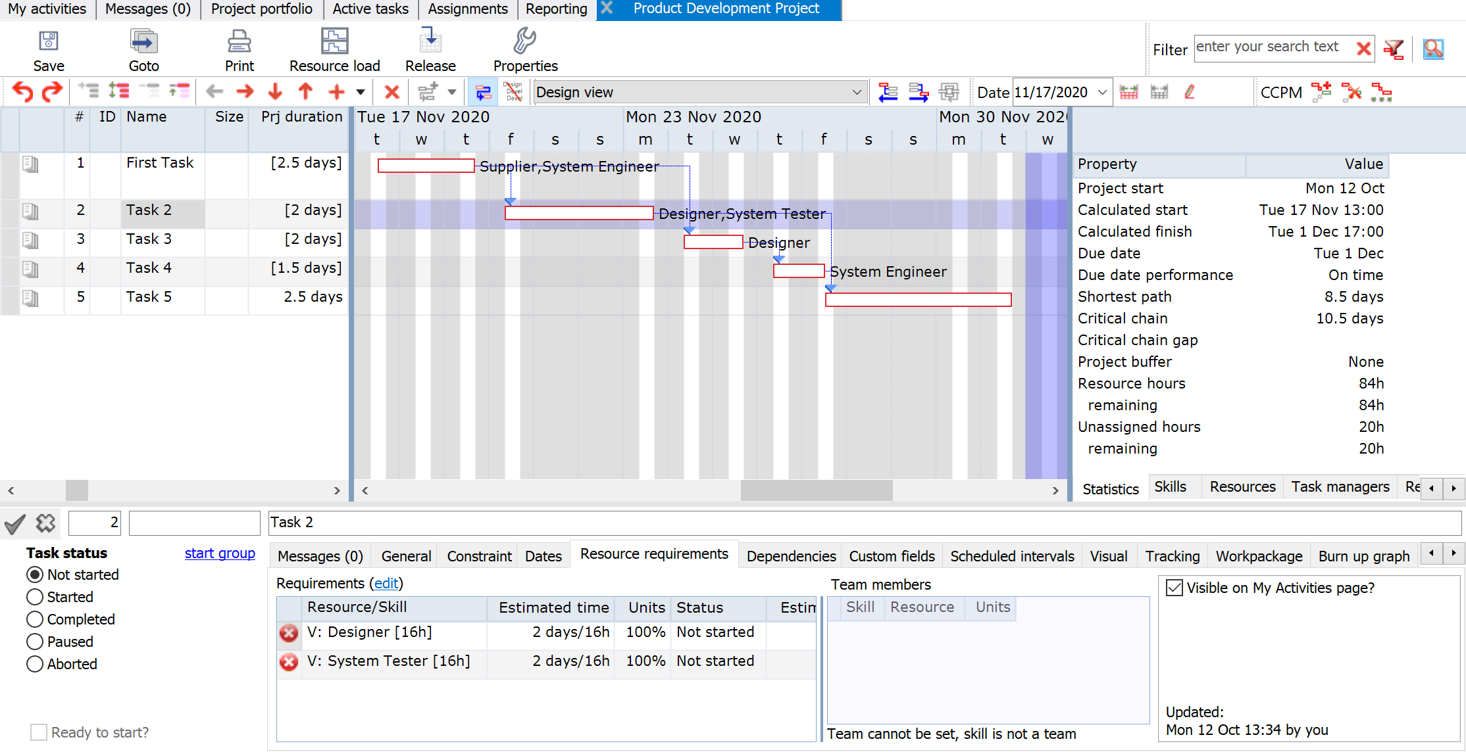
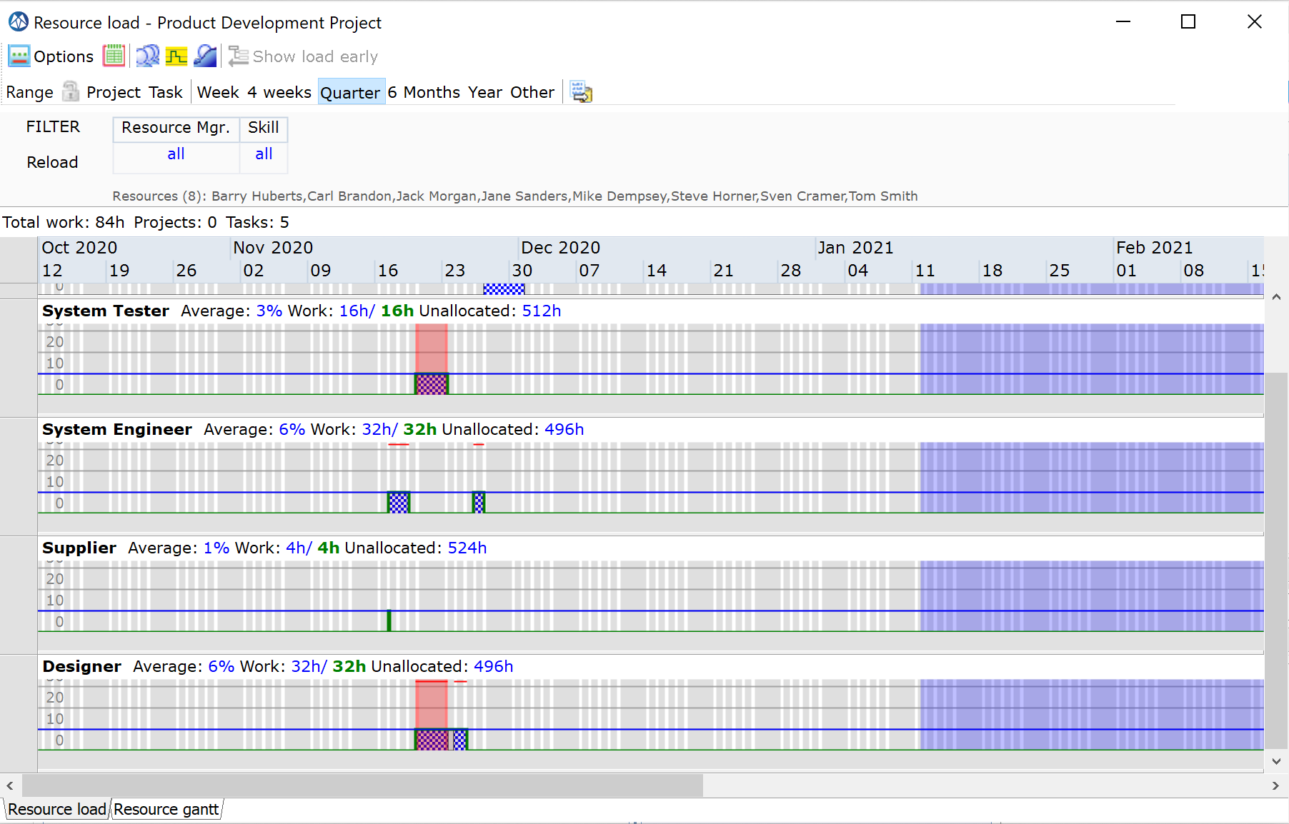
Review the resource load for your project (scenario Virtual Skills) Skills are “Virtual skills”
In case of “Virtual Skills” LYNX does not make a pre-selection and soft-allocates a resource name. Please refer to SLIDE 19

Slide 45
Add Task Managers

Slide 46
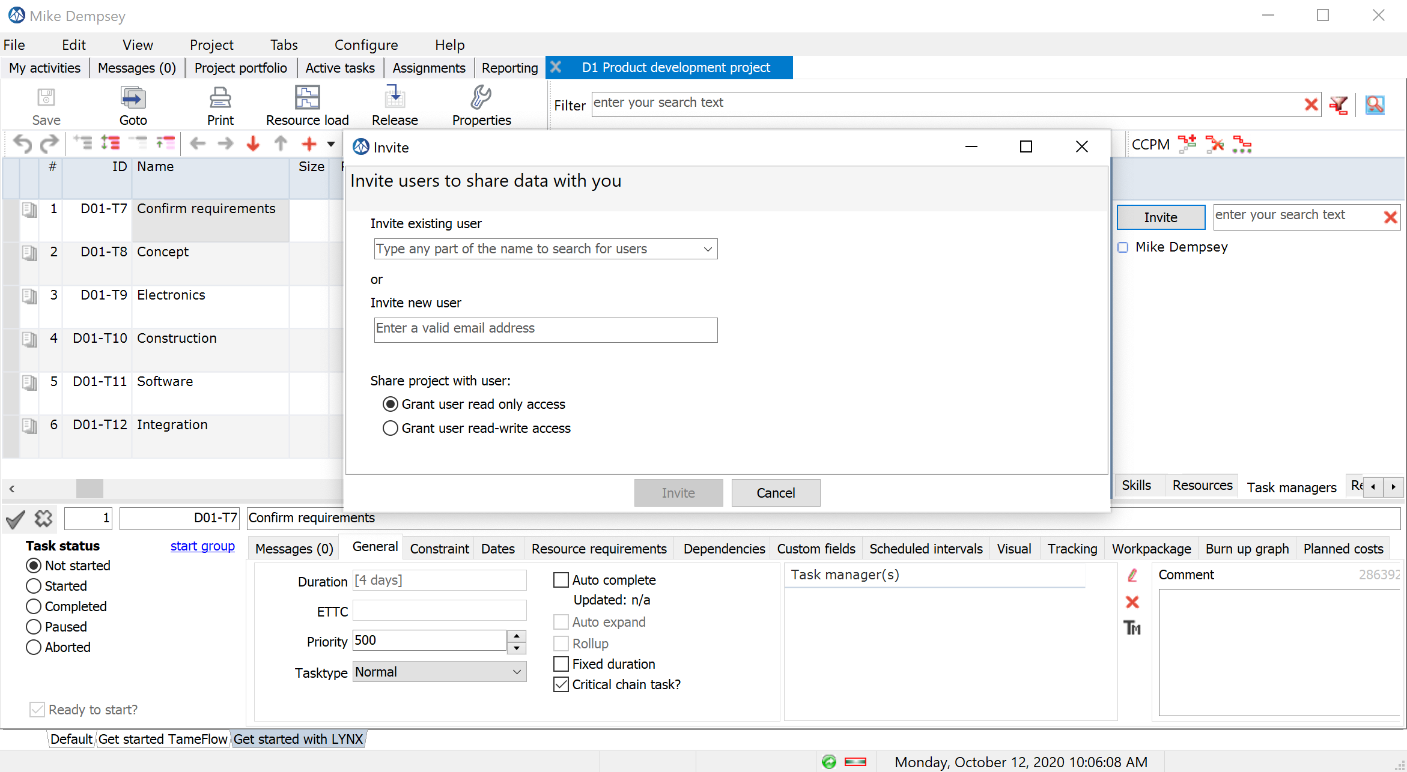
Invite multiple Task Managers involved to the TM List In a CCPM implementation typically a Task Manager is responsible for (daily) task updates
You can invite an existing user or invite a new user as a TM
Add a TM to the TM List for the project
Invite a TM for task #1, only!

Slide 47
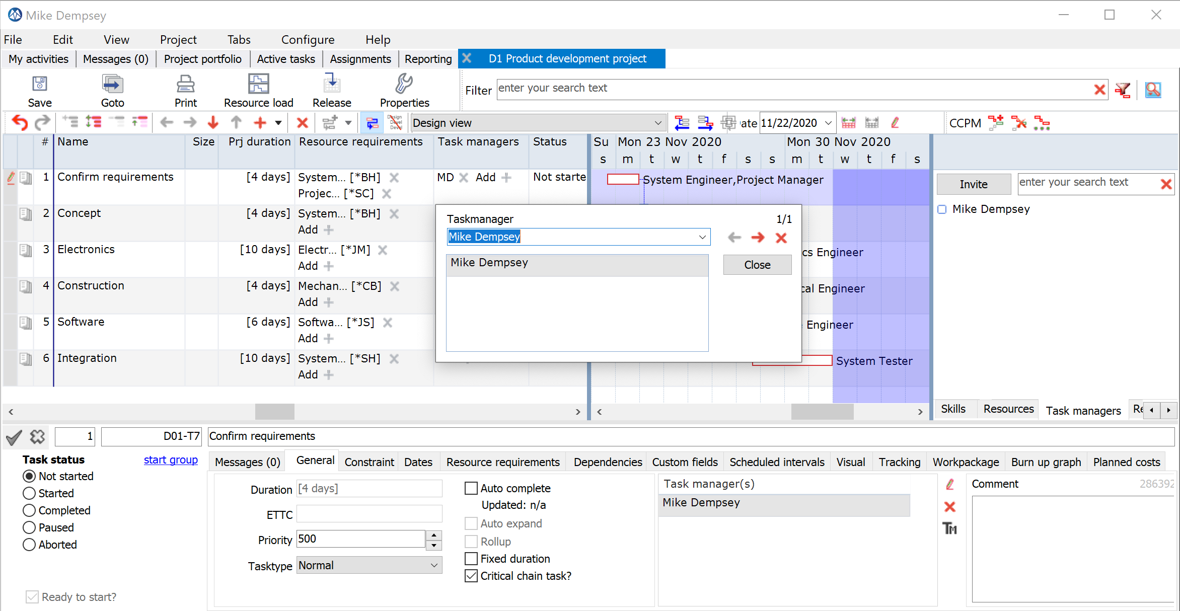
Add a Task Manager to task(s) Via the Task Manager column or via “Drag & Drop”
Add yourself as Task Manager to the first task
Mike Dempsey (current user) is added to task #1

Slide 48
Apply CCPM Behavior

Slide 49
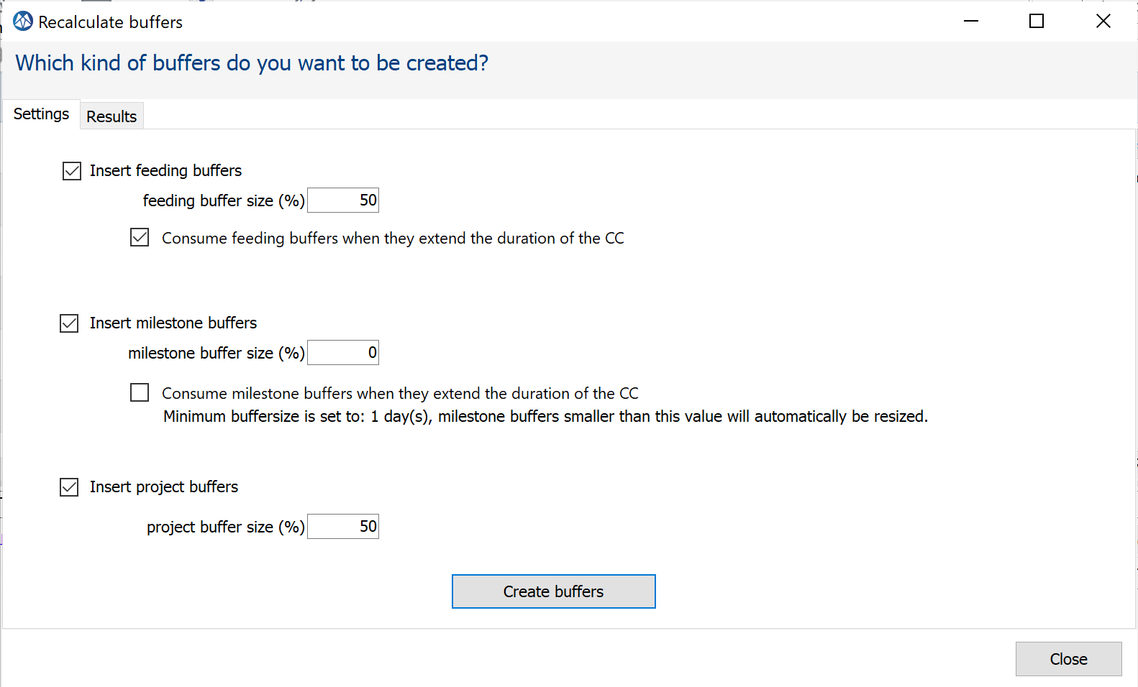
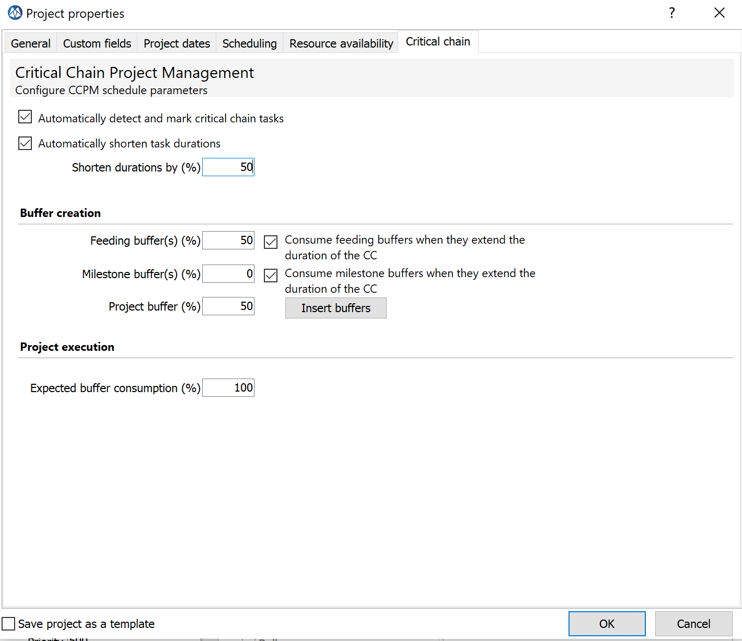
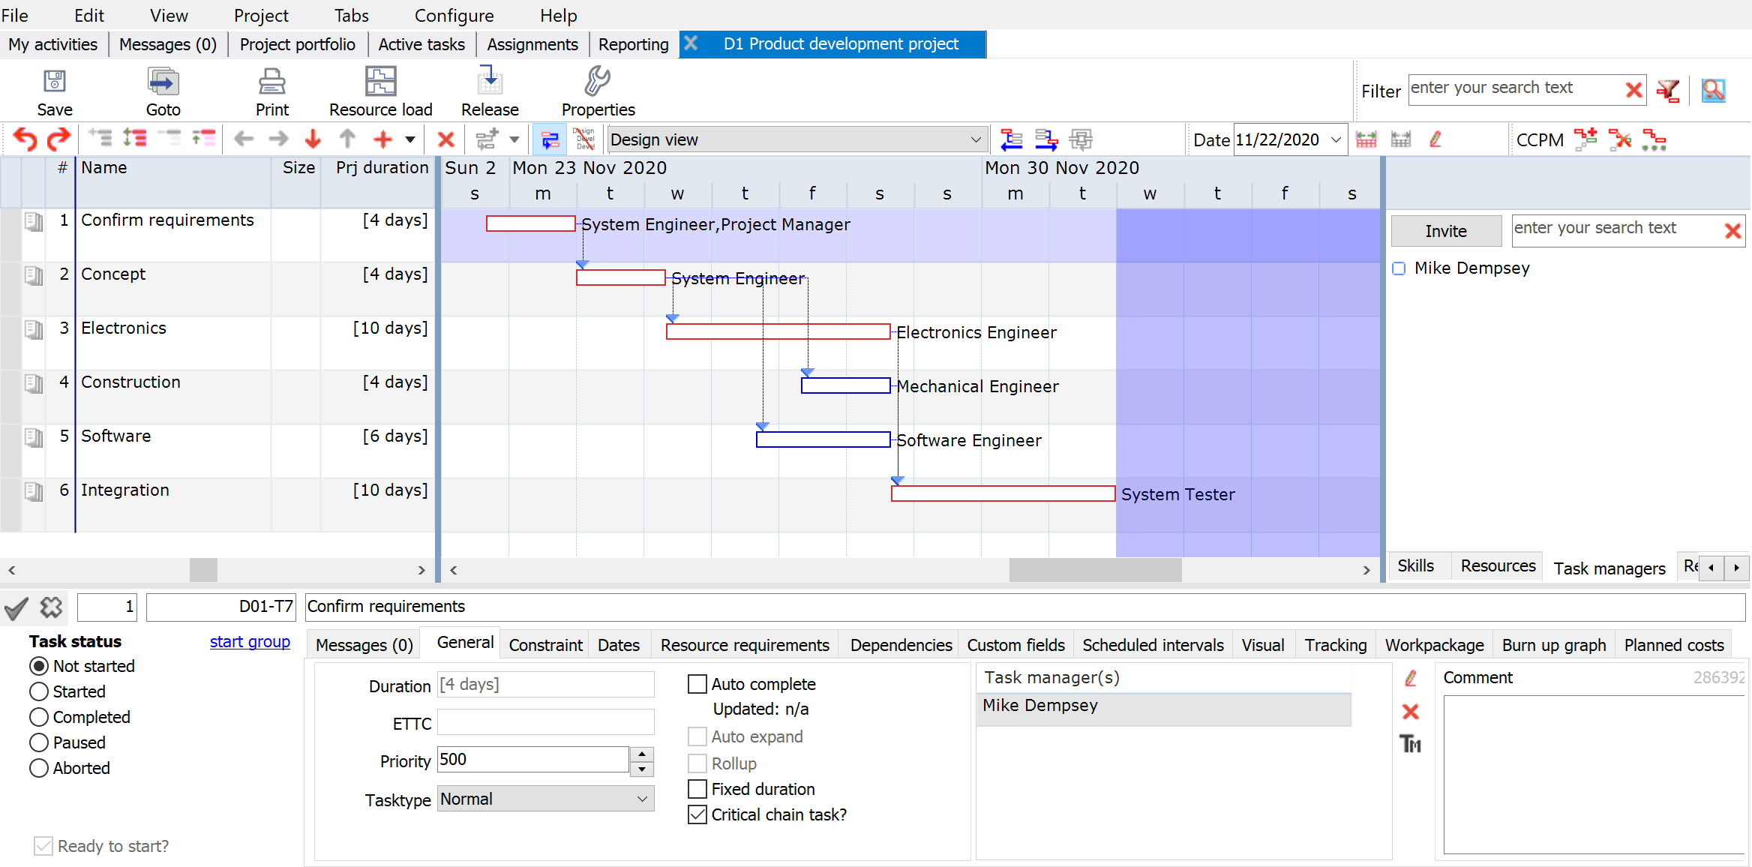
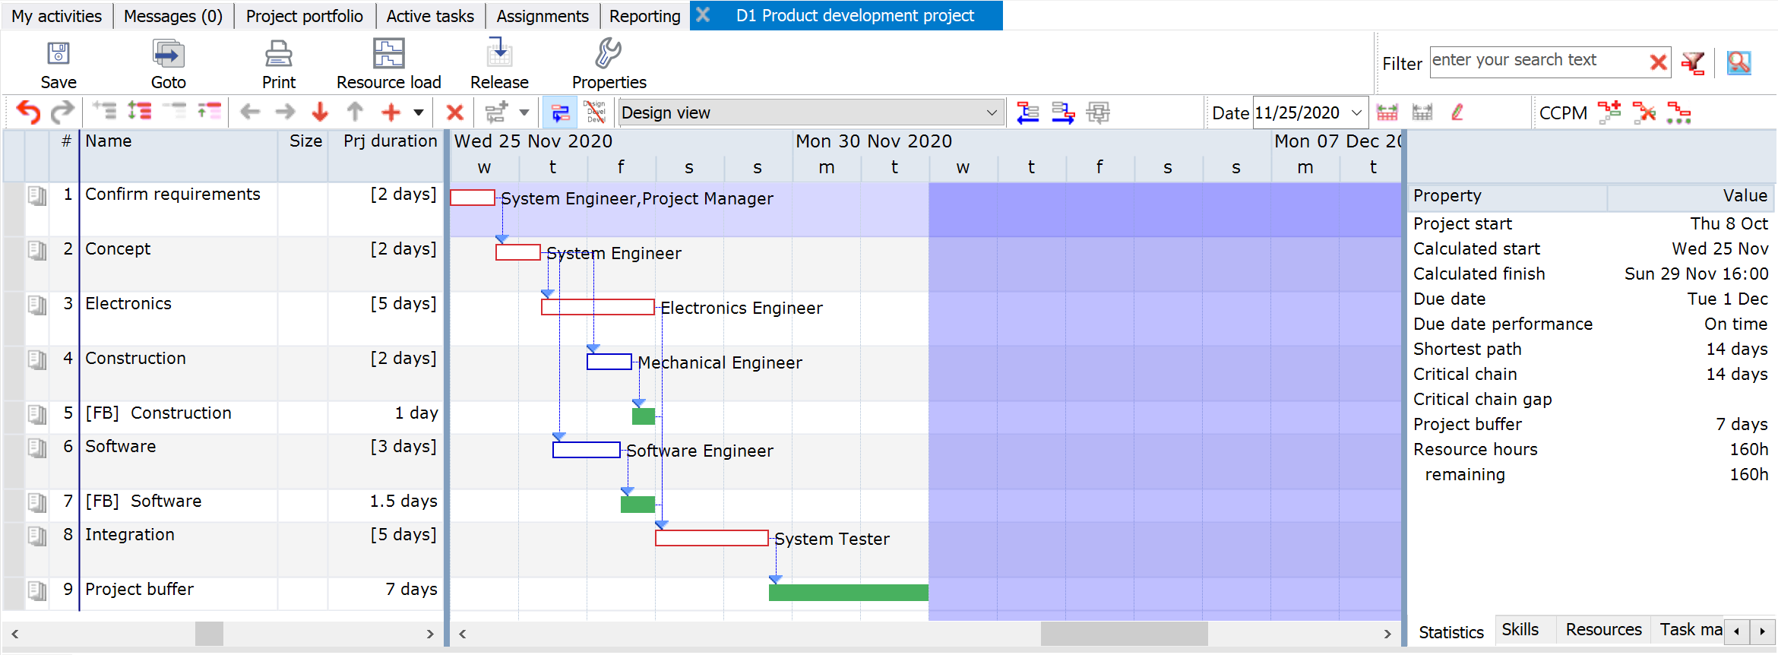
Apply Critical Chain Behavior in 3 Steps
You can keep or change the default percentages and confirm
2
3
1
Decide about Task Time Reduction
Length of the Critical Chain has been shortened with 50 %

Slide 50
Start a project from a template

Slide 51
Start a project from a template Where to find available templates?

Slide 52
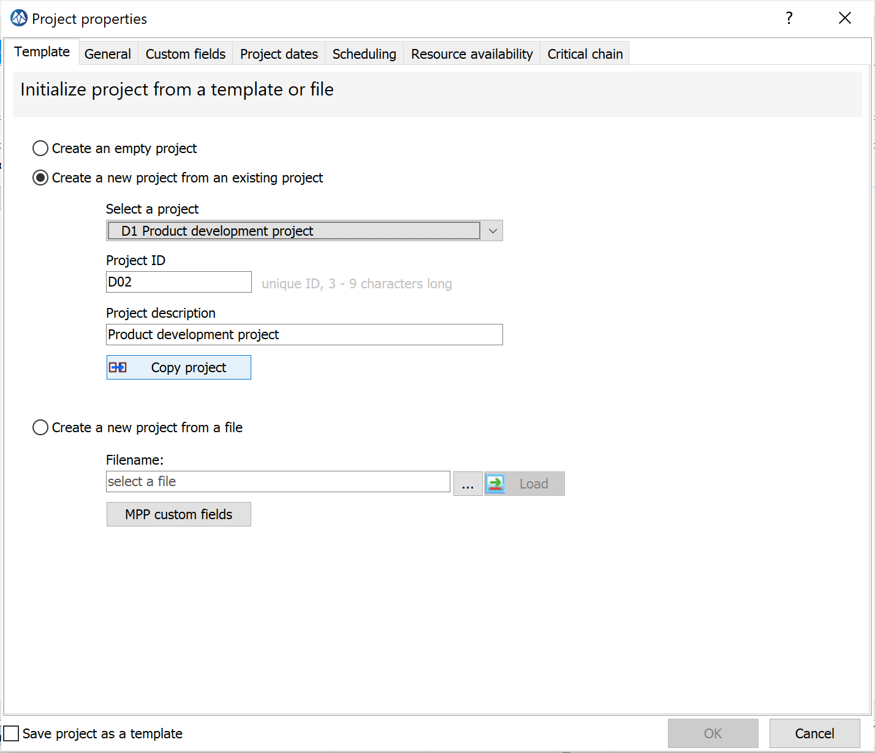
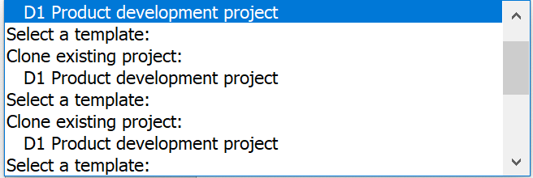
Start a project from a template
1
2
3
Select Copy Project after filling in the Project ID & description

Slide 53
Start a new project from a template
You can find your new project under “Not Started”

Slide 54
Special Items
Summary Tasks
Milestone Buffers

Slide 55
Special Items
Summary Tasks
Projects with multiple end-points:
Milestone Buffer(s)
Project Buffer

Slide 56
Release your project
Create active tasks

Slide 57
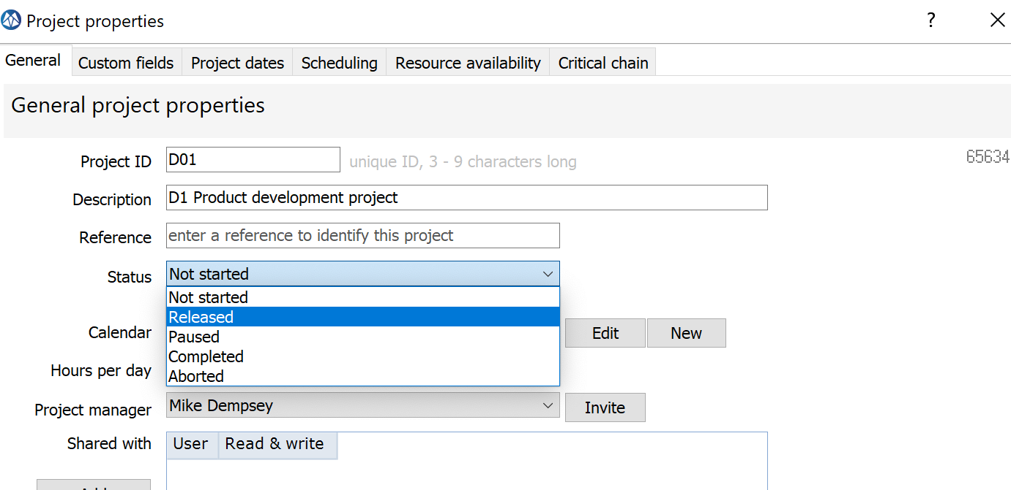
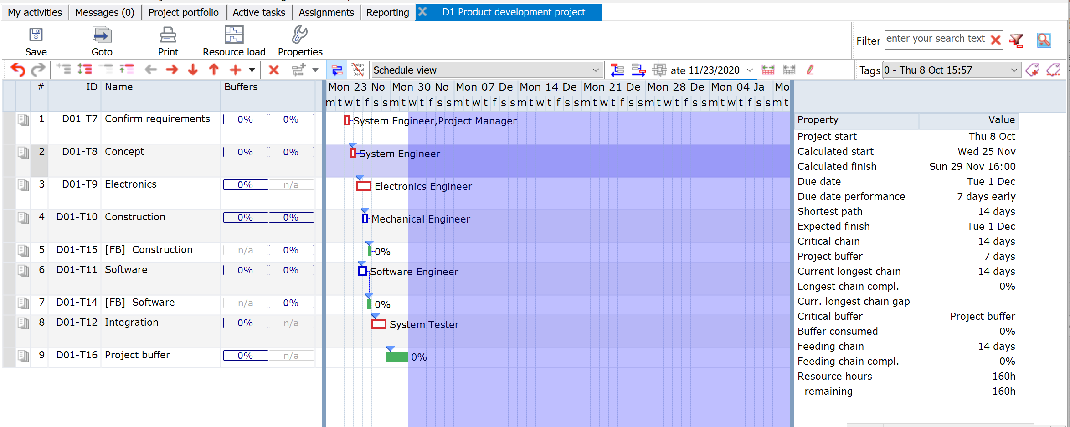
Release your project and its tasks
Select Project Properties
2
The release of the project has resulted in an update and extension of the statistics
1
3
After Release LYNX has created two buffer controls (project buffer column and feeding buffer column)

Slide 58
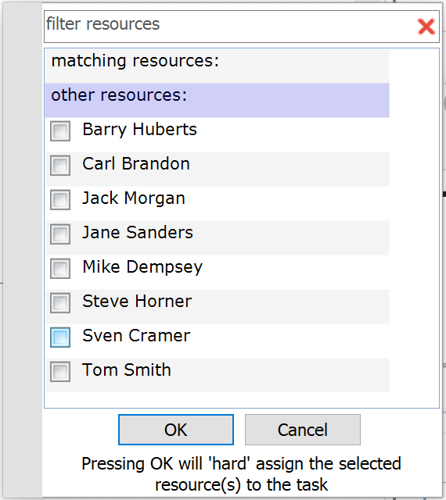
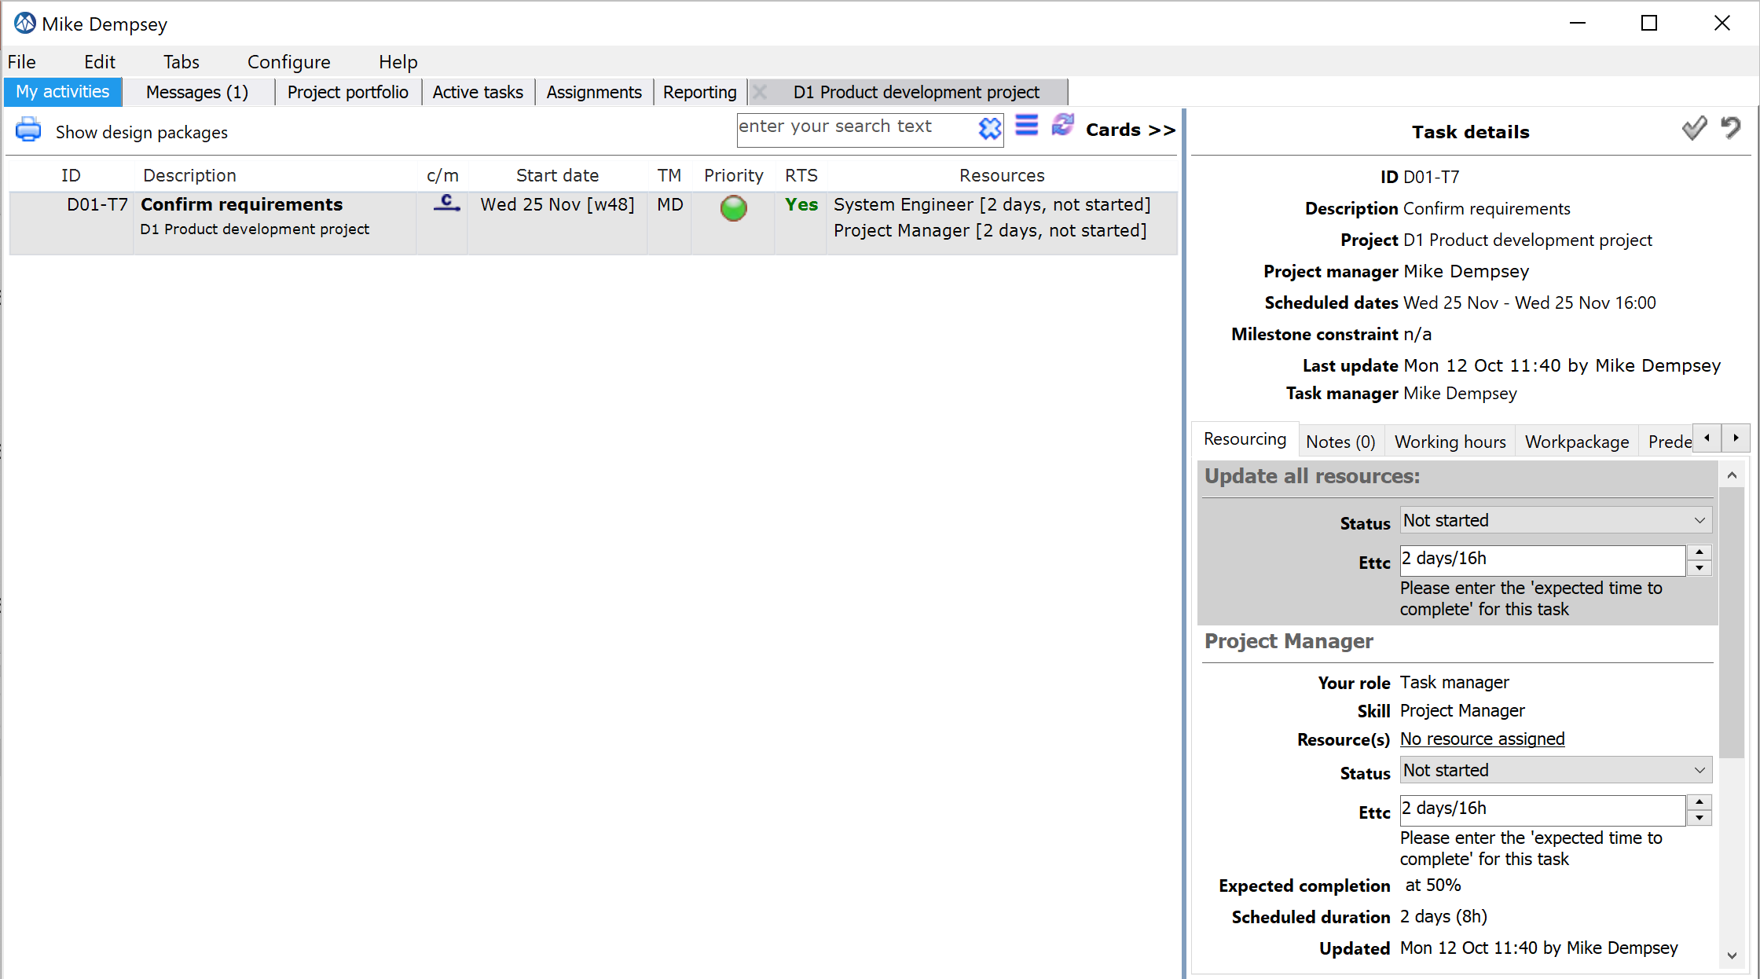
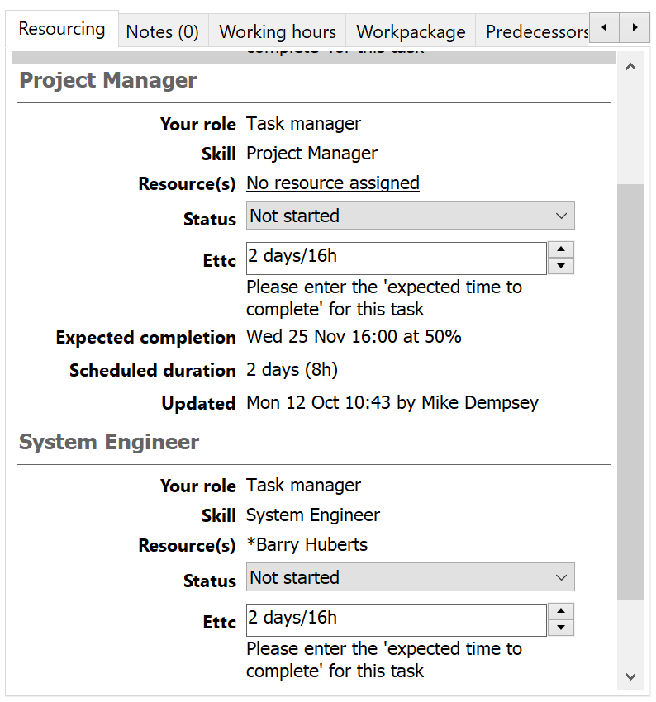
Select My activities in the Desktop Window Update Ettc for your first task
1
2
Opens the project plan
3
The Task Manager can:
Assign and confirm resources for a task
Start a task by changing the status
Enter the Estimated Time to Complete (e.g. on a daily basis)

Slide 59
A few tips and tricks

Slide 60
Search and Replace (CTRL F)

Slide 61
Mark Favorites

Slide 62
A few tips and tricks
FIND MORE TIPS AND TRICKS: https://support.a-dato.com/hc/en-us
Use right mouse click to filter / hide columns
Go to a “date line” and zoom in/out by moving the date line
Copy a selection of tasks with CTRL C (Copy) and CTRL V (Paste)
Click in the Gantt Chart and then Use CTRL + Scroll to Zoom

Slide 63
Continued
Right click on header of the project list, to remove any unwanted filter or sorting.
Right Click on a project row
All windows can be individually moved. You can use 2 screens side by side.

Slide 64
Resolve Warning Messages Plan cannot be calculated due to planning logic violations
In this example there is only 1 designer available. The planner has assigned 2 !
LYNX may not be able to recalculate the project due to a message.
The messages can be viewed in the “Messages” tab

Slide 65
Start adding “Notes”
2
Click the + icon to create a note
1
Click on this icon to add a note
3
Select the type of note you want to create

Slide 66
Special Items
Buffer Recovery
Level of Effort Tasks
One Click “Click-through” from a task in the task-list, directly into the project
Down-stream / Upstream chain views based on any selected task in the schedule
Ability to share de-buffered plans with external parties or customers
Possibility to exclude tasks from task time reduction
Cross-skill Resource Management
Split Critical Chain tasks in case of multiple resource with different workload
Auto Complete Option
intended for tasks with long and or fixed lead times only (such as shipping or purchasing tasks)
Display of “Last Progress Update”
for tasks that are started, which provides fast feedback when the last ETTC update has taken place

