Slide 1
Creating robust project networks
Repeatable process in 10 steps

Slide 2
The problem
“I stopped planning, because the plan changes every day”

Slide 3
The dilemma
Detailed
High level
define
measure
analyze
improve
control
explore
design
engineer
validate
transfer

Slide 4
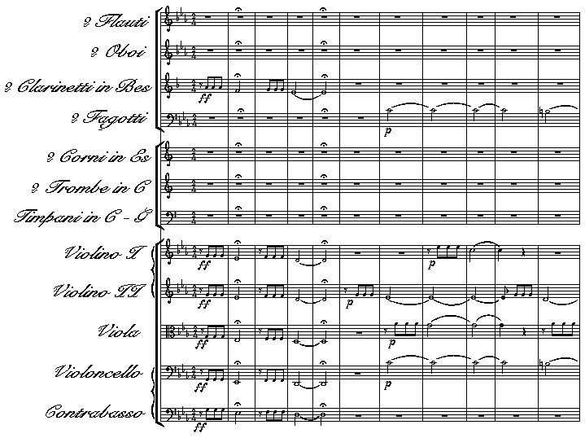
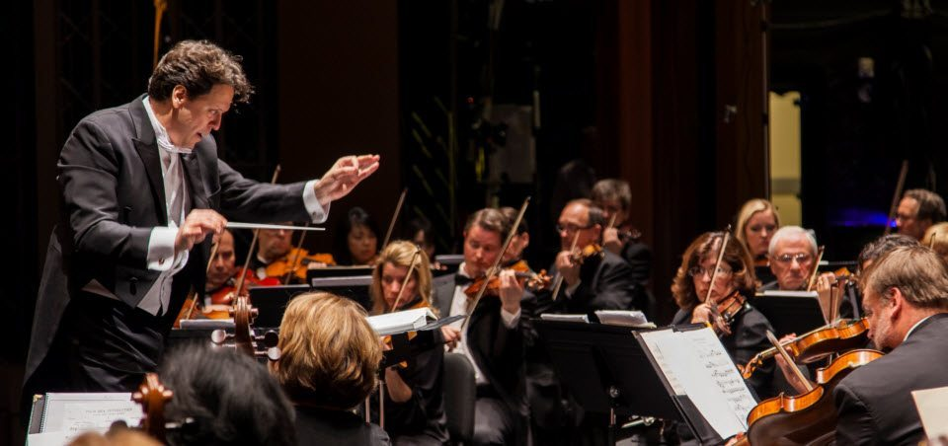
The goal of the plan
Achieve the goal of the project
help to execute the project
in the shortest possible time
Provide room to handle variation
Help to orchestrate the team

Slide 5
What is it not
A process description
A work instruction
An agenda
A todo list

Slide 6
Risks
Planning
Execution
The main risks to be avoided are:
Missing or unnecessary tasks
Missing or unnecessary dependencies
Wrong estimates
Too much detail
Not enough flexibility
Prior input was needed and is not ready
Scope is missed
Resources are wasted
Scope creep

Slide 7
Repeatable process (1/3)
The following 10 steps process has proven to be effective in determining a good project network:
Define the project’s measurable goals, tangible scope, and sponsor criteria
Define the tasks required for the backbone of the project network (one main path), starting at the end of the project and working towards the beginning.
tip: use sticky notes, do not build this on the computer
use a tangible deliverable, defined in step 1, as the 1st note. Eg. “perform the 1st commercial flight”
sentence “what must be completed or finished immediately before the task on the right can start”
sentence “is there anything else that must be completed before the task on the right can start”
choose the task which you expect to require most work to be done
continue until you are at the task that could start today
Add the tasks required to build the skeleton (other paths), working backwards from the end, completing all other paths.

Slide 8
Repeatable process (2/3)
Read the network forward, from the beginning, rigorously looking for additional dependencies
sentence “<this> must be done before <that> because ...”
rigorously look for other tasks that also depend on this task
Check every task against project goals, scope, and sponsor criteria
Determine resources (skill level and maximum number) that could be assigned to perform the task.
Do not assign named resources
This also includes critical equipment (large expensive)
Note where resource continuity is required
Break a task down if resource hands of to another resource
Best from left to right
Scrutinize the network logic using subject matter and/or skill set experts
Check your assumptions
Ensure the work is correct
Find the critical workers for the estimates

Slide 9
Repeatable process (3/3)
Define time estimates, with range of variability
Ask the experts
Ensure the work is well understood
Ambitious, standard, pessimistic
Consider iterations
Seek ways to reduce overall project duration without compromise
Critical path, critical chain: Focus on the critical tasks
Was there sufficient understanding when making the estimate
Can task be shortened by higher skilled resources
Can task be shortened by more resources
Does 100% of predecessor need to be completed (are we extremely conservative)
The same for the long feeding chains
Complete a final, overall project assessment
Holistic view, with the original team of sponsors, key stakeholders and experts

Slide 10
Practical checklist
Every task has
A clear description
which can be understood, also out of context
uses a verb
tells something about the state
A task manager
Skills assigned (not named resources)
Realistic estimate
A successor
A contribution to the goal
No more than ~ 200 activities
Only finish -> start dependencies
Prevent dependencies on summary tasks
FS relationship on last and 1st
Do you really need to wait for the last?
Prevent fixed dates, other than the finish date
Prevent bypasses
Feeding chains Just-In-Time
Use workpackages when possible

Slide 11
Best practices
The following items are considered as best practices:
Keep the project as simple as possible. Only add complexity if this is required.
Pool protection for the entire project in one place – at the end of the project
Use protection for non-critical paths in the project only where variability is either high or unpredictable.
Put as many resource as practical on the project. Even if resource efficiency suffers slightly, this is better than spreading resources thin.
Stagger the project in a manner that recognizes the capacity of the organization to do project work.
Use workpackages instead of many detailed tasks

Slide 12
Quotes
“Sophisticated problems require simple solutions”
“Make it as simple as possible. And as complex as needed”

Slide 13
Dictionaries - masterlists
States
draft
concept
final
approved
communicated
shared
Skills
architect
designer
system engineer
verification engineer
validation engineer
quality engineer
regulatory engineer
SW development engineer
Mechanical engineer
...

