Slide 1
LYNX Training Program
Ad Vermeulen
Niels Mani

Slide 2
Sample Agenda – Project Managers
The [Company] Change Project
LYNX Training (A-dato) – Test space
LYNX Overview
Getting Started – the basics (as per handout)
Overview [COMPANY] Specifics
Template
Custom Fields
Get started with your own project in LYNX
[COMPANY] Operational Space
Wrap-up

Slide 3
Sample Agenda – Task Managers
The [Company] Change project - summary
LYNX Task Management
LYNX Overview
My activities for Task Managers
Exercise
Resource Management Tools
Wrap-up

Slide 4
LYNX Role Based Training
LYNX for Project Managers
LYNX for Task Managers
LYNX for Resource Managers
LYNX for Portfolio Managers (multi-project)
Master Schedulers
Release Managers
LYNX TameFlow
Team Managers
Teams
Team members

Slide 5
Collaboration and Team work Working together at the same time in the same project
Projects, tasks, sub-tasks, cards
Resource manager
Team manager
Task manager
Skill/ Resource
Project manager
Portfolio manager
Team member
“Timing is everything”
There is only 1 moment you can be on time!
If you are not there you are either too early or too late.
Johan Cruijff
External partner
Just “invite” others in one “click”
A-dato Confidential

Slide 6
[Company] Structure Working together at the same time in the same project
Projects, tasks, sub-tasks, cards
Resource manager
LYNX Task manager
Project manager
PMO
Team member
Resource Assignm.
Progress

Slide 7
[Company] Specifics
Template
Custom Fields
Resource / Skill Configuration:
Location
Other fields

Slide 8
Tuning the template (example)
Remove Modules that are not applicable (PMO)
Remove completed tasks (in case of ongoing projects)
Switch on “Auto Schedule”
When setting task durations:
Switch of Task Time Reduction
Side by Side:
Add column AMS Effort (Stunden)
Add Resource Requirements column

Slide 9
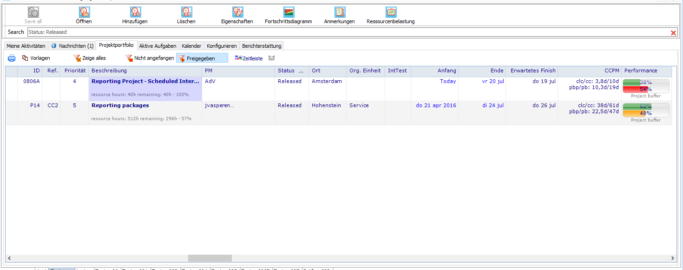
Multi-Lingual

