Slide 1
LYNX TameFlow Implementation Choices
Workdocument

Slide 2
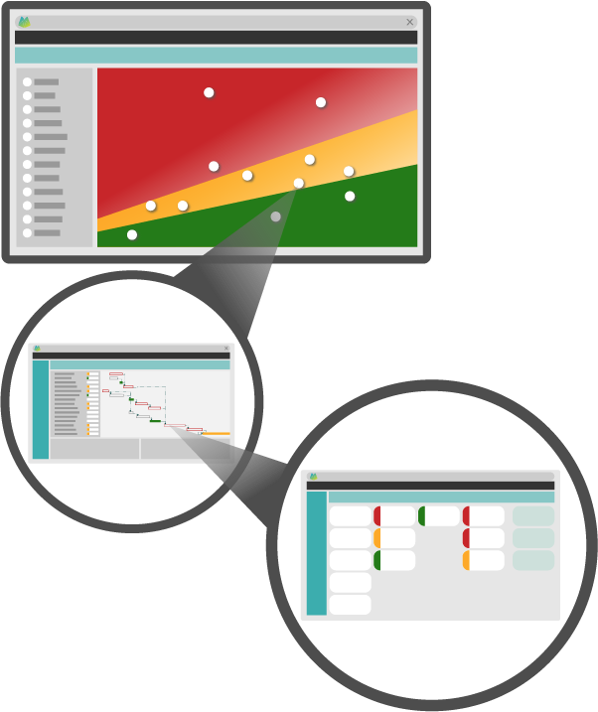
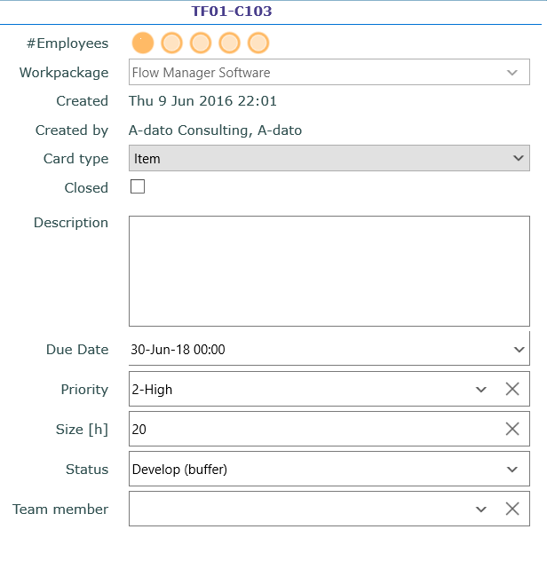
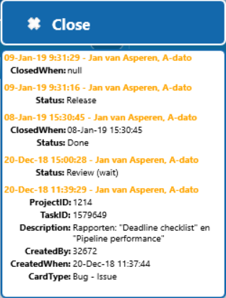
LYNX and LYNX TameFlow
Multi-project resource management
Skills, profiles, resources, teams, team members
Portfolio / Multi Project
Scenario Planning
Projects with stages, phases and tasks
Card
Workpackages with Cards e.g. subtasks, user-stories

Slide 3
Project Workflows Network Logic building a Critical Chain or Shortest Path
START
Concept
Hardware
Software
Integration
Buffer

Slide 4
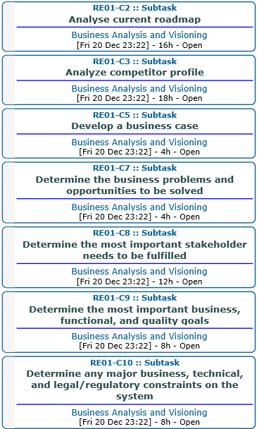
Project Workflows Normal tasks and Workpackages (bundle of “cards”)
START
Normal
Normal
Level 1
Workpackage
Level 2
Normal
Buffer
Worpackage with a bundle of cards
Bundle of Cards

Slide 5
Applications of LYNX TameFlow Projects and Services Workflows
Project Workflows
Services Workflows (or “Non-project work”)
Due Date Performance
Service Level Performance (SLA)

Slide 6
Scope Implementation Choices (1) Workpackage Identification
Identify which parts of the project or type of work will be managed as “Workpackages”
List examples here
…
In which type of Workflows are applicable?:
Workpackages within Project Workflow
Workpackages within Services Workflow

Slide 7
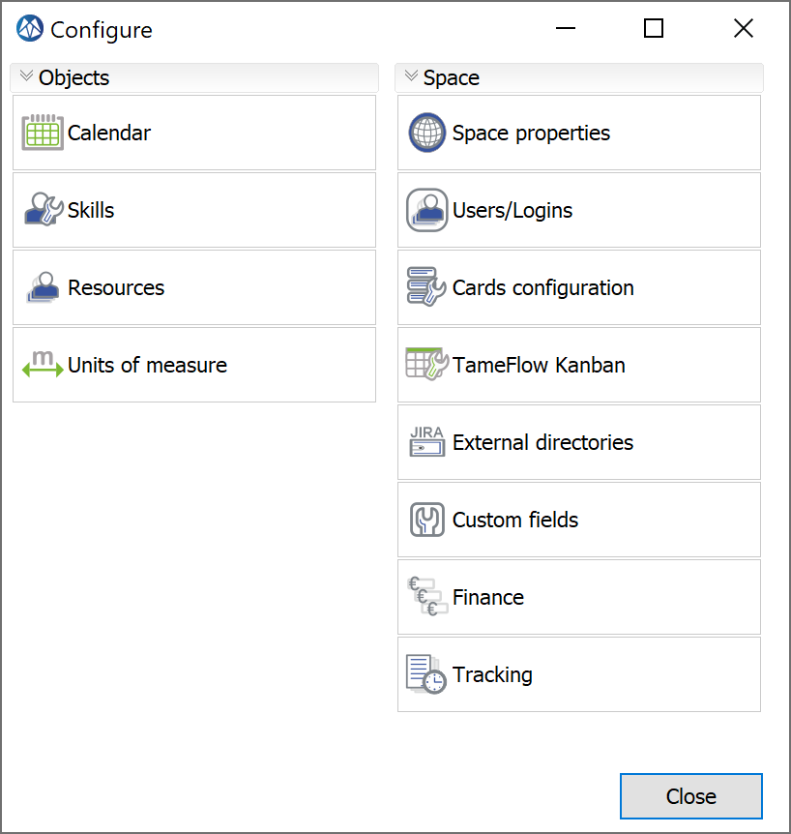
Scope Implementation Choices (2) For Workpackages and Cards
Which Card Types?
Which fields?
Status (workflow)
Size
Other?
Configure your LYNX TameFlow Taskboard
Which Stream(s)?
Which Board(s)
Prepare for getting Cards done
Standard Skill or Team Skill
Routing and Filtering of Cards

Slide 8
Resources
Section: Get Started with LYNX TameFlow:
https://support.a-dato.com/hc/en-us/sections/360003735037-Make-a-jumpstart-with-LYNX-TameFlow
Make a jumpstart with LYNX TameFlow
Get Started with LYNX TameFlow
Get Cards done with the LYNX TameFlow Taskboard or Cards View
Try some TameFlow Kanban Features
Try TameFlow Buffer Management
Get started with a Team Skill
Card Configuration Templates:
https://support.a-dato.com/hc/en-us/articles/360039475533-LYNX-TameFlow-Card-Type-Configuration-Templates#DownloadadetailedOverviewofCardTypeconfigurationoptionsbelow!

Slide 9
Determine your Card Types and their fields
The following Card Types will be used e.g.:
Subtask
User Story
Other?
Specify the Card Fields:
Status (workflow) = Mandatory
Size and its unit of measure = Mandatory
Other fields
Describe use and process flow
Which type of work (workpackages)?

Slide 10
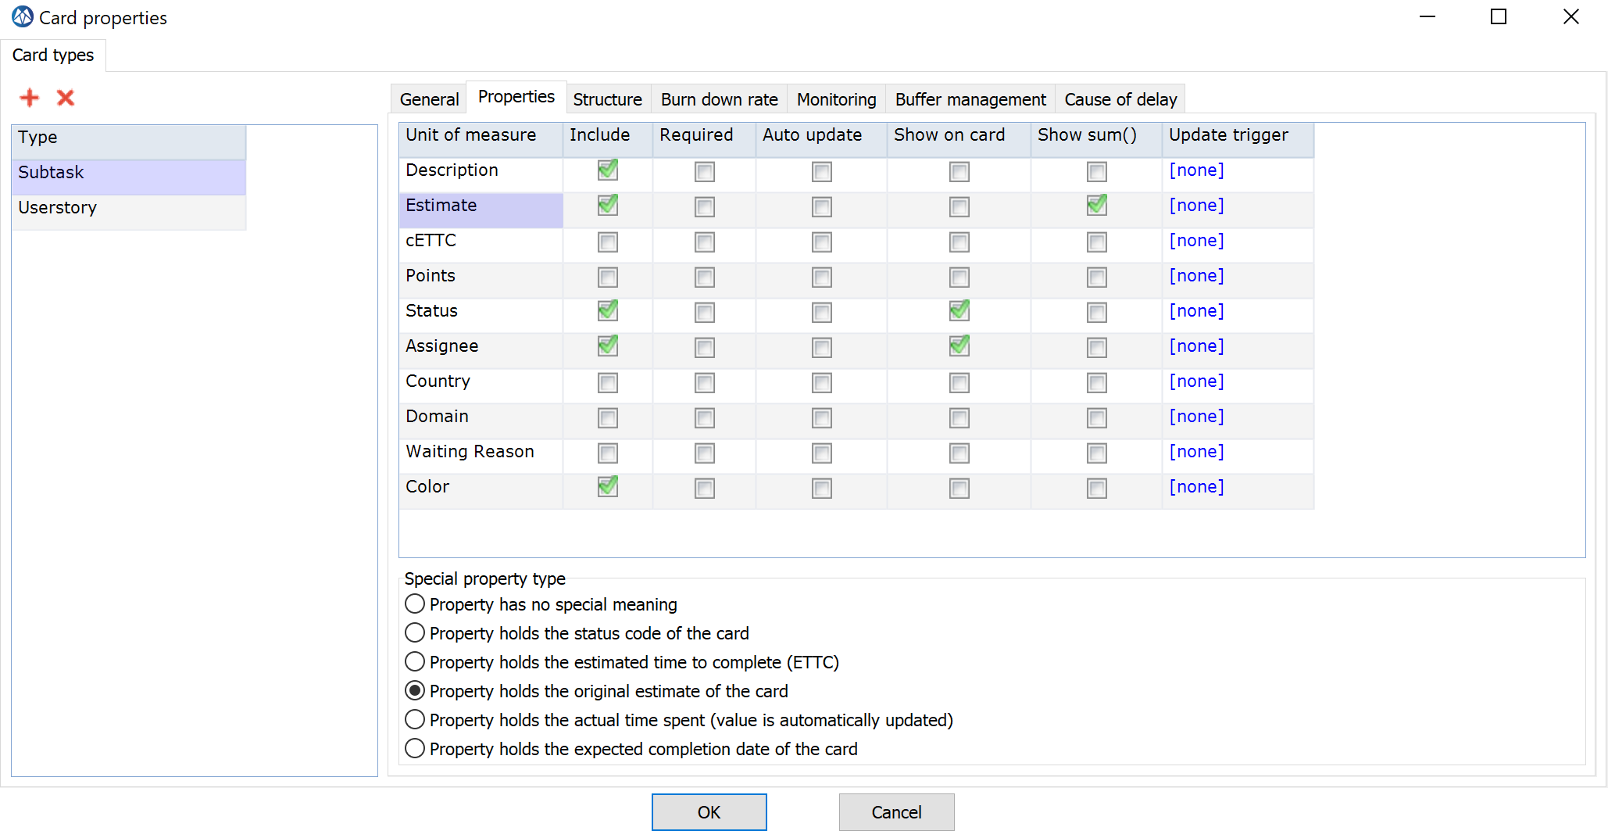
Some Examples (1)

Slide 11
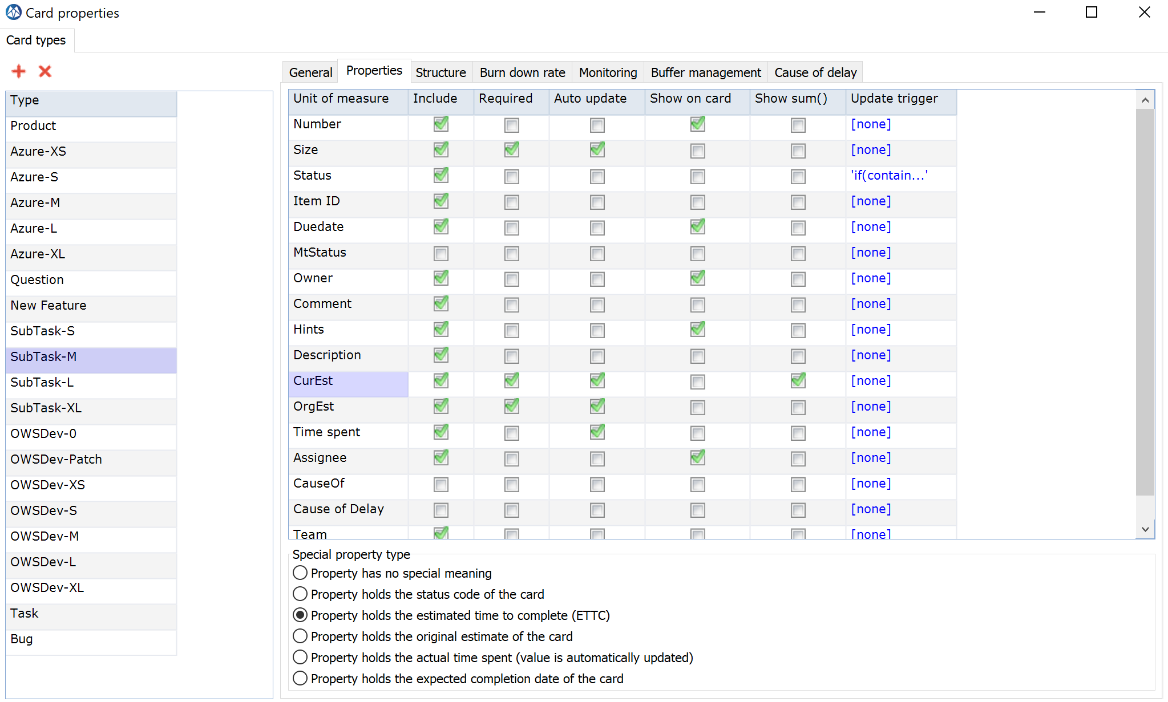
Some Examples (2)

Slide 12
Describe Card Type “X”:
Card Fields
Status (workflow)
Size and its unit of measure:
Timespan: Hours
Units: Points, DD (Developer Days) etc.
Other fields
Default values to be considered
Card Buffer Management: Yes/No
Due Date Field
Type of Buffer Management

Slide 13
Describe Card Type “Y”:

Slide 14
Define Stream(s) + Board
Minimum is one Stream/Board Combination
Stream configuration
Board configuration
Stream Configuration:
..
Board Configuration:
Any handover points in the workflow (select “wait”)

Slide 15
Workpackage “Resource Requirements” Use Standard Skill or Team Skill
Options:
Standard Skills
Virtual
Normal
Team Skill
Pro’s and Con’s:
……

