Slide 1
LYNX Project and Portfolio Management Critical Chain Project Management
LYNX Training - Introduction

Slide 2
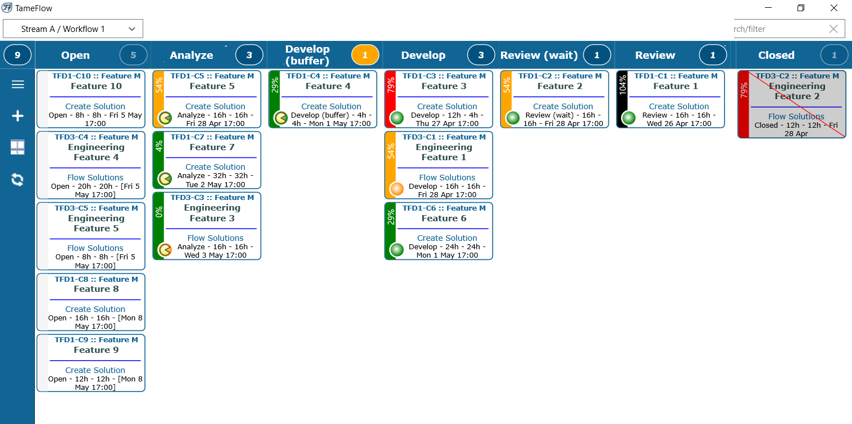
Scope
Plan the Work
Work the Plan
Communicate
Introduction
What is
LYNX about?
Project
Tasks
Workpackages
Cards
Task Management
Cards Management
Kanban Board
Progress
Reports
Export

Slide 3
Collaboration and Teamwork Working together at the same time in the same project(s)
Projects, tasks, sub-tasks, cards
Resource manager
Team manager
Task manager
Skill/ Resource
Project manager
Portfolio manager
Team member
“Timing is everything”
There is only 1 moment you can be on time!
If you are not there you are either too early or too late.
Johan Cruijff
External partner
Just “invite” others in one “click”
A-dato Confidential

Slide 4
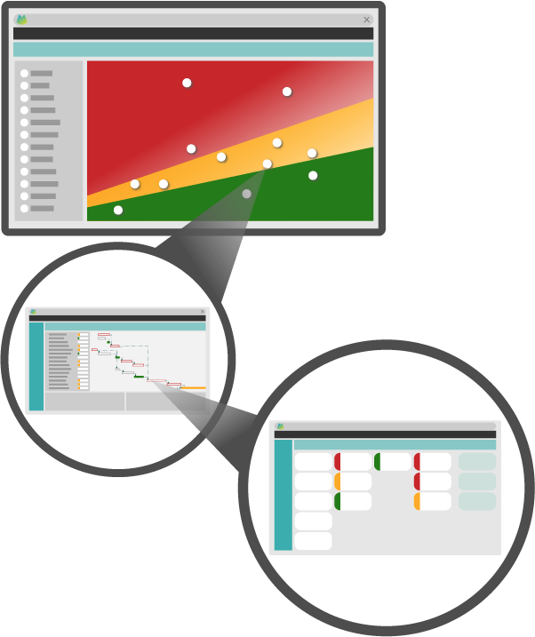
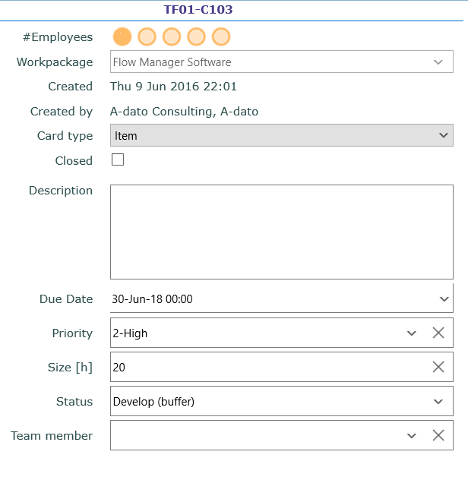
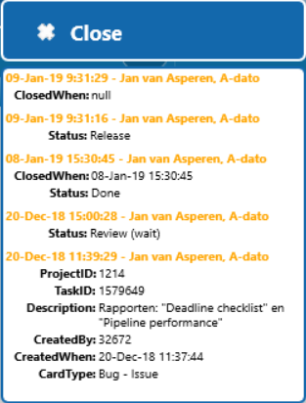
Why LYNX? LYNX brings everything together..
Resource manager
Portfolio manager
Multi-Skill Resource Management
Skills, profiles, resources, teams, team members
Portfolio / Multi Project
Scenario Planning & Simulation
Project manager
Task manager
Projects with stages, phases, tasks, workpackages
with cards
Card
Resource
Team manager
Taskboards with Cards e.g. subtasks, user-stories
Team member

Slide 5
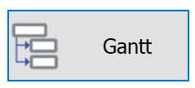
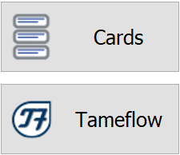
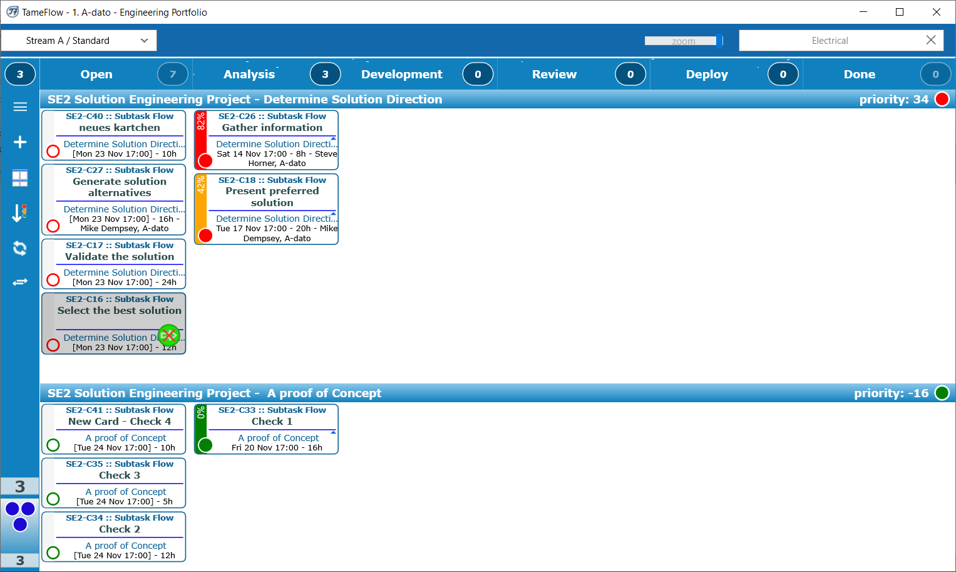
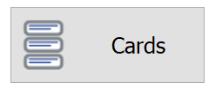
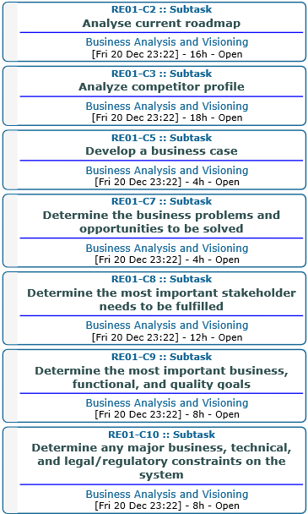
Why LYNX? Embedding Agile/Kanban way of working into projects
Project manager
Level 1
Level 2
The TameFlow Approach
Level 2
Through LYNX TameFlow, Agile and Kanban workflows are integrated, bringing Agile CCPM to life.
Team member
Task manager

Slide 6
Why LYNX? Enabling a different approach offering ingredients to improve…..
Today
Tomorrow
Improvement Potential...
Overload
Multi-tasking
Task Interruptions
Cherry picking
Early starts
De-synchronisation
Batching
Parkinson’s law
Student syndrome
Local safeties
Kopfmonopole
Global priorities
WIP Control
Roadrunner
Single tasking
Single-touching
Global buffers
Late binding
Full-kit
Single-piece flow
Late binding
Less pressure and stress
Easier collaboration
More reliable projects
Better timing, more flow
More transparency
Win (back) capacity
Finish projects faster
…..
A different approach
Symptoms
New Reality

Slide 7
LYNX Role Based Training
LYNX for Project Managers
LYNX for Portfolio Managers (multi-project)
Master Schedulers
Release Managers
LYNX for Resource Managers
LYNX for Task Managers
LYNX TameFlow
Team Managers
Teams
Team members
Full Users
Light Users
Team Users

Slide 8
Summary Customer Overview
Fields of application
Design and Engineering
Building and Construction
Service and Maintenance
Organisation
Global footprint
Currently over 100 customers, across all continents
From small to very large implementations (with over 400 users and hundreds of projects)

Slide 9
Diamond Aircraft Industries

Slide 10
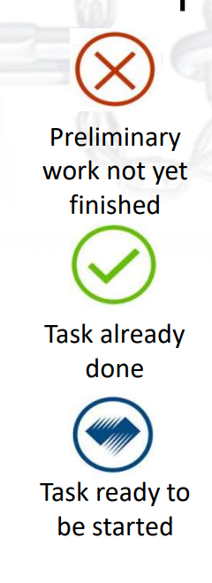
Diamond Air Experiences and improvements
What has improved and is better?
Self-organizing teams across the companies
Teamwork & mutual support across projects.
Continuous improvement & innovation
Burnout rate zero, stable operations
Transparency (real-time information) is up
Deblocking Board for Project Managers

Slide 11
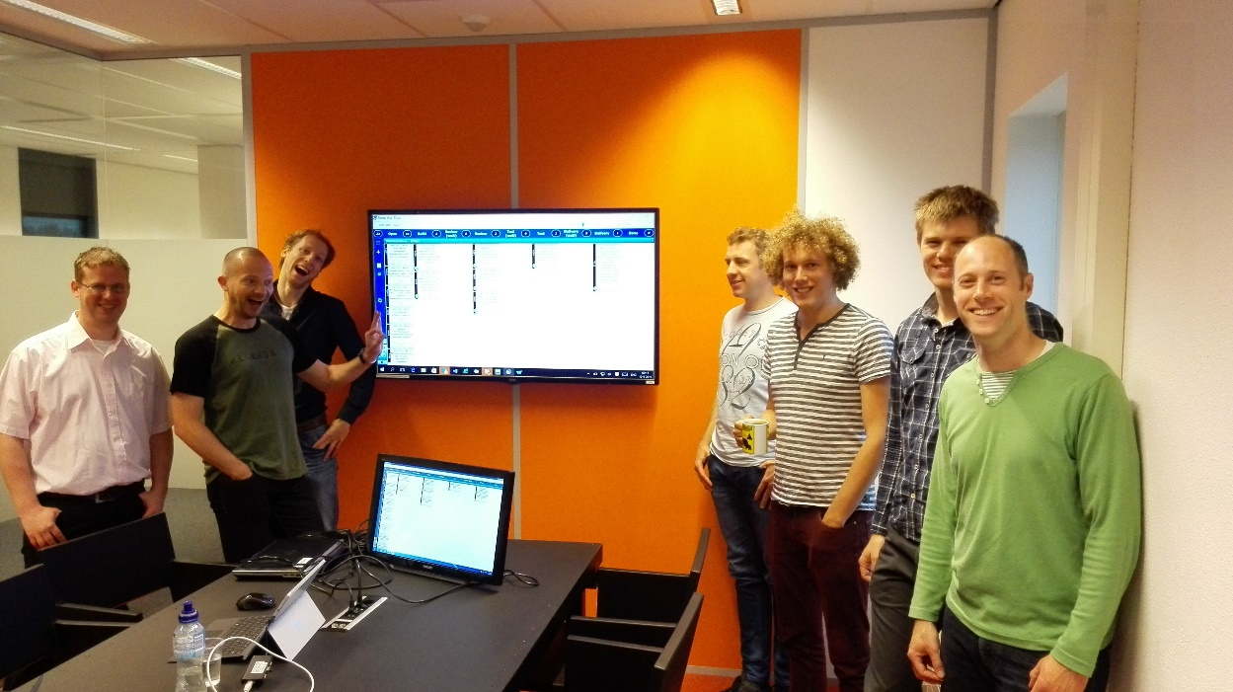
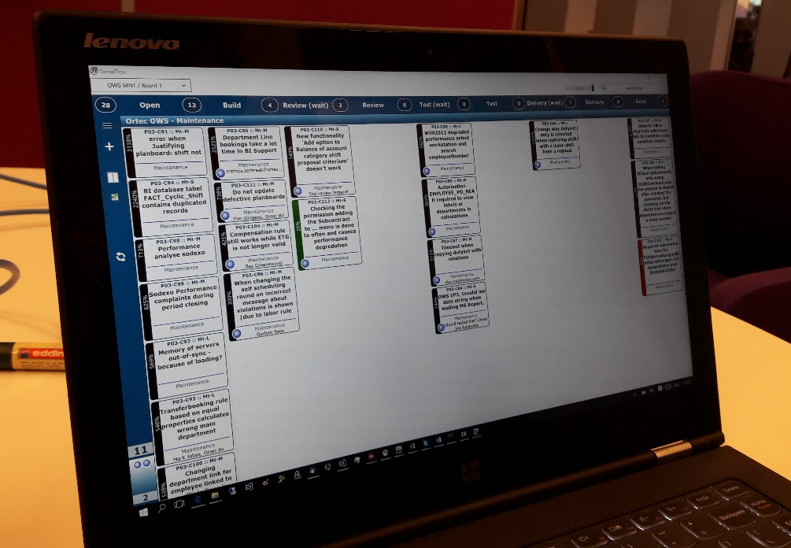
ORTEC

Slide 12
Before we start…
Login and Workspaces

Slide 13
Visit the LYNX Help Center

Slide 14
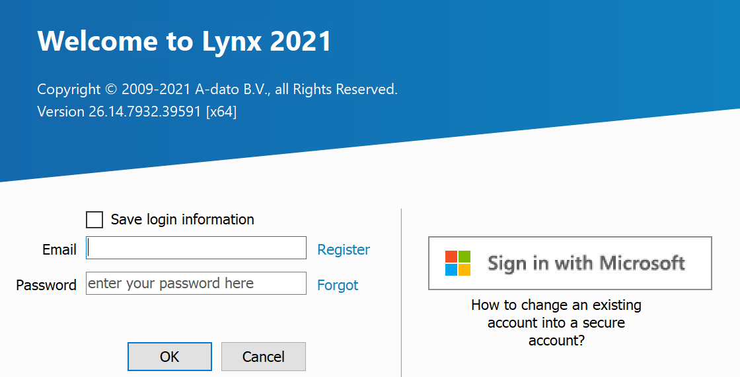
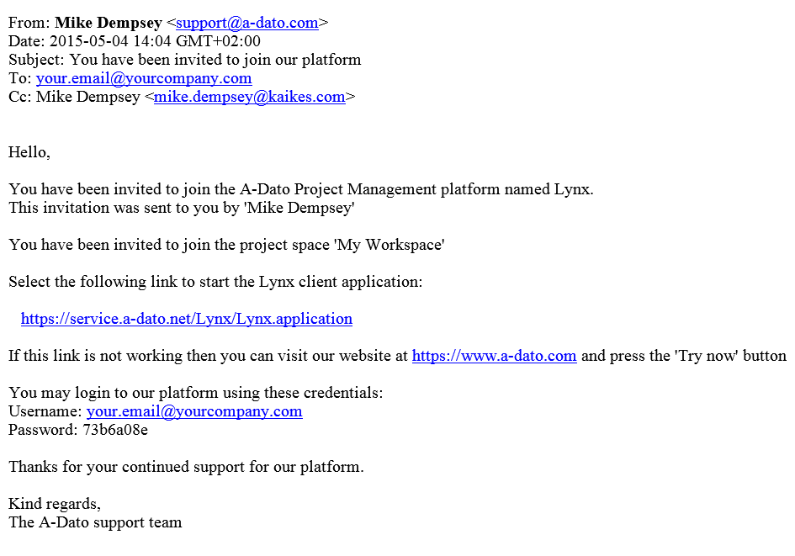
Login with your (new) credentials you received per email
If you already received an invitation to join LYNX from another user (e.g. colleague, admin, workspace owner) your login credentials are provided in the invitation email.
If you are invited as a first-time user, LYNX will provide an initial password, which can be changed in MyProfile

Slide 15
Setting up your account in Lynx
There are many ways to Rome, I tell you the most convenient for now:
Opening lynx
Setting up your personal data in “Profile”

Slide 16
New User Registration
Do not forget to enter your initials.

Slide 17
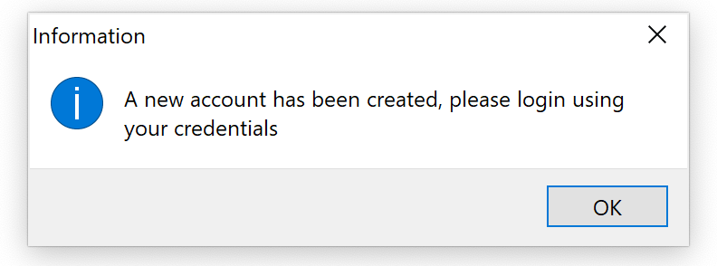
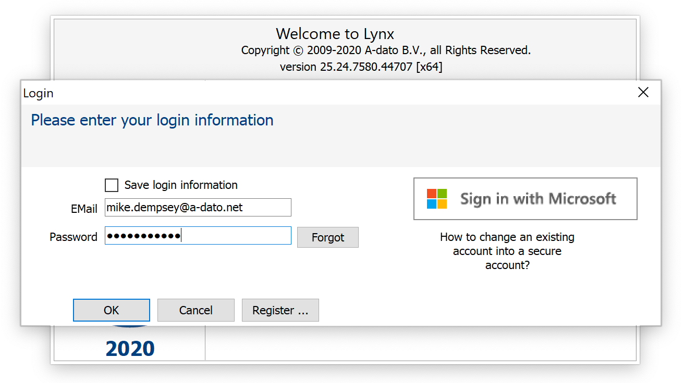
Login after registration with your email and your password

Slide 18
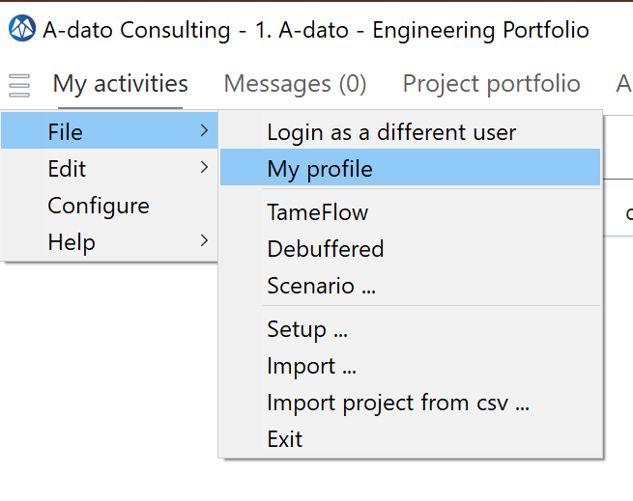
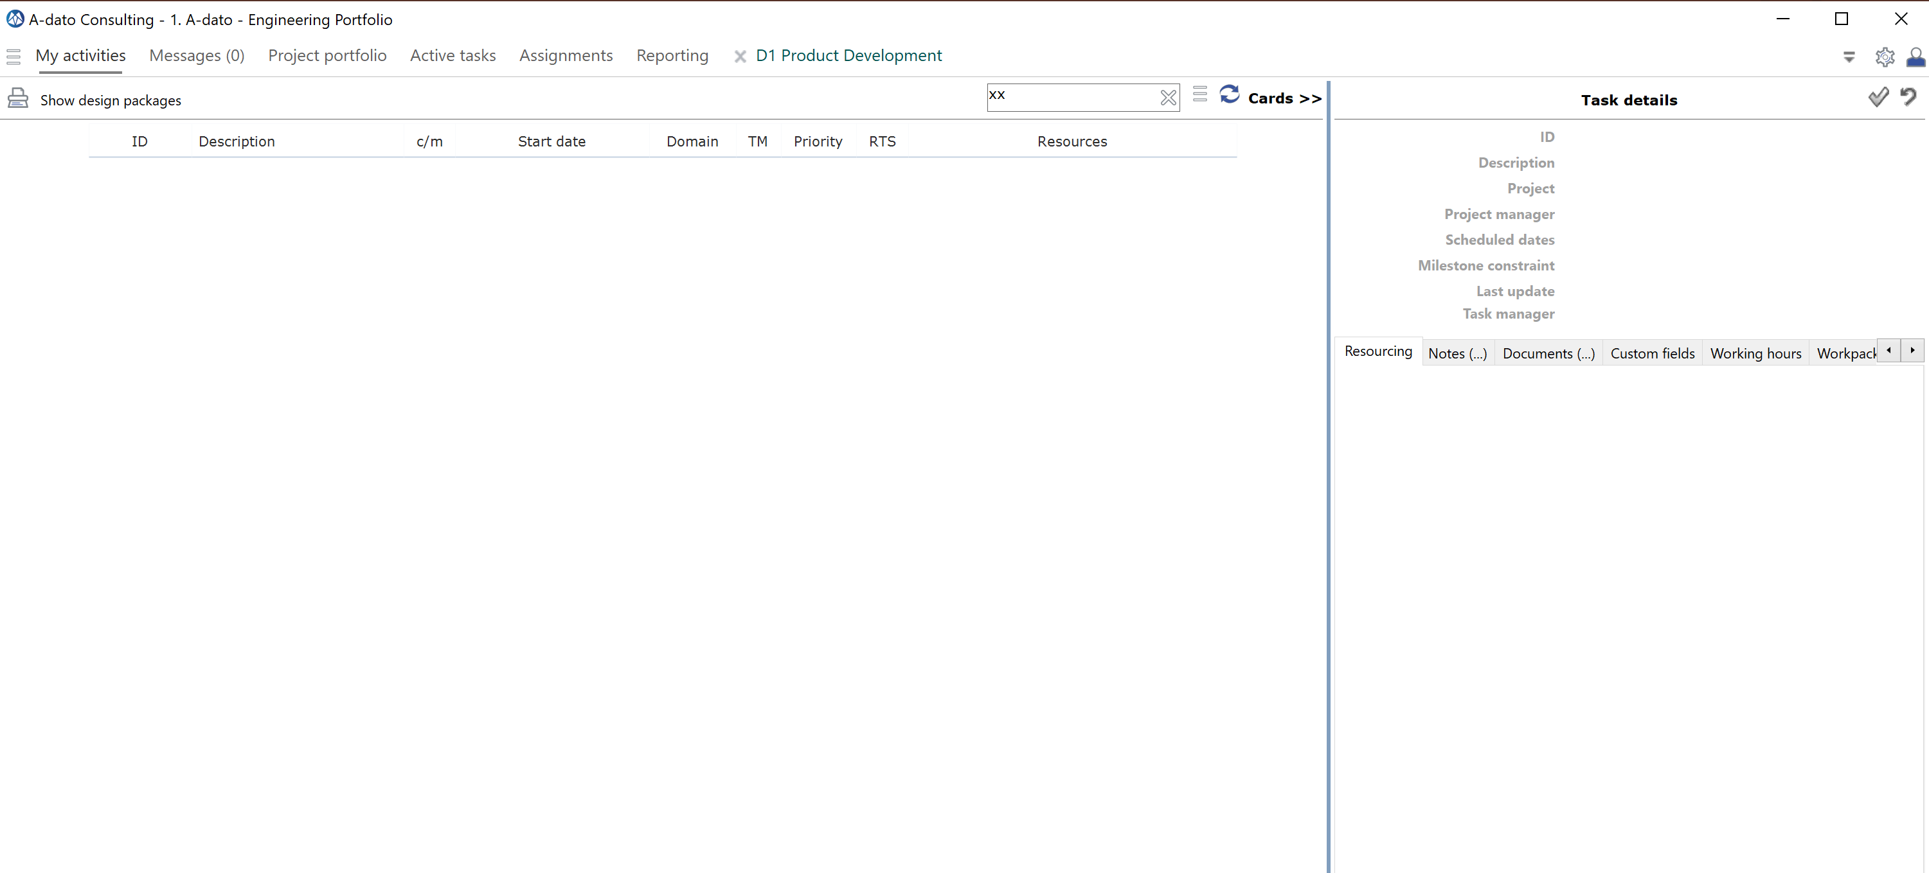
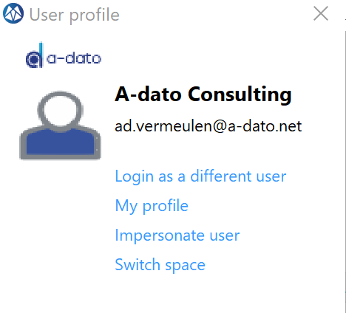
Select “My profile”
The name of you “Space” is displayed here.
This screen this screen may still be empty (as long as no tasks are assigned to you)

Slide 19
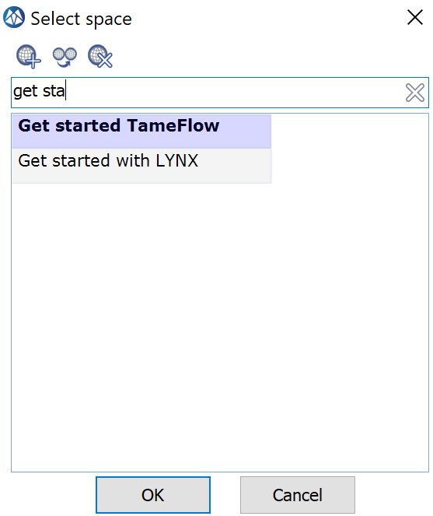
Check (change) your “Space”
The name of you “Space” is displayed here.

Slide 20
Get started with LYNX
LYNX for Project Managers

Slide 21
LYNX Role Based Training
LYNX for Project Managers
LYNX for Portfolio Managers (multi-project)
Master Schedulers
Release Managers
LYNX for Resource Managers
LYNX for Task Managers
LYNX TameFlow
Team Managers
Teams
Team members
Full Users
Light Users
Team Users

Slide 22
Contents
DOWNLOAD LYNX
https://www.a-dato.com/download-lynx/
Introduction
Planning
Execution
Create your first project (21)
Add Tasks (26)
Add Dependencies (31)
Add Skills and Resources (39)
Add Task Managers (45)
Apply CCPM Behavior (48)
A different approach
Philosophy behind LYNX
Release your project and tasks for execution (56)
Other:
A few tips and tricks
More information
Visit the
LYNX HELP CENTER
https://support.a-dato.com/hc/en-us

Slide 23
Project Control – Think Different

Slide 24
Theory: Project management principles
Theory
If all tasks finish in time, the project finishes on time
A delay on the critical path is a delay on the project
Dedicated team does the work

Slide 25
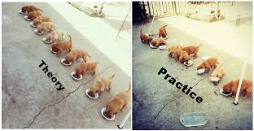
Practice: Most projects are late and over budget!
Practice
Tasks run late even if you gave yourself extra time. In the end the project is late
One of your team members is working on another assignment
Murphey does exist and things derail
………..
Room for Improvement….

Slide 26
Let’s take a different approach…

Slide 27
Philosophy (behind Lynx)
Projects consist of people!
Thus, when managing projects, it is about people
(and processes).

Slide 28
Task Durations (within Projects)
Task
Work
Typical task Execution Pattern
Wait
Work
Work
Work
Work
Typical
“Flow Ratio”
Work
100 %
10 - 20 %
Wait
Work
Notes:
Vaak niet boeven 20 % - EERDER ROND DE 5
Zin is krom. → om echtt te verbeteren kan je veel nbeter richten op verminderen van de wachttijden

Slide 29
Where to start improving? “Low” hanging fruit
Wait
Work
Most jobs are not slow, but typically just have to wait a lot.
Notes:
Overlay met euro tekens, waar zet je geld op in? → groen kost heel veel.

Slide 30
Today: What makes people (and organisations) unhappy?
Undesired
Impact
Overload
Multi-tasking
Task Interruptions
Too early starts
Cherry picking
De-synchronisation
Batching
Local safeties / Padding
Spreading resources thin
Parkinson’s law
Student syndrome
“Kopfmonopole”
Too many things going on = mental pressure
Delays and waiting time
Many unfinished tasks, more Work-in-Progress
Task Interruptions
Favorite tasks first
Working on non-critical work first
Efficient but not effective
Every person adds private buffer – long leadtimes
Low Flow Ratio
Budget time → Actual time
Last minute rushing, forget stuff
A guaranteed “bottleneck”

Slide 31
Tomorrow: What makes people (and organisations) happy?
Desired
Impact
WIP Control
Single tasking
Single-touching
Full-kit
Objective priorities
Synchronisation
Single-piece flow
Global buffers
Aggregation
Relay race
Vertical Integration
Late binding
“Constraint” thinking → Work on less than X things at the time
Inverse of multi-tasking
Less interruptions = higher flow %
Everything is prepared to finish in one go (mise en place)
Prevents loud-mouth-management
The show CAN go on
Effective instead of efficient
Team focus on project “constraint”
Good enough estimates will do
No handover delays
Impact workfloor directly visible on strategic level
Flexibility and high flow ratio

Slide 32
How to get there?
Undesired
Desired
Overload
Multi-tasking
Task Interruptions
Too early starts
Cherry picking
De-synchronisation
Batching
Local safeties
Padding
Parkinson’s law
Student syndrome
Kopfmonopole
WIP Control
Single tasking
Single-touching
Full-kit
Objective priorities
Synchronisation
Single-piece flow
Global buffers
Aggregation
Roadrunner
Vertical Integration
Late binding
Different way of planning
Different way of working

Slide 33
Any system needs WIP control….
Cycle time (duration)
OUTPUT
Reliability

Slide 34
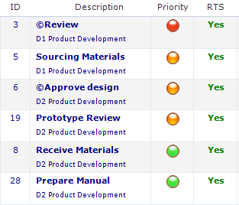
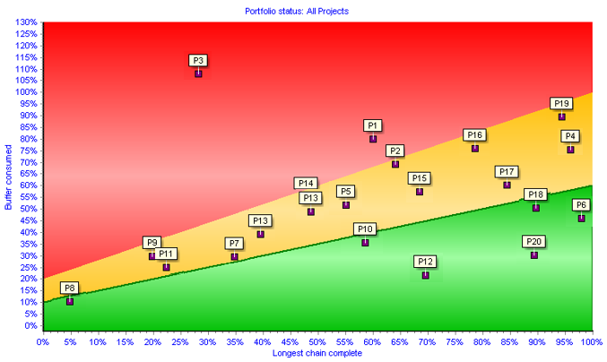
A different approach… Critical Chain (Multi-)Project Management: Key Ingredients
Buffer Management
+ Critical Chain
Execute by Single Priority
Manage across projects
(Control the WIP)
Buffer
50%
Traffic light = 1 Operational Priority for everybody (across projects)
Heatmap or Feverchart

Slide 35
CCPM: Theory of Constraints What do we mean with a “Critical Chain”?
The capacity of the “bottleneck” determines the maximum output that can be achieved
The “critical path” (longest path) is the “bottleneck” in a project because it determines the total duration of the project………
8
2
15
A
B
D
A
C
5
5
1
Or isn’t it……?

Slide 36
CCPM: Critical Resources
Question:
Who are the critical resources or critical departments within your company?
What is impact of their availability on your project or other projects?

Slide 37
CCPM: Critical Resources → impact on your project.. Ability to identify “Invisible dependencies”
Task B is not Critical !
8
2
8
2
15
A
B
A
B
19
D
D
A
C
A
C
5
5
5
1
5
1
Critical Path = 14
Critical Chain = 19

Slide 38
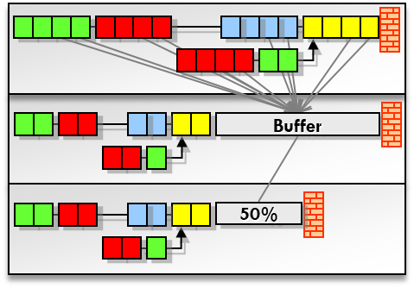
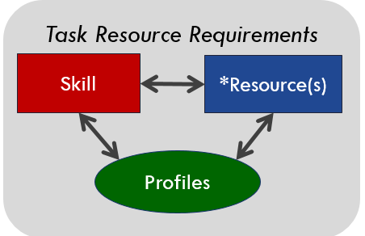
Levers for improvement! Operations Management for (multi-)project operations
Introduction of Buffer Management with Dynamic Schedules →Manage the Buffer
Aggregate and (re-)move safety time
Critical Longest Chain Scheduling
Introduction of one single priority and feedback loop → Execute by single priority
Synchronized Execution of Tasks
Track progress by Expected-Time-To-Complete (~ ETA)
Introduction of Pipeline and Portfolio Management → Control the WIP
Constraint based Work-in-Progress management
Flow Control with Release management (staggering)
Introduction of Aggregation and (dynamic) “Late Binding”
By skill(group) → Flexible Capacity

Slide 39
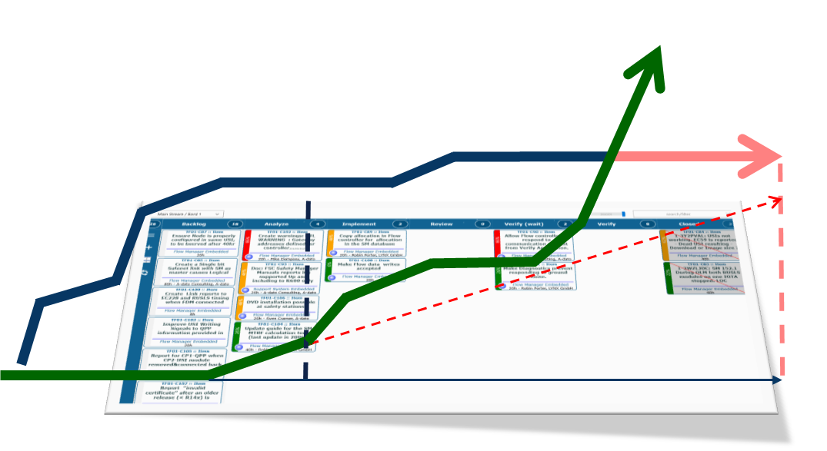
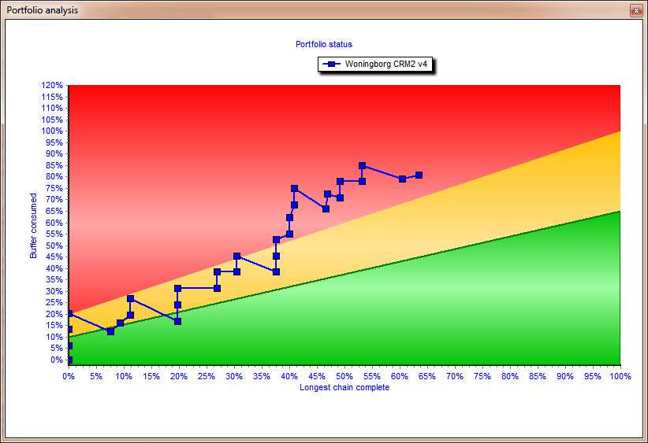
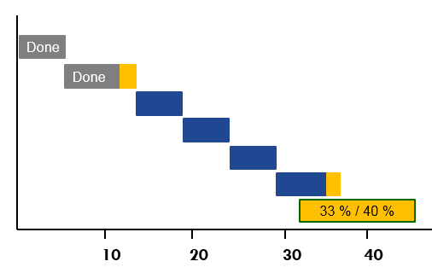
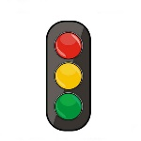
Improving with LYNX..
Pipeline & Scenario Planning
Release Wizard
Scenario Wizard
“Strategic Priorities”
Stakeholder
„Priority board“
PIPELINE
Layer 1
Multi-Project
New projects
Project #4
Project # 5
#2
Project #3
Project #1
Projects
CCPM Engine
Buffer Management
“Operational Priorities”
Layer 2
Single Project
teams
Workpackages with Cards
Agile/Kanban Processes
e.g. Sub-tasks / Stories
Layer 3
Workpackages Agile & Kanban
Notes:
3 lagen model. – wat is dan nog een missing link? → kenniswerk. Agile and everything is good.

Slide 40
Layer 3: LYNX TameFlow Task Board, including Flow Buffer Management

Slide 41
Focus of this Training: Layer 2
Create Projects
CCPM
Buffer Management
“Operational Priorities”
Layer 2
Single Project

Slide 42
Introduction of Buffer Management
What can you do with Red, Orange and Green?

Slide 43
A Standard Plan
Psychological effects of the standard plan:
Safe estimates (or overambitions)
Student Syndrome
Parkinson's law
Padding
Achievable
Contingency
Time
10
20
30
40
50
60
CRITICAL CHAIN / PATH = 60
Notes:
Laat zien hoe buffer naar achteren wordt geplaatst en ingekort. Om dit te bewaken heb je een goede projectmanagement tool nodig, want: hoe weet je of en hoeveel je al van die centrale projectbuffert hebt gebruikt?

Slide 44
A Buffered Plan (1)
Pooling of Contingency Insurance Model
Achievable
Contingency
Time
10
20
30
40
50
60
2/3
1/3
45
Notes:
Laat zien hoe buffer naar achteren wordt geplaatst en ingekort. Om dit te bewaken heb je een goede projectmanagement tool nodig, want: hoe weet je of en hoeveel je al van die centrale projectbuffert hebt gebruikt?

Slide 45
A Buffered Plan (2)
Achievable
Contingency
Time
10
20
30
40
50
60
2/3
1/3
60
Notes:
Laat zien hoe buffer naar achteren wordt geplaatst en ingekort. Om dit te bewaken heb je een goede projectmanagement tool nodig, want: hoe weet je of en hoeveel je al van die centrale projectbuffert hebt gebruikt?

Slide 46
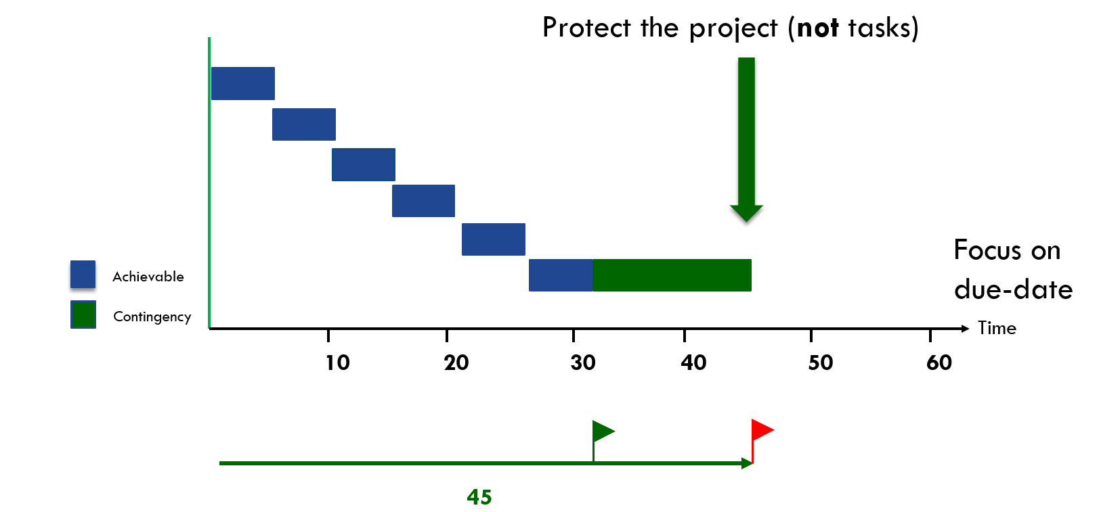
Pooling of Contingency – Insurance Model Buffer Management
“To be safer, (re)move the safety”
Notes:
Laat zien hoe buffer naar achteren wordt geplaatst en ingekort. Om dit te bewaken heb je een goede projectmanagement tool nodig, want: hoe weet je of en hoeveel je al van die centrale projectbuffert hebt gebruikt?

Slide 47
Green 50 % progress on the longest chain / 15 % buffer used
Today
Project is on track. The risk that the project will be late is very low.
Done
Done
Done
50 % / 15 %
10
20
30
40
50
60
Time
45
“To be safer, (re)move the safety”
Notes:
Laat zien hoe buffer naar achteren wordt geplaatst en ingekort. Om dit te bewaken heb je een goede projectmanagement tool nodig, want: hoe weet je of en hoeveel je al van die centrale projectbuffert hebt gebruikt?

Slide 48
Red 55 % progress on the longest chain / 65 % buffer used
Today
Relatively to much buffer is used. Measure are need to make sure the project can be delivered on time.
Done
Done
Done
Done
55 % / 65 %
10
20
30
40
50
60
Time
45
“To be safer, (re)move the safety”
Notes:
Laat zien hoe buffer naar achteren wordt geplaatst en ingekort. Om dit te bewaken heb je een goede projectmanagement tool nodig, want: hoe weet je of en hoeveel je al van die centrale projectbuffert hebt gebruikt?

Slide 49
What can you do with Red, Orange and Green? CCPM: Project Trend Line
Fever Chart

Slide 50
What can you do with Red, Orange and Green? Resolve day-to-day resource conflicts (and prevents (bad) multi-tasking)
The perfect original plan for ONE System Engineer called “Mike”
D2
D1
T1
D2
T1
The actual situation Today
D1
D1
T1
How to solve the “resource conflict” for Mike?
D2
Manage the Queue !
Today
Execution sequence of the queue for Mike
T1
D1
D2
Today
„In the Autopilot-Modus, Resource Managers , Task- and Project managers are supported by Operational Priorities for the synchronized execution of their projects”

Slide 51
“To do” List: My activities Sequence from red to green
Notes:
1. Doorlooptijd van elke taak – er gaat meer dan 30 % verloren aan verstoringen, andere zaken
2. Weniger Projekte geleichzeitig
3. Stoppen met Teiltermine, focus op endtermine en een prioriteit
4. Focus op fertig machen

Slide 52
What can you do with Red, Orange and Green? Manage all projects together

Slide 53
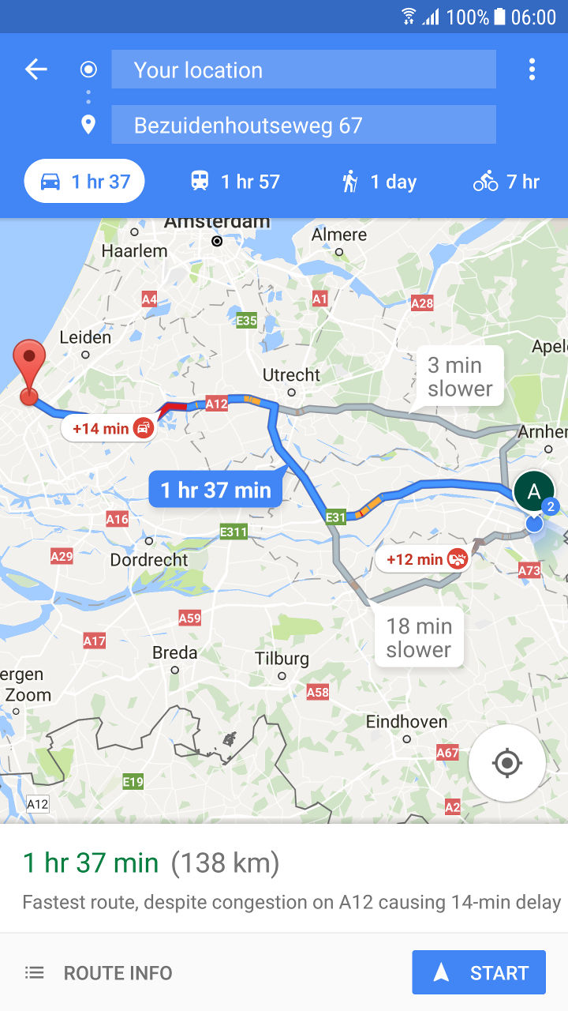
What is needed? Fast-Feedback Loop (ETTC)
Continuous (frequent) update of the “Expected Time to Complete” for each active task (ETTC)
Flawless handovers:
Ensure Delivery is complete
Be Ready-to-Start
Good preparation
Notes:
SHOW
We know now what we should not do but what do we need to do?

Slide 54
How to achieve improvements?
Aggregation and (dynamic) “Late Binding”

Slide 55
Achieving more “Flow” and Resource Management Allocate work to team (or skill) first (not individuals)
Aggregation of resource requirements on „Skill(group)“ or „Team“ Level
Resources are “pooled” by „Skill“ or Team
Specification of any “Task Resource Requirement” by “Skill”
Principle of (dynamic) “Late Binding”
Keep your options open as long as possible (“rotation”)
Prevent “Kopfmonopole”

Slide 56
The “Late Binding“ solution within LYNX Specification of “Resource Requirements“
Implementation of the ISA95 Skill / Resource and Aggregation Model
Skills
Resources
Profile Properties
Projects and Tasks
Projects and Tasks
Task Resource Requirements
Task Resource Requirements
Normal
Skill
*Resource(s)
Virtual Skill
# FTE
Resource Names
Properties
Properties

Slide 57
LYNX Resource/Skill and Team Model Multi-Skill and Properties
Team
Resources and skills are separated and have an “N to N” relationship:
A resource can have multiple skills
A skill can be implemented by multiple resources
Special “Properties” identification via (unlimited) properties at skill and resource level
Team assignment: Resources are assigned to a team
Engineering
Design
Programming
....
Skill (Group)
Resources
Name 1
Name 2
Name 3
…
“Properties”
Programming Language
Technology
Expertise (seniority)
......
LYNX “protects” resources with unique competencies or domain know-how!
This model is following the ISA 95 Standard

Slide 58
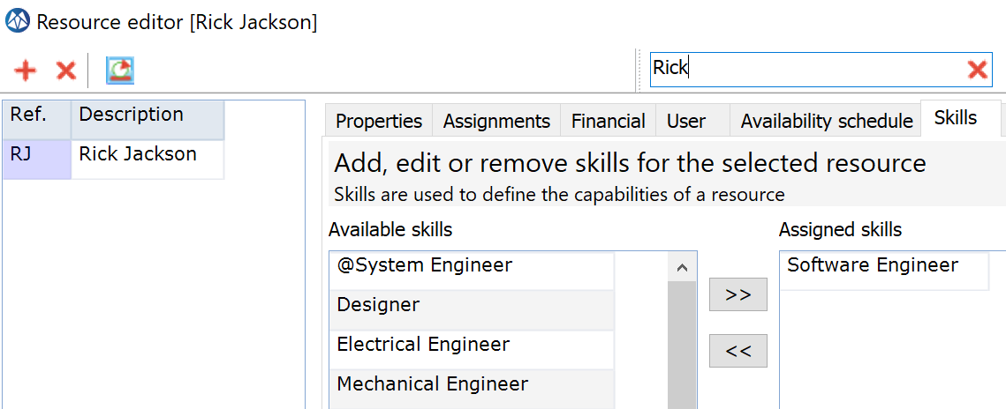
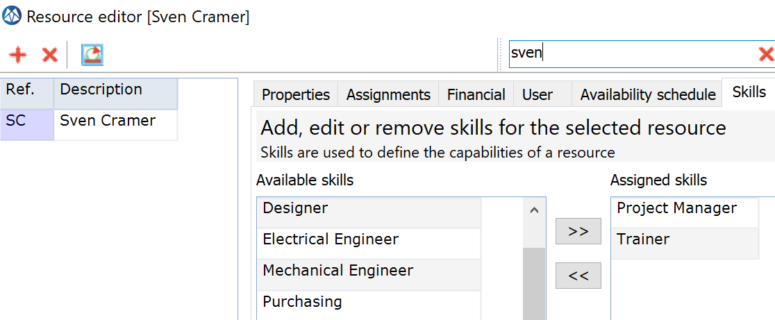
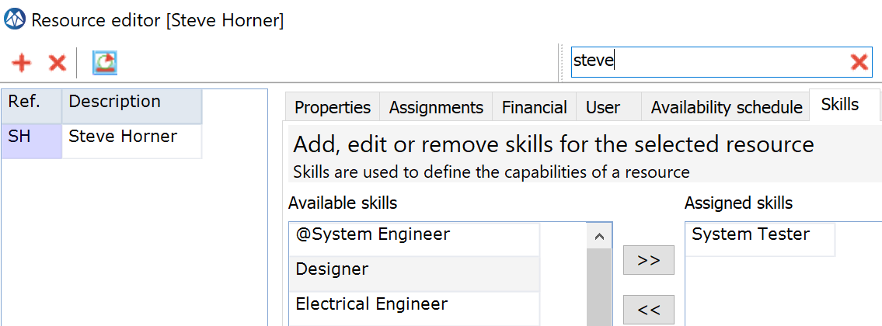
Examples

Slide 59
The Principle of (dynamic) „Late Binding“ and Capacity Flexibility Timing Skill Specification and Resource Confirmations
Project Planning Phase
Project Release Phase
Execution Phase
Skill Specifications
Resource Confirmations (names)
Confirmations preferably as late as possible
(when Tasks are Ready to Start !)

Slide 60
Create your First Project
Project Properties

Slide 61
Add your first Project
Project portfolio:
Choose “Add”
Project Properties:
General: add general information
Project dates: enter initial dates as expected or known
Scheduling: review scheduling settings

Slide 62
Create your first project
ID
Description
Optional:
Start date
End date

Slide 63
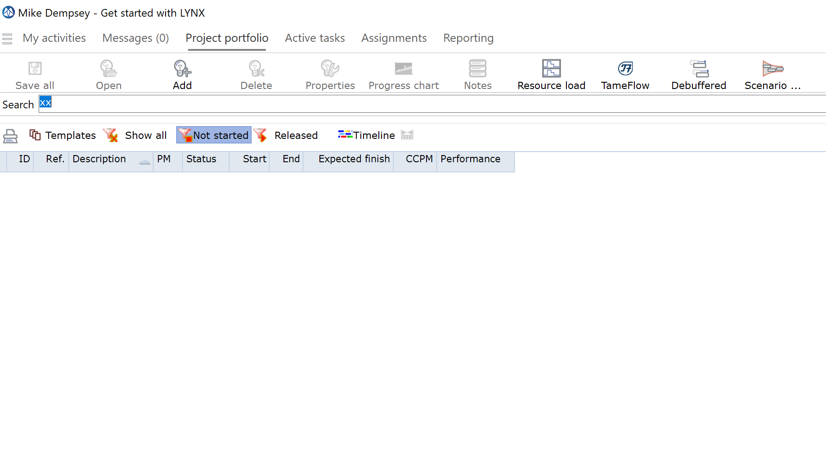
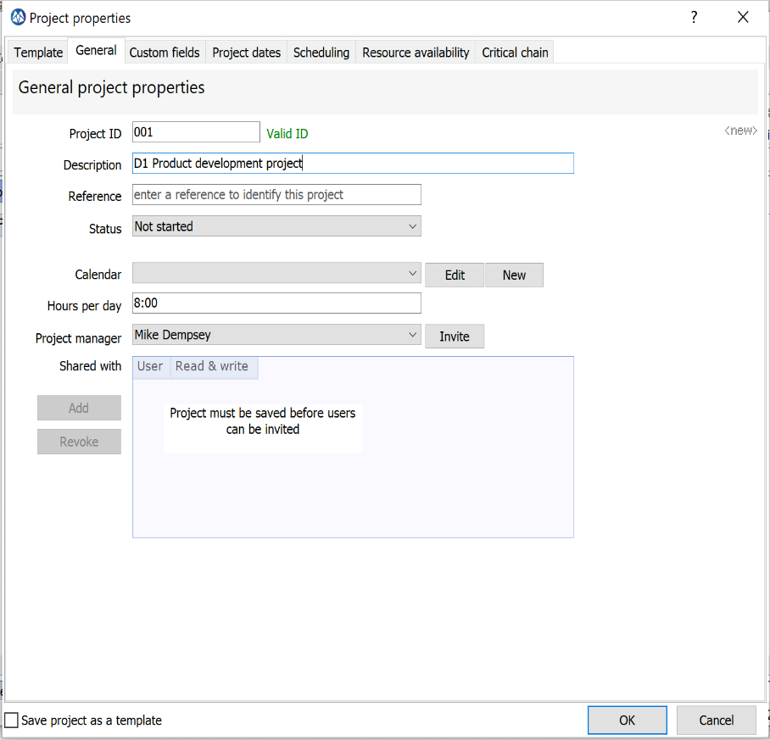
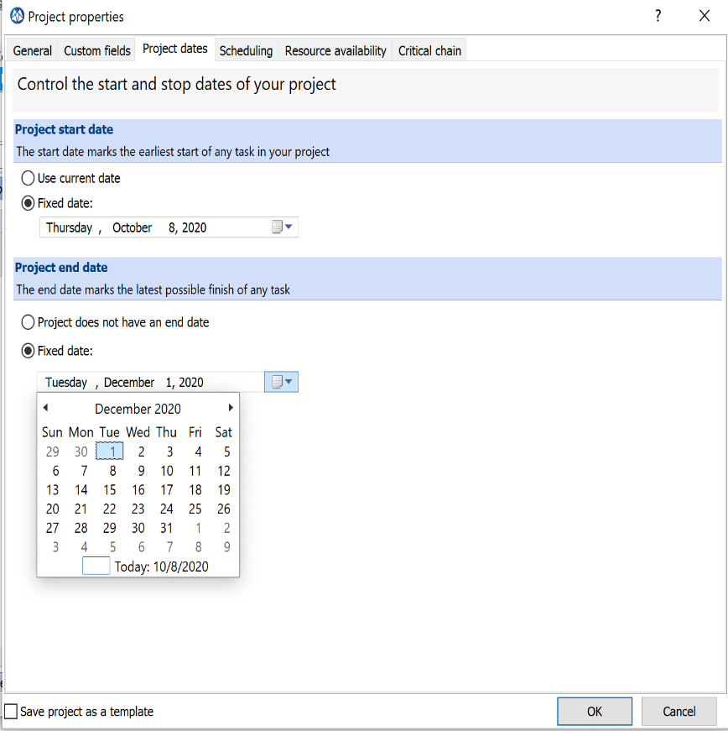
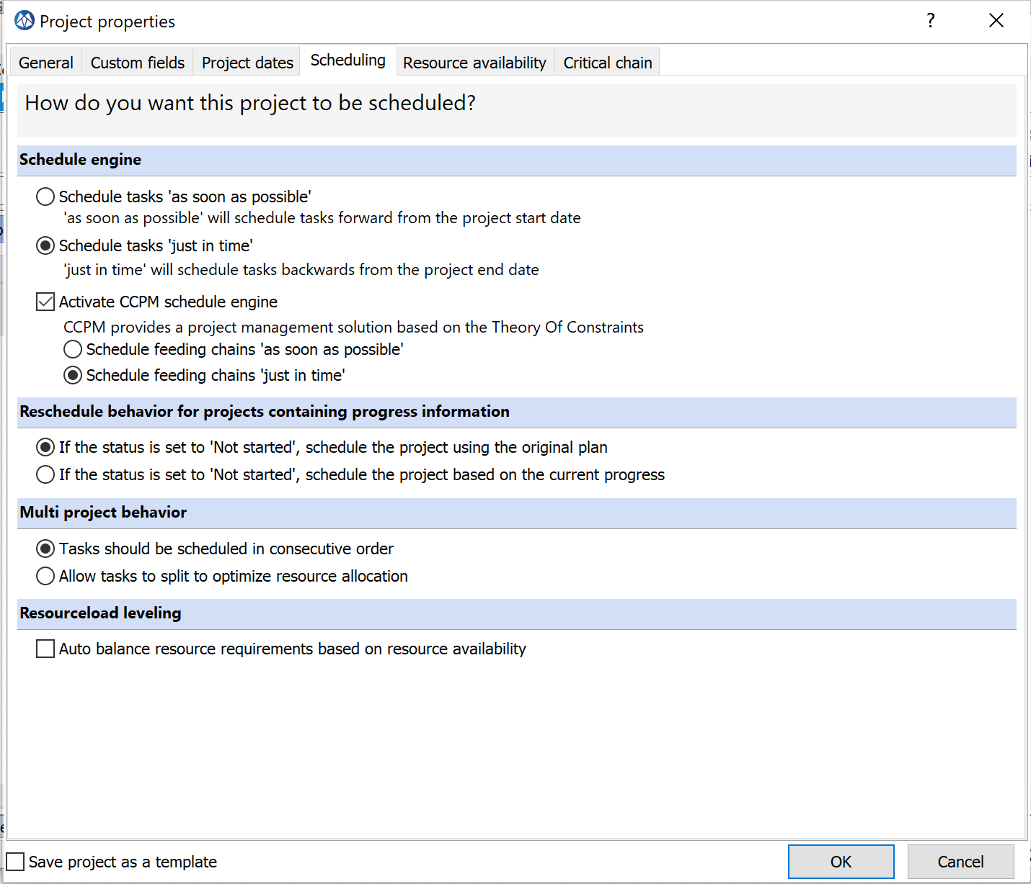
Add your first project
Select Project Portfolio in the Desktop Window (F5)
Select Add
1
2
3
Add a Project ID and Project name (description)
Ensure the “Critical Chain Engine” is selected.
Select your preferences. In CCPM Just in Time is considered as “Best Practice.”
Add an initial desired or requested end-date (due date)

Slide 64
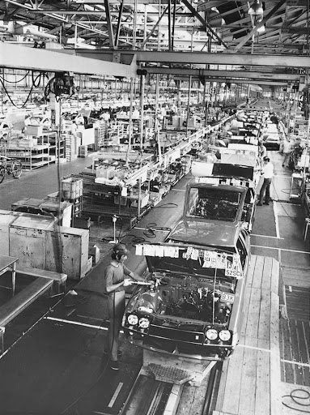
Why “Just in time” is a good idea..
Widely spread and adopted in logistics and production:
Less inventory
More flow
Less Work-in-Progress (WIP)
Reliability
…..
JIT for Projects requires:
CCPM Thinking and JIT Scheduling Options:
Critical Chain
Feeding Chain

Slide 65
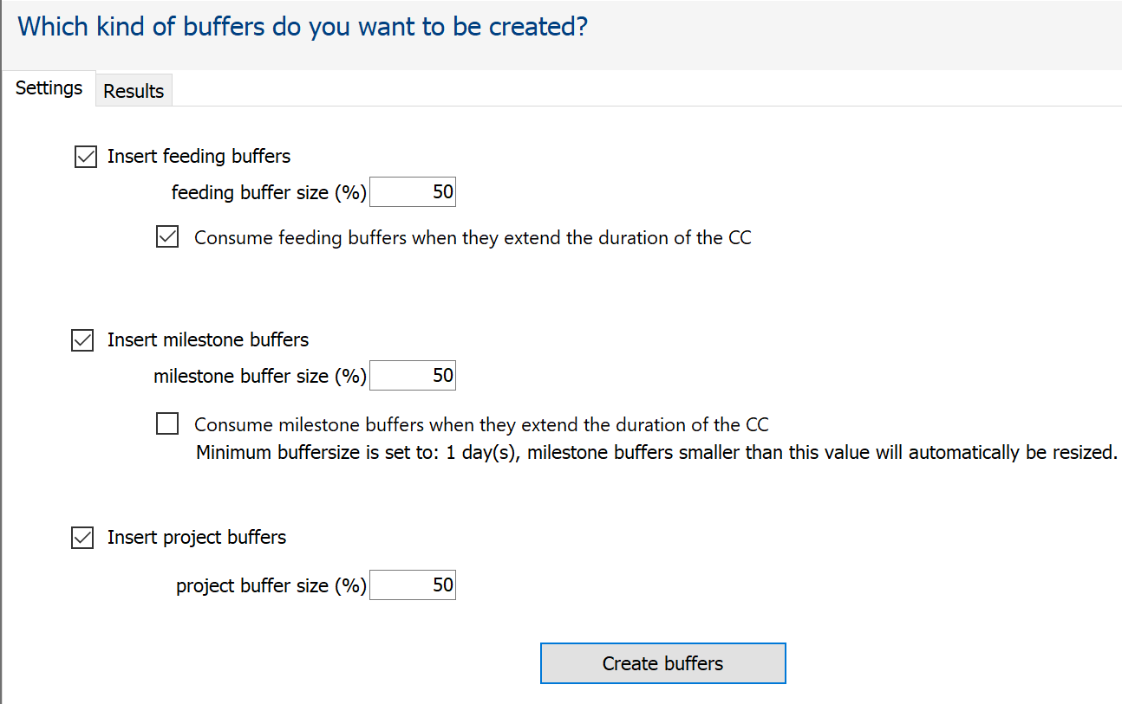
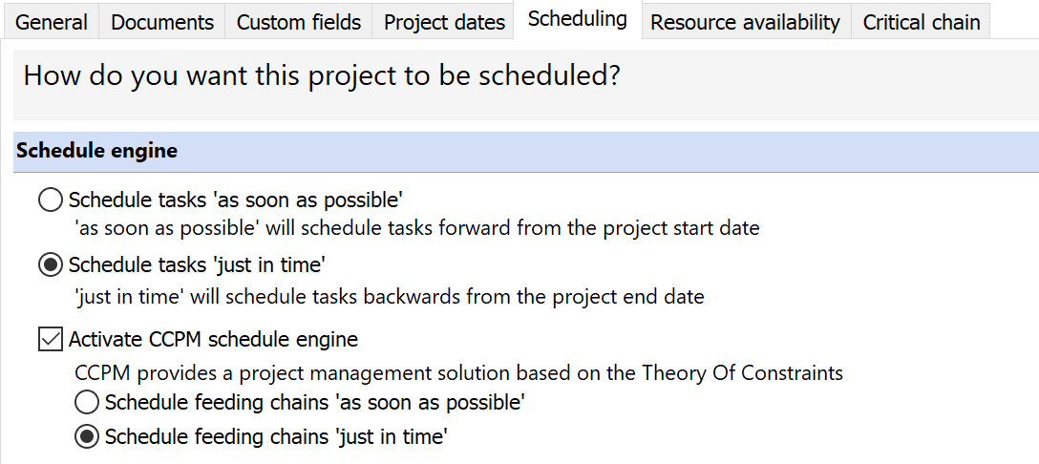
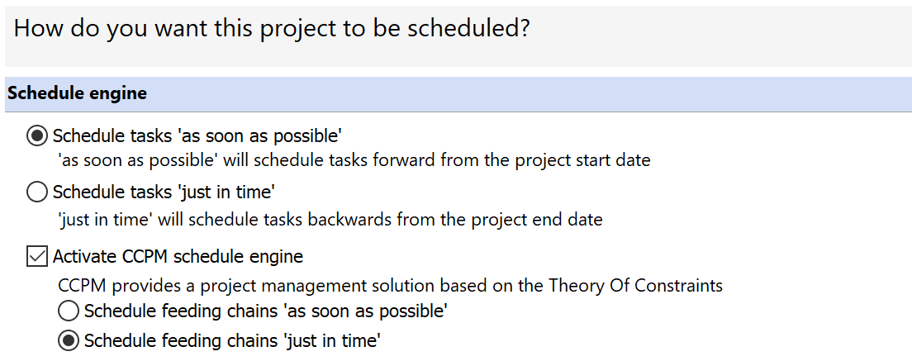
Scheduling Settings Options
2 X JIT
ASAP + JIT
Today
2 X ASAP

Slide 66
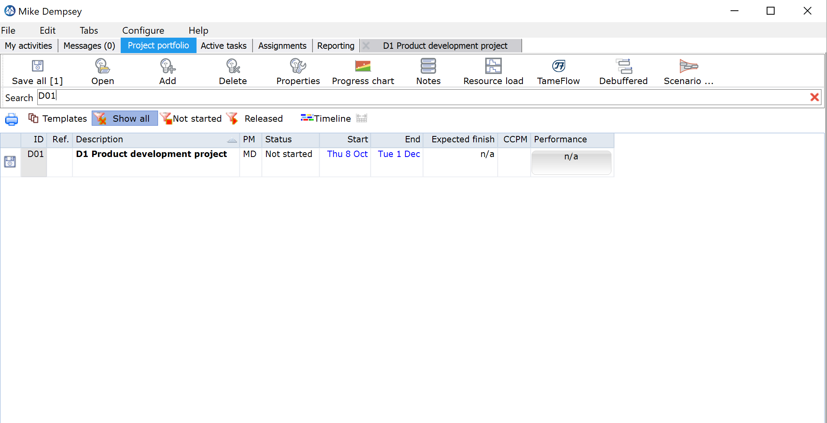
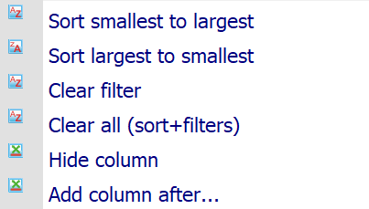
Your first project is listed in the Project Portfolio / Not started
Default filters to apply to list of projects:
Status “ Not Started”
Status “Released”
Show all
Show Templates
Filter applied to list of projects
TIP: Try right mouse-click on column headers for additional sorting and filtering
Double clicking opens the project
Your FIRST project (D1) has been created and is listed in the Project Portfolio, with status “ Not started”
If you want to go back to or recover the default sorting and filtering

Slide 67
Level 1: Project Workflows or Mastertiming Network Logic building a Critical Chain or Shortest Path
START
Concept
Hardware
Software
Integration
Buffer

Slide 68
Create the Project Plan
Add Task(s):
Optional:
Summary Tasks
Level of Effort (LOE) Tasks
Auto-expand
Fixed Duration
Create the Project Network:
Add task dependencies (predecessors / successors)
Add Skills (and *Resources)
Convert the plan into a Critical Chain Plan:
Apply “Shorten Task Duration”?
Select and insert Buffers:
Project Buffer
Feeding Buffer(s)
Milestone Buffer(s)

Slide 69
Multi-Level Planning Level 1: Task and Workpackages Level 2: Cards
START
Normal
Normal
Level 1
Workpackage
Level 2
Normal
Buffer
Worpackage with a bundle of cards
Bundle of Cards

Slide 70
Add Workpackage(s)
Add Workpackage(s):
Select Tasktype: Workpackage
Set “Unit of Measure”
Set initial “Size” per Workpackage
Add Cards:
Userstories
Subtasks
Etc.
Add Skills (and *Resources):
Standard Skill (Normal or Virtual)
Optional:
Team Skill

Slide 71
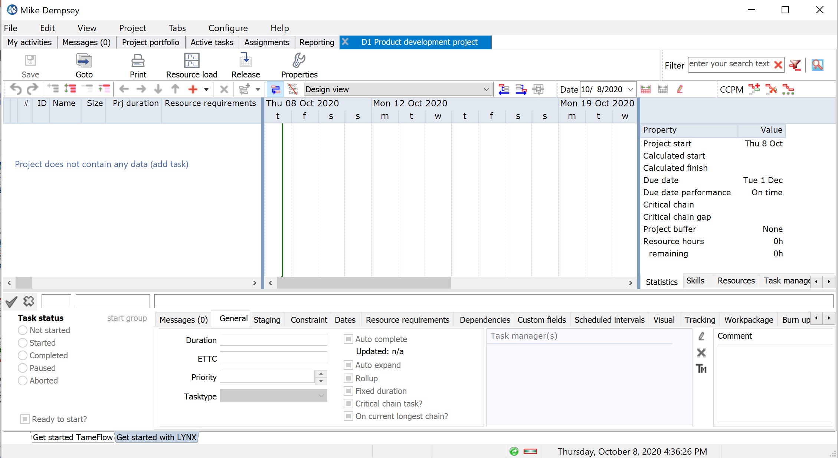
The “Project Window” – Multiple Views and Windows
Auto scale timebar
D01 Product Development Project Window
Undo and Redo buttons
Gantt Chart
Task Grid
Also click in the Gantt area to confirm changes
Multiple tabs
Confirms Task Property updates
Task Properties

Slide 72
Add Tasks

Slide 73
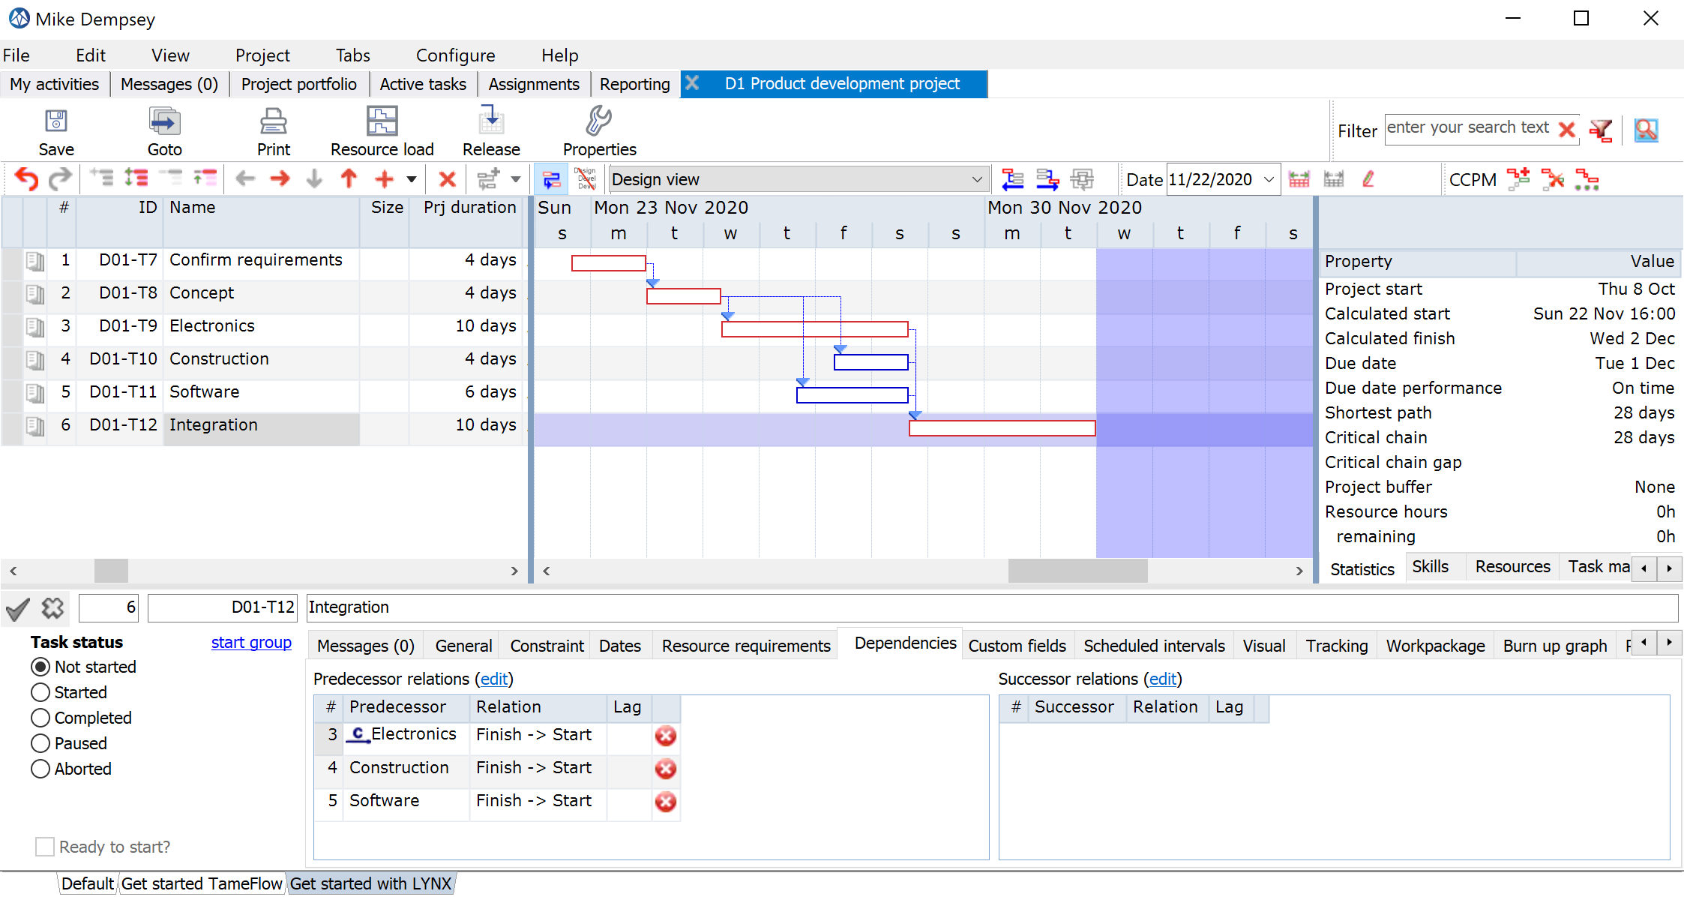
Target Plan
Feeding Chains
Just in Time

Slide 74
Create a plan
There are many ways to Rome, I tell you the most convenient for now:
Options:
Use the target plan example
Use your own project plan
Add at the minimum 5 tasks

Slide 75
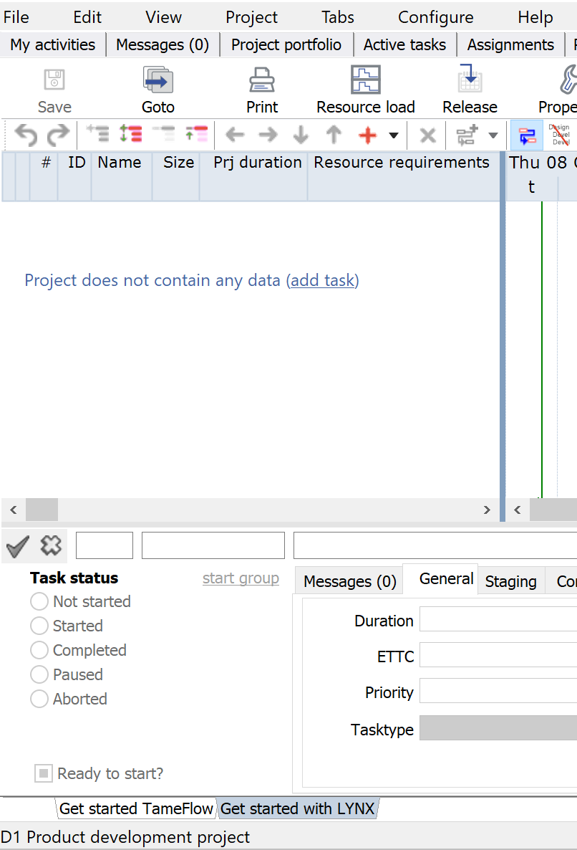
Add Tasks
Green Line = TODAY
Any new task gets a default duration of 1 day after giving the task a name. You can change the expected duration in the duration column.
Start here to create your first task.
Click in the Gantt Chart, to confirm your update! *
* Background of this process is the optimization of the performance and prevents that any (small) change triggers a re-calculation of the complete (large) project plan

Slide 76
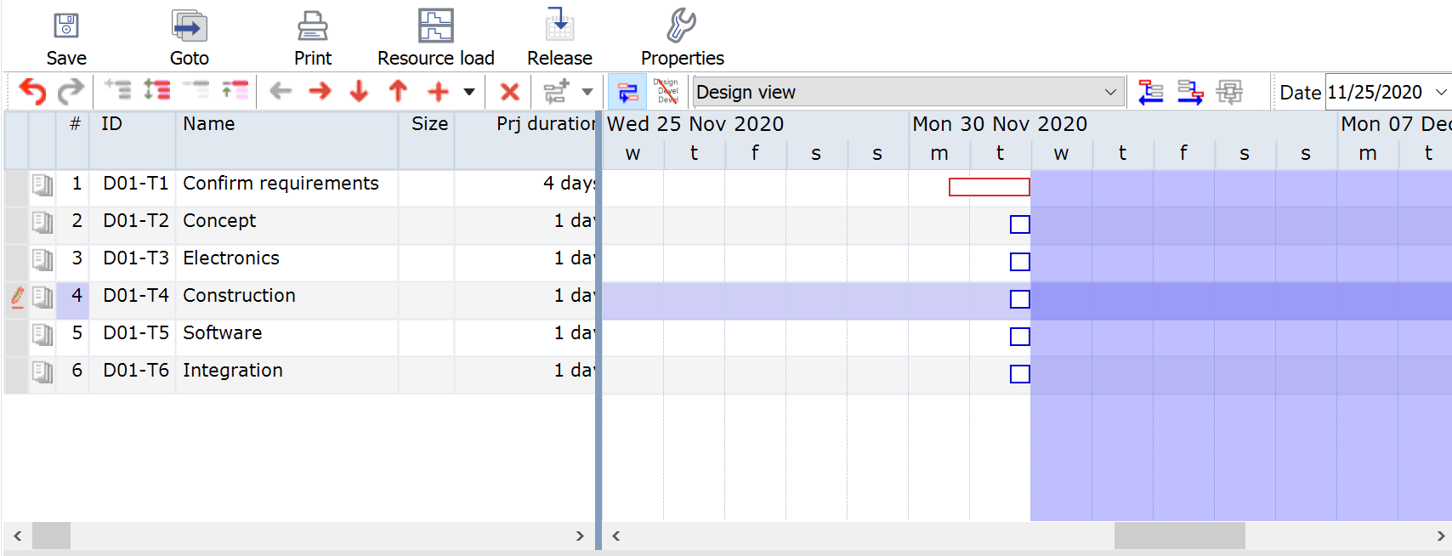
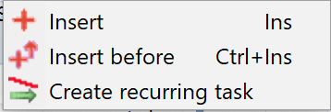
Add more tasks
Add a new task by pressing the +. Via the dropdown you can also add a task before (Ctrl Insert).
Delete a task with X
Tasks 2 – 6 are considered feeding chain tasks, not (yet) part of the “ Critical Chain”.
In this example “Feeding Chains” are positioned “ Just in Time,” offset against the Critical Chain (task 1).
Use the “down arrow” key on you key-board to quickly add new rows
Press “Enter” or Click to confirm your changes

Slide 77
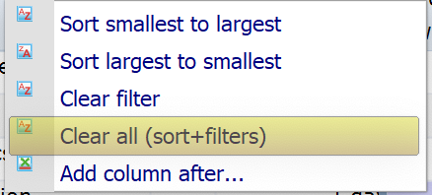
Save
Right click on header of the task list, to remove any unwanted filter or sorting.
Click on Auto scale for an adjusted timebar
Each tasks gets its own ID
Change Task duration here

Slide 78
Create a plan
There are many ways to Rome, I tell you the most convenient for now:
Options:
Use the target plan example
Use your own project plan
Add at the minimum 5 tasks
Add also:
Dependencies
Skills (*Resources)

Slide 79
Add Dependencies
(and remove)

Slide 80
Add Dependencies between tasks
Button for adding dependencies between tasks. The default is a Finish-Start dependency (just click on button, without opening drop-down)
Use the drop-down to see all options.
In CCPM typically only Finish Start is used.
Between task 1 and 2 there is a Finish-Start relation.
See also the CTRL Fast-Keys!
Task 1 and 2 are selected for adding a dependency (use SHIFT or CTRL to select two or more tasks)

Slide 81
You can also select Tasks with your mouse in the Gantt Chart to add a dependency
Dependency will go from the task selected first to the next selected task(s)

Slide 82
Add dependencies via the Edit Boxes Predecessor box and Successor box
The edit boxes are very useful especially in case of projects with many tasks.
Use this filter

Slide 83
Deleting dependencies Via Task properties → Tab “Dependencies”
Delete Successor relationship between task # 3 and task #6.

Slide 84
Add/update dependencies Select view → Data entry view

Slide 85
Review result and statistics
Use the Auto scale timebar (F4), to scale your plan to fit in the Gantt window.
Current length of the Critical Chain is 28 days
Task properties/Dependencies for task #6
Project statistics are displayed here.

Slide 86
Select “Critical Chain View”
Only tasks on the Critical Chain are displayed

Slide 87
Add Skills & Resources

Slide 88
Add skills (and resources)
2.
Drag & Drop Skills to the selected tasks (1 or more)
A System Engineer will be added to the selected task(s)
1.
Select the Skill/Resource/Task Manager Window

Slide 89
Adding Skills via the Resource requirements column

Slide 90
Review the resource load for your project
Resource Requirements for Task 2 are red shaded in the load graph

Slide 91
Modify Task Estimated Time and Units % (optional)
You can modify the estimated time and unit percentage

Slide 92
Review the resource load for your project (scenario Virtual Skills) Skills are “Virtual skills”
In case of “Virtual Skills” LYNX does not make a pre-selection and soft-allocates a resource name. Please refer to SLIDE 19

Slide 93
Add Task Managers
Prepare for Execution (Doing the work)

Slide 94
Invite multiple Task Managers involved to the TM List In a CCPM implementation typically a Task Manager is responsible for (daily) task updates
You can invite an existing user or invite a new user as a TM
Add a TM to the TM List for the project
Invite a TM for task #1, only!

Slide 95
Add a Task Manager to task(s) Via the Task Manager column or via “Drag & Drop”
Add yourself as Task Manager to the first task
Mike Dempsey (current user) is added to task #1

Slide 96
Apply CCPM Behavior
Add buffers

Slide 97
Apply Critical Chain Behavior in 3 Steps
You can keep or change the default percentages and confirm
2
3
1
Decide about Task Time Reduction
Length of the Critical Chain has been shortened with 50 %

Slide 98
Start a project from a template

Slide 99
Start a project from a template Where to find available templates?

Slide 100
Start a project from a template
1
2
3
Select Copy Project after filling in the Project ID & description

Slide 101
Start a new project from a template
You can find your new project under “Not Started”

Slide 102
Special Items
Summary Tasks
Milestone Buffers

Slide 103
Special Items
Summary Tasks
Projects with multiple end-points:
Milestone Buffer(s)
Project Buffer

Slide 104
Release your project
Create active tasks

Slide 105
Release your project and its tasks
Select Project Properties
2
The release of the project has resulted in an update and extension of the statistics
1
3
After Release LYNX has created two buffer controls (project buffer column and feeding buffer column)

Slide 106
Select My activities in the Desktop Window Update Ettc for your first task
1
2
Opens the project plan
3
The Task Manager can:
Assign and confirm resources for a task
Start a task by changing the status
Enter the Estimated Time to Complete (e.g. on a daily basis)

Slide 107
A few tips and tricks

Slide 108
Search and Replace (CTRL F)

Slide 109
Mark Favorites

Slide 110
A few tips and tricks
FIND MORE TIPS AND TRICKS: https://support.a-dato.com/hc/en-us
Use right mouse click to filter / hide columns
Go to a “date line” and zoom in/out by moving the date line
Copy a selection of tasks with CTRL C (Copy) and CTRL V (Paste)
Click in the Gantt Chart and then Use CTRL + Scroll to Zoom

Slide 111
Continued
Right click on header of the project list, to remove any unwanted filter or sorting.
Right Click on a project row
All windows can be individually moved. You can use 2 screens side by side.

Slide 112
Resolve Warning Messages Plan cannot be calculated due to planning logic violations
In this example there is only 1 designer available. The planner has assigned 2 !
LYNX may not be able to recalculate the project due to a message.
The messages can be viewed in the “Messages” tab

Slide 113
Start adding “Notes”
2
Click the + icon to create a note
1
Click on this icon to add a note
3
Select the type of note you want to create

Slide 114
Special Items
Buffer Recovery
Level of Effort Tasks
One Click “Click-through” from a task in the task-list, directly into the project
Down-stream / Upstream chain views based on any selected task in the schedule
Ability to share de-buffered plans with external parties or customers
Possibility to exclude tasks from task time reduction
Cross-skill Resource Management
Split Critical Chain tasks in case of multiple resource with different workload
Auto Complete Option
intended for tasks with long and or fixed lead times only (such as shipping or purchasing tasks)
Display of “Last Progress Update”
for tasks that are started, which provides fast feedback when the last ETTC update has taken place

