Slide 1
Get started with LYNX
LYNX Task Management Training

Slide 2
LYNX is used for multi-project management.. Objectives and Challenges
Teams
&
Resources
Optimal Conditions for innovation
Deliver quality
Be able to focus and getting work done
Must be Reliable and Fast
Manage Scope, Time and Budget
Needs to know if the project is on “track”
Satisfy the stakeholders
Project
Multi-Project and Portfolio
Portfolio with many projects
High Due-Date performance
Deliver more projects
1. In Time 2. Within budget 3. Deliver Scope 4. Right Quality 5. Across Projects

Slide 3
Making Collaboration and Decision Making Easier Working together at the same time in the same project(s)
Real Time Data
Projects, tasks, sub-tasks, cards
Resource manager
Team manager
Task manager
Skill/ Resource
Project manager
Portfolio manager
Team member
“Timing is everything”
There is only 1 moment you can be on time!
If you are not there you are either too early or too late.
Johan Cruijff
External partner
Transparency

Slide 4
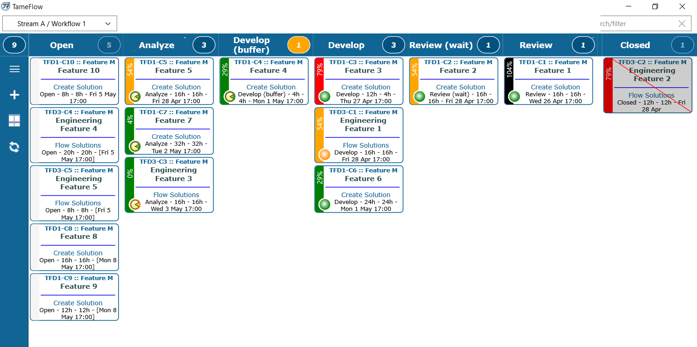
Scope
Task manager
Team member
Project manager
Skill/ Resource
Plan the Work
Work the Plan
Communicate
Introduction
What is
LYNX about?
Project
Tasks
Workpackages
Cards
Task Management
Cards Management
Kanban Board
Progress
Reports
Export

Slide 5
LYNX Role Based Training
LYNX for Project Managers
LYNX for Portfolio Managers (multi-project)
Master Schedulers
Release Managers
LYNX for Resource Managers
LYNX Task Management
LYNX Task Managers
LYNX Resource Users
LYNX Team Managers
LYNX Resource Managers
LYNX TameFlow
For teams
For you
My activities Roles

Slide 6
Task Management Training - Topics
LYNX Overview
Philosophy behind LYNX
Login Stuff
A project example
Task Management:
My Activity View
Before starting a task
Starting a task
Progress reporting (Ettc)
Communication (Notes)
Add (delegate) Task Managers
Impersonation(“Vertreterregelung”)
Resource management tools
Resource Load Diagram
My Resources
Debuffered View
Reporting

Slide 7
Imagine you are Robin Porter… My activities

Slide 8
LYNX Project and Portfolio Management Critical Chain Project Management
All rights reserved - Confidential
Integration of Agile and Kanban Workflows – Agile CCPM
Notes:
Als we het hebben over projecten dan zien wij dat bedrijven en projectorganisaties zich op zich voorbereiden voor de realisatie van een project. Scope wordt beschreven, rollen en verantwoordelijkheden, risico analyse, governance structuur, etc. Dus je kan zeggen dat organisaties goed voorbereid voor de praktijk / avontuur ingaan. Zo volwassen is men geworden.
Het punt is het blijft een avontuur. Dus alle risico’s die van te voren benoemd waren komen voor. En ook Murphy komt om de hoek kijken. En daar sta je dan. Onze boodschap is: als je dan het avontuur ingaat zorg dat je de juiste instrumenten bij je hebt. Een kompas en GPS, zodat je tijdens je avontuur de juiste beslissing kan nemen en controle over je bestemming kan houden.

Slide 9
Making Collaboration and Decision Making Easier Working together at the same time in the same project(s)
Real Time Data
Projects, tasks, sub-tasks, cards
Resource manager
Team manager
Task manager
Skill/ Resource
Project manager
Portfolio manager
Team member
“Timing is everything”
There is only 1 moment you can be on time!
If you are not there you are either too early or too late.
Johan Cruijff
External partner
Transparency

Slide 10
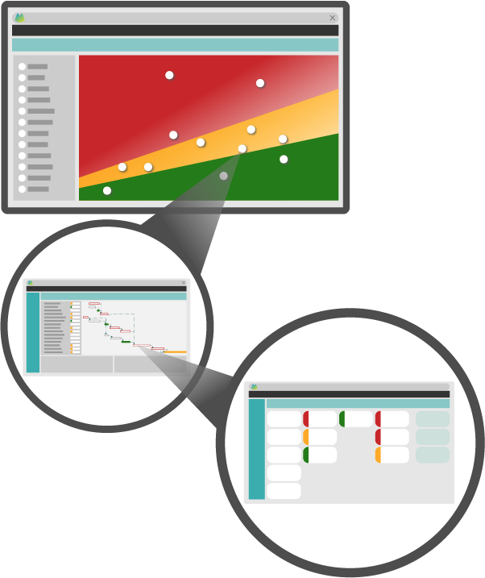
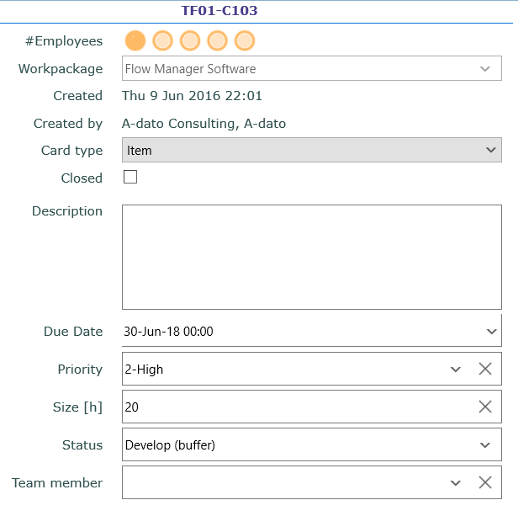
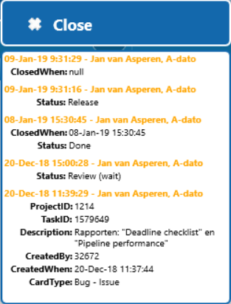
LYNX brings everything together…
Resource manager
Portfolio manager
Multi-Skill Resource Management
Skills, profiles, resources, teams, team members
Portfolio / Multi Project
Scenario Planning & Simulation
Project manager
Task manager
Projects with stages, phases, tasks, workpackages
with cards
Card
Resource
Team manager
Taskboards with Cards e.g. subtasks, user-stories
Team member

Slide 11
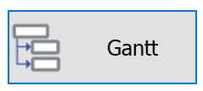
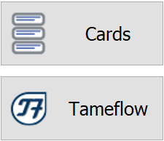
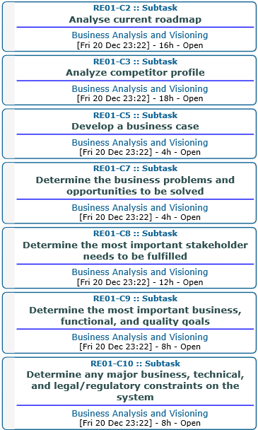
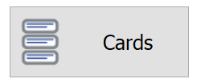
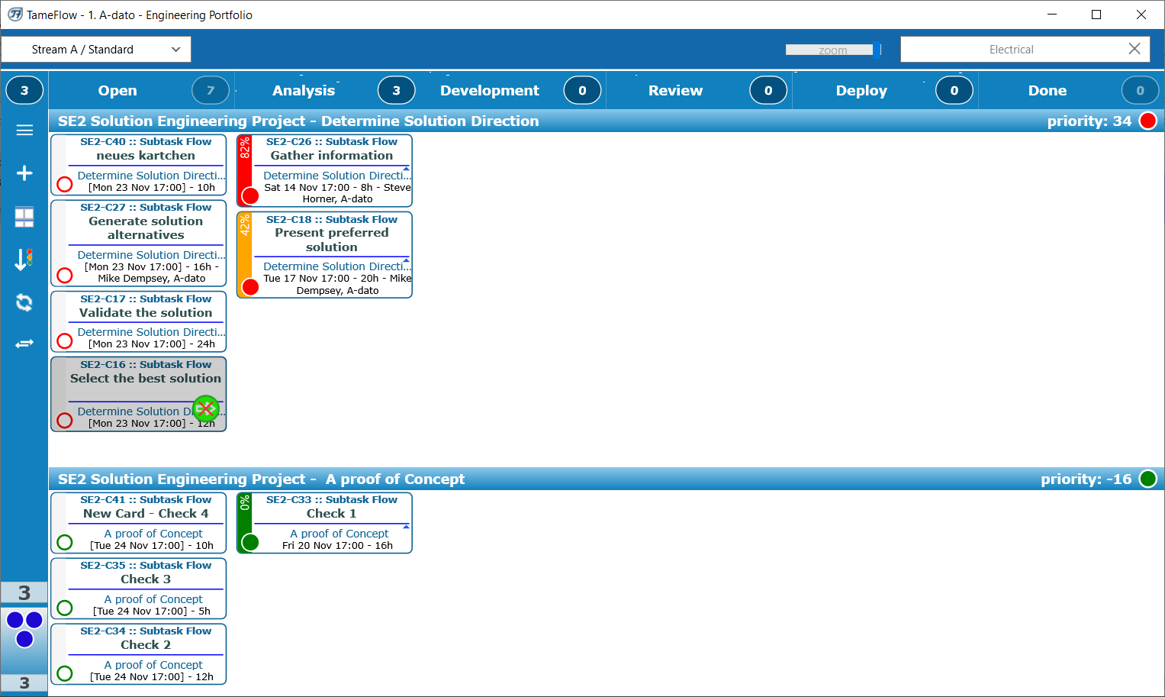
And also integrates the Agile/Kanban way of working into projects… Multi-Level Planning
Project manager
Level 1
Task manager
Level 2
Level 2
Team member
The TameFlow Approach
Resource User
Through LYNX TameFlow, Agile and Kanban workflows are integrated, bringing Agile CCPM to life.

Slide 12
LYNX TameFlow Task Board with Flow Buffer Management

Slide 13
LYNX offers a different approach.. The 5 Foundation Pillars of LYNX
Dynamic Critical Chain Scheduling
Buffer Management
Manage Queues with Priorities
Late Binding
Manage Flow and Work-in-Progress
(WIP)

Slide 14
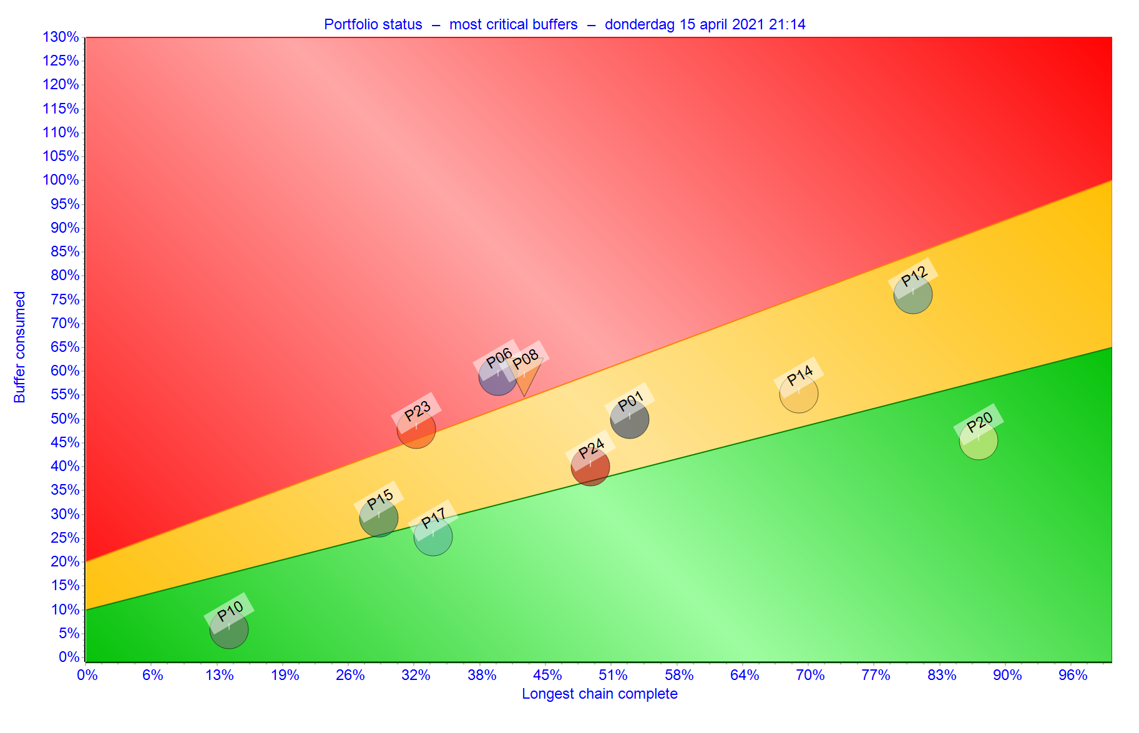
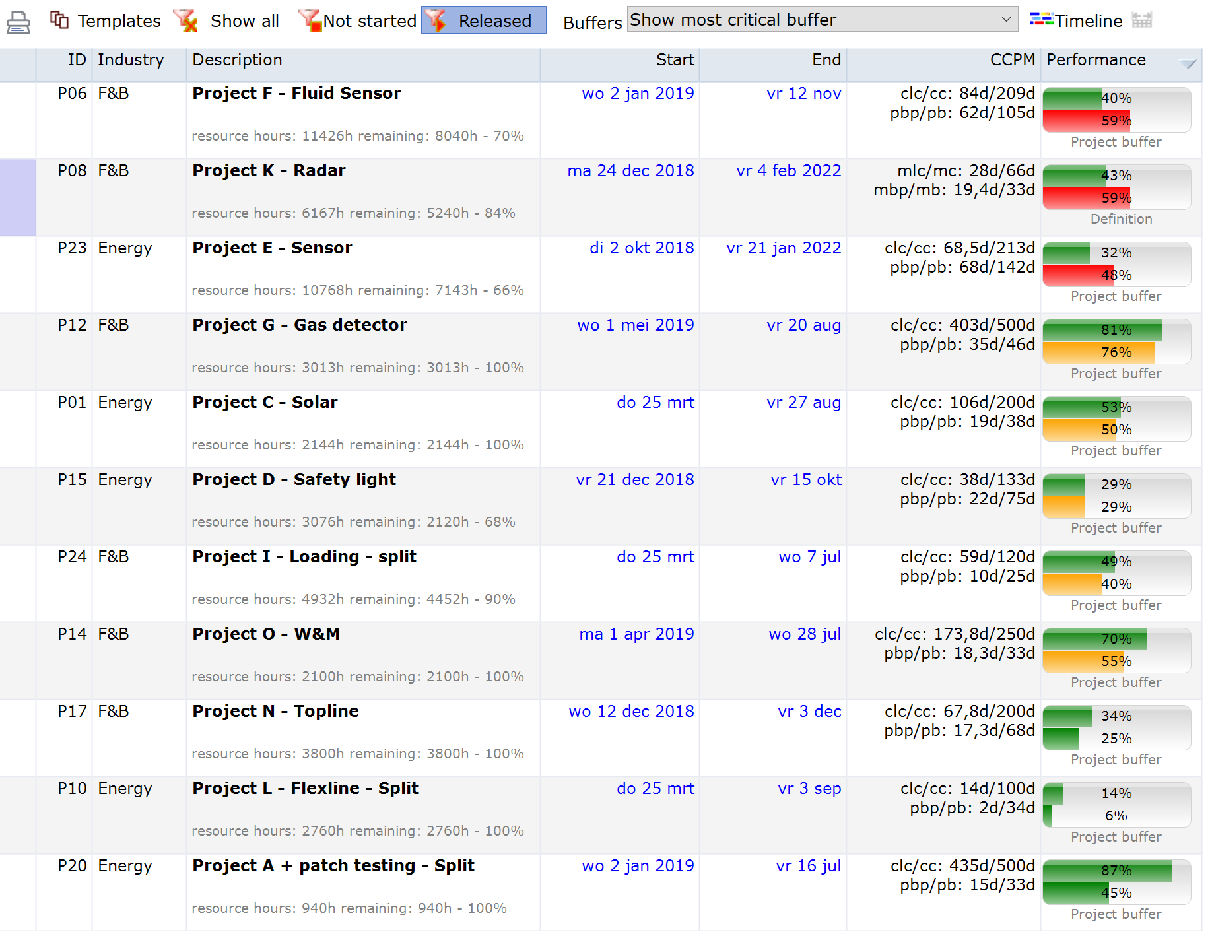
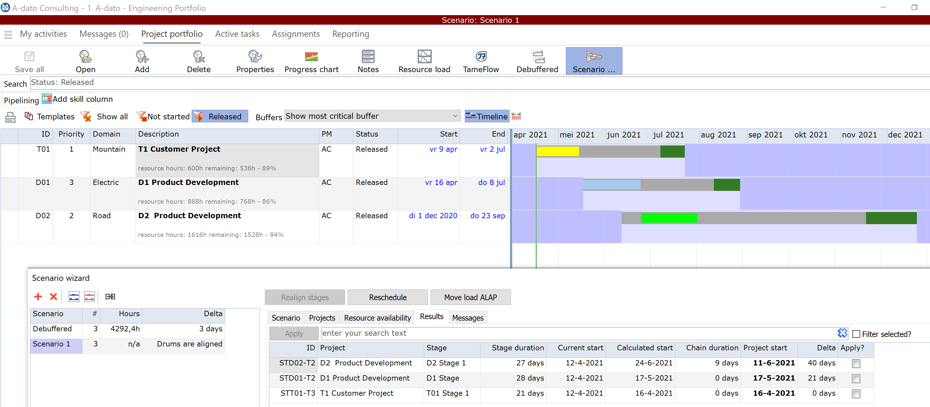
Including heatmaps and simulation.. Managing Work-in-Progress
LYNX Scenario Wizard
LYNX Release Wizard
LYNX Debuffered Mode
Portfolio manager
Notes:
In this example the staggering is done at Skill level. It concerns a portfolio with 11 active projects. All project are equally important to the company, and have been assigned a so-called business priority of 10 (we will use the business priorities later in this presentation)
In the background the resource load diagram shows that an overallocation exist on the skill System Engineer.
In diesem Beispiel erfolgt die Staffelung auf Skill-Ebene. Es handelt sich um ein Portfolio mit 11 aktiven Projekten.
Alle Projekte sind für das Unternehmen gleich wichtig und haben eine sogenannte Geschäftspriorität von 10 erhalten (wir werden die Geschäftsprioritäten später in dieser Präsentation verwenden).
Im Hintergrund zeigt das Ressourcendiagramm, dass es auf dem Skill System Engineer ein Überlast gibt.

Slide 15
Giving you the potential to improve…..
Today
Tomorrow
Improvement Potential...
Overload
Multi-tasking
Task Interruptions
Cherry picking
Early starts
De-synchronisation
Batching
Parkinson’s law
Student syndrome
Local safeties
Kopfmonopole
Global priorities
WIP Control
Roadrunner
Single tasking
Single-touching
Global buffers
Late binding
Full-kit
Single-piece flow
Late binding
More Flow, better timing
Less pressure and stress
Easier collaboration
More reliable projects
More transparency
Win (back) capacity
Finish projects faster
…..
A different approach
Symptoms
New Reality

Slide 16
Summary Customer Overview
16
Fields of application
Design and Engineering
Building and Construction
Service and Maintenance
Organisation
Global footprint
Currently over 100 customers, across all continents
From small to very large implementations (with over 400 users and hundreds of projects)

Slide 17
Philosophy (behind Lynx)
Projects consist of people!
Thus, when managing projects, it is about people
(and processes).

Slide 18
Task Durations (within Projects)
Task
Work
Typical task Execution Pattern
Wait
Work
Work
Work
Work
Typical
“Flow Ratio”
Work
100 %
10 - 20 %
Wait
Work
Notes:
Vaak niet boeven 20 % - EERDER ROND DE 5
Zin is krom. → om echtt te verbeteren kan je veel nbeter richten op verminderen van de wachttijden

Slide 19
Where to start improving? “Low” hanging fruit
Wait
Work
Most jobs are not slow, but typically just have to wait a lot.
Notes:
Overlay met euro tekens, waar zet je geld op in? → groen kost heel veel.

Slide 20
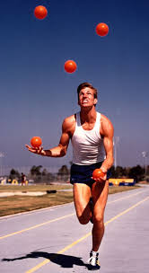
Today: What makes people (and organisations) unhappy?
Undesired
Impact
Overload
Multi-tasking
Task Interruptions
Too early starts
Cherry picking
De-synchronisation
Batching
Local safeties / Padding
Spreading resources thin
Parkinson’s law
Student syndrome
“Kopfmonopole”
Too many things going on = mental pressure
Delays and waiting time
Many unfinished tasks, more Work-in-Progress
Task Interruptions
Favorite tasks first
Working on non-critical work first
Efficient but not effective
Every person adds private buffer – long leadtimes
Low Flow Ratio
Budget time → Actual time
Last minute rushing, forget stuff
A guaranteed “bottleneck”

Slide 21
Tomorrow: What makes people (and organisations) happy?
Desired
Impact
WIP Control
Single tasking
Single-touching
Full-kit
Objective priorities
Synchronisation
Single-piece flow
Global buffers
Aggregation
Relay race
Vertical Integration
Late binding
“Constraint” thinking → Work on less than X things at the time
Inverse of multi-tasking
Less interruptions = higher flow %
Everything is prepared to finish in one go (mise en place)
Prevents loud-mouth-management
The show CAN go on
Effective instead of efficient
Team focus on project “constraint”
Good enough estimates will do
No handover delays
Impact workfloor directly visible on strategic level
Flexibility and high flow ratio

Slide 22
How to get there?
Undesired
Desired
Overload
Multi-tasking
Task Interruptions
Too early starts
Cherry picking
De-synchronisation
Batching
Local safeties
Padding
Parkinson’s law
Student syndrome
Kopfmonopole
WIP Control
Single tasking
Single-touching
Full-kit
Objective priorities
Synchronisation
Single-piece flow
Global buffers
Aggregation
Roadrunner
Vertical Integration
Late binding
Different way of planning
Different way of working

Slide 23
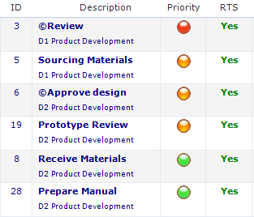
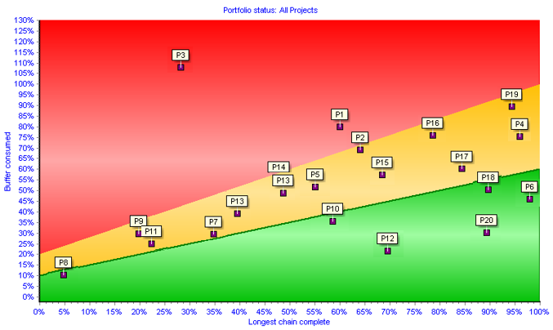
A different approach… Critical Chain (Multi-)Project Management: Key Ingredients
Buffer Management
+ Critical Chain
Execute by Single Priority
Manage across projects
(Control the WIP)
Buffer
50%
Traffic light = 1 Operational Priority for everybody (across projects)
Heatmap or Feverchart

Slide 24
CCPM: Theory of Constraints What do we mean with a “Critical Chain”?
The capacity of the “bottleneck” determines the maximum output that can be achieved
The “critical path” (longest path) is the “bottleneck” in a project because it determines the total duration of the project………
8
2
15
A
B
D
A
C
5
5
1
Or isn’t it……?

Slide 25
CCPM: Critical Resources
Question:
Who are the critical resources or critical departments within your company?
What is impact of their availability on your project or other projects?

Slide 26
CCPM: Critical Resources → impact on your project.. Ability to identify “Invisible dependencies”
Task B is not Critical !
8
2
8
2
15
A
B
A
B
19
D
D
A
C
A
C
5
5
5
1
5
1
Critical Path = 14
Critical Chain = 19

Slide 27
How to improve? The 5 Foundation Pillars of LYNX
Dynamic Critical Chain Scheduling
Buffer Management
Manage Queues with Priorities
Late Binding
Manage Flow and Work-in-Progress
(WIP)

Slide 28
Introduction of Buffer Management
What can you do with Red, Orange and Green?
Any task needs some contingency or safety embedded to cope with:
Complexity
Uncertainty and variation
Murphy
However…

Slide 29
A Standard Plan
Psychological effects of the standard plan:
Safe estimates (or overambitions)
Student Syndrome
Parkinson's law
Padding
Achievable
Contingency
Time
10
20
30
40
50
60
CRITICAL CHAIN / PATH = 60
Notes:
Laat zien hoe buffer naar achteren wordt geplaatst en ingekort. Om dit te bewaken heb je een goede projectmanagement tool nodig, want: hoe weet je of en hoeveel je al van die centrale projectbuffert hebt gebruikt?

Slide 30
A Buffered Plan (1)
Pooling of Contingency Insurance Model
Achievable
Contingency
Time
10
20
30
40
50
60
2/3
1/3
45
Notes:
Laat zien hoe buffer naar achteren wordt geplaatst en ingekort. Om dit te bewaken heb je een goede projectmanagement tool nodig, want: hoe weet je of en hoeveel je al van die centrale projectbuffert hebt gebruikt?

Slide 31
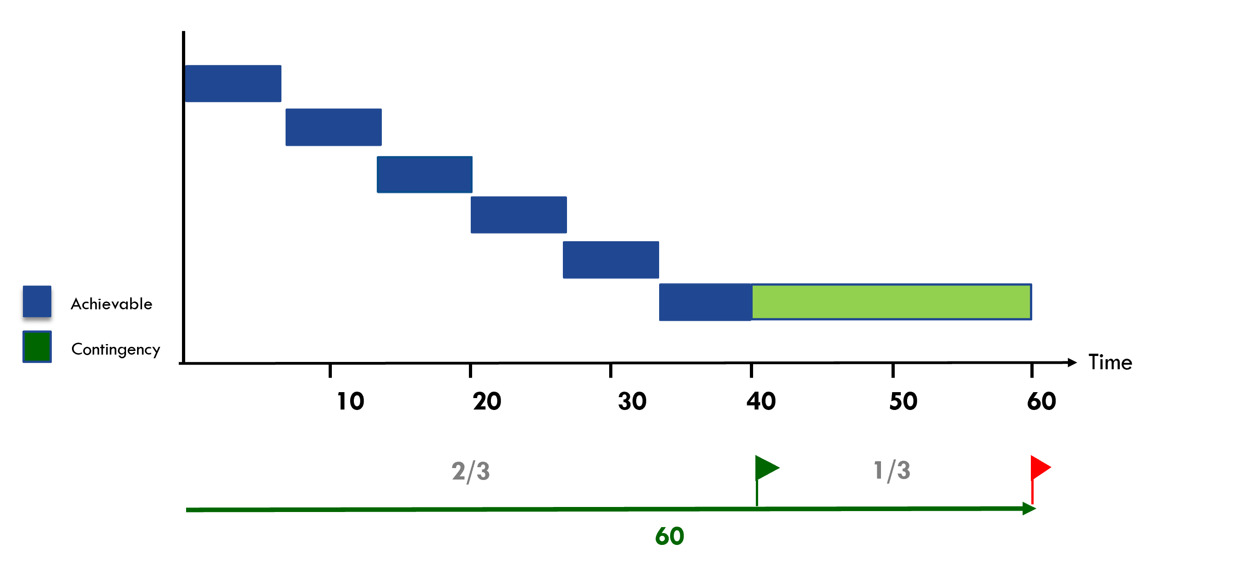
A Buffered Plan (2)
Notes:
Laat zien hoe buffer naar achteren wordt geplaatst en ingekort. Om dit te bewaken heb je een goede projectmanagement tool nodig, want: hoe weet je of en hoeveel je al van die centrale projectbuffert hebt gebruikt?

Slide 32
A Buffered Plan (2)
Achievable
Contingency
Time
10
20
30
40
50
60
2/3
1/3
60
Notes:
Laat zien hoe buffer naar achteren wordt geplaatst en ingekort. Om dit te bewaken heb je een goede projectmanagement tool nodig, want: hoe weet je of en hoeveel je al van die centrale projectbuffert hebt gebruikt?

Slide 33
Green 50 % progress on the longest chain / 15 % buffer used
Today
Project is on track. The risk that the project will be late is very low.
Done
Done
Done
50 % / 15 %
10
20
30
40
50
60
Time
45
“To be safer, (re)move the safety”
Notes:
Laat zien hoe buffer naar achteren wordt geplaatst en ingekort. Om dit te bewaken heb je een goede projectmanagement tool nodig, want: hoe weet je of en hoeveel je al van die centrale projectbuffert hebt gebruikt?

Slide 34
Red 55 % progress on the longest chain / 65 % buffer used
Today
Relatively to much buffer is used. Measure are need to make sure the project can be delivered on time.
Done
Done
Done
Done
55 % / 65 %
10
20
30
40
50
60
Time
45
“To be safer, (re)move the safety”
Notes:
Laat zien hoe buffer naar achteren wordt geplaatst en ingekort. Om dit te bewaken heb je een goede projectmanagement tool nodig, want: hoe weet je of en hoeveel je al van die centrale projectbuffert hebt gebruikt?

Slide 35
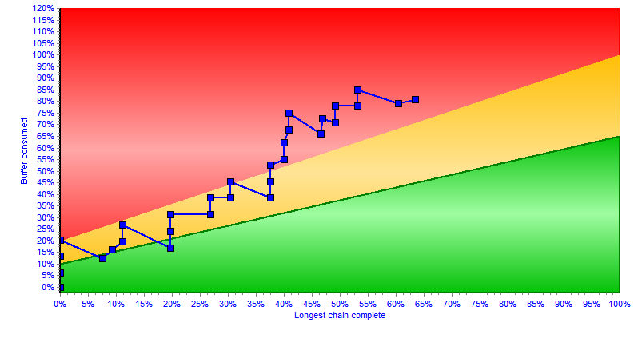
What can you do with Red, Orange and Green? CCPM: Project Trend Line
Fever Chart

Slide 36
What can you do with Red, Orange and Green? Resolve day-to-day resource conflicts (and prevents (bad) multi-tasking)
The perfect original plan for ONE System Engineer called “Mike”
D2
D1
T1
D2
T1
The actual situation Today
D1
D1
T1
How to solve the “resource conflict” for Mike?
D2
Manage the Queue !
Today
Execution sequence of the queue for Mike
T1
D1
D2
Today
„In the Autopilot-Modus, Resource Managers , Task- and Project managers are supported by Operational Priorities for the synchronized execution of their projects”

Slide 37
“To do” List: My activities Sequence from red to green
Notes:
1. Doorlooptijd van elke taak – er gaat meer dan 30 % verloren aan verstoringen, andere zaken
2. Weniger Projekte geleichzeitig
3. Stoppen met Teiltermine, focus op endtermine en een prioriteit
4. Focus op fertig machen

Slide 38
What can you do with Red, Orange and Green? Manage all projects together

Slide 39
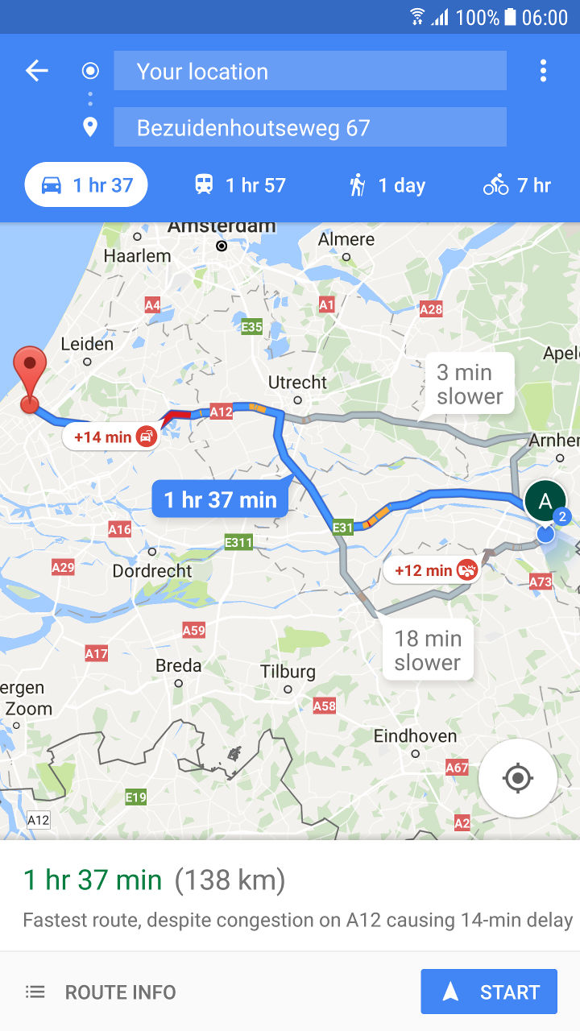
What is needed? Fast-Feedback Loop (ETTC)
Continuous (frequent) update of the “Expected Time to Complete” for each active task (ETTC)
Flawless handovers:
Ensure Delivery is complete
Be Ready-to-Start
Good preparation
Task
Management
Notes:
SHOW
We know now what we should not do but what do we need to do?

Slide 40
How to achieve improvements?
Aggregation and (dynamic) “Late Binding”
“If we bind tasks to resources at long time horizons (early) we are affected by the cumulative variance of all preceding tasks. By committing at a short time-horizon (late), we can avoid this accumulation of variance”.

Slide 41
Achieving more “Flow” and Resource Management Allocate work to team (or skill) first (not individuals)
Aggregation of resource requirements on „Skill(group)“ or „Team“ Level
Resources are “pooled” by „Skill“ or Team
Specification of any “Task Resource Requirement” by “Skill”
Principle of (dynamic) “Late Binding”
Keep your options open as long as possible →Non-Binding *Soft-Assignments”
Prevent “Kopfmonopole”
“If we bind tasks to resources at long time horizons (early) we are affected by the cumulative variance of all preceding tasks. By committing at a short time-horizon (late), we can avoid this accumulation of variance”.

Slide 42
The “Late Binding“ solution within LYNX Specification of “Resource Requirements“
Implementation of the ISA95 Skill / Resource and Aggregation Model
Skills
Resources
Profile Properties
Projects and Tasks
Projects and Tasks
Task Resource Requirements
Task Resource Requirements
Normal
Skill
*Resource(s)
Virtual Skill
# FTE
Resource Names
Properties
Properties

Slide 43
LYNX Resource/Skill and Team Model Multi-Skill and Properties
Team
Resources and skills are separated and have an “N to N” relationship:
A resource can have multiple skills
A skill can be implemented by multiple resources
Special “Properties” identification via (unlimited) properties at skill and resource level
Team assignment: Resources are assigned to a team
Engineering
Design
Programming
....
Skill (Group)
Resources
Name 1
Name 2
Name 3
…
“Properties”
Programming Language
Technology
Expertise (seniority)
......
LYNX “protects” resources with unique competencies or domain know-how!
This model is following the ISA 95 Standard

Slide 44
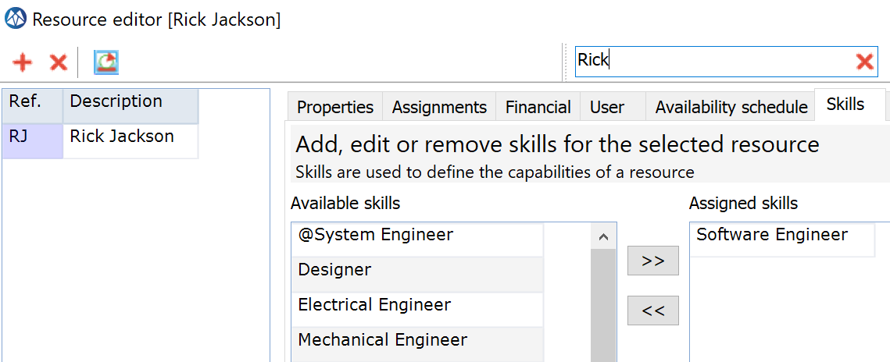
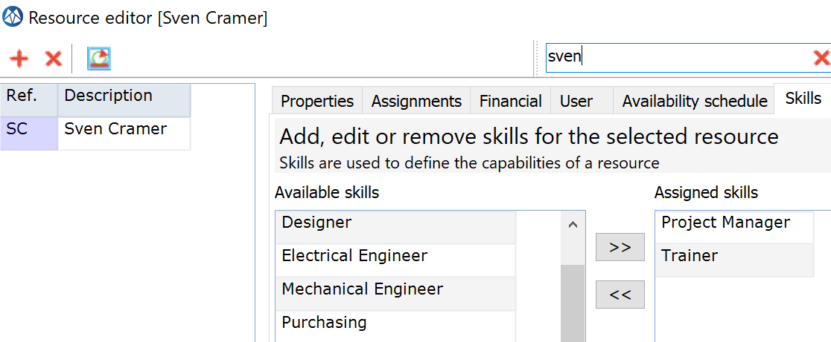
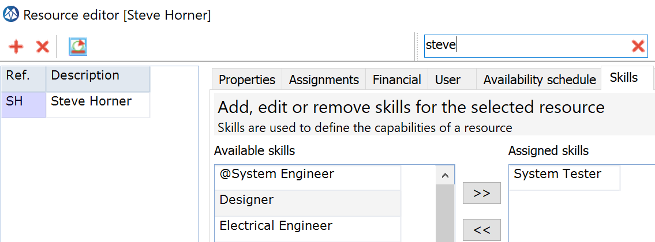
Examples

Slide 45
The Principle of (dynamic) „Late Binding“ and Capacity Flexibility Timing Skill Specification and Resource Assignments
Project Planning Phase
Project Release Phase
Execution Phase
Skill Specifications
“Non-Binding *Soft-Assignments”
Resource Assignments (names)
“Hard assignments”
Hard assignments preferably as late as possible
(when Tasks are Ready to Start !)

Slide 46
Before we start…
Login and Workspaces

Slide 47
Visit the LYNX Help Center
Visit the
LYNX HELP CENTER
https://support.a-dato.com/hc/en-us

Slide 48
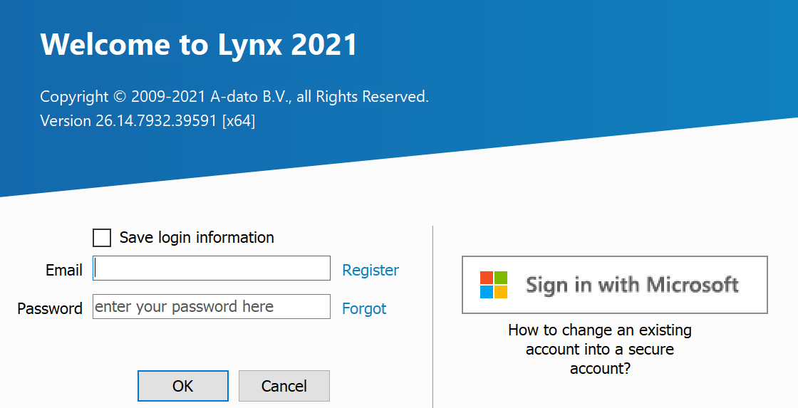
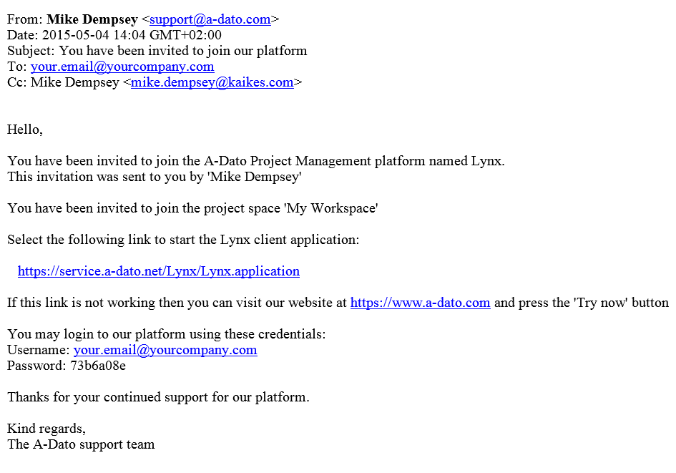
Login with your (new) credentials you received per email
If you already received an invitation to join LYNX from another user (e.g. colleague, admin, workspace owner) your login credentials are provided in the invitation email.
If you are invited as a first-time user, LYNX will provide an initial password, which can be changed in MyProfile

Slide 49
New User Registration
Do not forget to enter your initials.

Slide 50
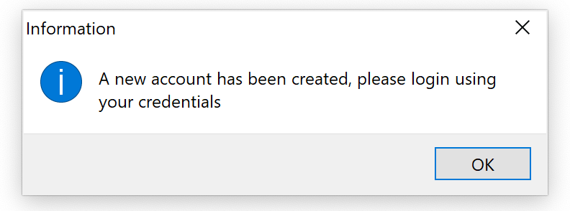
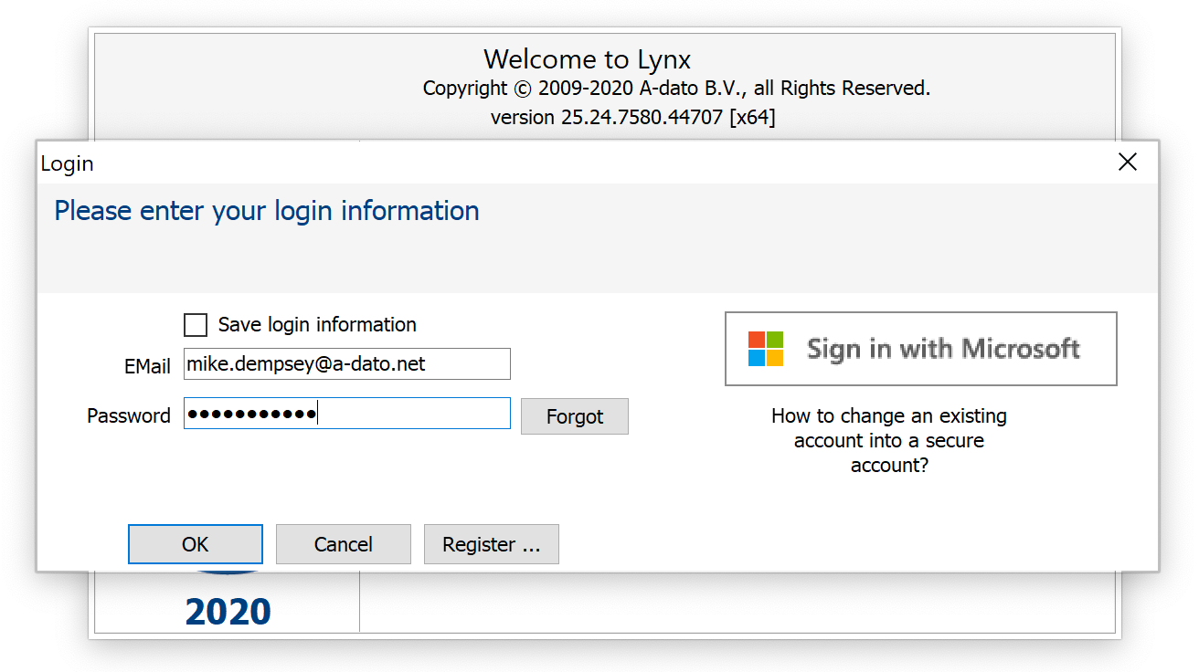
Login after registration with your email and your password

Slide 51
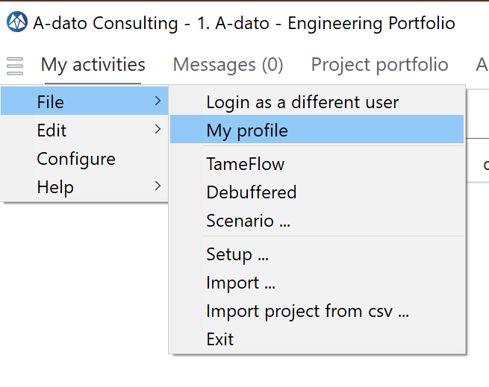
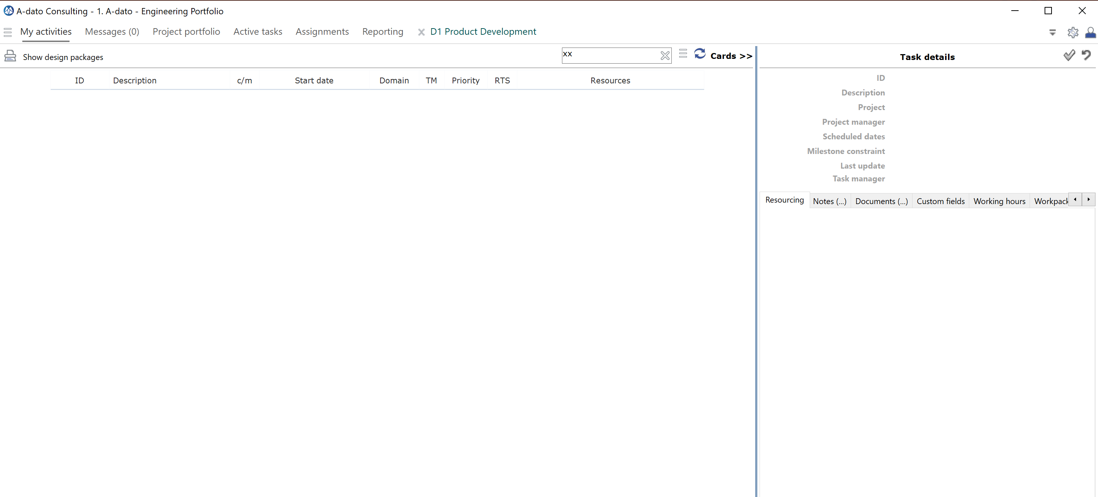
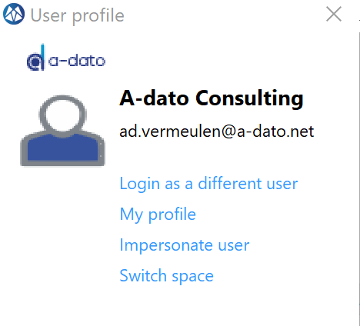
Select “My profile”
The name of you “Space” is displayed here.
This screen this screen may still be empty (as long as no tasks are assigned to you)

Slide 52
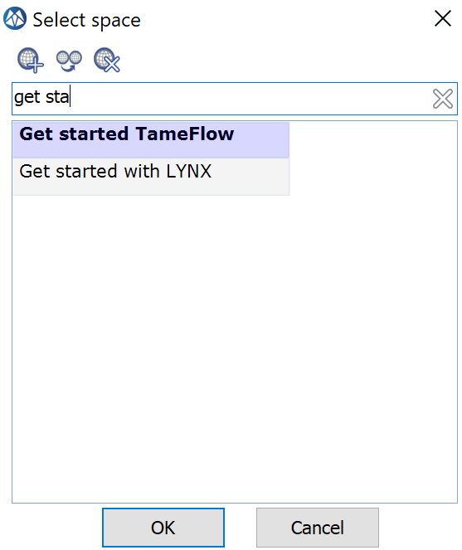
Check (change) your “Space”
The name of you “Space” is displayed here.

Slide 53
Get started with Task Management
Assign and confirm a resource name
Start a task by changing the status
Update progress (Ettc = Estimated time to complete)

Slide 54
What is needed? Task Management
Flawless handovers:
Ensure Delivery is complete
Be Ready-to-Start
Good preparation
Continuous (frequent) update of the “Expected Time to Complete” for each active task (ETTC)
Task
Management
Assign and confirm a resource name
Start a task by changing the status
Update progress (Ettc = Estimated time to complete)
Notes:
SHOW
We know now what we should not do but what do we need to do?

Slide 55
LYNX Task Management via the “Task Manager Role”
START
Concept
Hardware
Task manager
Software
Integration
Buffer

Slide 56
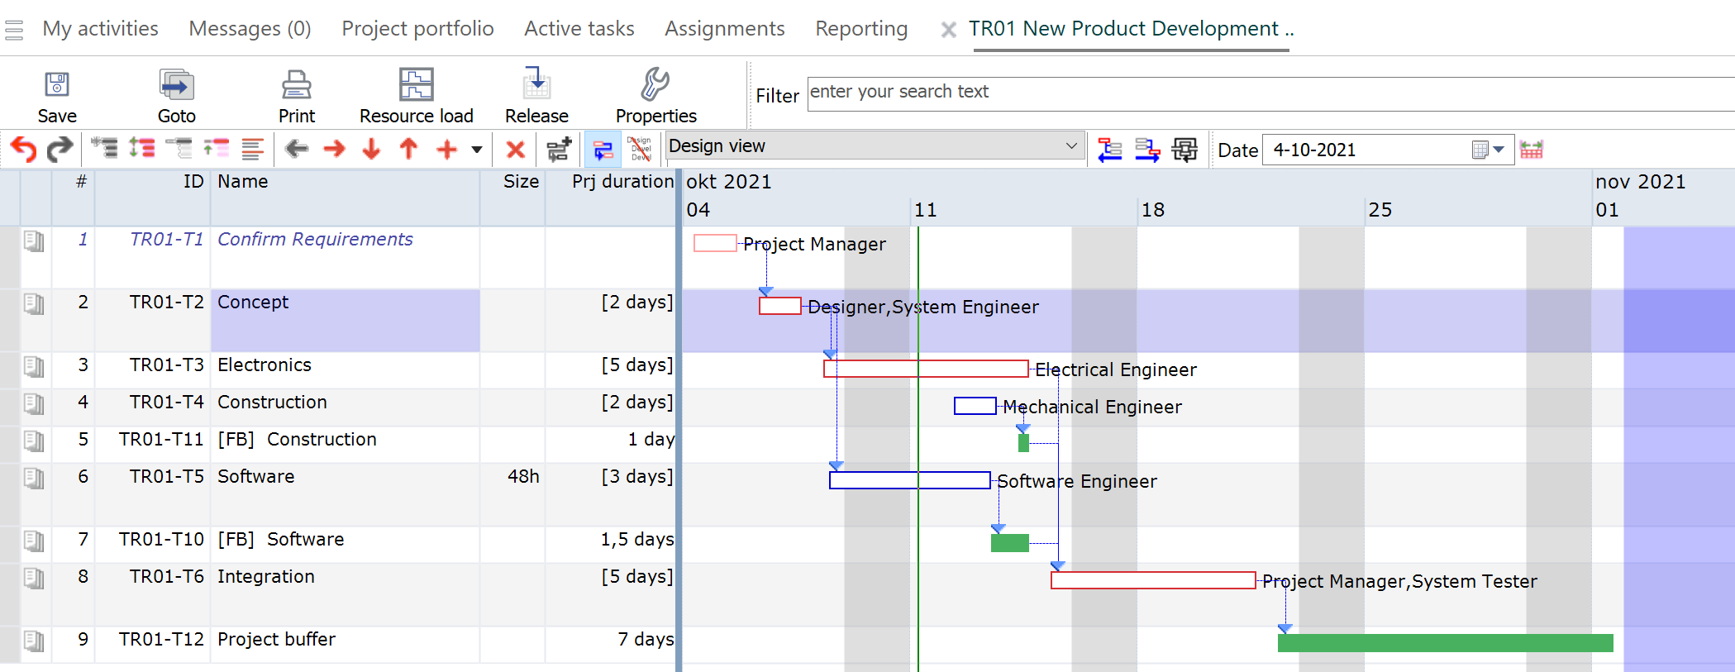
Intermezzo Your tasks in a project plan created by a project manager

Slide 57
“To do” List Sequence from red to green
Notes:
1. Doorlooptijd van elke taak – er gaat meer dan 30 % verloren aan verstoringen, andere zaken
2. Weniger Projekte geleichzeitig
3. Stoppen met Teiltermine, focus op endtermine en een prioriteit
4. Focus op fertig machen

Slide 58
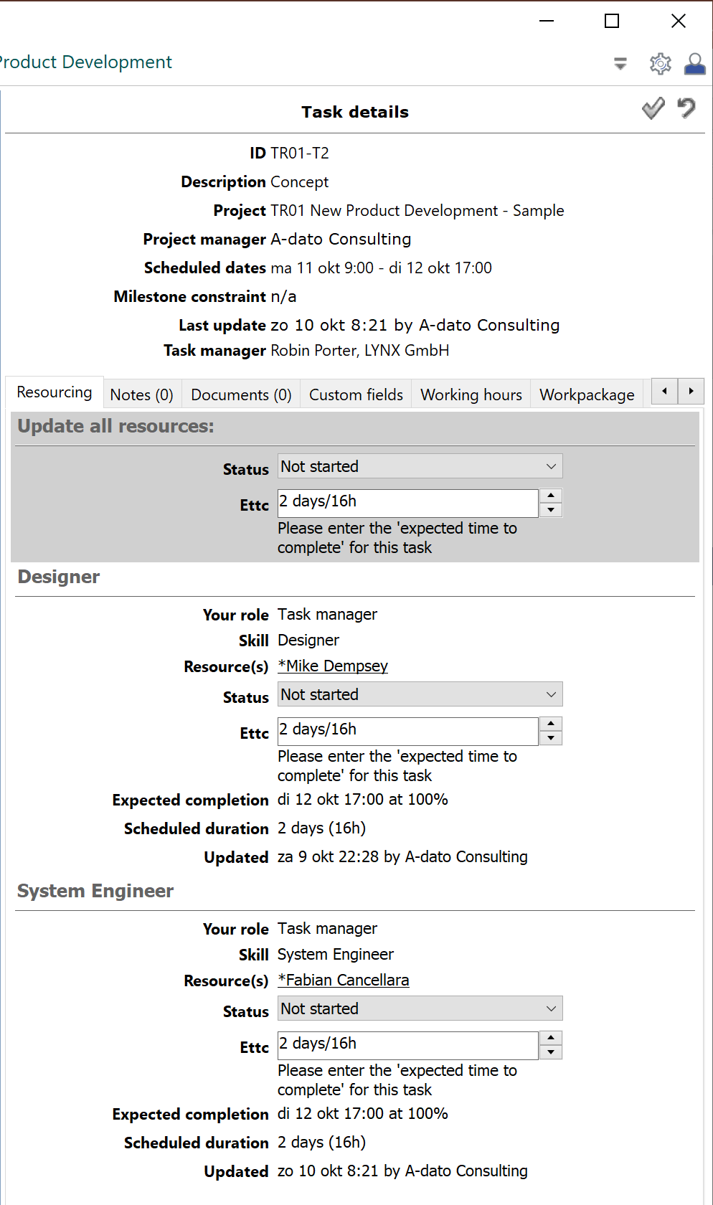
Manage the Task From…..
Save!
Refresh
Opens the project plan

Slide 59
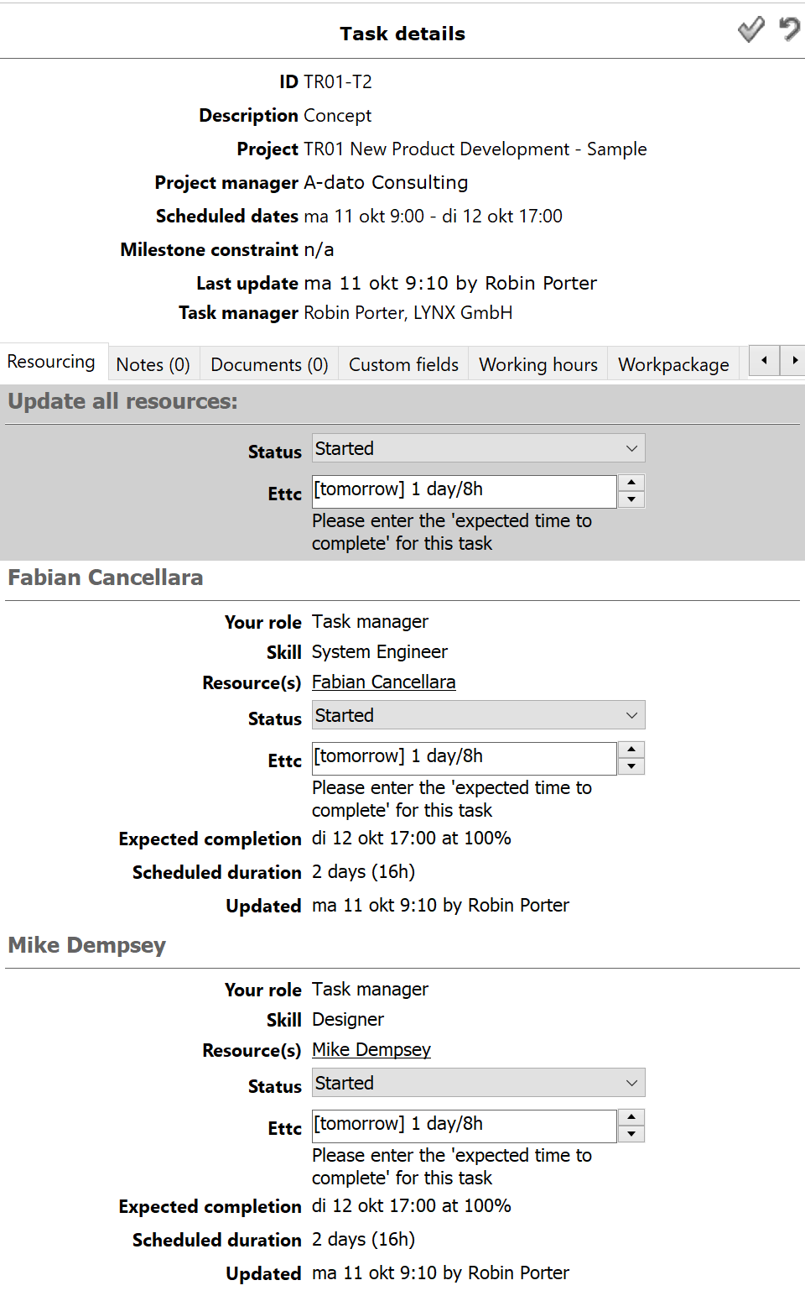
Manage the Task To…..
Ettc is default in Days
You may also enter hours: 40h
Steps:
Assign and confirm a resource name
Start a task by changing the status
Update progress (Ettc=Estimated time to complete)

Slide 60
Upcoming tasks Not ready to start yet..(RTS = No)

Slide 61
Have a look into the plan

Slide 62
Have a look in the plan

Slide 63
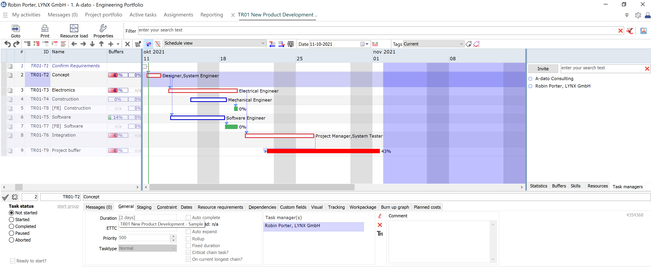
Your Task Manager Assignments Access to your tasks

Slide 64
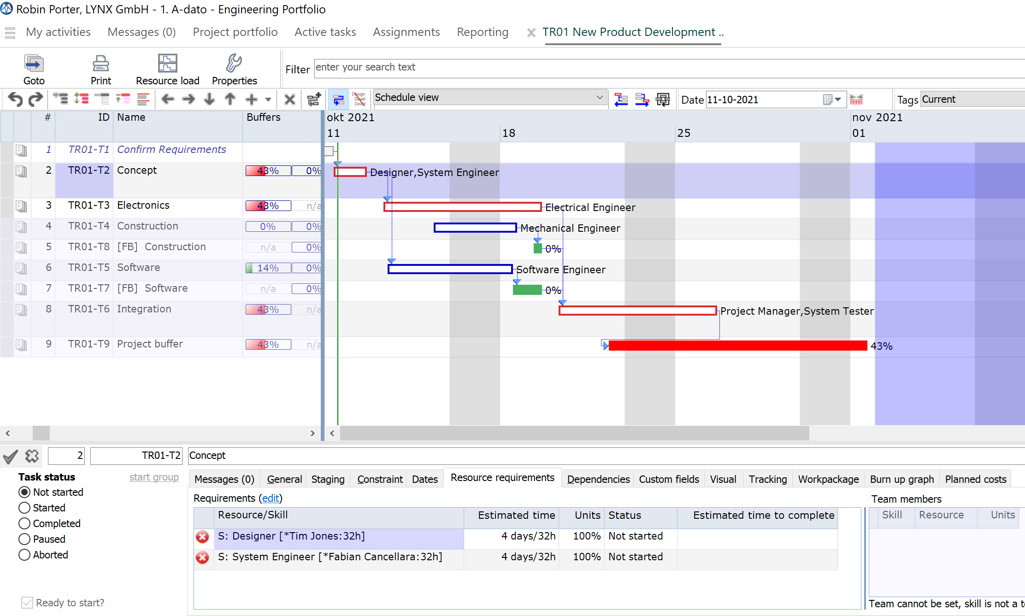
Review Resource Requirements
As TM you can update these values

Slide 65
How to change assignments?
Select another designer..

Slide 66
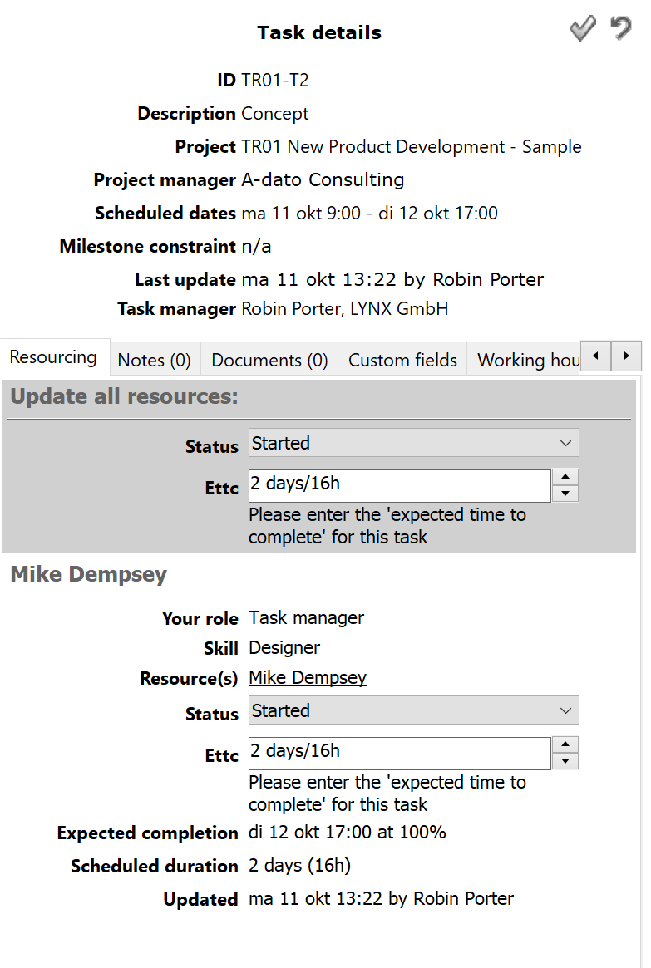
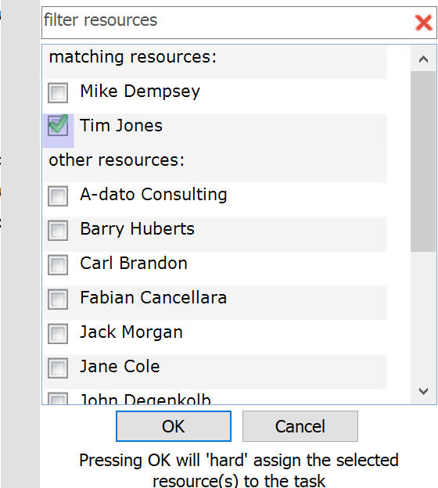
Change via Resourcing Dialog
See video with other re-assignment options

Slide 67
Add other Task Managers
Delegate Task Management

Slide 68
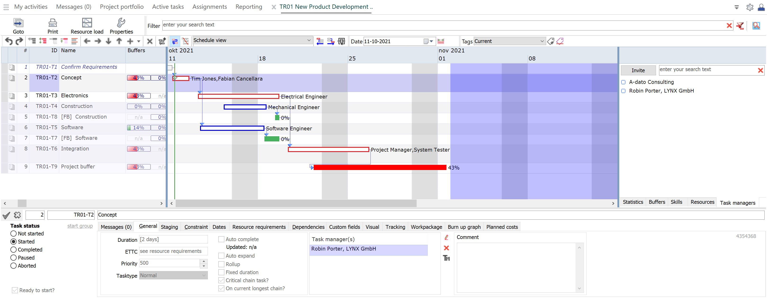
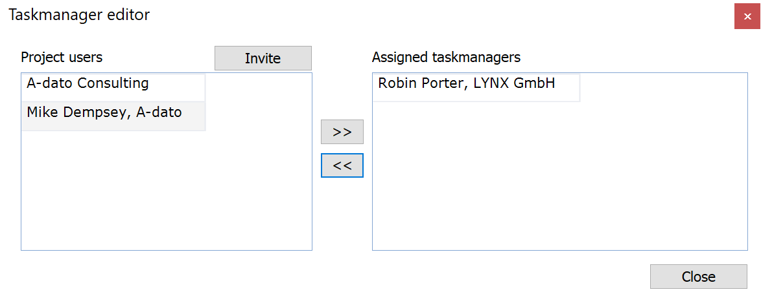
Open the plan and the Task manager box

Slide 69
Change to “Leading” Task Manager Move Mike up in the list

Slide 70
Result

Slide 71
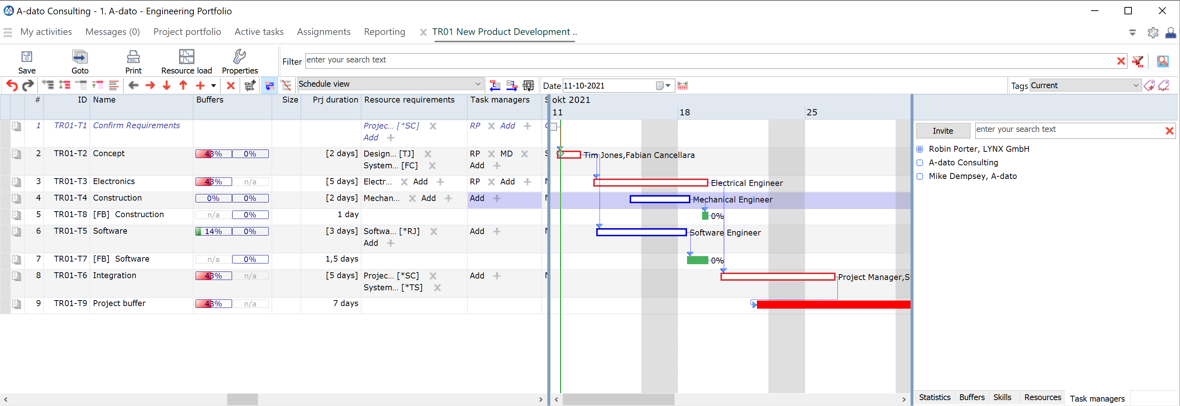
Other TM Assignment options Note: requires additional rights for the TM: Read and Write access

Slide 72
Impersonation Mode Robin Porter is taking over tasks of Mike Dempsey (Temporarily)

Slide 73
Task Management via Other Roles
The “My activities Roles”

Slide 74
LYNX Task Management for “My activities Users” the “My activities” roles
Resource User
Team manager
START
Concept
Hardware
The
My Activities Roles
Software
Integration
Buffer
Task manager
Resource manager

Slide 75
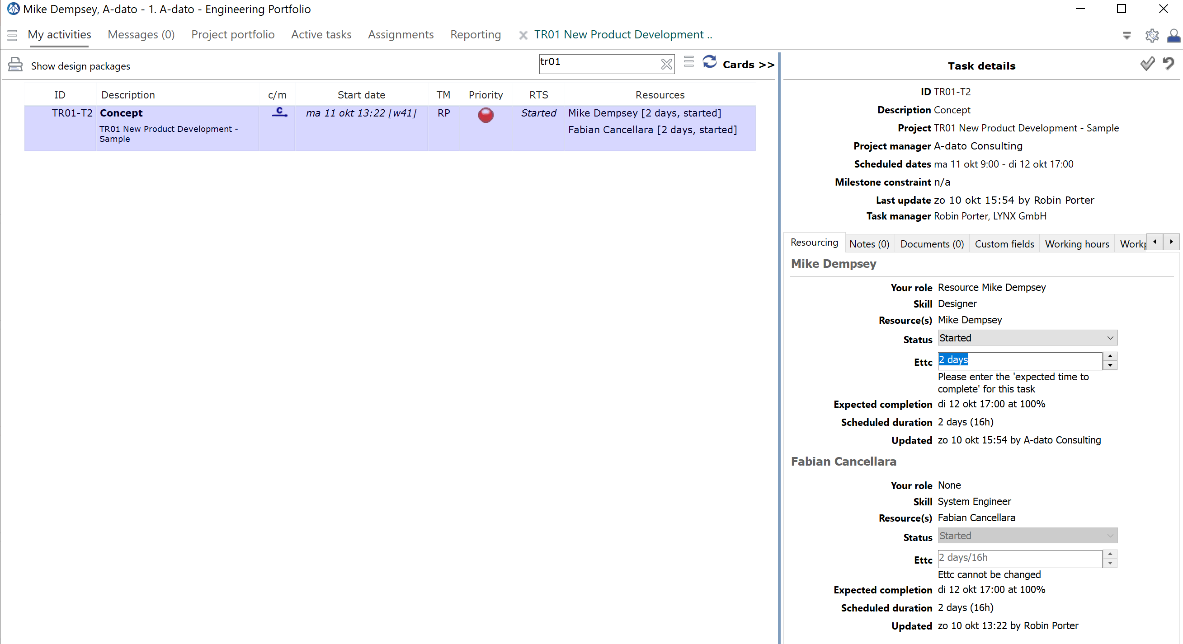
My activities for “Resource users”
Resource User
Mike can only update his own assignment for the task, in the role of Resource User.
Mike has no access to the System Engineer box.

Slide 76
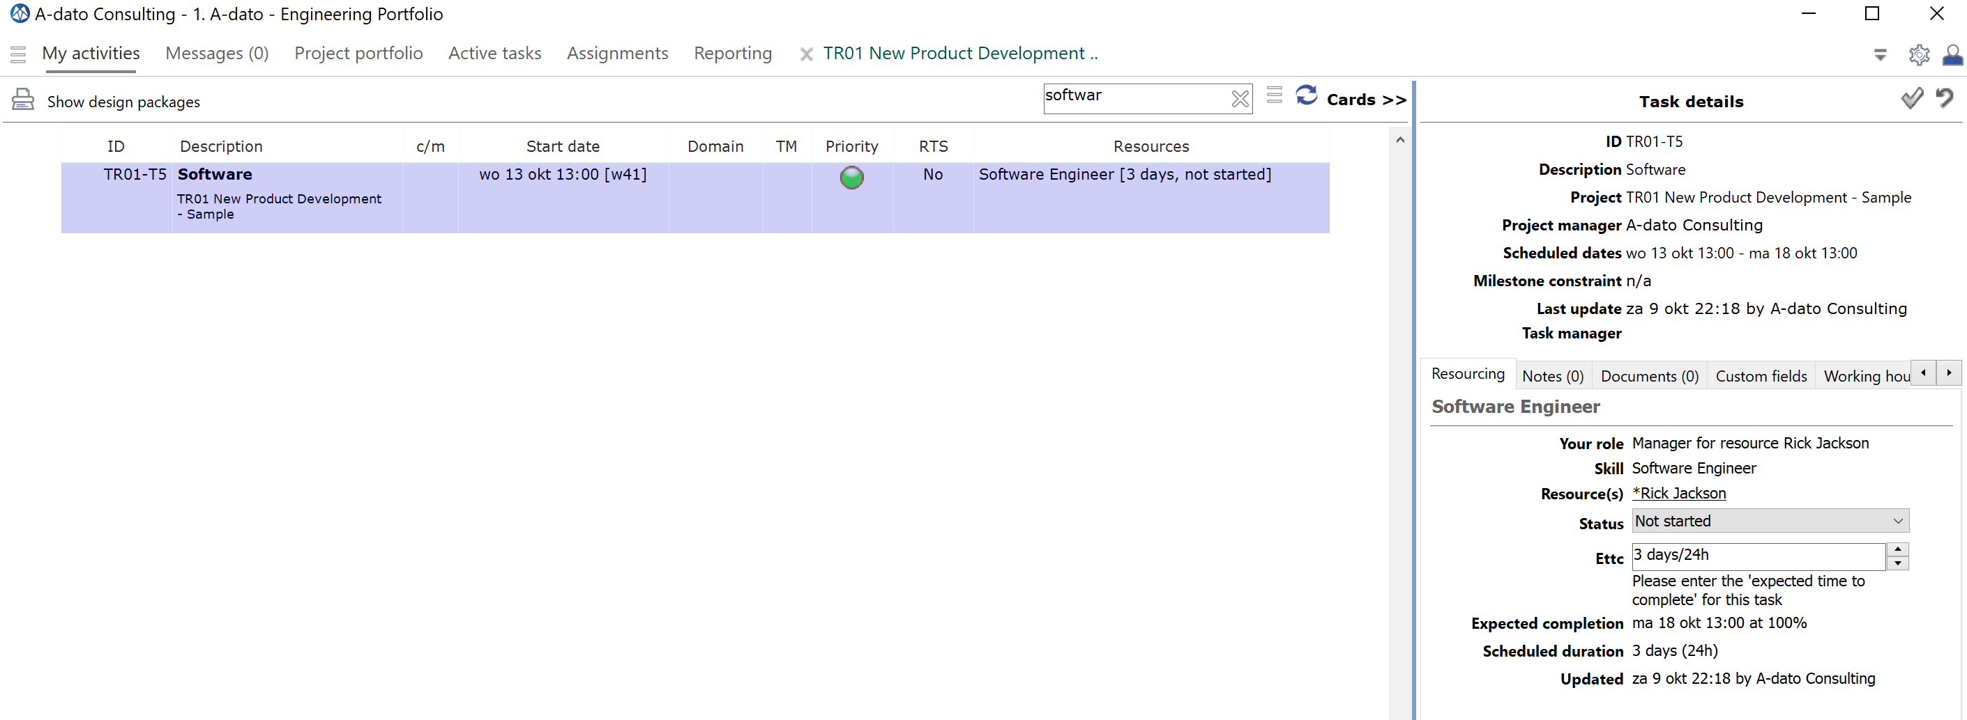
My activities for other roles
Resource manager

Slide 77
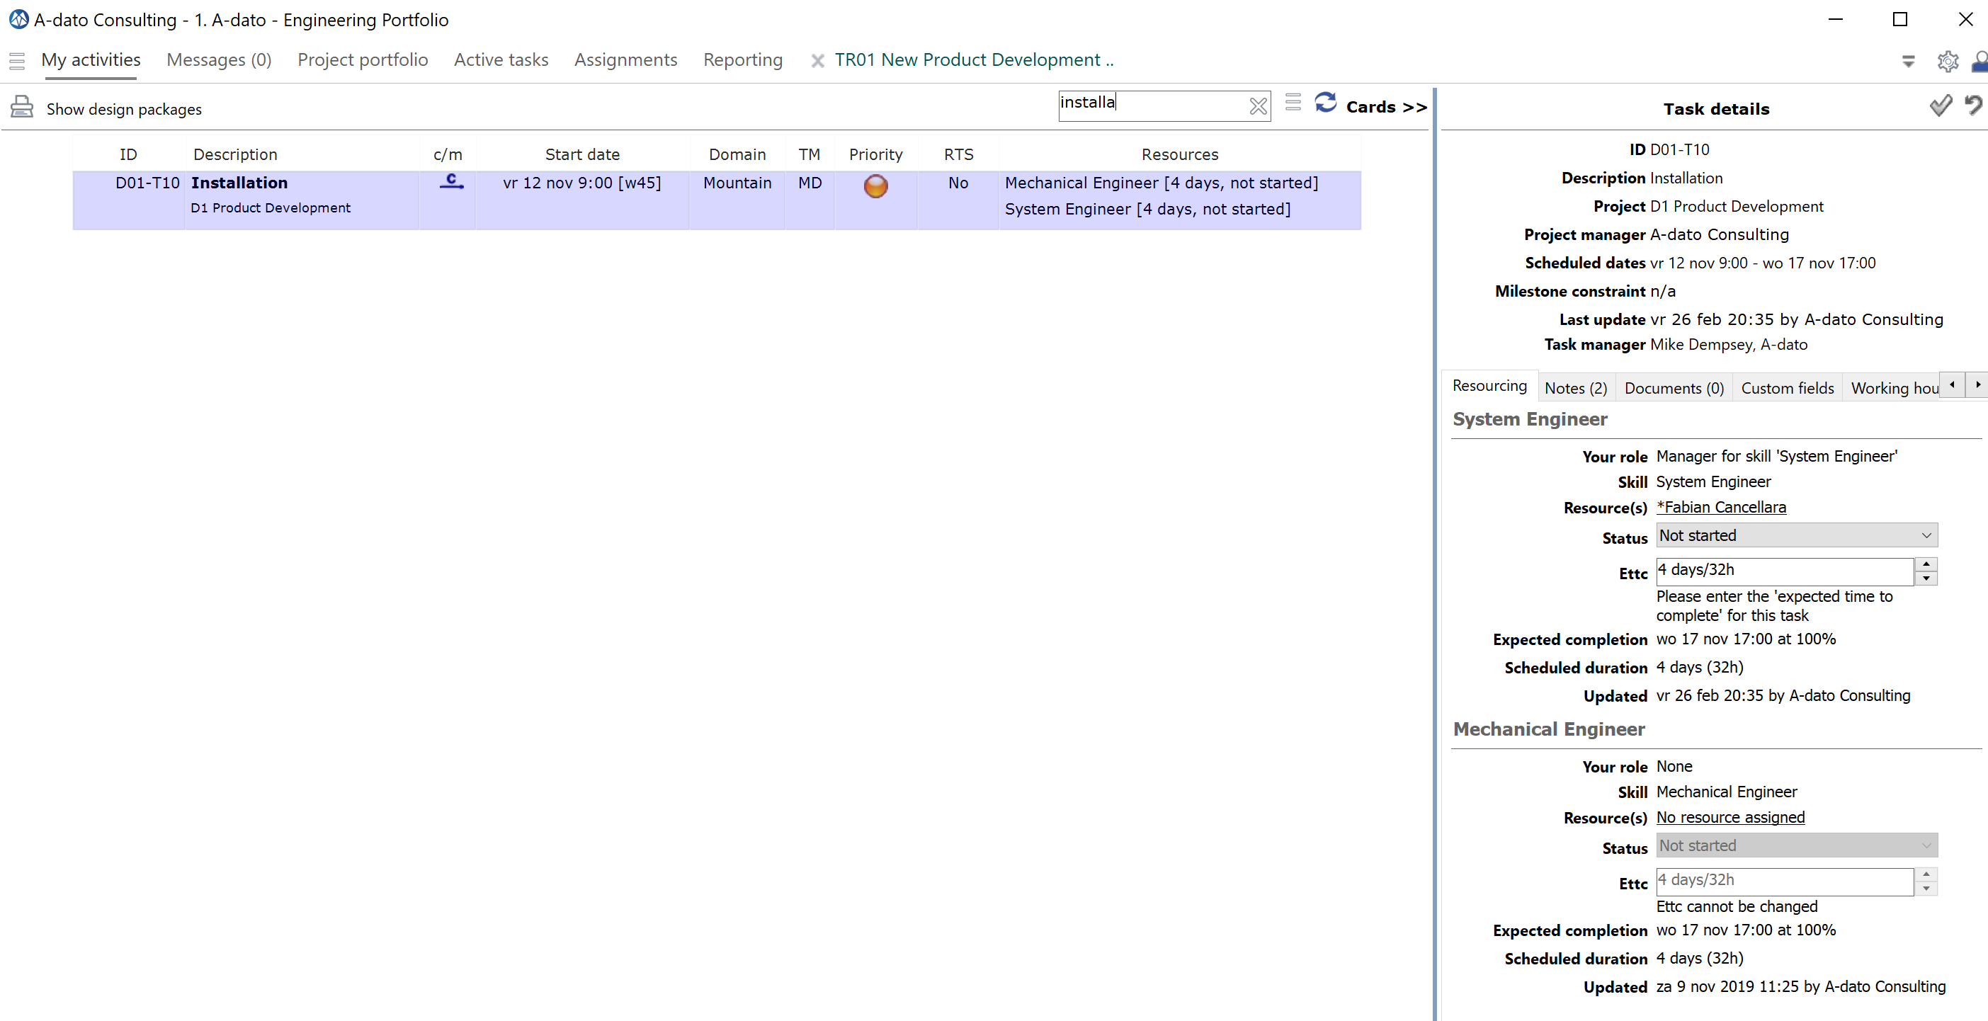
My activities for other roles
Team manager

Slide 78
Task Management for Workpackages
With Standard Skills

Slide 79
Task Management of Workpackages
START
Normal
Normal
Level 1
Workpackage
Level 2
Normal
Buffer
Worpackage with a bundle of cards
Bundle of Cards

Slide 80
What is different? Workpackages versus Normal Tasks
What is not different?*
My activities procedure:
Assign resources
Starting a workpackage
Progress reporting
What is different?:
Cards Management
Input for Ettc determination:
Size monitoring
Counters in the workpackages
Additional views:
LYNX Cards Views
LYNX TameFlow Taskboards
*if selected skills are of type “Standard Skills” (Normal or Virtual)
Rules for publishing cards on LYNX Taskboards:
Project must be “Released”
Workpackage must be started
LYNX Cardsview
Working with Cards
Sequencing Cards

Slide 81
Cards Management LYNX Cards View and LYNX TameFlow
Project manager
Level 1
Task manager
Level 2
My activities Roles
Level 2
The TameFlow Approach
Through LYNX TameFlow, Agile and Kanban workflows are integrated, bringing Agile CCPM to life.

Slide 82
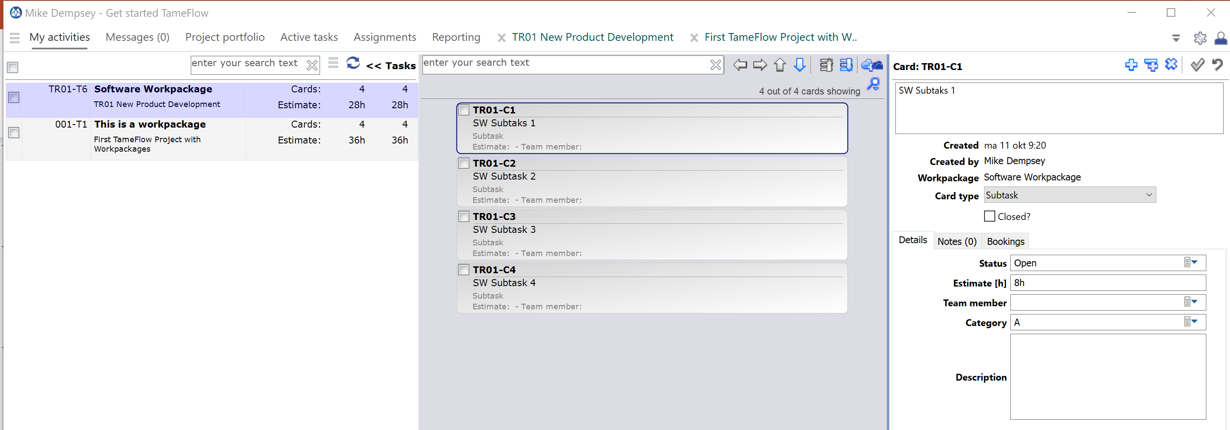
LYNX Cards View and Editor My activities
A task manager can add, change and remove cards via this view.

Slide 83
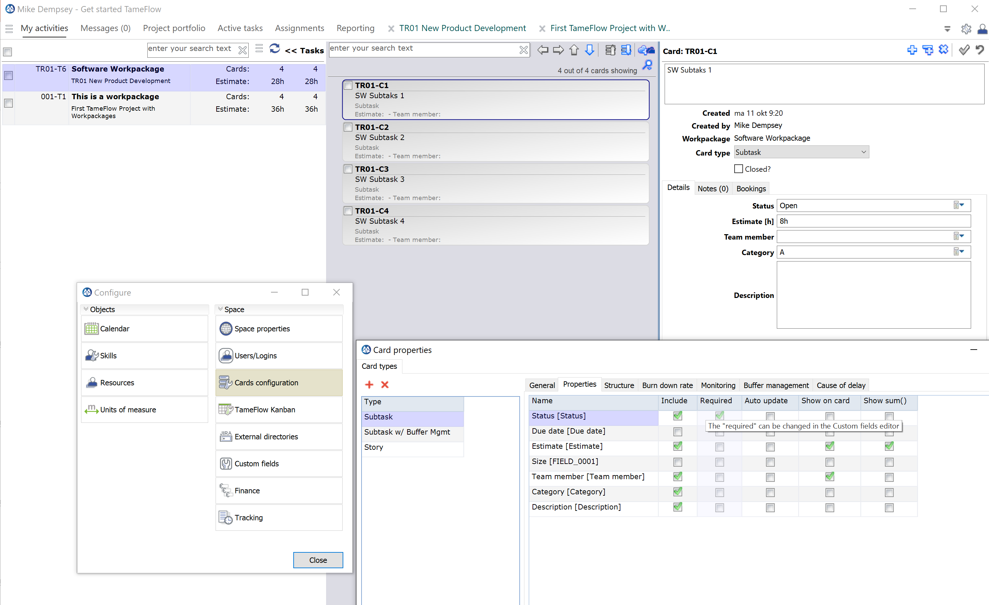
Cards Configuration

Slide 84
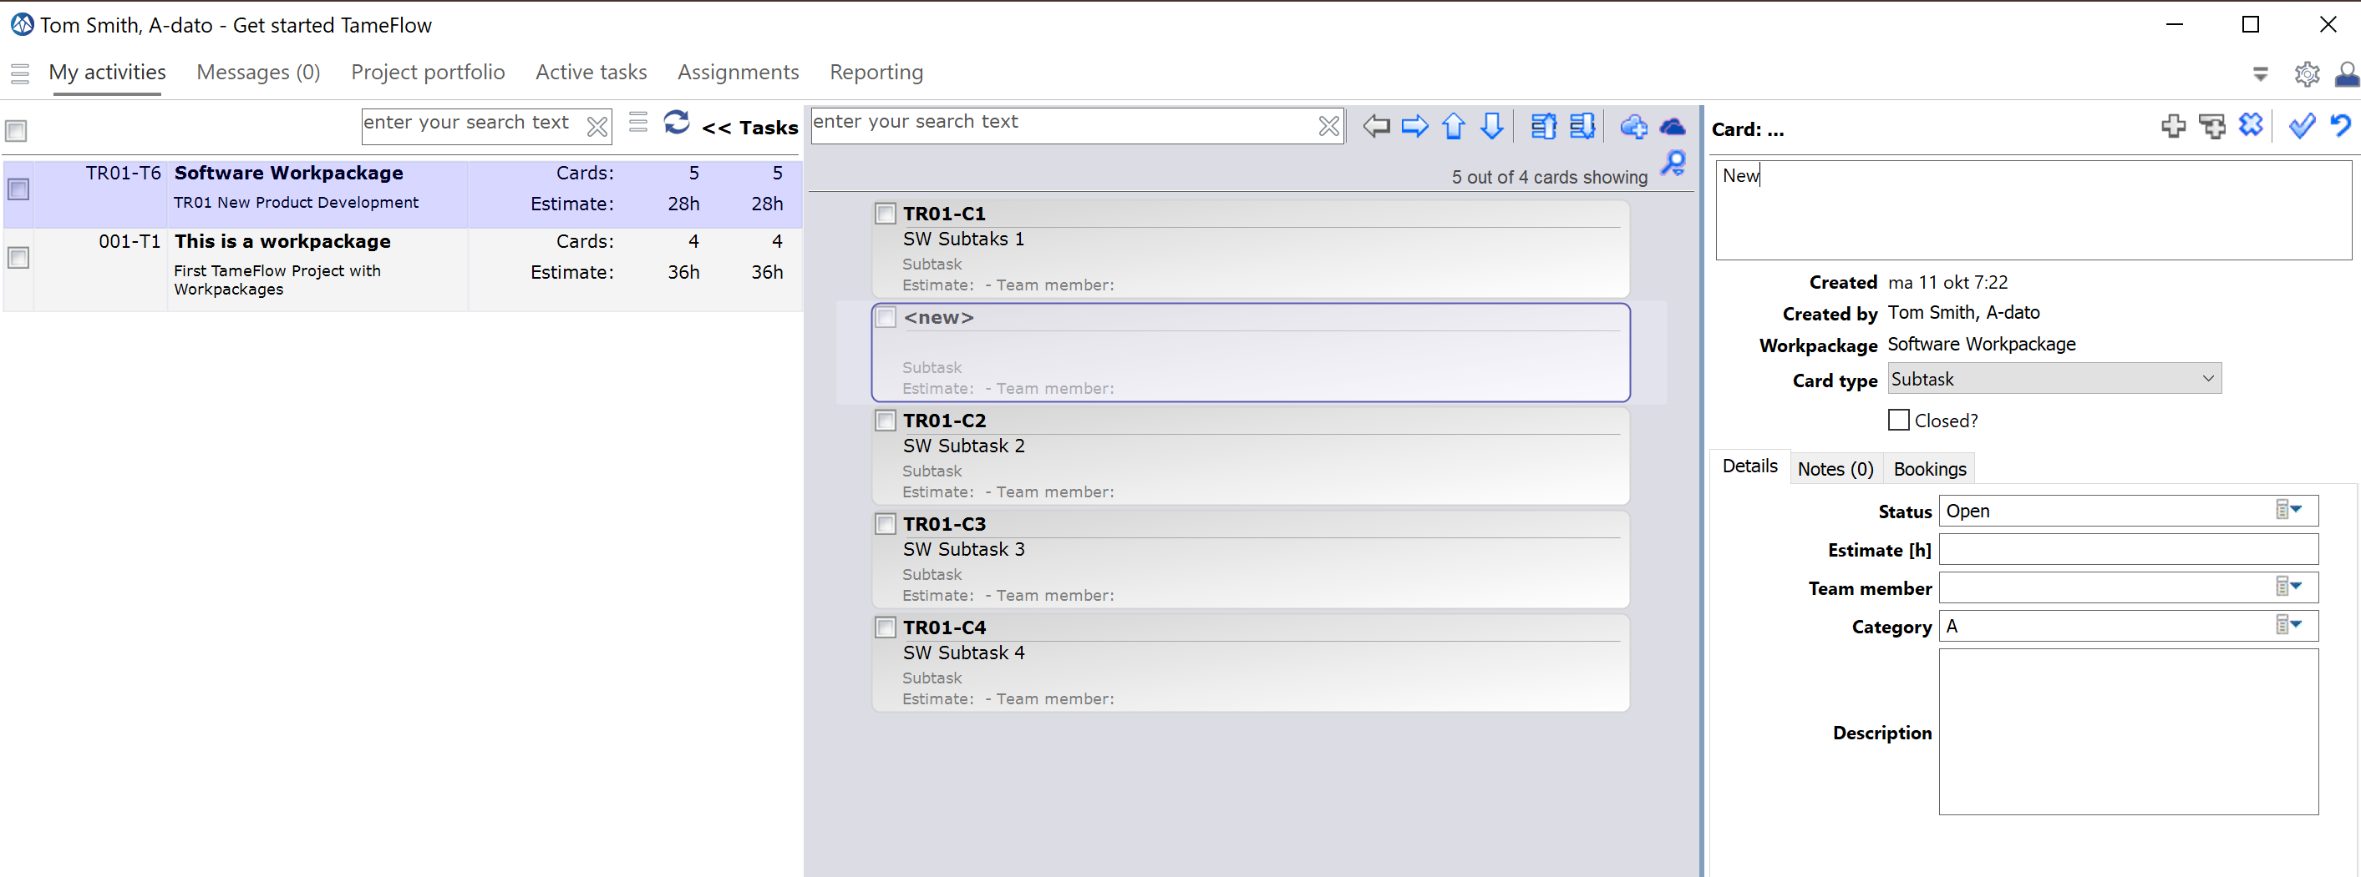
Working with the Cardsview

Slide 85
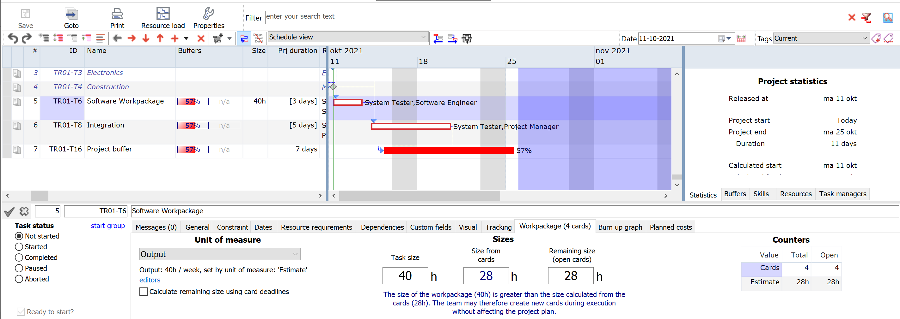
Size Monitoring

Slide 86
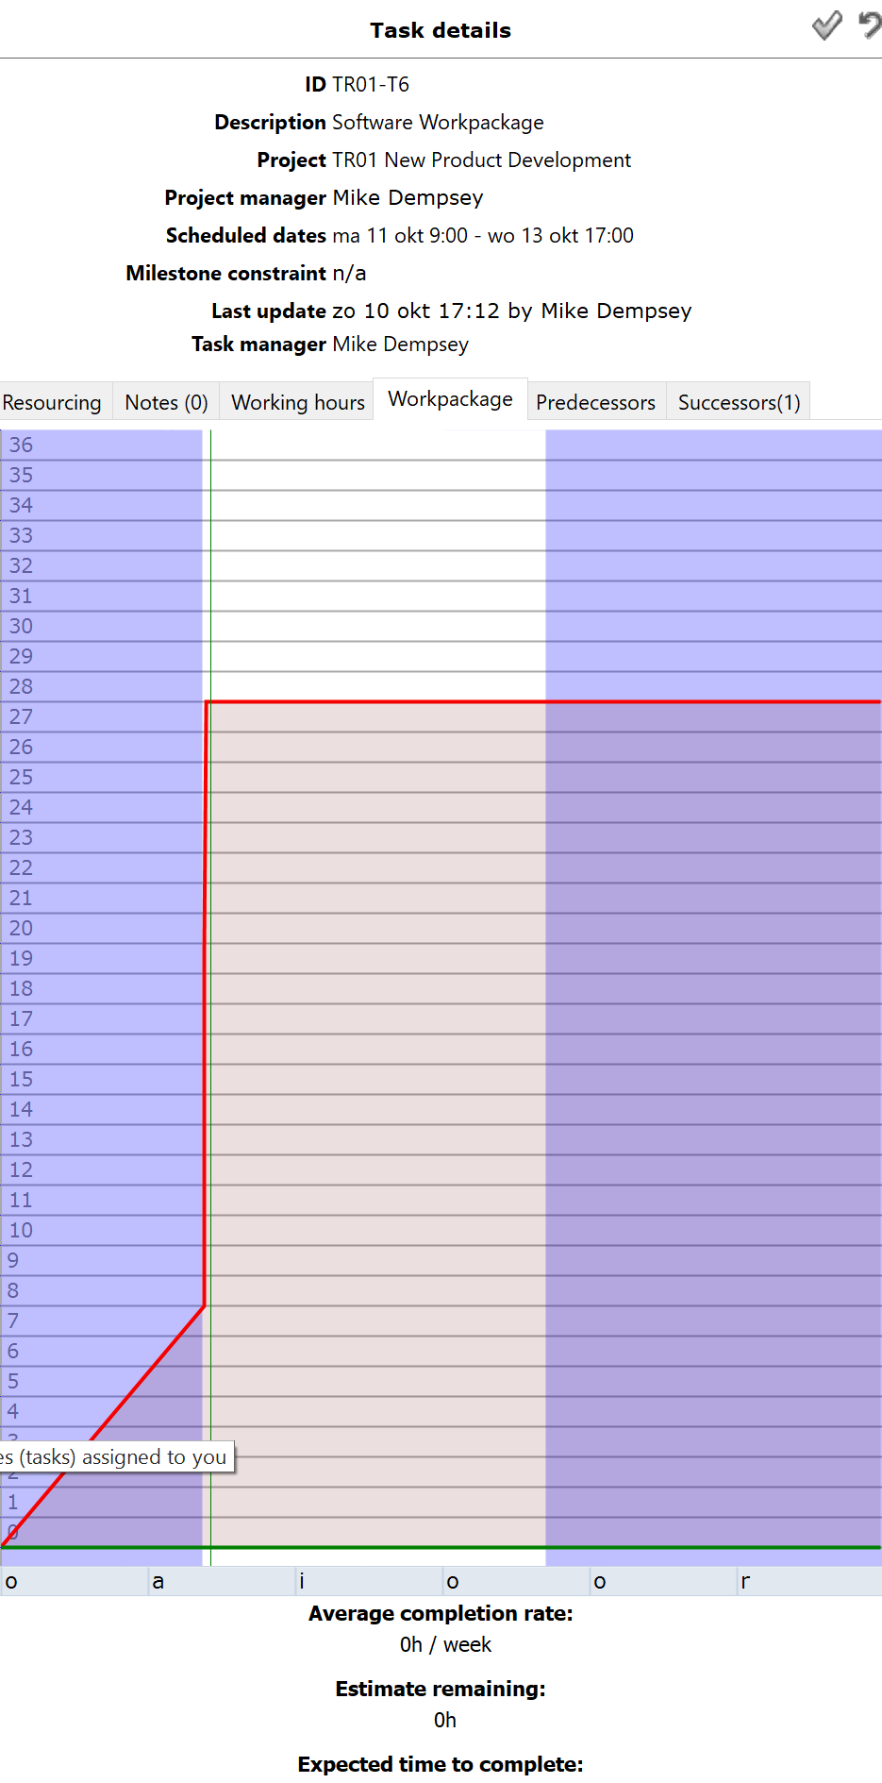
Burn-up Graphs

Slide 87
Let’s go… Rick and Tom are assigned, workpackage is started by Mike
The Software Workpackage Team:
Rick + Tom + Mike (TM)

Slide 88
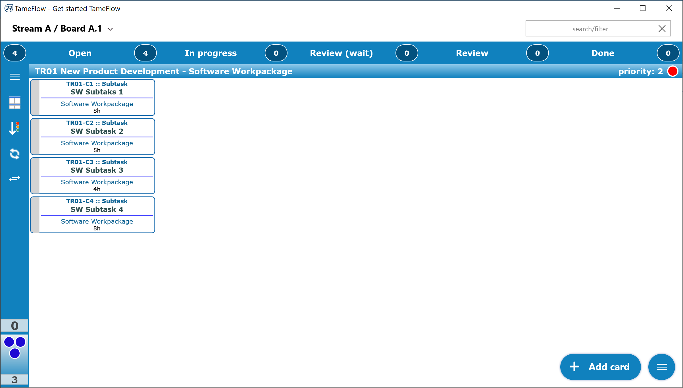
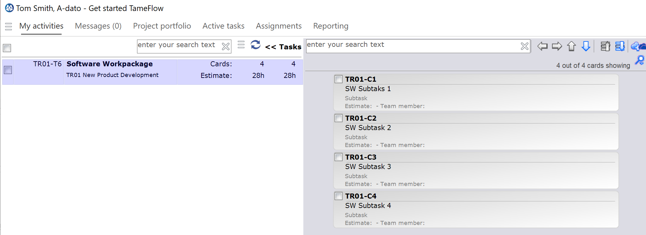
Workpackage appears in the Taskview and Cardsview of Tom and Rick (and in LYNX TameFlow)

Slide 89
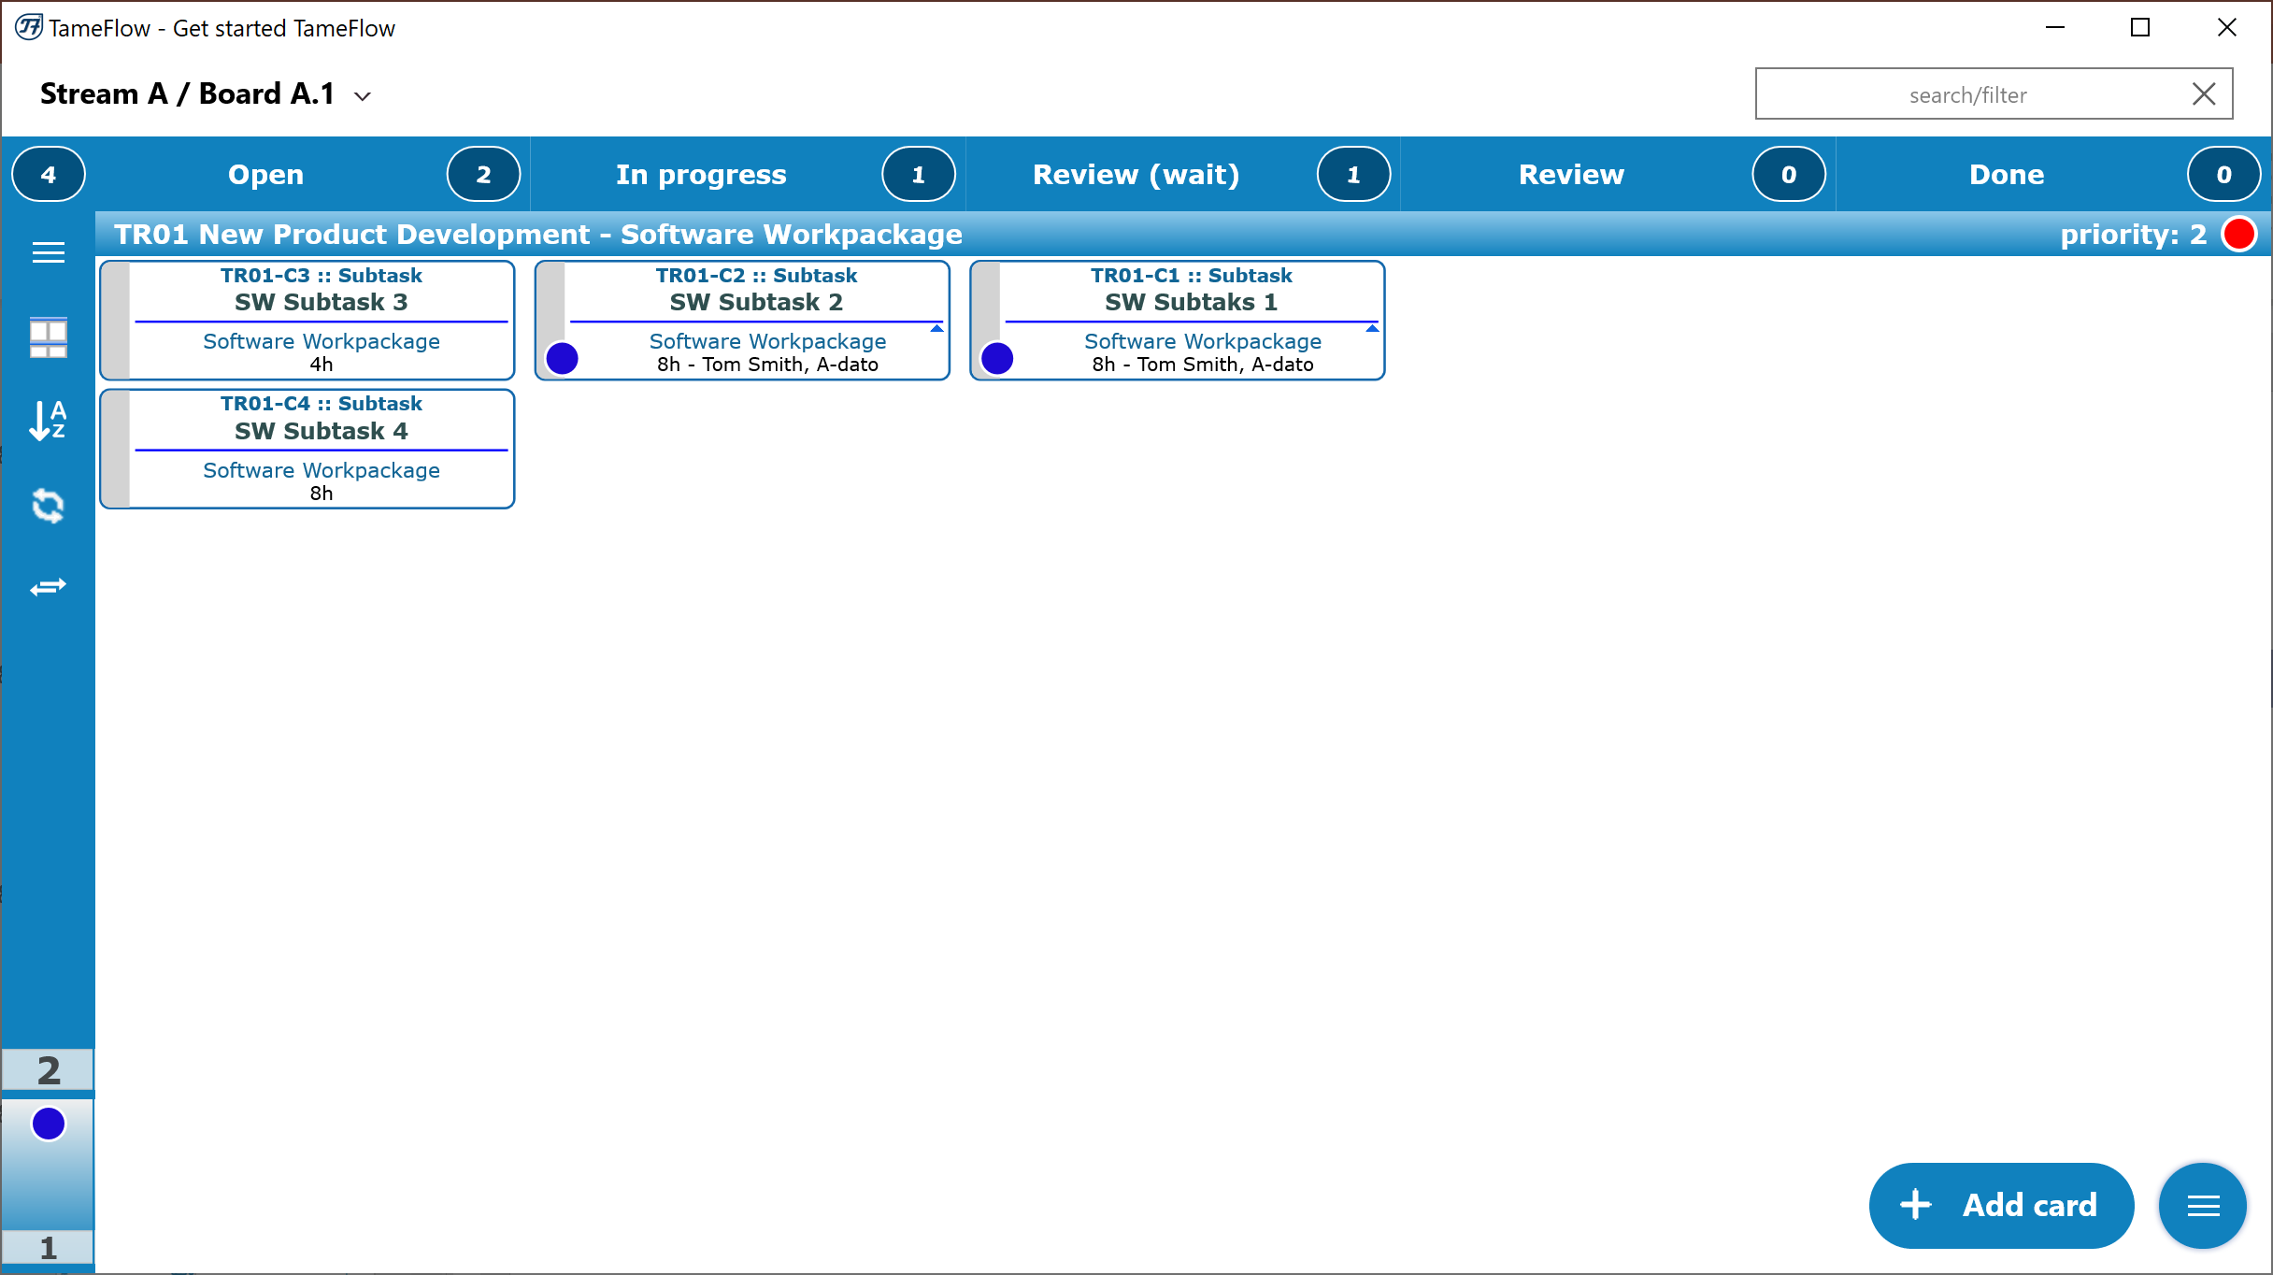
The Software Workpackage Team can get going..

Slide 90
Let’s start another workpackage.. In a few days, and preferably Just-in-Time to keep WIP down

Slide 91
LYNX TameFlow – Toms Workpackages

Slide 92
Size monitoring Team can add more cards….

Slide 93
Determine Ettc from Card Counters

Slide 94
Additional Topics
LYNX Notes and Documents for Task Managers

Slide 95
LYNX Notes System

Slide 96
LYNX Document System

Slide 97
Resource Management Tools

Slide 98
Resoure Load Diagram (s)

Slide 99
The All Graph
Shows Resource Load across your resources

